Slide 1
Digital Electronics Prepared by: Dr. Kiran Kumar B M

Slide 2
Course Content
Digital Electronics:
Evolution of Integrated Circuits- SSI, MSI, LSI and VLSI, Binary, Octal and Hexadecimal number systems and conversions, Boolean Algebra, Truth table of logic gates- AND, OR, NOT, NAND, NOR; Universal gates..

Slide 3
Digital Electronics
At the end of this lecture, student will be able to :
Introduction to digital electronics
Understand the evolution Of Integrated Circuits
Define An integrated circuit
Classification of an integrated circuit
Acquire the knowledge of Positional-Value System
List of the Various radix
Distinguish between various number systems
Convert binary to decimal conversion
Acquire the knowledge of octal to decimal conversion
Convert hexadecimal to decimal conversion
Acquire the knowledge of decimal to binary conversion

Slide 4
Topics
Evolution Of Integrated Circuits
INTEGRATED CIRCUITS: SSI, MSI, LSI, VLSI
Binary, Octal and Hexadecimal number systems and conversions
Boolean Algebra
Truth table of logic gates- AND, OR, NOT, NAND, NOR; Universal gates.

Slide 5
Introduction to digital electronics
What is Digital Electronics
Digital Electronics is the branch of electronics which deals with the digital signals to perform various tasks and meet various requirements
It is based upon the digital design methodologies and consists of digital circuits, IC’s and logic gates
It uses only binary digits, i.e. either ‘0’ or ‘1’

Slide 6
Evolution Of Integrated Circuits
The Progression Of The Evolution Of Integrated Circuits Started With The Innovation Of Vacuum Tubes Invented In 1897 By John Ambrose
Transistors Further Replaced Vacuum Tubes In The Year 1947, Created By William Shockley, Which Brought A New Boom To The Electronic Industry
Transistors Were Developed As A Feasible Substitute For Bulky Vacuum Tubes Due To Their Tiny Size And Lack Of High-End Power Requirements
Later In 1959, Integrated Circuits Were Invented Which Could Fabricate Numerous Components On A Single Wafer
Also, ICs Consumed A Lesser Amount Of Power And Also Produced A Smooth Output Resulting In Their Widespread Usage.

Slide 7
INTEGRATED CIRCUITS: SSI, MSI, LSI, VLSI
The evolution of integrated circuits is a compilation of numerous electrical components, such as transistors, capacitors, resistors, etc., that can fabricate on a single semiconductor chip
It combines both active elements like diodes and transistors with passive components like resistors and capacitors in a monolithic structure, so the complete unit in a monolithic circuit.
All the components are formed within the chip and no components is seen projected above the surface of the chip.
An integrated circuit is a device capable of performing a wide range of complex operations, such as oscillating, flip-flopping, countering, amplification, timers, and many more.

Slide 8
INTEGRATED CIRCUITS: SSI, MSI, LSI, VLSI
The number of components fitted into a standard-size IC represents its integration scale, in other words, it’s a density of components. It is classified as follows
SSI – Small-Scale Integration
MSI – Medium Scale Integration
LSI – Large-Scale Integration
VLSI – Very Large-Scale Integration

Slide 9
SSI – Small-Scale Integration
Small Scale Integration (SSI) is a term used in the field of electronics and digital circuit design to describe a level of integrated circuit (IC) technology.
SSI refers to the integration of a relatively small number of electronic components or logic gates onto a single semiconductor chip
Here are some key points about SSI
Component Integration
SSI involves the integration of a limited number of electronic components onto a single chip. These components can include basic logic gates, flip-flops, multiplexers, and simple arithmetic and memory units. It has less than 100 components (about 10 Gates).

Slide 10
SSI – Small-Scale Integration
Low Complexity
SSI devices are relatively simple in terms of functionality and complexity. They are typically used for basic digital tasks and do not include complex functions found in larger-scale integrated circuits.
Applications
SSI devices have been used in a variety of applications, including early digital calculators, simple control systems, and basic digital signal processing tasks. They have also been employed in smaller-scale custom digital projects
Count of Gates
The number of gates or components integrated in SSI devices can vary, but it generally falls in the range of a few to a few dozen logic gates. These gates are interconnected to perform specific digital functions.

Slide 11
SSI – Small-Scale Integration
Package Size
SSI devices are relatively small in terms of physical size and come in various packages, including dual-inline packages (DIPs) and surface-mount devices (SMDs).
Advantages
SSI devices are cost-effective for basic digital functions, consume relatively low power, and are suitable for simpler electronic designs. They are also relatively easy to prototype and experiment with.
Limitations
The simplicity of SSI limits the complexity of the tasks they can perform.
.

Slide 12
MSI – Medium Scale Integration
MSI involves integrating a moderate number of electronic components or logic gates onto a single semiconductor chip.
Here are some key points about MSI:
Component Integration
MSI devices incorporate a moderate number of electronic components onto a single chip. These components can include more advanced logic gates, multiplexers, decoders, registers, and other digital building blocks. It contains less than 500 components or has more than 10 but less than 100 gates.
Moderate Complexity
MSI devices are more complex than SSI devices but less complex than LSI devices. They are capable of performing a wider range of digital functions and can handle more intricate tasks.

Slide 13
MSI – Medium Scale Integration
Applications
MSI ICs have been used in a variety of applications, including early microcomputers, data multiplexing and demultiplexing, and digital control systems. They are versatile and have found use in both consumer and industrial electronics.
Count of Gates
The number of gates or components integrated in MSI devices typically ranges from a few dozen to a few hundred logic gates. These gates are interconnected to perform specific digital functions.
Package Size
MSI devices come in various package sizes and forms, depending on their intended use and complexity. They can be found in dual-inline packages (DIPs), surface-mount devices (SMDs), and other package types..

Slide 14
MSI – Medium Scale Integration
Advantages
MSI devices strike a balance between complexity and ease of use. They offer greater functionality compared to SSI, making them suitable for a wide range of digital tasks, while still being relatively cost-effective and easy to design with.
Limitations
While MSI devices are more capable than SSI, they are not as versatile and powerful as LSI and Very Large Scale Integration (VLSI) devices. As technology continues to advance, more complex digital functions are often implemented using LSI and VLSI technologies.

Slide 15
LSI – Large-Scale Integration
Large Scale Integration (LSI) is a term used in the field of integrated circuit (IC) technology to describe a high level of integration, where a substantial number of electronic components or logic gates are integrated onto a single semiconductor chip
LSI represents a significant advancement in miniaturization and complexity compared to Medium Scale Integration (MSI) and Small Scale Integration (SSI).
Here are some key points about LSI:
Component Integration
LSI devices incorporate a large number of electronic components onto a single chip. These components can include complex logic gates, memory cells, microprocessors, and other sophisticated digital building blocks. Here number of components is between 500 and 300000 or has more than 100 gates.

Slide 16
LSI – Large-Scale Integration
High Complexity
LSI devices are highly complex and capable of performing advanced and intricate digital functions. They can execute complex operations, process data, and manage various tasks within a single chip.
Applications
LSI ICs have revolutionized the electronics industry and have been used in a wide range of applications, including microcomputers, digital signal processors, memory devices, and countless consumer electronics products.
Count of Gates
The number of gates or components integrated in LSI devices typically ranges from thousands to hundreds of thousands or even millions of logic gates. This level of integration enables the creation of powerful and versatile digital systems.

Slide 17
LSI – Large-Scale Integration
Package Size
LSI devices come in various package sizes and forms, depending on their complexity and intended use. They are commonly found in integrated circuit packages such as quad flat packages (QFPs) and ball grid arrays (BGAs).
Advantages
LSI devices represent a significant advancement in technology, offering high computational power, memory capacity, and versatility. They enable the creation of sophisticated electronic systems in a compact form factor.
Limitations
While LSI devices are powerful, they are not without limitations. They can generate substantial heat due to their complexity, and power consumption may be a concern in some applications. Additionally, designing and manufacturing LSI chips can be highly intricate and costly.
.

Slide 18
VLSI – Very Large-Scale Integration
Very Large Scale Integration (VLSI) is a term used in the field of integrated circuit (IC) technology to describe an extremely high level of integration.
VLSI represents a significant advancement beyond Large Scale Integration (LSI) and involves the integration of a vast number of electronic components or logic gates onto a single semiconductor chip
Here are some key points about VLSI:
Component Integration
VLSI devices incorporate an exceptionally large number of electronic components onto a single chip. These components can include highly complex logic gates, microprocessors, memory cells, analog circuits, and specialized functions.

Slide 19
VLSI – Very Large-Scale Integration
Extreme Complexity
VLSI devices are characterized by their extreme complexity and capability to perform a wide range of intricate digital and analog functions. They can execute complex computations, process high-speed data, and handle multifaceted tasks within a compact chip.
Applications
VLSI technology has had a transformative impact on various industries, including microelectronics, telecommunications, computing, and consumer electronics. VLSI devices power everything from powerful microprocessors to advanced communication systems.
Count of Gates
The number of gates or components integrated in VLSI devices is staggering, often ranging from millions to billions of logic gates. This level of integration enables the development of highly advanced and feature-rich electronic systems.

Slide 20
VLSI – Very Large-Scale Integration
Package Size
VLSI devices are typically packaged in compact and technologically advanced packages designed for efficient cooling and miniaturization. Surface-mount technology (SMT) and flip-chip packaging are common in VLSI applications.
Advantages
VLSI devices represent the pinnacle of integrated circuit technology, offering unparalleled computational power, memory capacity, and functionality. They enable the creation of cutting-edge electronics with a small physical footprint.
Limitations
Despite their capabilities, VLSI devices face challenges related to power consumption, heat dissipation, and manufacturing complexity. Designing VLSI chips requires expertise in complex electronic systems and is a resource-intensive process.

Slide 21
VLSI – Very Large-Scale Integration
Package Size
VLSI devices are typically packaged in compact and technologically advanced packages designed for efficient cooling and miniaturization. Surface-mount technology (SMT) and flip-chip packaging are common in VLSI applications.
Advantages
VLSI devices represent the pinnacle of integrated circuit technology, offering unparalleled computational power, memory capacity, and functionality. They enable the creation of cutting-edge electronics with a small physical footprint.
Limitations
Despite their capabilities, VLSI devices face challenges related to power consumption, heat dissipation, and manufacturing complexity. Designing VLSI chips requires expertise in complex electronic systems and is a resource-intensive process.

Slide 22
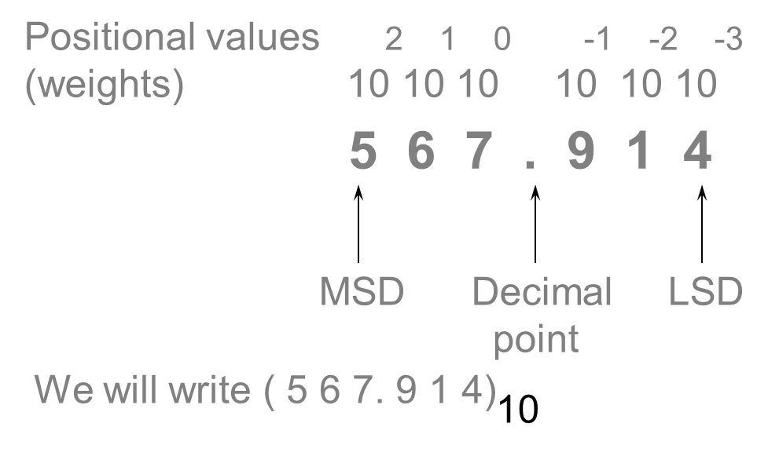
Positional-Value System
The value of a digit (“digit” from Latin word for finger) depends on its position

Slide 23
Decimal Number System
Base (also called radix) = 10
10 digits { 0, 1, 2, 3, 4, 5, 6, 7, 8, 9 }
Digit Position
Integer & fraction
Digit Weight
Weight = (Base) ^{Position}
Magnitude
Sum of “Digit x Weight”
Formal Notation
2
1
0
-1
-2
5
1
2
7
4
100
10
1
0.1
0.01
500
10
2
0.7
0.04
d₂*B²+d₁*B¹+d₀*B⁰+d₋₁*B⁻¹+d₋₂*B⁻²
(512.74)₁₀

Slide 24
Octal Number System
Base = 8
8 digits { 0, 1, 2, 3, 4, 5, 6, 7 }
Weights
Weight = (Base) ^{Position}
Magnitude
Sum of “Digit x Weight”
Formal Notation
64
8
1
1/8
1/64
5
1
2
7
4
2
1
0
-1
-2
5 *8²+1 *8¹+2 *8⁰+7 *8⁻¹+4 *8⁻²
=(330.9375)₁₀
(512.74)₈

Slide 25
Binary Number System
Base = 2
2 digits { 0, 1 }, called binary digits or “bits”
Weights
Weight = (Base) ^{Position}
Magnitude
Sum of “Bit x Weight”
Formal Notation
Groups of bits 4 bits = Nibble
8 bits = Byte
4
2
1
1/2
1/4
1
0
1
0
1
2
1
0
-1
-2
1 *2²+0 *2¹+1 *2⁰+0 *2⁻¹+1 *2⁻²
=(5.25)₁₀
(101.01)₂
1 0 1 1
1 1 0 0 0 1 0 1

Slide 26
Hexadecimal Number System
Base = 16
16 digits { 0, 1, 2, 3, 4, 5, 6, 7, 8, 9, A, B, C, D, E, F }
Weights
Weight = (Base) ^{Position}
Magnitude
Sum of “Digit x Weight”
Formal Notation
256
16
1
1/16
1/256
1
E
5
7
A
2
1
0
-1
-2
1 *16²+14 *16¹+5 *16⁰+7 *16⁻¹+10 *16⁻²
=(485.4765625)₁₀
(1E5.7A)₁₆

Slide 27
Conversion Among Bases
The possibilities:
Decimal
Octal
Binary
Hexadecimal

Slide 28
Contd..
Weight
125₁₀ => 5 x 10⁰ = 5 2 x 10¹ = 20 1 x 10² = 100 125
Base

Slide 29
Binary to Decimal
Technique
Multiply each bit by 2^{n}, where n is the “weight” of the bit
The weight is the position of the bit, starting from 0 on the right
Add the results
Example
Bit “0”
101011₂ => 1 x 2⁰ = 1 1 x 2¹ = 2 0 x 2² = 0 1 x 2³ = 8 0 x 2⁴ = 0 1 x 2⁵ = 32
43₁₀

Slide 30
Octal to Decimal
Decimal
Octal
Binary
Hexadecimal

Slide 31
Octal to Decimal
Technique
Multiply each bit by 8^{n}, where n is the “weight” of the bit
The weight is the position of the bit, starting from 0 on the right
Add the results
Example
724₈ => 4 x 8⁰ = 4 2 x 8¹ = 16 7 x 8² = 448 468₁₀

Slide 32
Hexadecimal to Decimal
Decimal
Octal
Binary
Hexadecimal

Slide 33
Hexadecimal to Decimal
Technique
Multiply each bit by 16^{n}, where n is the “weight” of the bit
The weight is the position of the bit, starting from 0 on the right
Add the results
Example
ABC₁₆ => C x 16⁰ = 12 x 1 = 12 B x 16¹ = 11 x 16 = 176 A x 16² = 10 x 256 = 2560
2748₁₀

Slide 34
Decimal to Binary
Technique
Divide by two, keep track of the remainder
First remainder is bit 0 (LSB, least-significant bit)
Second remainder is bit 1
Etc.

Slide 35
Decimal to Binary
Example
125₁₀ = ?₂
2 125 62 1
2 31 0
2 15 1
2 7 1
2 3 1
2 1 1
2 0 1
125₁₀ = 1111101₂

Slide 36
Octal to Binary
Decimal
Octal
Binary
Hexadecimal

Slide 37
Octal to Binary
Technique
Convert each octal digit to a 3-bit equivalent binary representation
Example
705₈ = ?₂
7 0 5
111 000 101
705₈ = 111000101₂

Slide 38
Hexadecimal to Binary
Decimal
Octal
Binary
Hexadecimal

Slide 39
Hexadecimal to Binary
Technique
Convert each hexadecimal digit to a 4-bit equivalent binary representation
Example
10AF₁₆ = ?₂
1 0 A F
0001 0000 1010 1111
10AF₁₆ = 0001000010101111₂

Slide 40
Decimal to Octal
Decimal
Octal
Binary
Hexadecimal

Slide 41
Decimal to Octal
Technique
Divide by 8
Keep track of the remainder
Example
1234₁₀ = ?₈
8 1234
154 2
8
19 2
8
2 3
8
0 2
1234₁₀ = 2322₈

Slide 42
Decimal to Hexadecimal
Decimal
Octal
Binary
Hexadecimal

Slide 43
Decimal to Hexadecimal
Technique
Divide by 16
Keep track of the remainder
Example
1234₁₀ = ?₁₆
16 1234
77 2
16
4 13 = D
16
0 4
1234₁₀ = 4D2₁₆

Slide 44
Binary to Octal
Decimal
Octal
Binary
Hexadecimal

Slide 45
Binary to Octal
Technique
Group bits in threes, starting on right
Convert to octal digits
Example
1011010111₂ = ?₈
1 011 010 111
1 3 2 7
1011010111₂ = 1327₈

Slide 46
Binary to Hexadecimal
Technique
Group bits in fours, starting on right
Convert to hexadecimal digits
Example
1010111011₂ = ?₁₆
10 1011 1011
B B
1010111011₂ = 2BB₁₆

Slide 47
Octal to Hexadecimal
Decimal
Octal
Binary
Hexadecimal

Slide 48
Octal to Hexadecimal
Technique
Use binary as an intermediary
Example
1076₈ = ?₁₆
1 0 7 6
001 000 111 110
2 3 E
1076₈ = 23E₁₆

Slide 49
Hexadecimal to Octal
Decimal
Octal
Binary
Hexadecimal

Slide 50
Hexadecimal to Octal
Technique
Use binary as an intermediary
Example
1F0C₁₆ = ?₈
1 F 0 C
0001 1111 0000 1100
1 7 4 1 4
1F0C₁₆ = 17414₈

Slide 51
Boolean Algebra
1854: Logical algebra was published by George Boole → known today as “Boolean Algebra”
It’s a convenient way and systematic way of expressing and analyzing the operation of logic circuits
Boolean algebra is a branch of mathematics that deals with operations on logical values with binary variables
The Boolean variables are represented as binary numbers to represent truths: 1 = true and 0 = false.

Slide 52
Boolean Operations & Expressions
Variable – a symbol used to represent a logical quantity
Complement – the inverse of a variable and is indicated by a bar over the variable
Literal – a variable or the complement of a variable

Slide 53
Basic Boolean Equations
For the basic gates/functions
AND
Z = A B
X = C D E 3 input gate
Y = F G H K 4 input gate
OR
Z = A + B
Y = F + G + H + K 4 input gate
NOT
Z = A
Y = (F G H K) actually 2 level logic

Slide 54
Boolean Addition and Multiplication
Boolean Addition and Multiplication
The OR operation is often called Boolean addition. Variables that are ORed together form a sum term
The AND operation is often called Boolean multiplication. Variables that are ANDed together form a product term
Example #1
The expression (A+B+C)(D+E) is the product of two sum terms.
Example #2
The expression AB + CD + AD is the sum of three product terms.

Slide 55
Boolean Addition
Boolean addition is equivalent to the OR operation
A sum term is produced by an OR operation with no AND ops involved
i.e.
A sum term is equal to 1 when one or more of the literals in the term are 1
A sum term is equal to 0 only if each of the literals is 0
0+0 = 0
0+1 = 1
1+0 = 1
1+1 = 1

Slide 56
Boolean Multiplication
Boolean multiplication is equivalent to the AND operation
A product term is produced by an AND operation with no OR ops involved
i.e.
A product term is equal to 1 only if each of the literals in the term is 1
A product term is equal to 0 when one or more of the literals are 0
0·0 = 0
0·1 = 0
1·0 = 0
1·1 = 1

Slide 57
Laws & Rules of Boolean Algebra
The basic laws of Boolean algebra:
The commutative laws
The associative laws
The distributive laws

Slide 58
Commutative Laws
The commutative law of addition for two variables is written as:
A+B = B+A
The commutative law of multiplication for two variables is written as:
AB = BA
A
A+B
B
B+A
B
A
A
AB
B
B+A
B
A

Slide 59
Associative Laws
The associative law of addition for 3 variables is written as:
A+(B+C) = (A+B)+C
The associative law of multiplication for 3 variables is written as:
A(BC) = (AB)C
A
A
A+B
A+(B+C)
B
B
(A+B)+C
C
B+C
C
A
A(BC)
A
AB
B
B
(AB)C
C
BC
C

Slide 60
Distributive Laws
The distributive law is written for 3 variables as follows:
A(B+C) = AB + AC
B
A
AB
B+C
C
B
X
X
A
A
C
AC
X=A(B+C)
X=AB+AC

Slide 61
Boolean Algebra and Logic Gates
x | y | x.y |  | x | y | x+y |  | x | x’
0 | 0 | 0 |  | 0 | 0 | 0 |  | 0 | 1
0 | 1 | 0 |  | 0 | 1 | 1 |  | 1 | 0
1 | 0 | 0 |  | 1 | 0 | 1
1 | 1 | 1 |  | 1 | 1 | 1
x.(y+z) = (x.y)+(x.z)
x | y | z | Y+z | x.(y+z) | x.y | x.z | (x.y)+x.z
0 | 0 | 0 | 0 | 0 | 0 | 0 | 0
0 | 0 | 1 | 1 | 0 | 0 | 0 | 0
0 | 1 | 0 | 1 | 0 | 0 | 0 | 0
0 | 1 | 1 | 1 | 0 | 0 | 0 | 0
1 | 0 | 0 | 0 | 0 | 0 | 0 | 0
1 | 0 | 1 | 1 | 1 | 0 | 1 | 1
1 | 1 | 0 | 1 | 1 | 1 | 0 | 1
1 | 1 | 1 | 1 | 1 | 1 | 1 | 1

Slide 62
Rules of Boolean Algebra

Slide 63
DeMorgan’s Theorem
DeMorgan’s 1st Theorem
The complement of a product of variables is equal to the sum of the complemented variables
AB = A + B
Applying DeMorgan’s first theorem to gates:

Slide 64
DeMorgan’s Theorem
DeMorgan’s 2st Theorem
The complement of a sum of variables is equal to the product of the complemented variables
A + B = A . B
Applying DeMorgan’s second theorem to gates:

Slide 65
DeMorgan’s Theorem
Apply DeMorgan’s theorem to remove the overbar covering both terms from the expression
X = C + D.
Example
To apply DeMorgan’s theorem to the expression, you can break the overbar covering both terms and change the sign between the terms. This results in
X = C . D. Deleting the double bar gives X = C . D.
Solution
=

Slide 66
Truth table
A truth table is a mathematical table that lists all the possible values a logical function can attain
A truth value is typically either true or false, or 1 or 0
Truth tables are used in Boolean algebra and in other areas of mathematics and science that rely on Boolean logic to show the possible outcomes of an expression or operation in terms of its truth or falseness

Slide 67
Logic Gates
These are important digital devices that are mainly based on the Boolean function
Logic gates are used to carry out logical operations on single or multiple binary inputs and give one binary output
In simple terms, logic gates are the electronic circuits in a digital system.
Types of Basic Logic Gates
There are several basic logic gates used in performing operations in digital systems. The common ones are
OR Gate
AND Gate
NOT Gate
XOR Gate
Additionally, these gates can also be found in a combination of one or two. Therefore, we get other gates, such as NAND Gate, NOR Gate, EXOR Gate and EXNOR Gate.

Slide 68
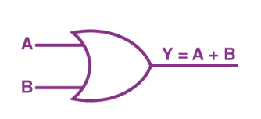
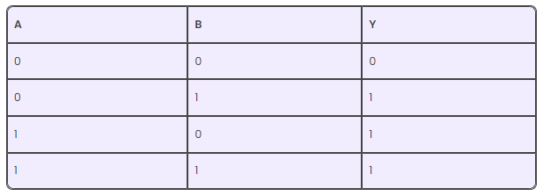
OR Gate
In an OR gate, the output of an OR gate attains state 1 if one or more inputs attain state 1.
The Boolean expression of the OR gate is Y = A + B, read as Y equals A ‘OR’ B.
The truth table of a two-input OR basic gate is given as

Slide 69
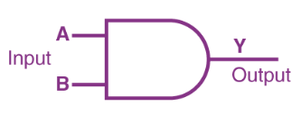
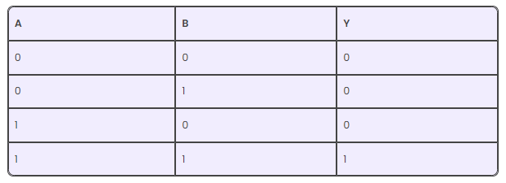
AND Gate
In the AND gate, the output of an AND gate attains state 1 if and only if all the inputs are in state 1.
The Boolean expression of AND gate is Y = A.B
The truth table of a two-input AND basic gate is given as

Slide 70

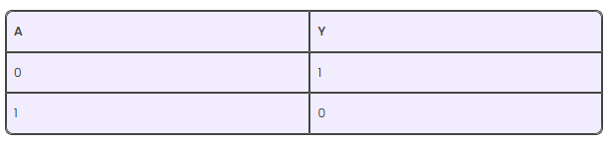
NOT Gate
In a NOT gate, the output of a NOT gate attains state 1 if and only if the input does not attain state 1
The Boolean expression is
It is read as Y equals NOT A.
The truth table of NOT gate is as follows

Slide 71
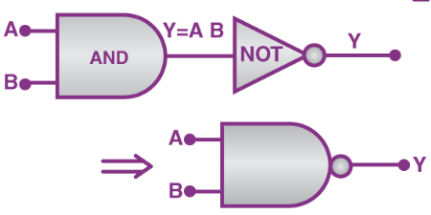
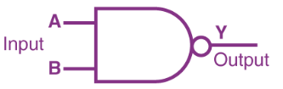
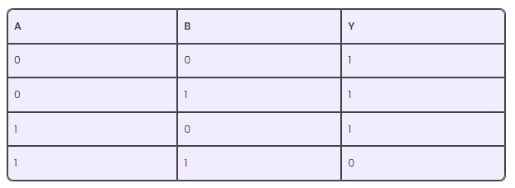
NAND Gate
This basic logic gate is the combination of AND and NOT gates
The Boolean expression of the NAND gate is
The truth table of a NAND gate is given as

Slide 72
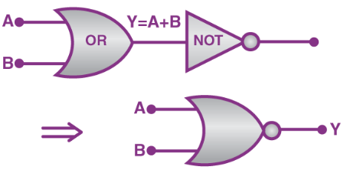
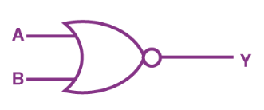
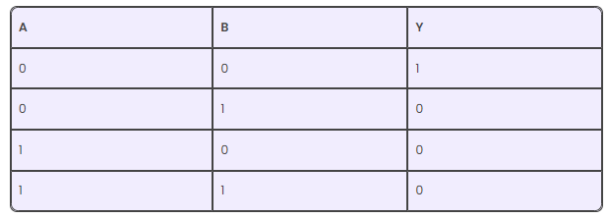
NOR Gate
This gate is the combination of OR and NOT gates
The Boolean expression of the NOR gate is
The truth table of a NOR gate is as follows

Slide 73
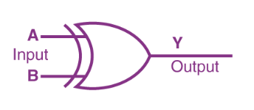

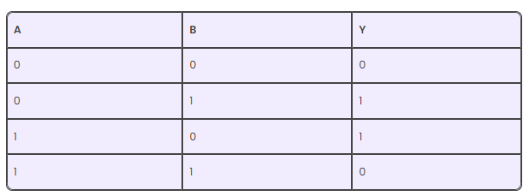
Exclusive-OR gate (XOR Gate)
In an XOR gate, the output of a two-input XOR gate attains state 1 if one adds only input and attains state 1.
The Boolean expression of the XOR gate is
The truth table of an XOR gate is

Slide 74
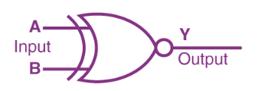

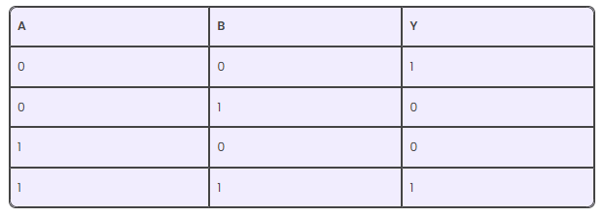
Exclusive-NOR Gate (XNOR Gate)
In the XNOR gate, the output is in state 1 when both inputs are the same, that is, both 0 or both 1.
The Boolean expression of the XNOR gate
The truth table of an XNOR gate is given below

Slide 75
Universal Logic Gates
A universal logic gate is a type of logic gate that can be used to implement any logical functions one that can be used to implement any logic function without using any other type of logic gate
There are two types of universal logic gates: NAND gate and NOR gate.

Slide 76
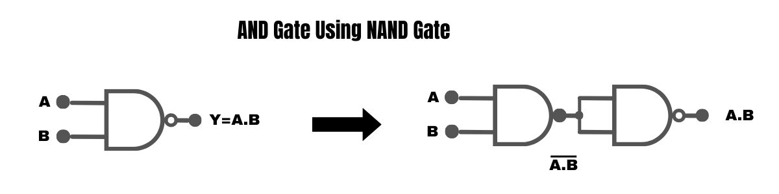
Universal Logic Gates
AND Gate Using NAND Gate
You require two NAND gates to create an AND gate.
In the first NAND gate, the outcome is the inverse of the logical AND operation between the two inputs.
The second NAND gate then inverts the output from the first gate, thus producing the original AND logic.

Slide 77
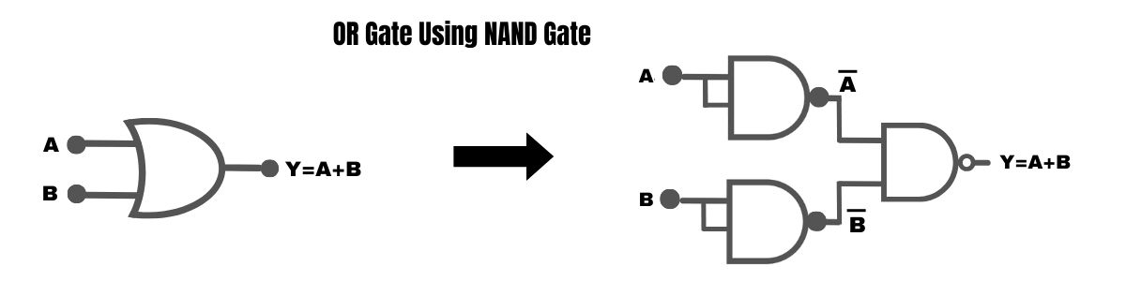
Universal Logic Gates
OR Gate Using NAND Gate
Constructing an OR gate involves three NAND gates.
The first NAND gate produces the inverse of the first input.
The second NAND gate generates the inverse of the second input.
The third NAND gate computes the logical OR of the outputs from the first two NAND gates.

Slide 78
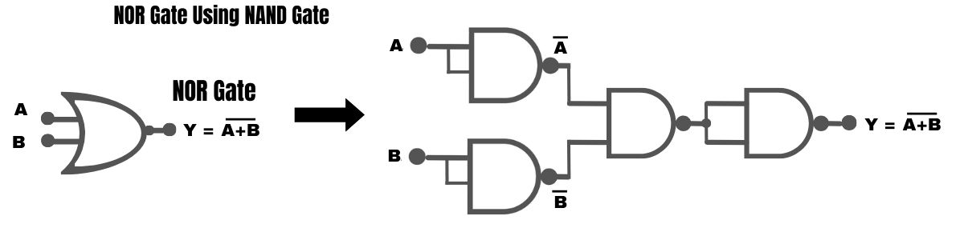
Universal Logic Gates
NOR Gate Using NAND Gate
NOR gate with inputs A and B can be constructed using three NAND gates

Slide 79
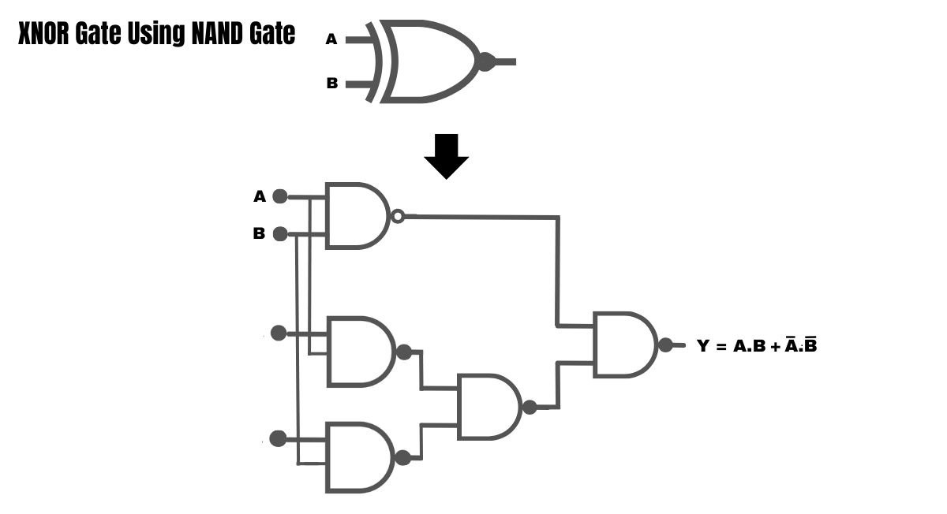
Universal Logic Gates
XNOR Gate Using NAND Gate
The first NAND gate takes the inputs A and B and inverts them.
The second NAND gate takes the inverted inputs and performs an OR operation.
The third NAND gate takes the output of the second NAND gate and inverts it again.

Slide 80
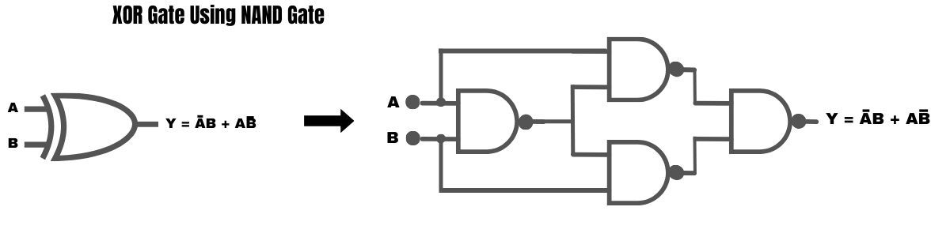
Universal Logic Gates
XOR Gate Using NAND Gate
Building an XOR gate requires four NAND gates.
The first two NAND gates produce the inverse of the respective inputs.
The third NAND gate computes the logical AND of the outputs from the first two NAND gates.
The fourth NAND gate inverts the output of the third NAND gate, resulting in the XOR operation.

Slide 81
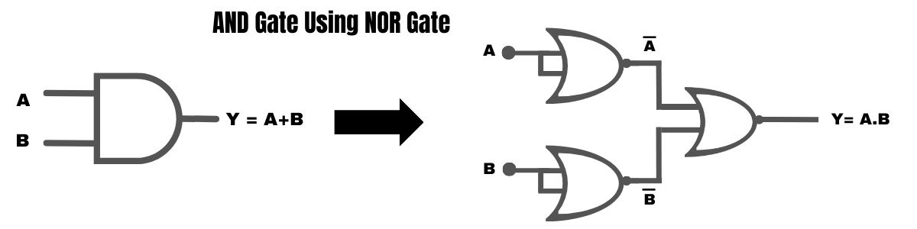
Universal Logic Gates
AND Gate Using NOR Gate
Three NOR gates are required to construct an AND gate.
The first NOR gate’s output is the inverse of the logical OR operation between the two inputs.
The second NOR gate inverts the output of the first NOR gate, resulting in the original AND logic

Slide 82
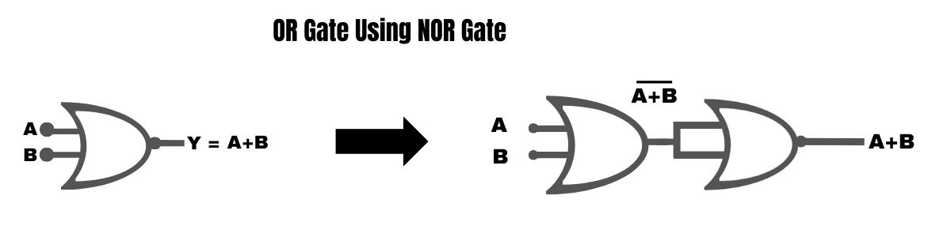
Universal Logic Gates
OR Gate Using NOR Gate
An OR gate can be created using two NOR gates, as demonstrated.
The output of the first NOR gate is the complement of each input.
The second NOR gate computes the logical OR of the outputs from the first NOR gate.

Slide 83
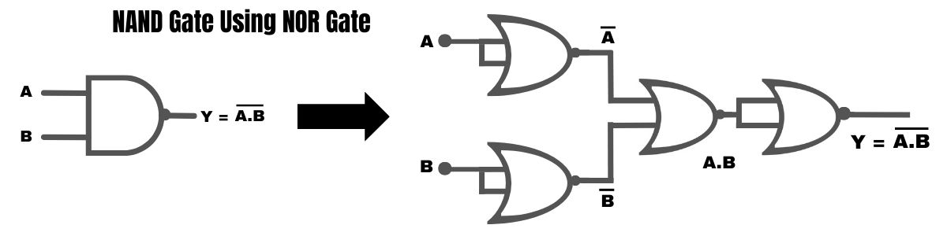
Universal Logic Gates
NAND Gate Using NOR Gate
A NAND gate can be implemented using NOR gates.
The first NOR gate takes the input A and inverts it.
The second NOR gate takes the input B and inverts it.
The third NOR gate takes the outputs of the first two NOR gates and performs an OR operation.
The output of the third NOR gate is the output of the NAND gate.

Slide 84
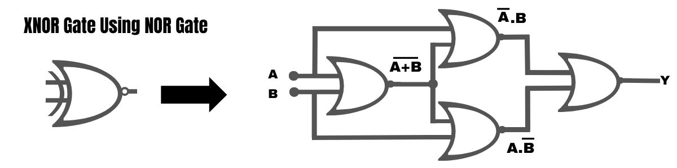
Universal Logic Gates
XNOR Gate Using NOR Gate
The first NOR gate takes the inputs A and B and inverts them.
The second NOR gate takes the inverted inputs and performs an OR operation.
The third NOR gate takes the output of the second NOR gate and inverts it again.
The output of the third NOR gate is the output of the XNOR gate

Slide 85
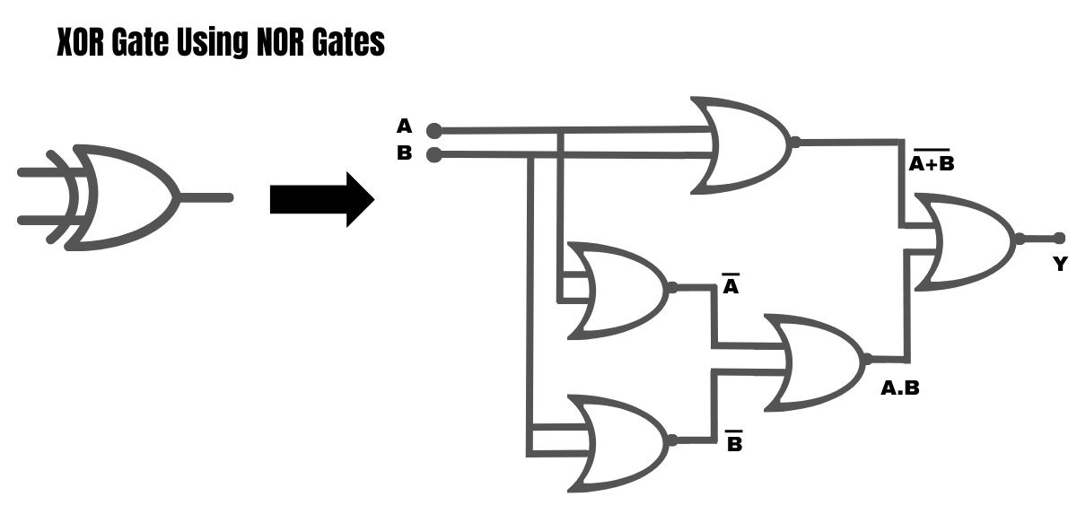
Universal Logic Gates
XOR Gate Using NOR Gate
An XOR gate can be implemented using 3 NOR gates –
The 1st NOR gate takes the inputs A and B and inverts them.
The 2nd NOR gate takes the inverted inputs and inverts them again.
The 3rd NOR gate takes the outputs of the first two NOR gates and performs a NOR operation

