Slide 1
Capstone Project: Sales Insights & Forecasting
Author: Jagadish Kumar

Slide 2
Key Model Metrics
{'R2': 0.08875403067113141, 'MAE': 14546.084923279499, 'RMSE': 21798.815114170342}

Slide 3
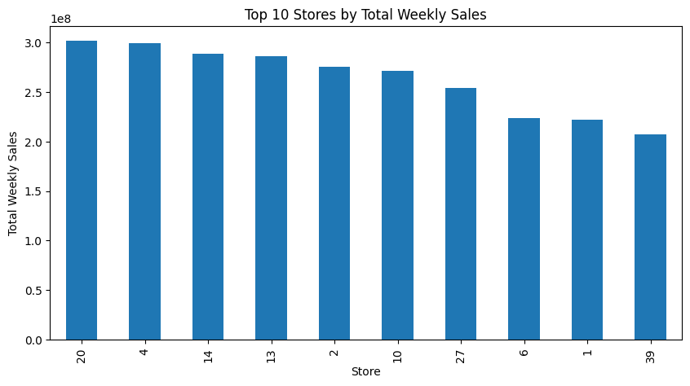
Top 10 Stores

Slide 4
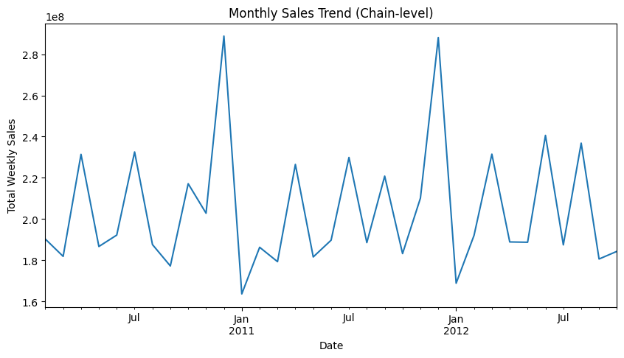
Monthly Sales Trend

Slide 5
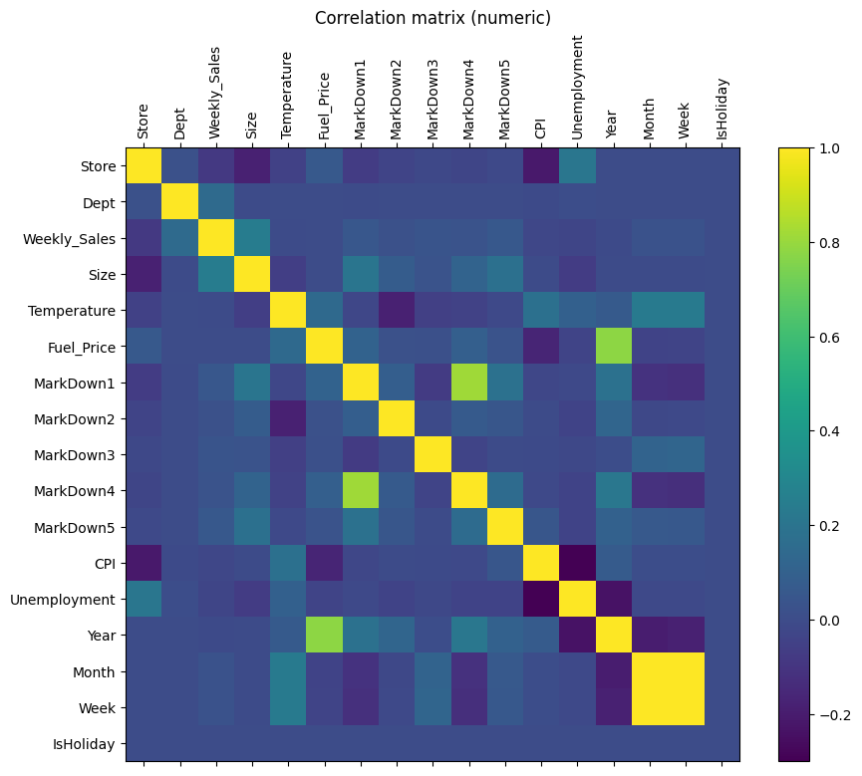
Correlation Matrix

Slide 6
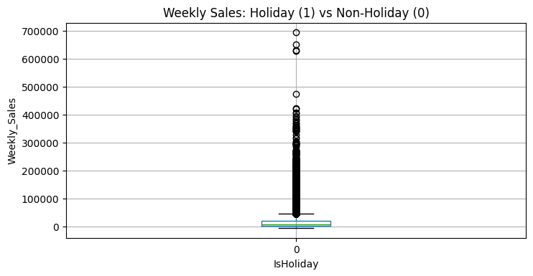
Holiday Boxplot

Slide 7
Executive Summary
• Identified store performance patterns
• Evaluated holiday vs non-holiday sales
• Built regression model for weekly sales
• Produced 12-week demand forecast
• Recommendations: inventory planning, staffing, promotions

