Slide 1
MEASURING HEALTH STATUS OF LEAF
BY
CHARAN KUMAR.P – 170040656
YASHWANTH REDDY.P - 170040653
JAGADISH.P - 170040690

Slide 2
INTRODUCTION:
Measuring the health status of leaf using ARDUINO UNO then storing the data in cloud and verifying the analysis report in serial monitor.
Using RGB sensor, which senses the leaf colour and compare it with the built storage of Micro controller
Later sends the report to the server without the presenting of the server at crop location to measure .

Slide 3
COMPONENTS REQUIRED
ARDUINO UNO QUANTITY :01
PC LOADED WITH THINGSPEAK QUANTITY :01
RGB SENSOR QUANTITY :01
CONNECTING WIRES BUNDLE QUANTITY :01
PLANT ( INPUT ) QUANTITY :01

Slide 4
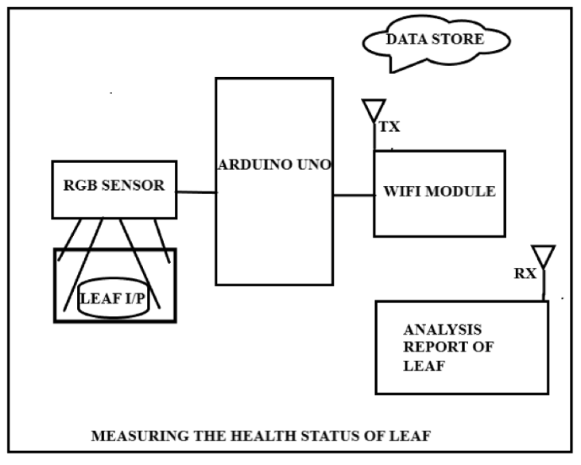
BLOCK DIAGRAM:

Slide 5
ADVANTANGES
Work became more easier.

Slide 6
REFERENCES
https://www.mouser.com/catalog/specsheets/tcs3200-e11.pdf

Slide 7
THANK YOU

