Slide 1
Lead Scoring

Slide 2
Problem:
An education company named X Education sells online courses to industry professionals. On any given day, many professionals who are interested in the courses land on their website and browse for courses.
Conversion of leads is very low which 30% and hoping to increase the lead conversion rate to 80%.

Slide 3
Assumptions:
Removed all data having more than 5 values empty.
Assumed country to be ‘India’ if country value is not provided
Since the missing assymetrique score has same conversion rate as of aysmmetrique score 14, We impute the msissing value with 14.
Since the missing assymetric score has same conversion rate as of aysmmetrique score 15, We impute the msissing value with 15.

Slide 4
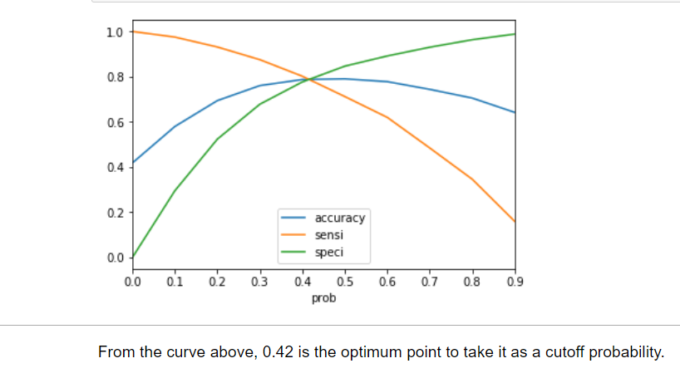
Logistic regression :

Slide 5
Model Performance
Considering 0.42 as optimum point , We got following results
Test data:
Accuracy : 78%, sensitivity – 87% ,specificity: 67%
Train data:
Accuracy : 78%, sensitivity – 78% ,specificity: 74%

Slide 6
Converting variables
Focussing on following variables will increase the chance of conversion of leads.
a)Lead Origin
b) Total Time Spent on Website
c)Asymmetrique activity score
d) Asymmetique profile score
e)Last activity
f)Tags
g)Total visits

Slide 7
Non converting variables
Page views per visit
Do not email

