Slide 1
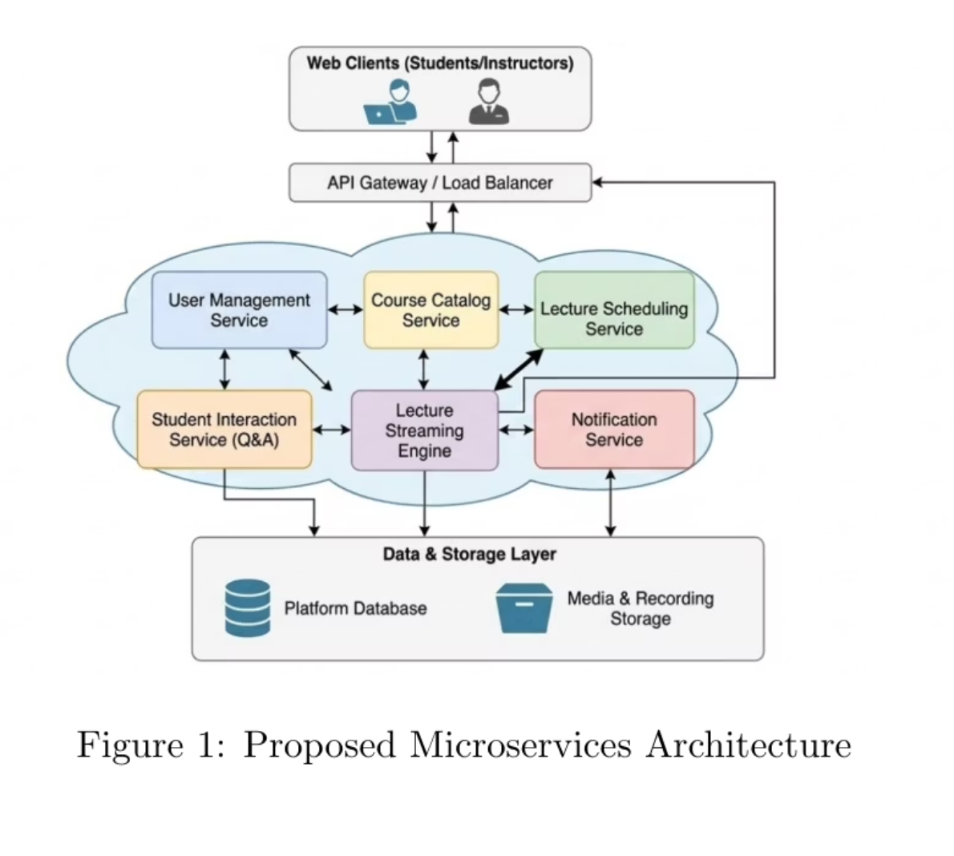

Team 43: OpenLecture: A Distributed Platform for Global Academic Lectures
Live Streaming
High-quality, low-latency video streaming enables real-time attendance from multiple locations.
Interactive Tools
Q&A sessions, polls, and chat features facilitate active participation and engagement.
Cross-Institutional Access
Seamless authentication allows students from partner universities to join lectures instantly.
Secure Infrastructure
Enterprise-grade security protects academic integrity and student data.

Slide 2
Functional and Non Functional Requirements
Functional Requirements
Non Functional Requirements
Notification Manager
Scalability
Course/Lectures Creation
Latency
Video Streaming of Course
Availability
Feedback and Rating
Performance
Lecture Access Control
Reliability

