Slide 1
Multi View Feature Learning - Jagadish Bapanapally
Reference – ‘On Deep Multi-View Representation Learning’ by
Weiran Wang -Toyota Technological Institute at Chicago
Raman Arora - Johns Hopkins University
Karen Livescu - Toyota Technological Institute at Chicago
Jeff Bilmes - University of Washington, Seattle

Slide 2
Outline
Introduction
Multi view learning
Multi view feature learning
Multi view feature learning model(DCCAE)
Results and challenges
Future work
Conclusions
References

Slide 3
Multi View Learning
Views may be obtained from multiple sources
Consensus : trains to maximize the mutual agreement on two distinct views
Complementary principle: Two distinct views that accurately describe the data.

Slide 4
Multi View Feature Learning
Learning features using multiple sources that belong to the same data
Eg: anomalies in surveillance data

Slide 5
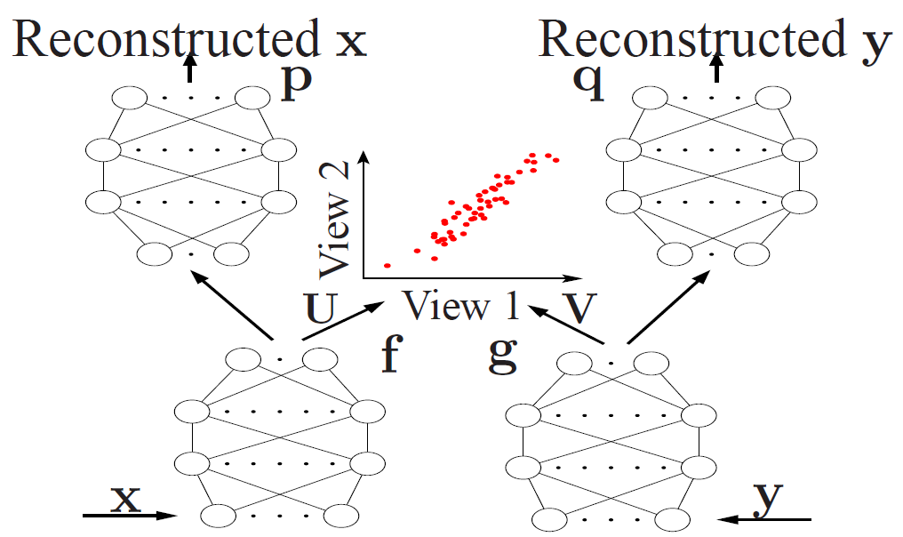
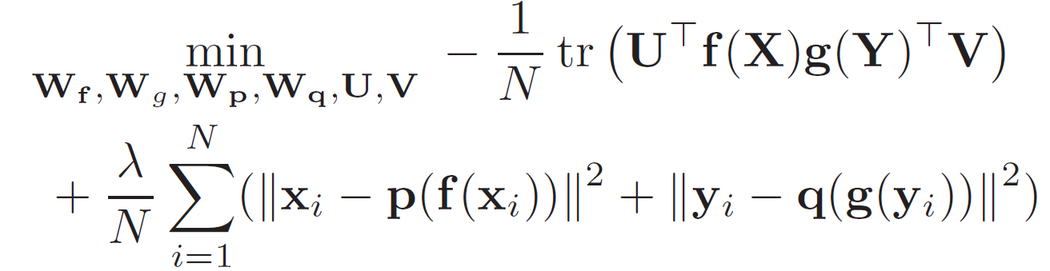
Deep Canonically Correlated Autoencoders
Objective function

Slide 6
Deep Canonically Correlated Autoencoders
Canonical Correlation Analysis

Slide 7
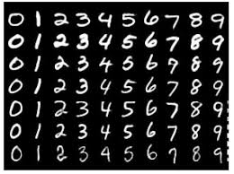
Data sets
MNIST (Modified National Institute of Standards and Technology database)

Slide 8
Deep Canonically Correlated Autoencoders(continued)
My model

Slide 9
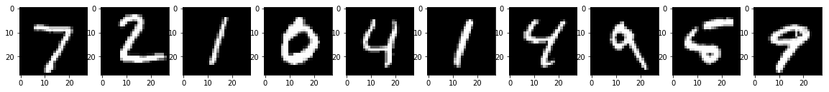
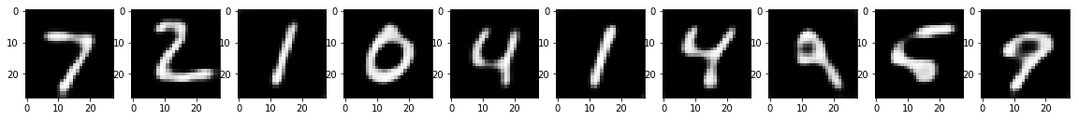
Results

Slide 10
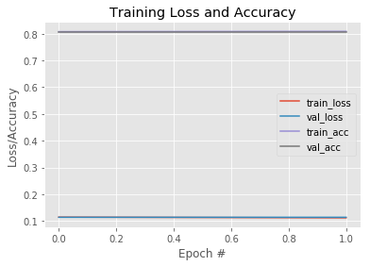
Results(continued)
Trainign loss: 0.1120 acc: 0.8088
Testing loss(val_loss): 0.1140 val_acc: 0.8072

Slide 11
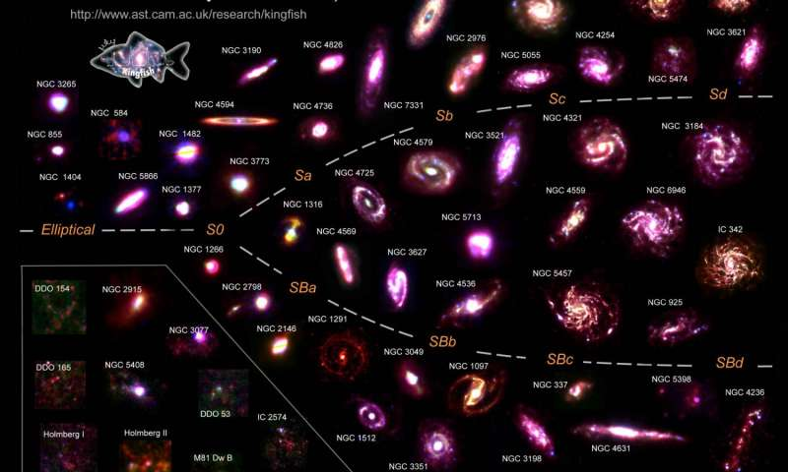
Future work
Use two views for training
Object classification

Slide 12
Conclusion

Slide 13
References
‘A Survey on Multi-view Learning’ by Chang Xu , Dacheng Tao, Chao Xu
https://keras.io/
https://www.tensorflow.org/api_docs/

Slide 14
Q and A

