Slide 1
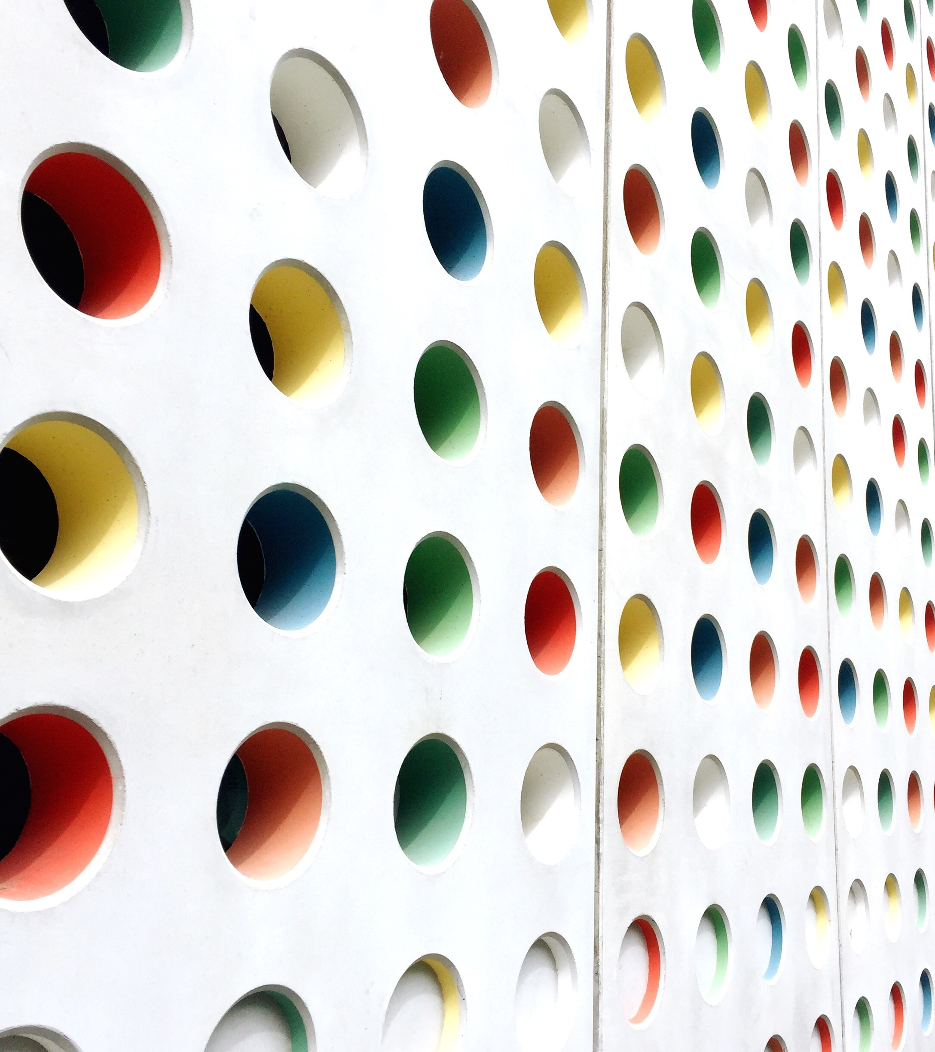
Assigning Regions to Sales Representatives at Pfizer Turkey
QUANTITATIVE METHODS IN MANAGEMENT – Assignment
Rathod jagadish – 2023smf6555

Slide 2
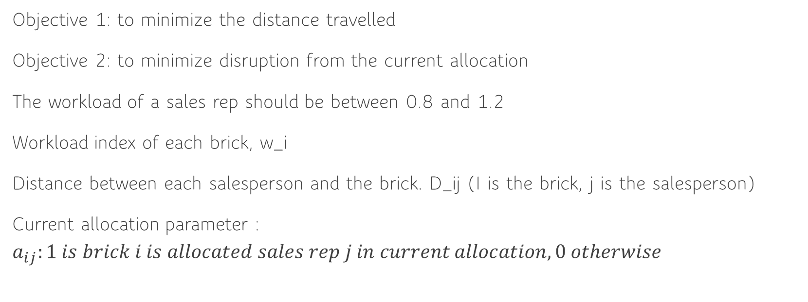
Problem requirements
Objective 1: to minimize the distance travelled
Objective 2: to minimize disruption from the current allocation
The workload of a sales rep should be between 0.8 and 1.2
Workload index of each brick, w_i
Distance between each salesperson and the brick. D_ij (I is the brick, j is the salesperson)
Current allocation parameter : $a_{ij}:1 is brick i is allocated sales rep j in current allocation, 0 otherwise$

Slide 3


Data Set
Variables:
X_ij : 1 if brick I is allocated to sales rep j in the new allocation, 0 otherwise
Objective 1: minimize \sum_{i,j} d_ij x_ij
Constraint 1: $\sum_{j}{x_{ij}=1 ∀i}$
Constraint 2: $0.8≤\sum_{i}{w_{i}x_{ij}≤1.2}$
Minimize disruption:$\sum_{i}{\sum_{j}{w_{i}{(1 −a_{ij})x}_{ij}/\sum_{i}{w_{i}}}}$*100
Obj: $z_{1}+εz_{2}$
$$z_{2}≤z_{2}^{∗} −ε_{1}$$
$$ε=0.00001$$
$$ε_{1}=0.01$$

Slide 4
Mod Code
# Define Sets
set Bricks;
set SalesReps;
# Define parameters
param Distance{Bricks, SalesReps}; # Travel distances
param Workload{Bricks}; # Workload index of each brick
param CurrentAllocation{Bricks, SalesReps}; # Current allocation parameter
# Define the binary decision variables
var NewAllocation{Bricks, SalesReps} binary;
var Disruption >= 0;
# Define the objective function
minimize TotalDistance:
sum{i in Bricks, j in SalesReps} Distance[i,j]*NewAllocation[i,j];
# Define constraints
s.t. AssignBricks{i in Bricks}: sum{j in SalesReps} NewAllocation[i,j] = 1;
s.t. Workload1{j in SalesReps}: 0.8<=sum{i in Bricks} Workload[i]*NewAllocation[i,j]<=1.2;
s.t. Disruption1: Disruption = ((sum{i in Bricks, j in SalesReps} Workload[i] * (1-CurrentAllocation[i,j])*NewAllocation[i,j])/(sum{i in Bricks} Workload[i]))*100;
Reference of Model file

Slide 5
Data Code
set Bricks := 1 2 3 4 5 6 7 8 9 10 11 12 13 14 15 16 17 18 19 20 21 22;
set SalesReps := 1 2 3 4;
param Workload :=
1 0.1609
2 0.1164
3 0.1026
4 0.1516
5 0.0939
6 0.1320
7 0.0687
8 0.0930
9 0.2116
10 0.2529
11 0.0868
12 0.0828
13 0.0975
14 0.8177
15 0.4115
16 0.3795
17 0.0710
18 0.0427
19 0.1043
20 0.0997
21 0.1698
22 0.2531;
param Distance
: 1 2 3 4 :=
1 16.16 24.08 24.32 21.12
2 19 26.47 27.24 17.33
3 25.29 32.49 33.42 12.25
4 0 7.93 8.31 36.12
5 3.07 6.44 7.56 37.37
6 1.22 7.51 8.19 36.29
7 2.8 10.31 10.95 33.5
8 2.87 5.07 5.67 38.8
9 3.8 8.01 7.41 38.16
10 12.35 4.52 4.35 48.27
11 11.11 3.48 2.97 47.14
12 21.99 22.02 24.07 39.86
13 8.82 3.3 5.36 43.31
14 7.93 0 2.07 43.75
15 9.34 2.25 1.11 45.43
16 8.31 2.07 0 44.43
17 7.31 2.44 1.11 43.43
18 7.55 0.75 1.53 43.52
19 11.13 18.41 19.26 25.04
20 17.49 23.44 24.76 23.21
21 11.03 18.93 19.28 25.43
22 36.12 43.75 44.43 0;
param CurrentAllocation
: 1 2 3 4 :=
1 0 0 0 1
2 0 0 0 1
3 0 0 0 1
4 1 0 0 0
5 1 0 0 0
6 1 0 0 0
7 1 0 0 0
8 1 0 0 0
9 0 0 1 0
10 0 1 0 0
11 0 1 0 0
12 0 1 0 0
13 0 1 0 0
14 0 1 0 0
15 1 0 0 0
16 0 0 1 0
17 0 0 1 0
18 0 0 1 0
19 0 0 0 1
20 0 0 0 1
21 0 0 0 1
22 0 0 0 1;
Reference of Data file

Slide 6
Run Code
reset;
model pfizer.mod;
data pfizer.dat;
option solver cplex;
solve;
display NewAllocation, TotalDistance, Disruption;
Reference of Run file

Slide 7
First Disruption
Second Disruption
NewAllocation [*,*]
: 1 2 3 4 :=
1 0 0 0 1
2 0 0 0 1
3 0 0 0 1
4 1 0 0 0
5 1 0 0 0
6 1 0 0 0
7 1 0 0 0
8 1 0 0 0
9 1 0 0 0
10 0 0 1 0
11 0 1 0 0
12 1 0 0 0
13 0 1 0 0
14 0 1 0 0
15 0 0 1 0
16 0 0 1 0
17 0 0 1 0
18 0 1 0 0
19 1 0 0 0
20 1 0 0 0
21 0 0 0 1
22 0 0 0 1;
NewAllocation [*,*]
: 1 2 3 4 :=
1 0 0 0 1
2 0 0 0 1
3 0 0 0 1
4 1 0 0 0
5 1 0 0 0
6 1 0 0 0
7 1 0 0 0
8 1 0 0 0
9 1 0 0 0
10 0 0 1 0
11 0 1 0 0
12 0 1 0 0
13 0 1 0 0
14 0 1 0 0
15 0 0 1 0
16 0 0 1 0
17 0 0 1 0
18 0 1 0 0
19 1 0 0 0
20 1 0 0 0
21 0 0 0 1
22 0 0 0 1;
TotalDistance = 154.6
Disruption = 30.1375
TotalDistance = 154.63
Disruption = 28.0675

Slide 8
Third Disruption
Fourth Disruption
NewAllocation [*,*]
: 1 2 3 4 :=
1 0 0 0 1
2 0 0 0 1
3 0 0 0 1
4 1 0 0 0
5 1 0 0 0
6 1 0 0 0
7 1 0 0 0
8 1 0 0 0
9 1 0 0 0
10 0 1 0 0
11 0 0 1 0
12 1 0 0 0
13 0 1 0 0
14 0 1 0 0
15 0 0 1 0
16 0 0 1 0
17 0 0 1 0
18 0 0 1 0
19 1 0 0 0
20 1 0 0 0
21 0 0 0 1
22 0 0 0 1;
NewAllocation [*,*]
: 1 2 3 4 :=
1 0 0 0 1
2 0 0 0 1
3 0 0 0 1
4 1 0 0 0
5 1 0 0 0
6 1 0 0 0
7 1 0 0 0
8 1 0 0 0
9 1 0 0 0
10 0 1 0 0
11 0 0 1 0
12 1 0 0 0
13 0 1 0 0
14 0 1 0 0
15 0 0 1 0
16 0 0 1 0
17 0 0 1 0
18 0 0 1 0
19 0 0 0 1
20 0 0 0 1
21 1 0 0 0
22 0 0 0 1;
TotalDistance = 155.04
Disruption = 24.9175
TotalDistance = 160.27
Disruption = 24.0625

Slide 9
Fifth Disruption
Sixth Disruption
NewAllocation [*,*]
: 1 2 3 4 :=
1 0 0 0 1
2 0 0 0 1
3 0 0 0 1
4 1 0 0 0
5 1 0 0 0
6 1 0 0 0
7 1 0 0 0
8 1 0 0 0
9 1 0 0 0
10 0 1 0 0
11 0 0 1 0
12 1 0 0 0
13 0 1 0 0
14 0 1 0 0
15 0 0 1 0
16 0 0 1 0
17 0 0 1 0
18 0 0 1 0
19 1 0 0 0
20 0 0 0 1
21 0 0 0 1
22 0 0 0 1;
NewAllocation [*,*]
: 1 2 3 4 :=
1 0 0 0 1
2 0 0 0 1
3 0 0 0 1
4 1 0 0 0
5 1 0 0 0
6 1 0 0 0
7 1 0 0 0
8 1 0 0 0
9 0 0 1 0
10 0 1 0 0
11 0 0 1 0
12 0 1 0 0
13 1 0 0 0
14 0 1 0 0
15 0 0 1 0
16 0 0 1 0
17 0 0 1 0
18 0 1 0 0
19 1 0 0 0
20 1 0 0 0
21 0 0 0 1
22 0 0 0 1;
TotalDistance = 160.76
Disruption = 22.425
TotalDistance = 163.42
Disruption = 21.0625

Slide 10
Seventh Disruption
Eighth Disruption
NewAllocation [*,*]
: 1 2 3 4 :=
1 0 0 0 1
2 0 0 0 1
3 0 0 0 1
4 1 0 0 0
5 1 0 0 0
6 1 0 0 0
7 1 0 0 0
8 1 0 0 0
9 0 0 1 0
10 0 1 0 0
11 0 0 1 0
12 1 0 0 0
13 0 1 0 0
14 0 1 0 0
15 0 0 1 0
16 0 0 1 0
17 0 0 1 0
18 1 0 0 0
19 1 0 0 0
20 1 0 0 0
21 0 0 0 1
22 0 0 0 1;
NewAllocation [*,*]
: 1 2 3 4 :=
1 0 0 0 1
2 0 0 0 1
3 0 0 0 1
4 1 0 0 0
5 1 0 0 0
6 1 0 0 0
7 1 0 0 0
8 1 0 0 0
9 0 0 1 0
10 0 1 0 0
11 0 1 0 0
12 1 0 0 0
13 1 0 0 0
14 0 1 0 0
15 0 0 1 0
16 0 0 1 0
17 0 0 1 0
18 0 0 1 0
19 1 0 0 0
20 1 0 0 0
21 0 0 0 1
22 0 0 0 1;
TotalDistance = 164.67
Disruption = 20.695
TotalDistance = 164.68
Disruption = 19.895

Slide 11
Ninth Disruption
Tenth Disruption
NewAllocation [*,*]
: 1 2 3 4 :=
1 0 0 0 1
2 0 0 0 1
3 0 0 0 1
4 1 0 0 0
5 1 0 0 0
6 1 0 0 0
7 1 0 0 0
8 1 0 0 0
9 0 0 1 0
10 0 0 1 0
11 0 0 1 0
12 0 1 0 0
13 0 1 0 0
14 0 1 0 0
15 1 0 0 0
16 0 0 1 0
17 0 0 1 0
18 0 1 0 0
19 1 0 0 0
20 1 0 0 0
21 0 0 0 1
22 0 0 0 1;
NewAllocation [*,*]
: 1 2 3 4 :=
1 0 0 0 1
2 0 0 0 1
3 0 0 0 1
4 1 0 0 0
5 1 0 0 0
6 1 0 0 0
7 1 0 0 0
8 1 0 0 0
9 0 0 1 0
10 0 0 1 0
11 0 1 0 0
12 0 1 0 0
13 0 1 0 0
14 0 1 0 0
15 1 0 0 0
16 0 0 1 0
17 0 0 1 0
18 0 1 0 0
19 1 0 0 0
20 1 0 0 0
21 0 0 0 1
22 0 0 0 1;
TotalDistance = 165.96
Disruption = 14.66
TotalDistance = 166.47
Disruption = 12.49

Slide 12
Eleventh Disruption
Twelfth Disruption
NewAllocation [*,*]
: 1 2 3 4 :=
1 0 0 0 1
2 0 0 0 1
3 0 0 0 1
4 1 0 0 0
5 1 0 0 0
6 1 0 0 0
7 1 0 0 0
8 1 0 0 0
9 0 0 1 0
10 0 0 1 0
11 0 1 0 0
12 0 1 0 0
13 0 1 0 0
14 0 1 0 0
15 1 0 0 0
16 0 0 1 0
17 0 0 1 0
18 0 0 1 0
19 1 0 0 0
20 1 0 0 0
21 0 0 0 1
22 0 0 0 1;
NewAllocation [*,*]
: 1 2 3 4 :=
1 0 0 0 1
2 0 0 0 1
3 0 0 0 1
4 1 0 0 0
5 1 0 0 0
6 1 0 0 0
7 1 0 0 0
8 1 0 0 0
9 0 0 1 0
10 0 1 0 0
11 0 0 1 0
12 0 1 0 0
13 0 0 1 0
14 0 1 0 0
15 1 0 0 0
16 0 0 1 0
17 0 0 1 0
18 0 1 0 0
19 1 0 0 0
20 1 0 0 0
21 0 0 0 1
22 0 0 0 1;
TotalDistance = 167.25
Disruption = 11.4225
TotalDistance = 168.19
Disruption = 10.775

Slide 13
Thirteenth Disruption
Fourteen Disruption
NewAllocation [*,*]
: 1 2 3 4 :=
1 0 0 0 1
2 0 0 0 1
3 0 0 0 1
4 1 0 0 0
5 1 0 0 0
6 1 0 0 0
7 1 0 0 0
8 1 0 0 0
9 0 0 1 0
10 0 1 0 0
11 0 0 1 0
12 0 0 1 0
13 0 1 0 0
14 0 1 0 0
15 1 0 0 0
16 0 0 1 0
17 0 0 1 0
18 0 0 1 0
19 1 0 0 0
20 1 0 0 0
21 0 0 0 1
22 0 0 0 1;
NewAllocation [*,*]
: 1 2 3 4 :=
1 0 0 0 1
2 0 0 0 1
3 0 0 0 1
4 1 0 0 0
5 1 0 0 0
6 1 0 0 0
7 1 0 0 0
8 1 0 0 0
9 0 0 1 0
10 0 0 1 0
11 0 1 0 0
12 0 1 0 0
13 0 1 0 0
14 0 1 0 0
15 1 0 0 0
16 0 0 1 0
17 0 0 1 0
18 0 0 1 0
19 1 0 0 0
20 0 0 0 1
21 0 0 0 1
22 0 0 0 1;
TotalDistance = 168.96
Disruption = 9.34
TotalDistance = 172.97
Disruption = 8.93

Slide 14
Fifteenth Disruption
Sixteenth Disruption
NewAllocation [*,*]
: 1 2 3 4 :=
1 0 0 0 1
2 0 0 0 1
3 0 0 0 1
4 1 0 0 0
5 1 0 0 0
6 1 0 0 0
7 1 0 0 0
8 1 0 0 0
9 0 0 1 0
10 0 1 0 0
11 0 0 1 0
12 0 1 0 0
13 0 0 1 0
14 0 1 0 0
15 1 0 0 0
16 0 0 1 0
17 0 0 1 0
18 0 1 0 0
19 1 0 0 0
20 0 0 0 1
21 0 0 0 1
22 0 0 0 1;
NewAllocation [*,*]
: 1 2 3 4 :=
1 0 0 0 1
2 0 0 0 1
3 0 0 0 1
4 1 0 0 0
5 1 0 0 0
6 1 0 0 0
7 1 0 0 0
8 1 0 0 0
9 0 0 1 0
10 0 1 0 0
11 0 0 1 0
12 0 0 1 0
13 0 1 0 0
14 0 1 0 0
15 1 0 0 0
16 0 0 1 0
17 0 0 1 0
18 0 0 1 0
19 1 0 0 0
20 0 0 0 1
21 0 0 0 1
22 0 0 0 1;
TotalDistance = 173.91
Disruption = 8.2825
TotalDistance = 174.68
Disruption = 6.8475

Slide 15
Seventeenth Disruption
Eighteenth Disruption
NewAllocation [*,*]
: 1 2 3 4 :=
1 0 0 0 1
2 0 0 0 1
3 0 0 0 1
4 1 0 0 0
5 1 0 0 0
6 1 0 0 0
7 1 0 0 0
8 1 0 0 0
9 0 0 1 0
10 0 1 0 0
11 0 0 1 0
12 0 0 1 0
13 0 1 0 0
14 0 1 0 0
15 1 0 0 0
16 0 0 1 0
17 0 0 1 0
18 0 0 1 0
19 0 0 0 1
20 1 0 0 0
21 0 0 0 1
22 0 0 0 1;
NewAllocation [*,*]
: 1 2 3 4 :=
1 0 0 0 1
2 0 0 0 1
3 0 0 0 1
4 1 0 0 0
5 1 0 0 0
6 1 0 0 0
7 1 0 0 0
8 1 0 0 0
9 0 0 1 0
10 0 0 1 0
11 0 1 0 0
12 0 1 0 0
13 0 1 0 0
14 0 1 0 0
15 1 0 0 0
16 0 0 1 0
17 0 0 1 0
18 0 0 1 0
19 0 0 0 1
20 0 0 0 1
21 0 0 0 1
22 0 0 0 1;
TotalDistance = 182.87
Disruption = 6.7325
TotalDistance = 186.88
Disruption = 6.3225

Slide 16
Nineteenth Disruption
Twentieth Disruption
NewAllocation [*,*]
: 1 2 3 4 :=
1 0 0 0 1
2 0 0 0 1
3 0 0 0 1
4 1 0 0 0
5 1 0 0 0
6 1 0 0 0
7 1 0 0 0
8 1 0 0 0
9 0 0 1 0
10 0 1 0 0
11 0 0 1 0
12 0 1 0 0
13 0 0 1 0
14 0 1 0 0
15 1 0 0 0
16 0 0 1 0
17 0 0 1 0
18 0 1 0 0
19 0 0 0 1
20 0 0 0 1
21 0 0 0 1
22 0 0 0 1;
NewAllocation [*,*]
: 1 2 3 4 :=
1 0 0 0 1
2 0 0 0 1
3 0 0 0 1
4 1 0 0 0
5 1 0 0 0
6 1 0 0 0
7 1 0 0 0
8 1 0 0 0
9 0 0 1 0
10 0 1 0 0
11 0 0 1 0
12 0 0 1 0
13 0 1 0 0
14 0 1 0 0
15 1 0 0 0
16 0 0 1 0
17 0 0 1 0
18 0 0 1 0
19 0 0 0 1
20 0 0 0 1
21 0 0 0 1
22 0 0 0 1;
TotalDistance = 187.82
Disruption = 5.675
TotalDistance = 188.59
Disruption = 4.24

Slide 17
Twenty first Disruption
NewAllocation [*,*]
: 1 2 3 4 :=
1 0 0 0 0
2 0 0 0 0
3 0 0 0 0
4 0 0 0 0
5 0 0 0 0
6 0 0 0 0
7 0 0 0 0
8 0 0 0 0
9 0 0 1 0
10 0 1 0 0
11 0 0 0 0
12 0 0 0 0
13 0 0 0 0
14 0 1 0 0
15 1 0 0 0
16 0 0 1 0
17 0 0 0 0
18 0 0 0 0
19 0 0 0 0
20 0 0 0 0
21 0 0 0 1
22 0 0 0 1;
TotalDistance = 46.7
Disruption = 0

Slide 18
Thank You

