Slide 1

PR · PRIMEROUTE
UK LOGISTICS · DISPATCH PLATFORM
Plan a full day of runs
in seconds, not hours.
One platform for driver tracking, route planning, warehouse routing,
compliance and dispatch — built for carriers moving real loads.
PRESENTED TO · [ CARRIER NAME ] [ DATE ]
01 / 24

Slide 2
PRIMEROUTE · UK LOGISTICS DISPATCH
02 / 24
INTRO · WHAT PRIMEROUTE PROMISES
From hours of planning to seconds of decision.
PrimeRoute was built for companies whose drivers run structured routes every day —
so the same planning work does not need to be redone by hand every morning.
Our algorithm assigns drivers to routes in seconds, weighing every variable at once.
Distance
Legal hours
Next run
Return base
driver → pickup
remaining vs required
what comes after this one
kill the deadhead
primeroute.uk

Slide 3
01
SECTION ONE · CRITICAL TAB
The Drivers tab
Where every route starts — the people, the phones, and the hours behind each run.
primeroute.uk

Slide 4
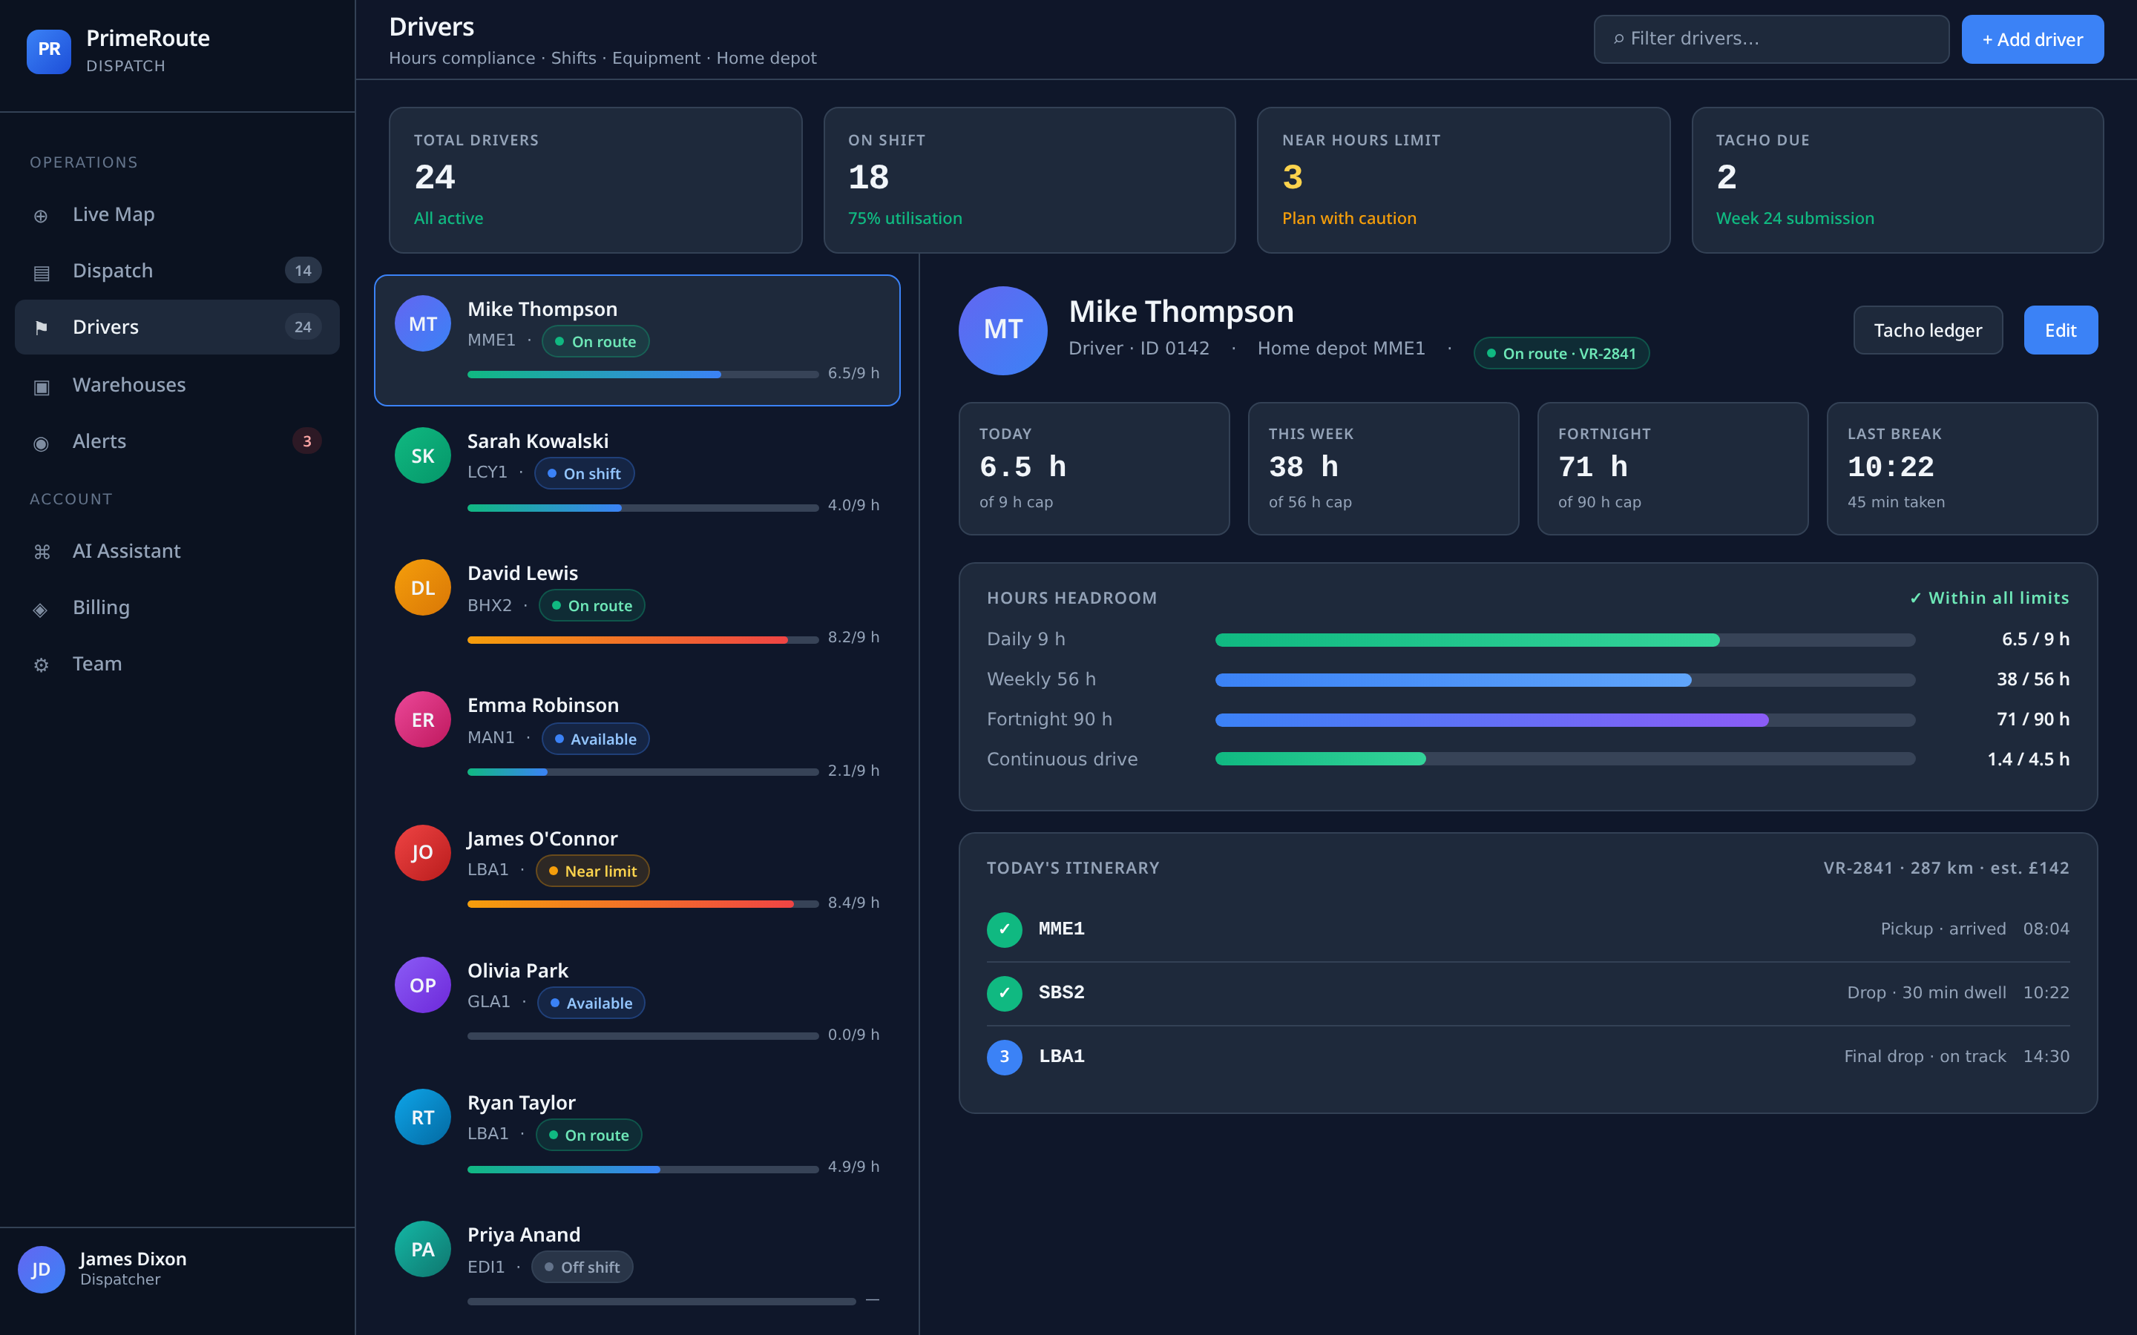
PRIMEROUTE · UK LOGISTICS DISPATCH
04 / 24
DRIVERS · THE PEOPLE + THE MOBILE APP
Drivers, paired with an app in their pocket.
The Drivers tab is the profile side of every person on the road.
It works hand-in-hand with a mobile PWA the driver installs on their phone.
The phone sends live coordinates back into PrimeRoute continuously —
so dispatch can see, in real time, where every driver sits in relation to the
next possible job.
DRIVERS TAB · IN-APP VIEW
primeroute.uk

Slide 5
PRIMEROUTE · UK LOGISTICS DISPATCH
05 / 24
DRIVERS · WHAT THE MOBILE APP DOES
One app. Everything a driver needs on shift.
01
Live GPS to dispatch
Coordinates stream to the platform so dispatch sees every driver on the live map.
02
Route delivery
Address, times, stop order — the full run pushed to the phone the moment it's assigned.
REVEAL 1 OF 3 · primeroute.uk

Slide 6
PRIMEROUTE · UK LOGISTICS DISPATCH
06 / 24
DRIVERS · WHAT THE MOBILE APP DOES
One app. Everything a driver needs on shift.
01
Live GPS to dispatch
Coordinates stream to the platform so dispatch sees every driver on the live map.
02
Route delivery
Address, times, stop order — the full run pushed to the phone the moment it's assigned.
03
Delays & VRID notes
Driver submits delays and leaves notes on the VRID they are running, without a phone call.
04
Shift & hours setup
Driver sets working days, or days + hours — the planner will never book them outside it.
REVEAL 2 OF 3 · primeroute.uk

Slide 7
PRIMEROUTE · UK LOGISTICS DISPATCH
07 / 24
DRIVERS · WHAT THE MOBILE APP DOES
One app. Everything a driver needs on shift.
01
Live GPS to dispatch
Coordinates stream to the platform so dispatch sees every driver on the live map.
02
Route delivery
Address, times, stop order — the full run pushed to the phone the moment it's assigned.
03
Delays & VRID notes
Driver submits delays and leaves notes on the VRID they are running, without a phone call.
04
Shift & hours setup
Driver sets working days, or days + hours — the planner will never book them outside it.
05
Return-base preference
Lives in London? The planner sends them to Leicester and pairs a run back — no deadhead. Leave it blank and they can be dispatched anywhere in the country.
06
Monday tacho submission
Every Monday the app requests last week's tach hours — driver confirms with one tap. No chasing.
REVEAL 3 OF 3 · primeroute.uk

Slide 8
PRIMEROUTE · UK LOGISTICS DISPATCH
08 / 24
DRIVERS · HOURS TRACKED BY THE PLATFORM
Driving hours are collected — not guessed.
PrimeRoute totals every driver's hours from the runs actually assigned plus the time
spent travelling from where they currently are to the pickup point.
That means the planner always knows how much legal headroom each driver has left —
and blocks assignments that would push them past it.
01
02
03
Run time
Pre-pickup transit
Weekly tach
Every stop, every leg
Live GPS → pickup ETA
Confirmed every Monday
from the assigned route
added to the daily total
cross-checked with system
primeroute.uk

Slide 9
02
SECTION TWO · CRITICAL TAB
The Warehouses tab
The locations layer — so the platform knows where every pickup and drop-off actually is.
primeroute.uk

Slide 10
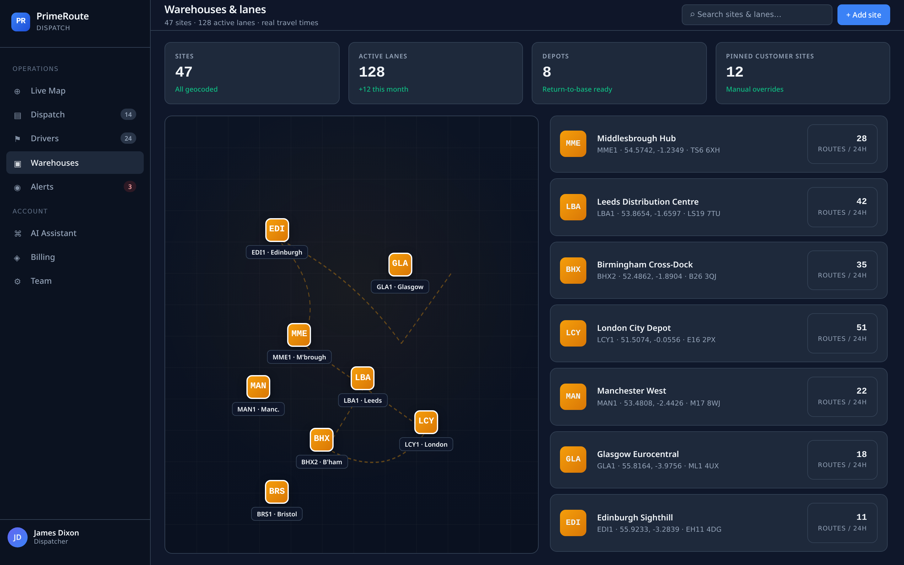
PRIMEROUTE · UK LOGISTICS DISPATCH
10 / 24
WAREHOUSES · THE LOCATIONS LAYER
Now the system knows where every job begins and ends.
Once we have live driver coordinates, PrimeRoute needs the second half of the picture:
the pickup and drop-off points.
Every location a driver could ever visit lives in the Warehouses tab —
so the planner can measure real distance, real transit and real windows.
For Amazon carriers we've done most of the work already.
80+
∞
1×
WAREHOUSES TAB
AMAZON SITES PRE-LOADED
ADD YOUR OWN
DONE ONCE, REUSED FOREVER
primeroute.uk

Slide 11
PRIMEROUTE · UK LOGISTICS DISPATCH
11 / 24
PAUSE · WHY THIS TWO-STEP SETUP MATTERS
You do this work once.
Then the routes just repeat.
Drivers and warehouses are your two foundational tabs — set them up cleanly and
the daily planning that follows becomes almost automatic. The routes you receive
from customers like Amazon are repetitive by nature; PrimeRoute is built to exploit that.
primeroute.uk

Slide 12
03
SECTION THREE · THE ENGINE
Dispatch & Planning
Where the daily magic happens — upload, auto-assign, review, ship.
primeroute.uk

Slide 13
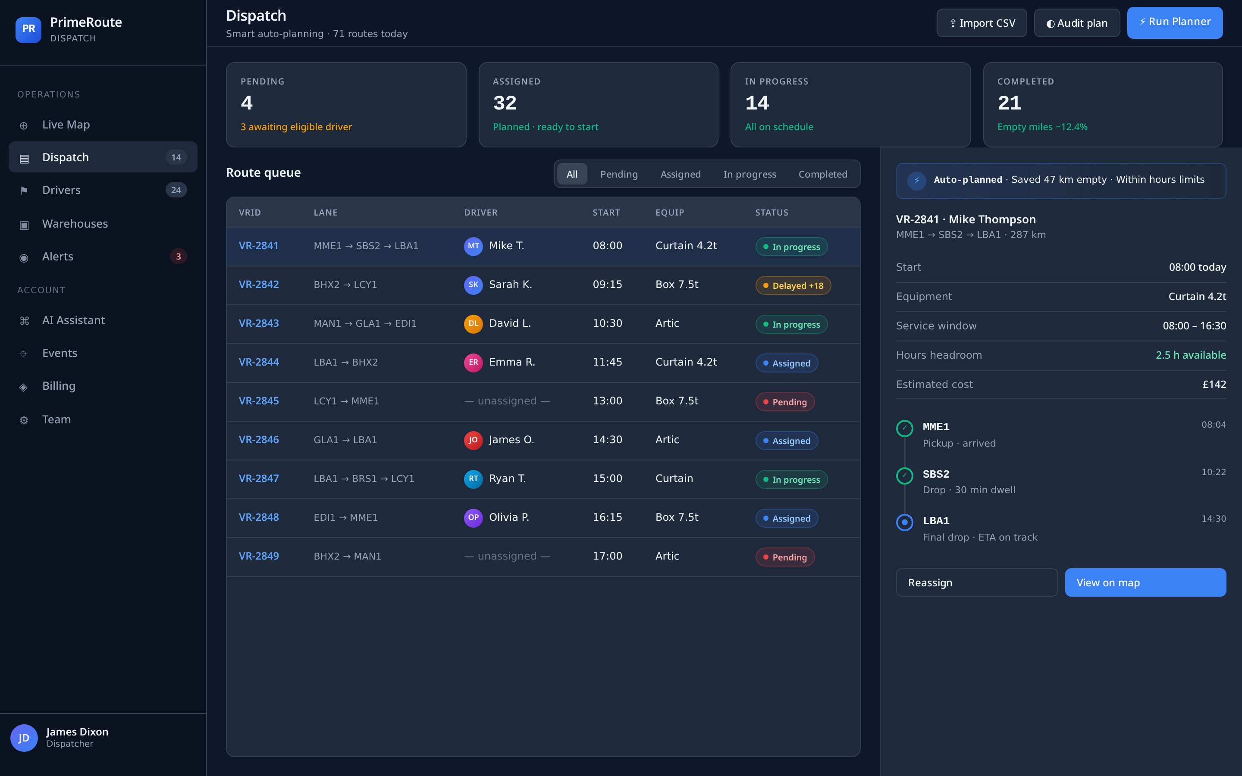
PRIMEROUTE · UK LOGISTICS DISPATCH
13 / 24
DISPATCH · STEP 1 · UPLOAD THE ROUTES
Start with the file the customer already sends you.
Working with Amazon? Download the daily Excel export directly from their portal.
Upload that same file into PrimeRoute — every route lands on the dispatch board,
already parsed: origin, destination, times, VRID, equipment type.
No re-typing. No copy-paste. No spreadsheet gymnastics.
The board becomes your single view of everything that needs a driver today.
DISPATCH BOARD · AFTER IMPORT
primeroute.uk

Slide 14
PRIMEROUTE · UK LOGISTICS DISPATCH
14 / 24
DISPATCH · STEP 2 · ONE-CLICK AUTO-PLAN
Press one button. Every route gets the right driver.
RESULT
Every route assigned to the best-fit driver.
The auto-planner solves the whole day at once — weighing every variable
we already introduced on the Drivers tab, simultaneously, in seconds.
Live driver location
Legal hours remaining
Shift & availability
Return-base preference
On-time by design.
Deadhead cut to the bone.
No illegal hours.
Follow-on route
Deadhead minimisation
primeroute.uk

Slide 15
PRIMEROUTE · UK LOGISTICS DISPATCH
15 / 24
DISPATCH · STEP 3 · FULL MANUAL CONTROL
The planner is smart. You're still in charge.
Anything the algorithm does, a dispatcher can override in two clicks.
Create
Edit
Cancel
Add a route by hand
Change stops, times, driver
Pull a run instantly
Map view
Notes
Re-plan
See the whole route drawn out
Attach context to any VRID
Recompute after any change
primeroute.uk

Slide 16
04
SECTION FOUR · THE REST OF THE COCKPIT
Everything else, quickly.
Live map, alerts, events and an AI assistant that behaves like a senior SOP manager.
primeroute.uk

Slide 17
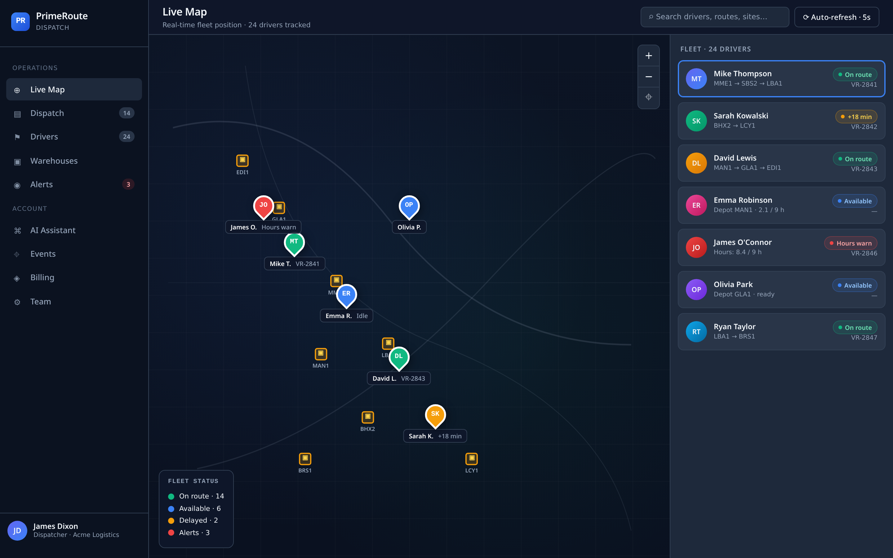
PRIMEROUTE · UK LOGISTICS DISPATCH
17 / 24
LIVE MAP · SEE THE FLEET IN REAL TIME
Every driver on one map. Click for a live ETA.
Every driver's phone is on the map, updated live.
Click a driver, then click a location — PrimeRoute calculates the transit time
between the two on the spot. Perfect for answering 'can they still make it?'
or ranking who is closest to a fresh job.
Search, filter, drill in — the map is the situational-awareness layer for the whole team.
LIVE MAP · FLEET VIEW
primeroute.uk

Slide 18
PRIMEROUTE · UK LOGISTICS DISPATCH
18 / 24
ALERTS · EVENTS · THE AUDIT TRAIL
Nothing slips. Everything is logged.
ALERTS
EVENTS
Only what needs your attention.
A timestamped record of everything.
· Delays and missed windows
· Hours-of-service warnings
· Unassigned routes
· Driver-app flags
Badge count on the sidebar so nothing quietly rots.
· Who assigned what, when
· Every driver status change
· Every import and re-plan
· Every note left on a VRID
Answers 'what happened here?' without a Slack thread.
primeroute.uk

Slide 19
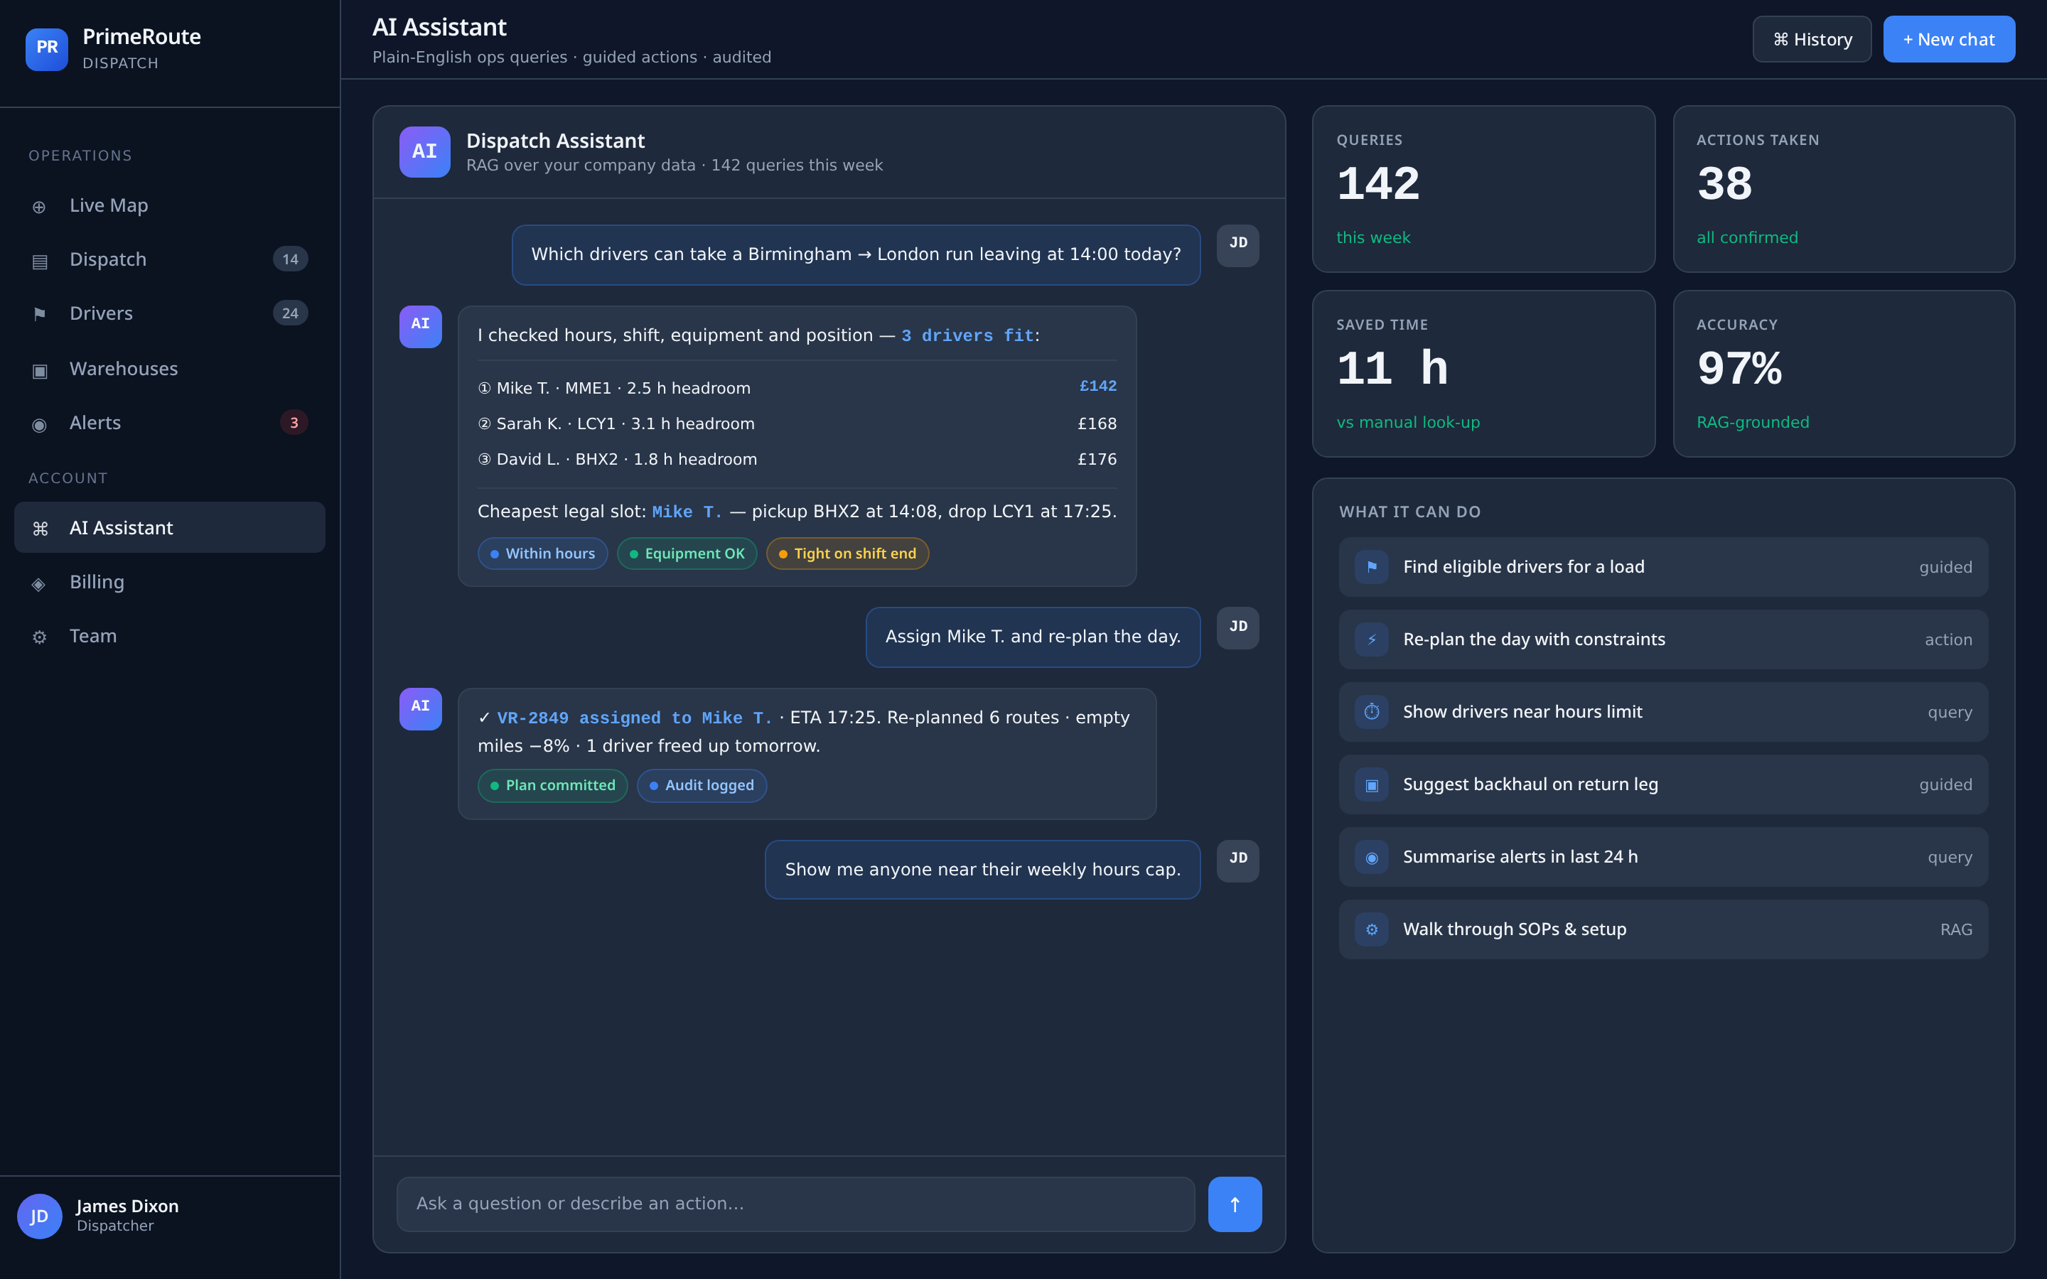
PRIMEROUTE · UK LOGISTICS DISPATCH
19 / 24
AI ASSISTANT · YOUR SOP ON DEMAND
An advanced SOP manager, on tap.
Every dispatcher, every new hire, gets a chat button in the sidebar.
Ask it anything about how PrimeRoute works — how planning weighs variables,
what a status means, how to fix a stuck driver, how to set up a new warehouse.
It reads from your live data and from the SOP knowledge base — so answers are
specific to your company, not generic help-desk copy.
Onboarding time drops. Escalations to management drop.
AI ASSISTANT · IN CONTEXT
primeroute.uk

Slide 20
05
SECTION FIVE · BEHIND THE SCENES
Company admin
The short bit — who runs the account, who pays the bill.
primeroute.uk

Slide 21
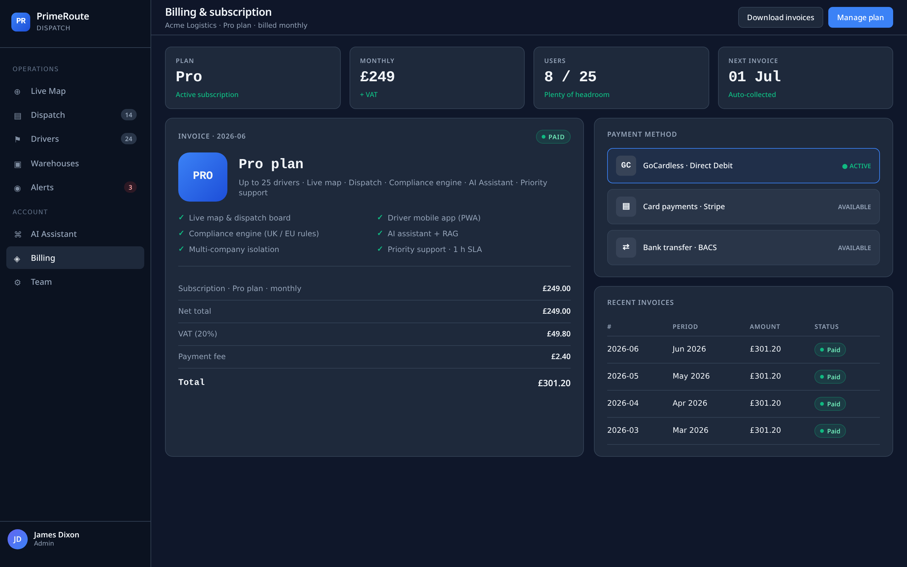
PRIMEROUTE · UK LOGISTICS DISPATCH
21 / 24
ADMIN · THE OWNER'S PANEL
The account owner runs it. Quietly.
A small admin surface for the person running the company account.
· Create and manage team profiles (dispatchers, planners, admins)
· Set roles and permissions
· Handle billing, invoices and payment method
· Configure company-wide preferences and branding
Set up once. Touch it rarely. Get on with the actual work.
ADMIN · BILLING VIEW
primeroute.uk

Slide 22
PRIMEROUTE · UK LOGISTICS DISPATCH
22 / 24
RECAP · HOW A DAY RUNS ON PRIMEROUTE
Five steps. One platform. Every day.
1
2
3
4
5
SET UP
IMPORT
AUTO-PLAN
EXECUTE
REVIEW
Drivers + Warehouses
Upload the Excel
Press the button
Driver app + live map
Alerts · Events · AI
Done once, reused forever.
Routes hit the dispatch board.
Best-fit driver on every run.
Real-time visibility, on-time delivery.
Nothing slips, everything's logged.
Hours of planning collapsed into seconds.
primeroute.uk

Slide 23
PR · PRIMEROUTE
READY WHEN YOU ARE
Let's plan your first day
on PrimeRoute.
We'll import a real week of your routes, connect your drivers and warehouses,
and show you the difference on your own data — in a single pilot session.
PRIMEROUTE.UK · HELLO@PRIMEROUTE.UK
23 / 23

