Slide 1
CROP PREDICTION USING MACHINE LEARNING
by
JAGANAATH P 220701095
Guide
Dr. Auxilia Osvin Nancy, MTech., Ph.D.,

Slide 2
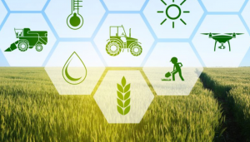
Introduction
Agriculture forms the backbone of India's economy, with more than 50% of workers employed in the sector.
Predicting crop yield is crucial for planning, allocating resources, and ensuring food security.
Conventional approaches depend substantially on local data, limited manual records, and expert opinion — rendering them inaccurate and inefficient.
India's heterogeneous agro-climatic conditions, soil varieties, and modes of cultivation contribute to the added complexity of yield forecasting.
Machine Learning (ML) presents a strong option by using large amounts of agricultural data to identify patterns and make reliable predictions.

Slide 3
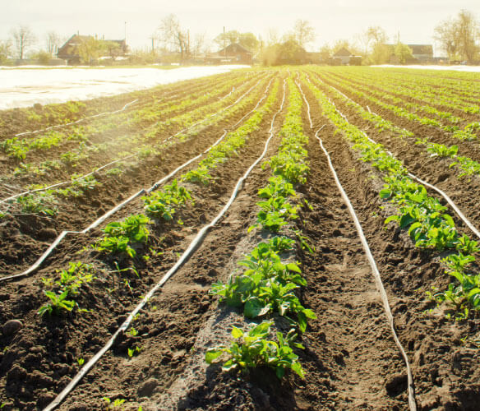
Literature Survey
Traditional approaches rely on expert opinion and past trends; frequently incorrect
because of India's heterogeneous:
Climatic conditions.
Soil types.
Practices of cultivation.
Machine Learning (ML) provides a data-based solution:
Extracts insights from intricate, multi-dimensional agricultural data.
Supports dynamic, scalable, and adjustable prediction models.
Research indicates ML enhances forecast accuracy, diminishes manual.
intervention, and aids in early decision-making.

Slide 4
Literature Survey
Data Sources Used in Research:
Weather information (rain, temp, humidity)
Soil information (pH, water content, fertility)
Crop information (type, variety, planting/harvest dates)
Historical yields
Satellite imagery and remote sensing
Popularly Applied ML Algorithms:
Regression Models – prediction of yield using input variables
Decision Trees & Random Forests – suitable for interpretability
Support Vector Machines (SVM) – performs well on small, clean datasets
Neural Networks – extract nonlinear patterns and high-order features

Slide 5
Literature Survey
Applications in India:
Rice yield prediction using ANN & SVM in Tamil Nadu and Punjab
Sugarcane and wheat models using Random Forests in Maharashtra
Cotton pest prediction using Decision Trees in Gujarat
Key Challenges:
Data Quality – inconsistent or missing data in rural areas
Model Interpretability – complex models not easily understood by farmers
Scalability & Generalization – models work well locally but fail across regions

Slide 6
Objectives
To develop a machine learning system capable of accurately predicting crop yields in India.
To collect, clean, and analyze agricultural data from various sources such as weather records, soil data, and historical yields.
To compare and evaluate different ML algorithms (e.g., Random Forest, SVM, Decision Tree) for their prediction accuracy.
To enhance agricultural productivity and support informed decision-making in farming.

Slide 7

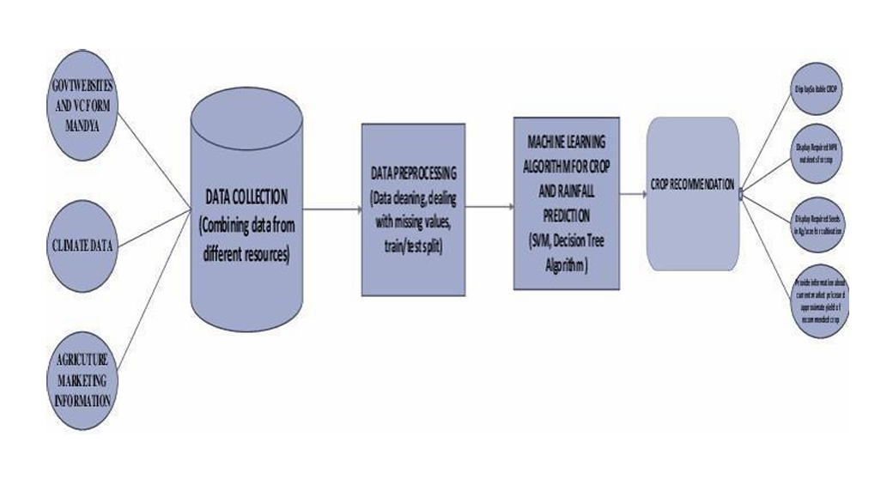
System Architecture

Slide 8
Methodology
Collected agricultural data from weather stations, soil surveys, and government records.
Extracted key features: temperature, rainfall, soil pH, crop type, and planting dates.
Handled missing values and outliers to ensure clean and consistent datasets.
Applied normalization and feature engineering for improved model accuracy.

Slide 9
Methodology
Trained multiple ML algorithms: Logistic Regression, Decision Tree, Random Forest, and SVM.
Split data into training and testing sets with cross-validation for reliable evaluation.
Optimized model performance using hyperparameter tuning techniques.
Evaluated models using metrics like accuracy & precision.

Slide 10
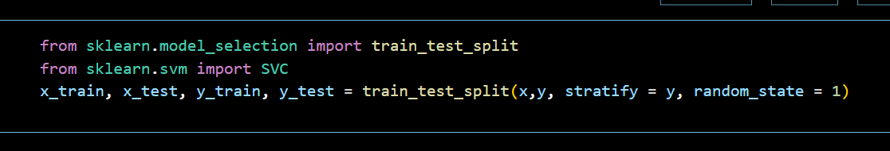
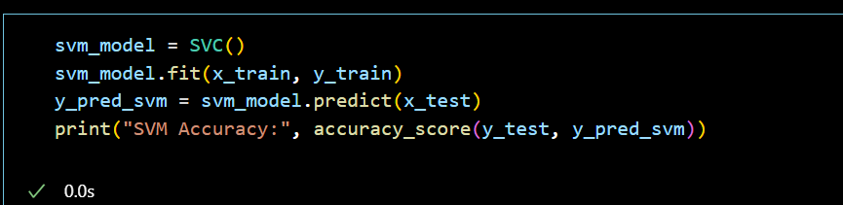
Implementation
SVM

Slide 11
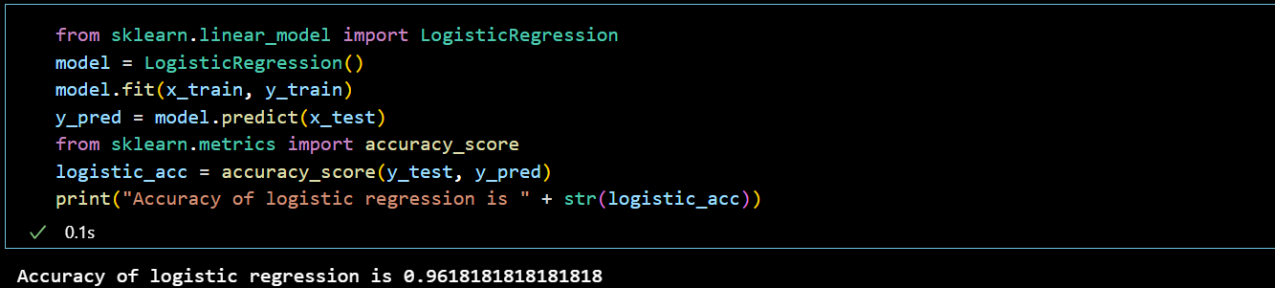
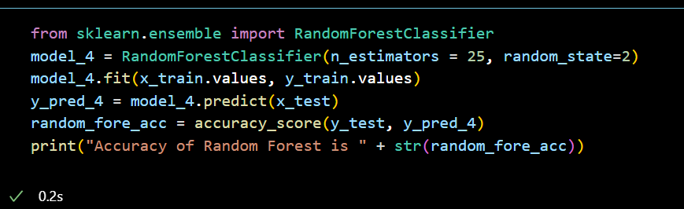
Implementation
Logistic Regression
Random Forest

Slide 12
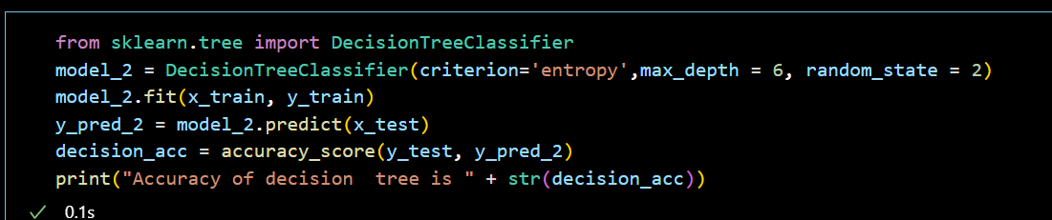
Implementation
Decision Tree Classifier

Slide 13




Results
Logistic Regression
Random Forest
Decision Tree
SVM

Slide 14
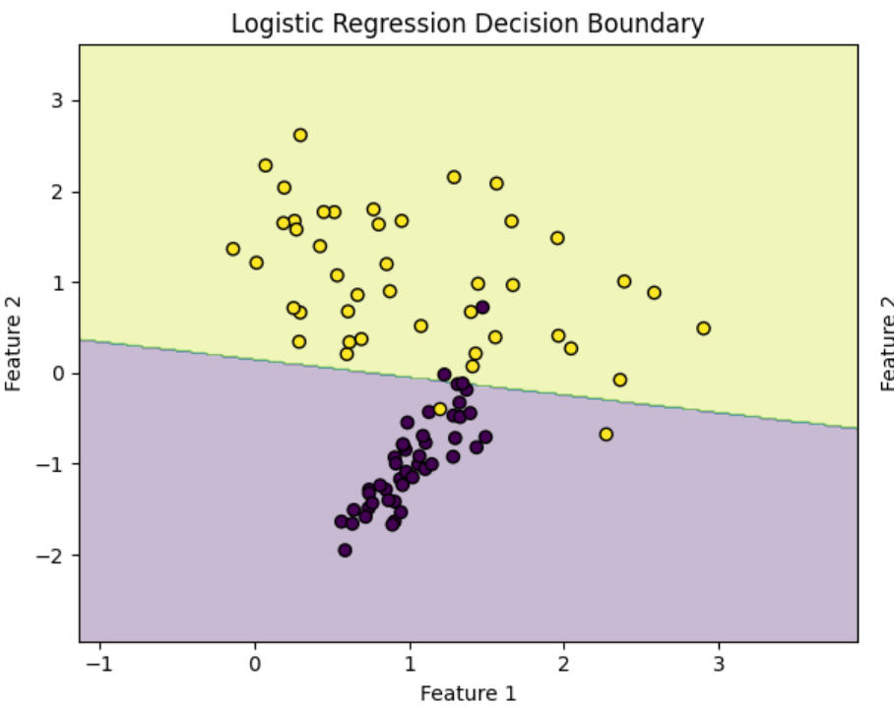
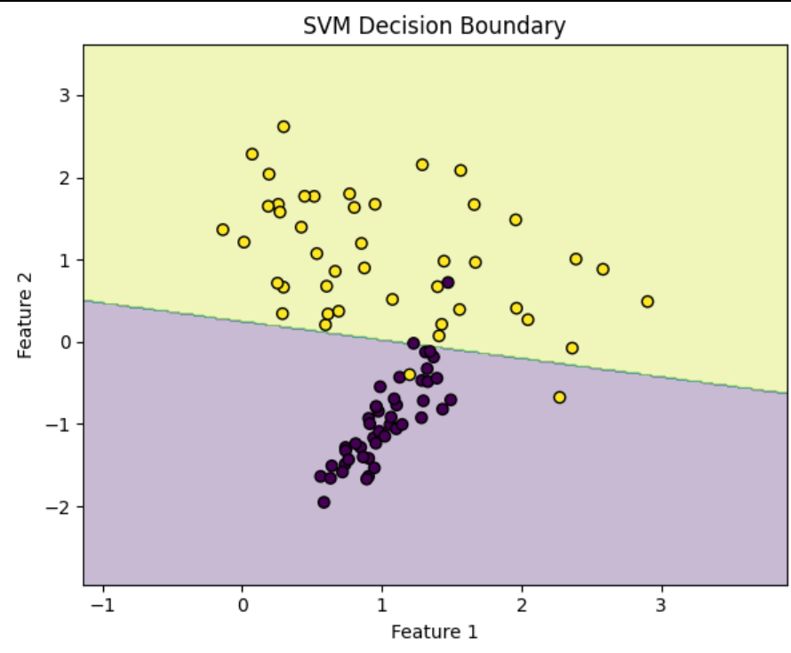
Results

Slide 15
Comparison with existing work
Existing ML-Based Systems
Focused on single regions or specific crops
Often lack scalability and real-time adaptability
Limited interpretability and accessibility for rural farmers
Our Proposed System
Integrates diverse data sources: weather, soil, crop, satellite imagery
Supports multiple ML algorithms with comparative evaluation (e.g., Random Forest, SVM, Logistic Regression)
Designed for usability in tech-limited areas with a simple user interface

Slide 16
Conclusion and Future Work
Developed a machine learning-based system to predict crop yields using diverse agricultural data.
Models like Random Forest and SVM showed high prediction accuracy, especially for Indian farming conditions.
Integrate real-time data using IoT sensors for soil, weather, and crop monitoring.
Use satellite imagery and drone data for precise field-level insights and early pest/disease detection.
Incorporate market price trends to guide profitable crop decisions.
.

Slide 17
Reference
Flask Framework for Python Developer (Book)
Data Analytics Using Python (Book)
Data Visualization Using Python (Book)
https://www.ncbi.nlm.nih.gov/
https://www.safetyandquality.gov.au https://www.covetus.com/blog/ https://www.nhsinform.scot/campaigns/health-and-social-care-stand ards/
https://analytics.ogle.com/analytics/academy.

Slide 18
THANK YOU

