Slide 1
Capstone Project
Presentation
Prepared by : Jagannathan

Slide 2
TABLE OF CONTENTS
Problem statement
Dataset understanding
About dataset
Exploratory Data Analysis (EDA)
Feature Engineering
Ml Algorithm used
Conclusion
Applications and Impact
Limitations

Slide 3

Problem statement:
Creating a predictive model using machine learning that predicts if an insurance claim is fraudulent or not. The prediction will be between YES/NO, its a Binary Classification task. A comparison study has been performed to understand which ML algorithm suits best to the dataset.

Slide 4
Dataset understanding
I will be creating a predictive model that predicts if an insurance claim is fraudulent or not. The answer between YES/NO. A comparison study has performed to understand which ML algorithm suits the best to the dataset.
By importing required packages,lets read the data by
df=pd.read_excel("Dataset.xlsx")
The dataset shape is
df.shape
(11565, 34)
Then we need to perform EDA (Exploratory data analysis) to check the imbalanced data in it and to check missingvalues or null values in the dataset
df[df.isnull().any(axis=1)].It checks all rows that have missing values. It returns an empty DataFrame since there are no rows with missing values

Slide 5
About dataset
This data set has 11565 rows and 34 columns
The target variable of this dataset is [FraudFound_P] its unique values are 0 which is predicted not
fraud and 1 whuch predicts its a fraud.
The other columns of the dataset are
[ ['Month', 'WeekOfMonth', 'DayOfWeek', 'Make', 'AccidentArea',
'DayOfWeekClaimed', 'MonthClaimed', 'WeekOfMonthClaimed', 'Sex',
'MaritalStatus', 'Age', 'Fault', 'PolicyType', 'VehicleCategory',
'VehiclePrice', 'PolicyNumber', 'RepNumber',
'Deductible', 'DriverRating', 'Days_Policy_Accident',
'Days_Policy_Claim', 'PastNumberOfClaims', 'AgeOfVehicle',
'AgeOfPolicyHolder', 'PoliceReportFiled', 'WitnessPresent', 'AgentType',
'NumberOfSuppliments', 'AddressChange_Claim', 'NumberOfCars', 'Year',
'BasePolicy', 'ClaimSize']]

Slide 6
Exploratory Data Analysis (EDA)
EDA (Exploratory Data Analysis) is done for
Understanding the Data
Data Quality Check
Uncovering Patterns and Trends
Reducing Dimensionality
Assumptions Verification
Uncovering Patterns and Trends by visualization
It handles various operations such as
Handling Missing Data
Data Visualization
Outlier Detection
Categorical Variable Analysis
Data Transformation
Time Series Analysis

Slide 7

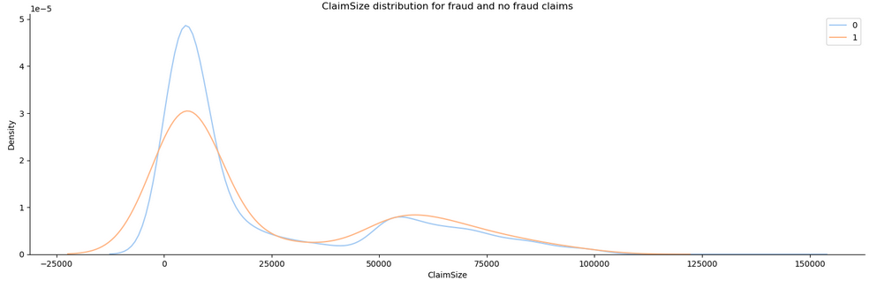
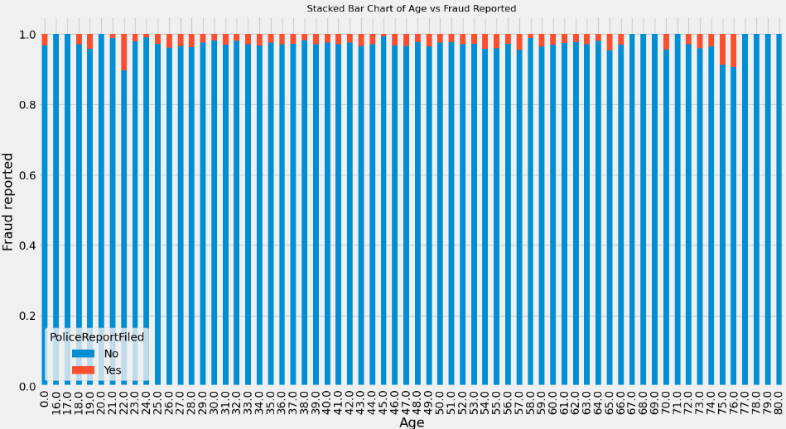
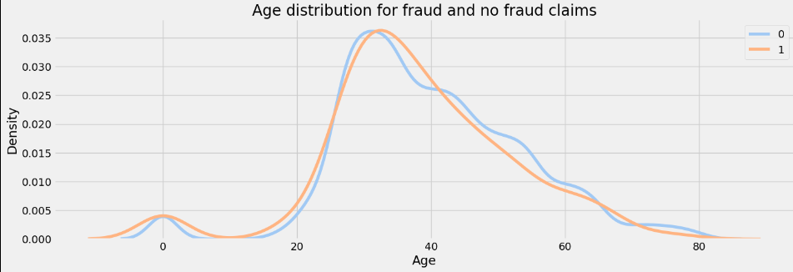
Age distribution for fraud and no fraud claims
stalked-bar chart plot for fraudulent claims by month.
ClaimSize distribution for fraud and no fraud claims

Slide 8
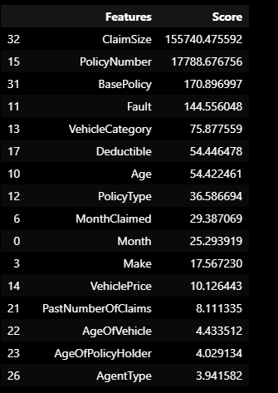
Feature Engineering:
Feature Engineering
By using feature engineering,It will transform the raw date data into meaningful features that can help improve the accuracy and effectiveness of our temperature prediction model.
In this model we used label-encoding technique:
from sklearn.preprocessing import LabelEncoder
label=LabelEncoder()
For selecting the best k-feature we import
from sklearn.feature_selection import SelectKBest
from sklearn.feature_selection import chi2
dfscores=pd.DataFrame(order_feature.scores_,columns=["scores"])
dfcolumns=pd.DataFrame(x.columns)
feature_rank=pd.concat([dfcolumns,dfscores],axis=1)
feature_rank.columns=["Features","Score"]
feature_rank.nlargest(33,'Score')
By having these k feature scores we can take the necessary best score columns and drop other columns

Slide 9
Ml Algorithm used
Logistic regression model
DecisionTree
XGBClassifier

Slide 10
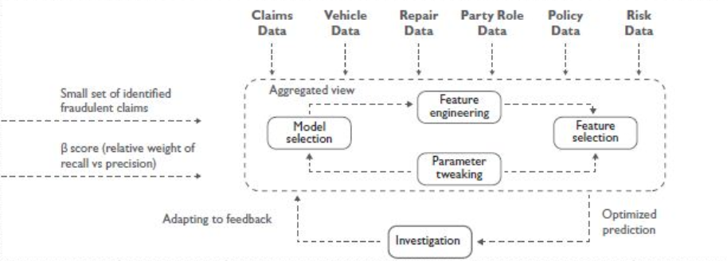
Model Building and Testing Architecture

Slide 11
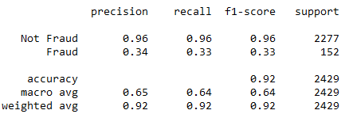
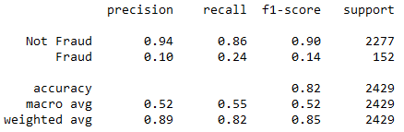
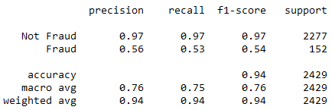
Score of the models scores of the models after training the data
XGBClassifier
Logistic regression
DecisionTree

Slide 12
Coclusion:
By training the each model each gives diffent accuracy .Among those three models XGBClassifier has the best
accuracy compared to logistic regression and decession tree models.
So inorder to get a perfect accuracy XGBClassifier can be used to train the data to have a good
prediction
Why Insurance fraud in ML?
Insurance frauds cover the range of improper activities which an individual may commit in order to achieve a
favorable outcome from the insurance company. This could range from staging the incident, misrepresenting
the situation including the relevant actors and the cause of incident and finally the extent of damage caused
Insurance fraud detection is an essential application of machine learning prediction that can benefit both
insurance companies and policyholders.
By leveraging machine learning for insurance fraud prediction, insurers can significantly reduce financial
losses due to fraud,enhance customer trust, and improve the overall efficiency of their claims processing and
investigation processes.
Machine learning techniques play a crucial role in identifying and preventing insurance fraud by providing
advanced analytics to detect suspicious behavior and patterns in insurance claims.

