Slide 1
RENESAS EK-RA8P1 | ARM CORTEX-M85 + ETHOS-U55 | µT-KERNEL 3.0
AgriEdge AI Bot
Offline, dual-stage edge AI kernel and software stack that diagnoses crop leaf disease and decides Treat vs. Prune, running entirely on a Renesas EK-RA8P1 microcontroller
99.15%
96.86%
39.4×
100%
3.82 ms
Teacher top-1 (ConvNeXt-Tiny)
MCU student top-1 (MobileNetV2-0.5)
Parameter reduction
NPU operator offload (65/65)
L1 inference on Ethos-U55
Team: Atanu Jana, Snehal Panda, Jagan Swain, Manoswini Nahak, Arpita Sahu | Mentor: Dr. Sandipan Mallik
Dataset: PlantVillage Solanaceae subset (pepper, potato, tomato), 20,623 images, 15 classes

Slide 2
01 | PROBLEM & MISSION
Why AgriEdge: late detection costs smallholders their crop
The problem
Solution scope
Small farmers in India (e.g. Odisha) lose crops to late disease detection
Commercial precision-ag systems need internet and cost too much
Manual scouting cannot cover every plant, every day
Schedule
µT-Kernel 3.0 real-time tasks, semaphores and event flags on the RA8P1
Diagnose
Layer 1: 15-class pathology + energy OOD gate on the Ethos-U55 NPU
Purpose
A kernel- and software-level solution: real-time diagnosis and triage on a single microcontroller
Early disease detection with on-device AI, no cloud or internet
Hardware-agnostic core that can be extended to a full robot later
Decide
Layer 2 lesion age D drives a Treat / Prune / None software decision
Extend
Same task interfaces can later host sensors, motion and actuators
AgriEdge AI | 2/21

Slide 3
02 | SYSTEM FLOW
End-to-end software pipeline on the dev kit
One frame through the kernel and dual-stage AI cascade
Kit camera frame into line buffer (FSP)
SensorTask: frame ready, signals semaphore
AITask wakes on semid_ai
Layer 1: 15-class + energy OOD gate
Class > 0 ?
Layer 2: lesion age D (days)
Decision: D <= 5 Treat, else Prune
ControlTask applies CMD_*
UITask: LCD + UART telemetry
Healthy: CMD_NONE, log status
Verification on the kit alone: flash the .elf from e² studio, point the kit camera at printed leaf test cards, read class, D and decision on the LCD and timestamped task traces on SCI8 UART
Decision outputs are software commands (CMD_NONE / CMD_TREAT / CMD_PRUNE); sensors, motion and actuators can be attached later behind the same task interfaces
Fully offline: no cloud, no external hardware required
AgriEdge AI | 3/21

Slide 4
03 | TARGET PLATFORM
Target platform: the Renesas EK-RA8P1 dev kit
Subsystem | Specification | Role / budget
MCU host | Renesas RA8P1, Cortex-M85 @ 1 GHz (Armv8.1-M) | Scheduling and FSP system control
NPU | Arm Ethos-U55, 256 MAC/cycle | 100% INT8 operator offload
SRAM | 2,048 KiB high-speed internal | L1 peak arena 402.1 KiB
Flash | 8,192 KiB dual-bank internal | 786.3 KiB L1 INT8 weights
Vision input | Kit camera (parallel DVP / MIPI CSI via FSP) | Frame capture into 16-byte aligned line buffers
Display | Kit LCD panel (GLCDC) | Class, D and decision telemetry
Console | SCI8 serial UART | Timestamped task-trace logging
Toolchain | e² studio, Renesas FSP, TFLM, Arm Vela | Build, flash, compile model for NPU
Boundary | No external hardware | All capture, inference and triage on the board
AgriEdge AI | 4/21

Slide 5
04 | SOFTWARE STACK
Layered embedded software stack
Application layer: Autonomous triage (Treat / Prune / None), telemetry, logging
Design decisions
C/C++ boundary: ai_inference.cpp exposes extern "C" ai_init() and ai_run_inference() to µT-Kernel C tasks
Zero-copy: camera line buffers map into the 16-byte aligned input tensor
No malloc/free: all tensors static, no fragmentation on long runs
Fully offline: no cloud or Wi-Fi dependency
TensorFlow Lite Micro C++ API: static arenas, MicroMutableOpResolver, model cascade
Arm Ethos-U core driver (Vela output): 100% INT8 operators on NPU
Renesas FSP: BSP clocks, camera capture (VIN), display (GLCDC), SCI8 UART
µT-Kernel 3.0 RTOS: scheduler, semaphores (tk_cre_sem), event flags (TWF_BITCLR)
EK-RA8P1 hardware: Cortex-M85, Ethos-U55, 2 MB SRAM, camera interface
AgriEdge AI | 5/21

Slide 6
05 | REAL-TIME KERNEL
µT-Kernel 3.0 multitasking engine
Task | Priority (lower = higher) | Stack | Synchronisation
SensorTask | 5 | 1,024 B | Signals semid_ai when frame ready
AITask | 7 | 8,192 B | Waits tk_wai_sem(semid_ai); wakes ControlTask
ControlTask | 8 | 1,024 B | tk_slp_tsk; applies decision command
UITask | 10 | 2,048 B | tk_slp_tsk; updates LCD + UART
SensorTask: frame ready
tk_sig_sem(semid_ai)
AITask: dual inference
tk_wup_tsk
ControlTask: actuate
UITask: LCD + UART
TWF_BITCLR clears only the satisfied flag bit, preserving pending flags for other tasks
High-priority SensorTask is never blocked by AI inference; extra hardware-facing tasks can later slot in by priority without touching the AI path
Event-driven, no polling: tasks sleep until signalled; watchdog + power management for reliability
AgriEdge AI | 6/21

Slide 7
06 | MEMORY
Memory architecture and budget
Bars scaled to 2,048 KiB SRAM (full width) and 8,192 KiB Flash
SRAM: Vela peak arena, L1
402.1 KiB (19.6%)
SRAM: 2 x 128 KiB arenas
256 KiB coded (12.5%)
Flash: L1 INT8 weights
786.3 KiB (9.6%)
Flash: L1 + L2 weights
1,346.5 KiB (16.4%)
Static dual-arena design
Open item to verify
Vela reports a 402.1 KiB peak arena for Layer 1, but the coded arenas are 128 KiB each. Raise the L1 arena (or re-measure) before on-board runs. Both fit easily in 2 MB SRAM.
arena_disease[128 KiB] and arena_days[128 KiB], 16-byte aligned (AXI 128-bit burst to NPU)
Isolated buffers stop L1/L2 corrupting each other
AgriEdge AI | 7/21

Slide 8
07 | DATASET
Leakage-free data: 20,623 images, 15 classes
20,623
clean unique images
15
classes: pepper, potato, tomato
21:1
imbalance (3,209 vs 152)
Why not a random split: PlantVillage has exact duplicates (md5/dhash purged) and same-leaf day-series (e.g. one leaf over Days 1-16), so random splits leak
Grouped by leaf ID + capture site; 70 / 15 / 15 stratified by class
Imbalance handled with normalised sqrt-inverse-frequency weighted sampling
0
physical leaves shared across splits
AgriEdge AI | 8/21

Slide 9
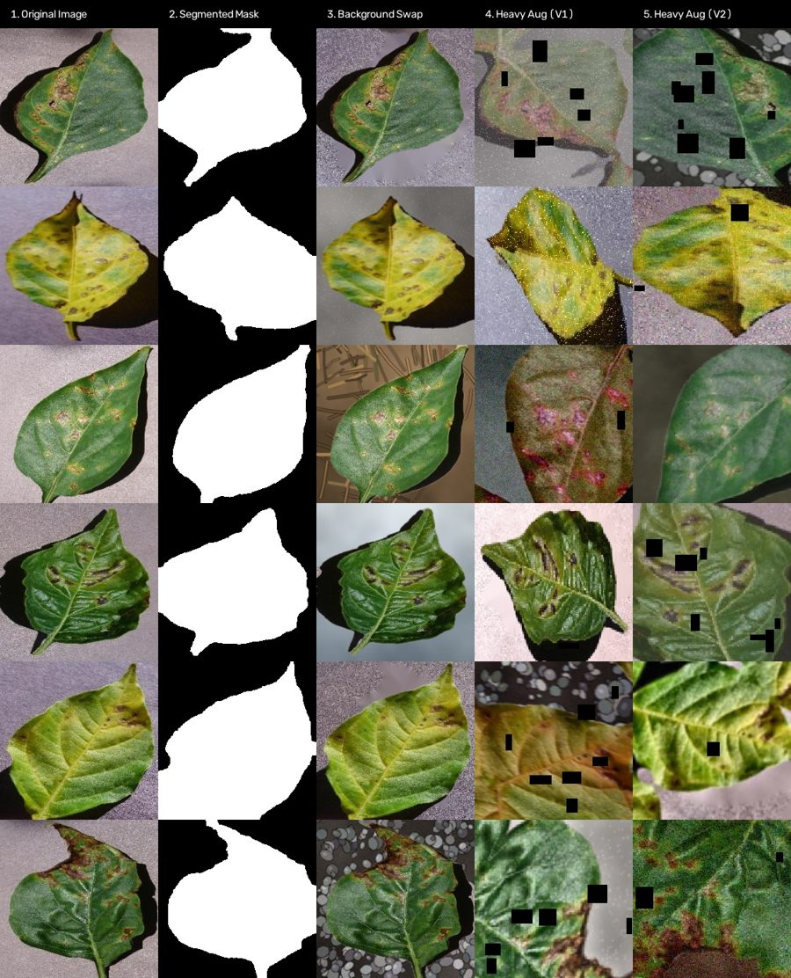
08 | ANTI-SHORTCUT PIPELINE
Forcing the model to read lesions, not backgrounds
8 of 15 classes come from single photo sessions, so backgrounds leak the label. Fix: segment, swap, randomise.
ExG = 2G-R-B
HSV threshold
Otsu
GrabCut refine
Cached leaf masks
RandomBackgroundSwap
CLAHE, blur, noise
98.67%
21.51%
60.63%
Leaf-only accuracy (macro-F1 0.9806)
Background-only (chance 6.67%)
Unseen capture sites (bal. acc 64.92%)
Blacking out the background barely hurts, so lesions drive the prediction
Cross-site accuracy is the remaining generalisation gap
Original | mask | BG swap | heavy aug V1 | V2
AgriEdge AI | 9/21

Slide 10
09 | MODEL DESIGN
Layer 1: teacher-to-student knowledge distillation
Model A: teacher (GPU / edge cloud)
224x224x3 input
ConvNeXt-Tiny (768-d)
Learnable GeM p=3
BN-neck + Dropout 0.3
Linear, 15 classes
Soft-target KL divergence, T = 3.0, alpha = 0.6 (+ label smoothing 0.1)
Model B: student (Renesas RA8P1 MCU)
160x160x3 input
MobileNetV2 0.5, fused ReLU6
Global avg pool
Linear, 15 classes
INT8 to Vela
27.83M params (106.2 MB FP32, 4.46 GFLOPs) vs 706,895 params (2.70 MB FP32, 48.96 MMACs): 39.4x fewer parameters
Student uses ReLU6 and GAP because they map natively to the Ethos-U55; teacher uses GELU + GeM for accuracy
AgriEdge AI | 10/21

Slide 11
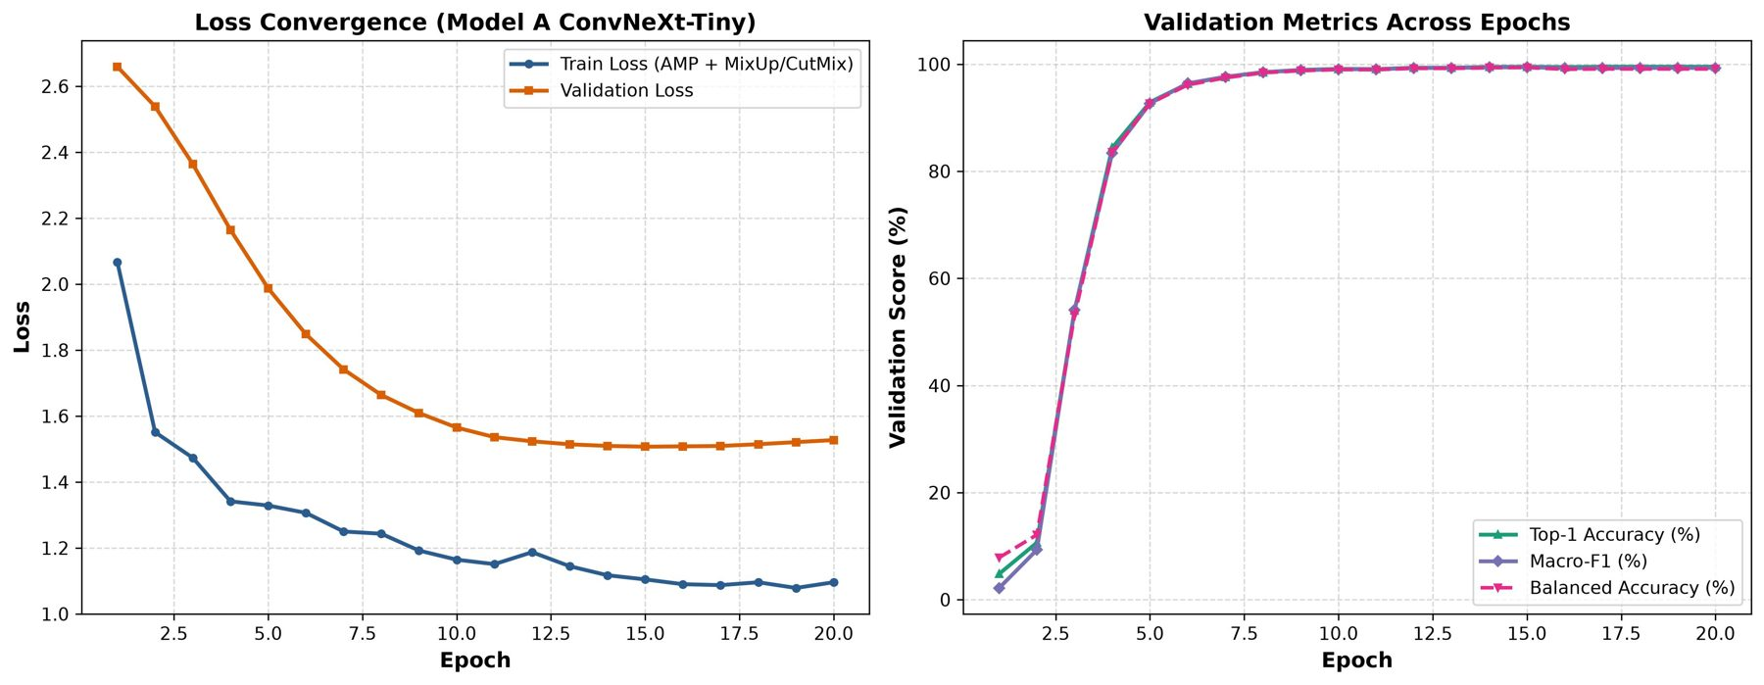
10 | TRAINING
Training recipe and convergence
Setting | Model A | Model B
Pretrain / arch | convnext_tiny (ImageNet-12k) | mobilenet_v2 x0.5
Epochs | 20 (3 warmup) | 15 (distill)
Optimizer | AdamW, wd 0.01 | AdamW, wd 0.01
Learning rate | 5e-4 (backbone 0.1x) | 1e-3
Schedule | Cosine annealing | Cosine annealing
Batch size | 64 | 64
Augmentation | Heavy: BG swap, CLAHE, noise | Medium: BG swap, ColorJitter
Regularisation | DropPath 0.1, Drop 0.3, MixUp/CutMix 0.8, AMP | Label smoothing 0.1, KD
EMA | 0.999 | none
Validation accuracy climbs from ~10% (epoch 2) to ~93% (epoch 5) and plateaus near 99% from epoch ~10
Train and validation loss both fall; validation loss floors near 1.51 around epochs 15-17 and drifts up slightly, while accuracy stays flat
Absolute losses stay high, consistent with MixUp/CutMix training and the under-confident probabilities on slide 16
No divergence between train and validation trends
AgriEdge AI | 11/21

Slide 12
11 | RESULTS
Headline metrics on 2,710 held-out test images
Metric | Model A | Model B | Delta
Top-1 accuracy | 99.15% (2687/2710) | 96.86% (2625/2710) | -2.29
Top-3 accuracy | 99.96% | 99.85% | -0.11
Top-5 accuracy | 99.96% | 100.00% | +0.04
Balanced accuracy | 98.37% | 96.49% | -1.88
Macro precision / recall | 99.23% / 98.37% | 96.90% / 96.54% | -2.33 / -1.83
Macro F1 | 98.77% | 96.71% | -2.06
Weighted F1 | 99.15% | 96.85% | -2.30
Cohen kappa / MCC | 0.9908 / 0.9908 | 0.9658 / 0.9659 | -0.025
Log loss / Brier | 1.5079 / 0.6494 | 0.6491 / 0.0531 | better on B
Latency, batch 1 | 6.05 ms (RTX 4060) | 3.82 ms (Ethos-U55) | -2.23 ms
Throughput, batch 32 | 468.3 FPS | 5,061.3 FPS | 10.8x
23 vs 85
Misclassifications (A vs B)
99.85%
Student top-3: correct label almost always in the shortlist
0.9658
Student kappa: near-perfect agreement
Higher log loss / Brier on A reflects under-confident probabilities (slide 17), not more errors.
AgriEdge AI | 12/21

Slide 13
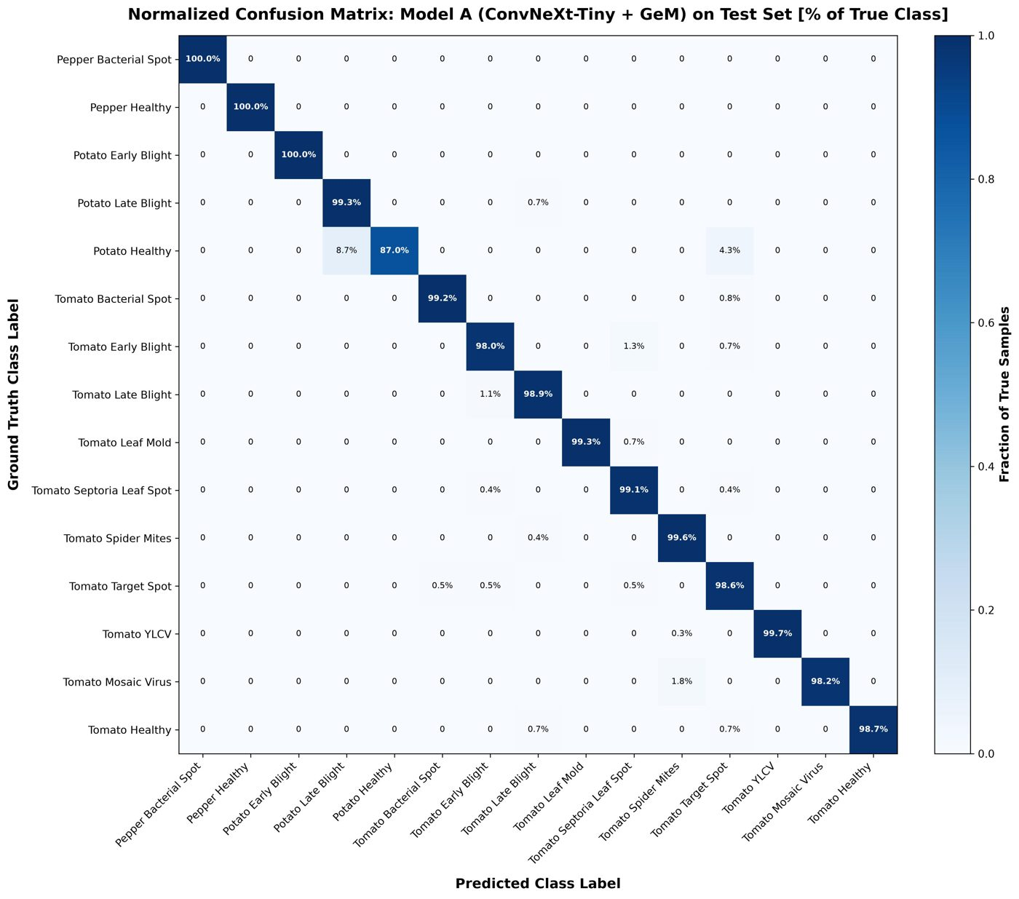
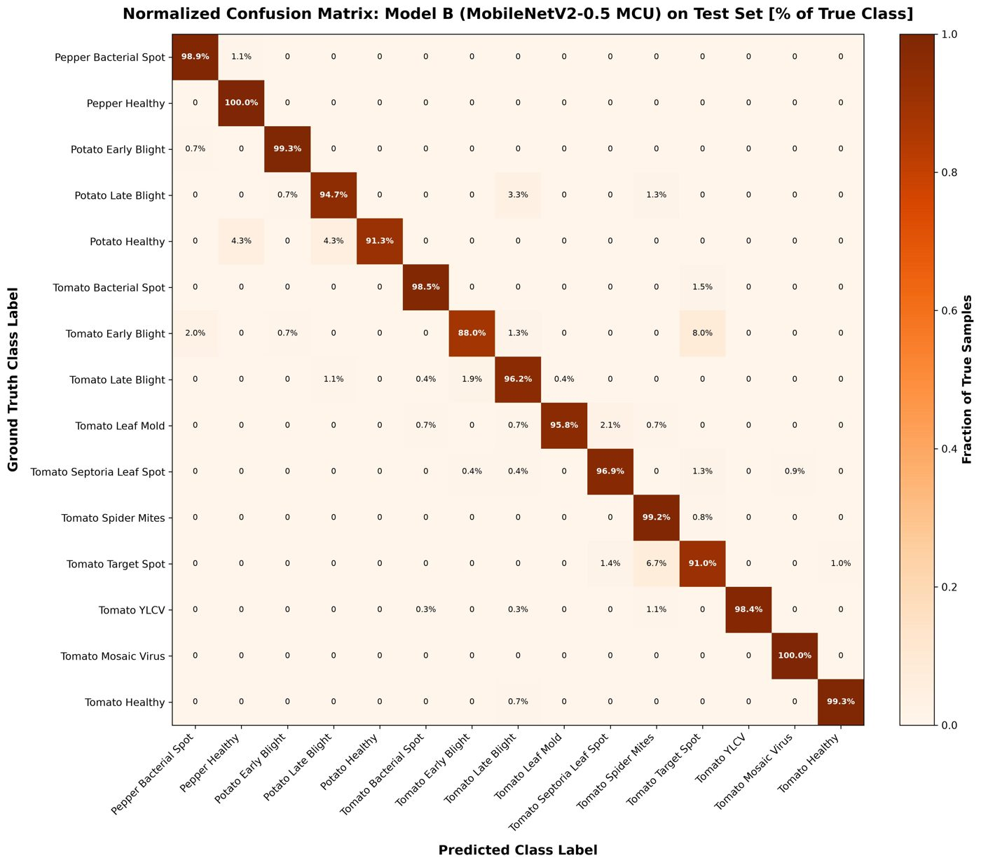
12 | CONFUSION MATRICES
Where each model makes its mistakes (row-normalised)
Model A: 23 errors, 13 classes >= 98%
Model B: 85 errors, all classes >= 88% recall
AgriEdge AI | 13/21

Slide 14
13 | PER-CLASS F1
Distillation keeps almost every class within a few points
-7.4
-5.7
+2.4
98.77 to 96.71
Target Spot F1 (worst drop)
Tomato Early Blight F1
Potato Healthy (student better)
Macro-F1, A to B
AgriEdge AI | 14/21

Slide 15
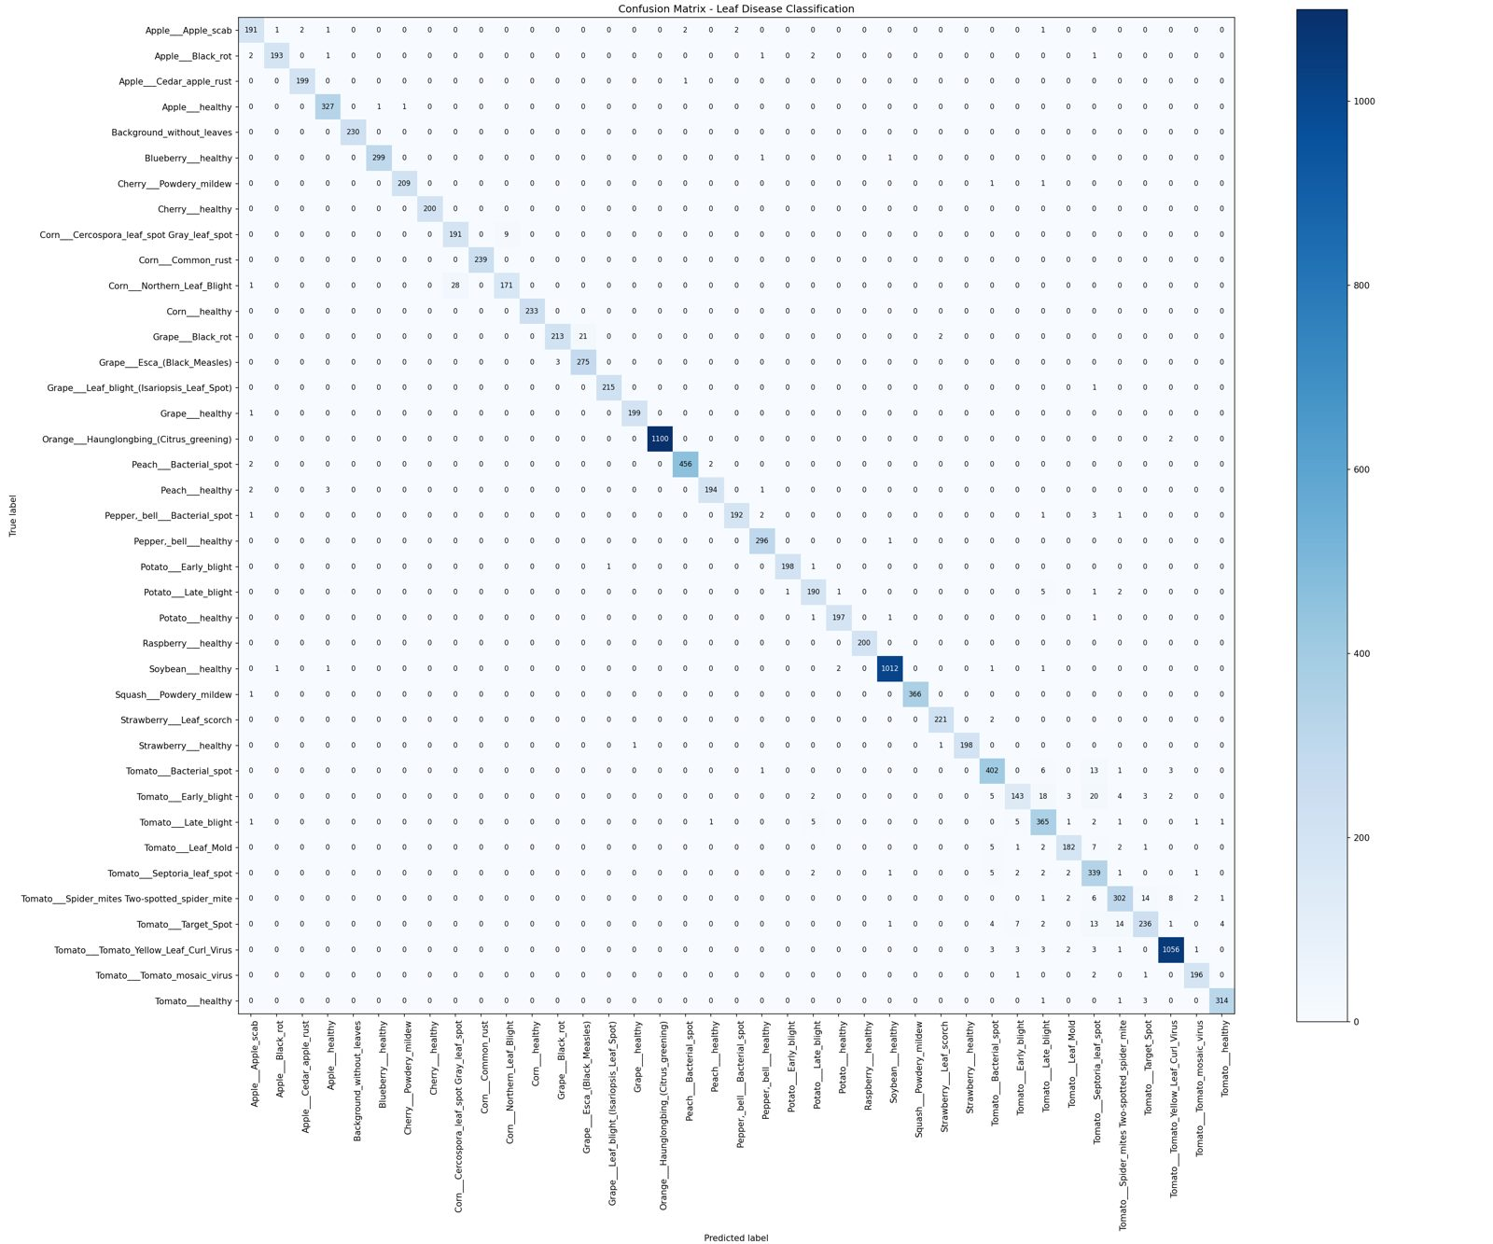
14 | ERROR ANALYSIS
Error modes: look-alike necrotic lesions dominate
Model A: 23 errors
Potato Healthy (23 test images): 3 missed, to Late Blight (2) and Target Spot (1)
Tomato Early Blight and Target Spot: 3 misses each, mostly with each other and Late Blight
5 classes at 100% precision
Model B: 85 errors
Main mode: Tomato Early Blight (18 FN) vs Target Spot (19 FN)
Early Alternaria rings look like Corynespora necrotic centres
Target Spot precision 90.1%; 21 false positives each for Spider Mites and Target Spot
Top-3 still 99.85%: a ranked shortlist is reliable
Earlier 39-class PlantVillage baseline (incl. background class). Largest confusions: Corn Northern Leaf Blight to Cercospora (28), Grape Black Rot to Esca (21), Tomato Early Blight to Septoria (20).
AgriEdge AI | 15/21

Slide 16
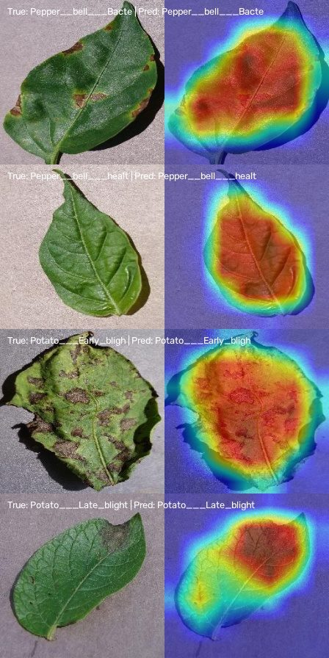
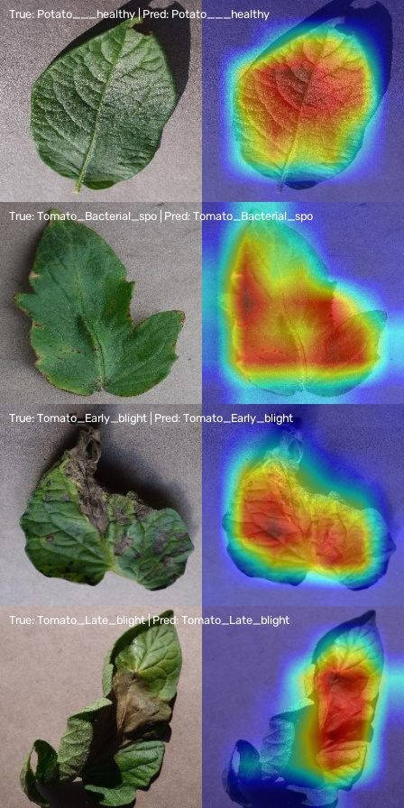
15 | EXPLAINABILITY
Grad-CAM: the model looks at lesions
What the heatmaps show
Attention concentrates on necrotic lesions, chlorotic margins and bacterial specks
Pepper bacterial spot: spots along the leaf; Potato early blight: concentric rings; Tomato late blight: expanding water-soaked borders
Healthy leaves show diffuse, whole-leaf attention with no lesion hotspot
Background and leaf edges stay cool, matching the spatial ablation (slide 8)
98.67%
21.51%
Leaf-only accuracy
Background-only accuracy
Grad-CAM shown for 8 representative test leaves (teacher model).
AgriEdge AI | 16/21

Slide 17
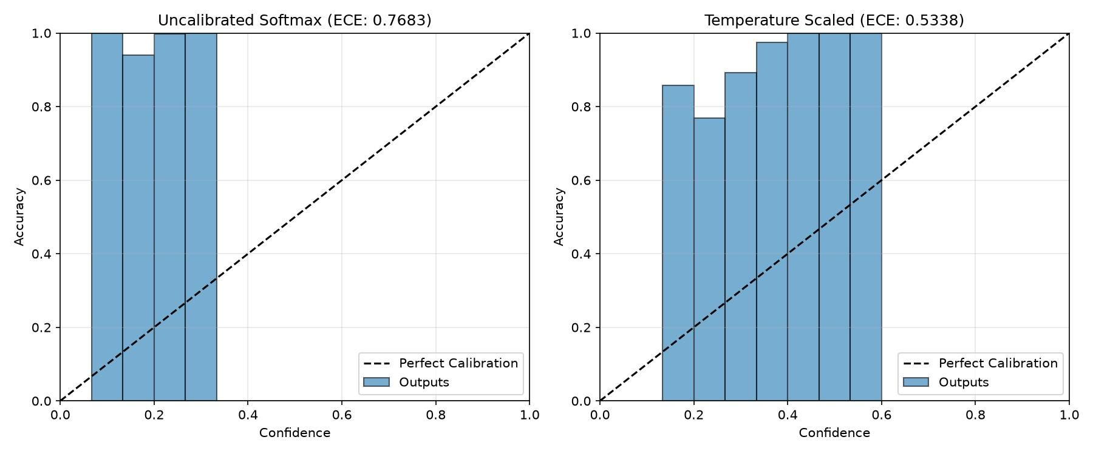
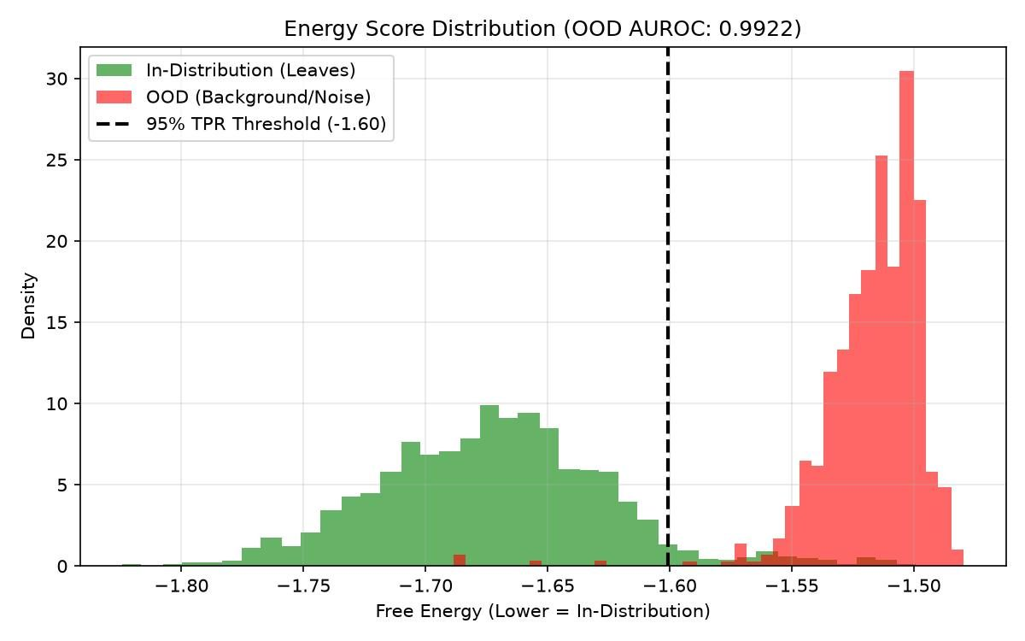
16 | CALIBRATION & OOD
Knowing when not to trust the prediction
Temperature scaling
Energy OOD rejection
Field meaning
T* = 0.5571 (below 1 sharpens)
ECE 0.7683 to 0.5338
Bins sit above the diagonal: the model is under-confident, not over-confident
E(x) = -T log sum exp(f_c/T)
Threshold -1.6006 at 95% TPR
AUROC 0.9922, FPR95 0.67%
Soil, wheels, hands, weeds get rejected
Use energy score, not softmax, as the gate
Residual ECE 0.53 still needs work
AgriEdge AI | 17/21

Slide 18
17 | LAYER 2 + DECISION
Cascade: classify, age the lesion, then act
Layer 1 verdict (energy-gated OOD)
Lesion stages
0-3 d incubation: pinprick chlorosis
3-5 d expansion: necrosis, halos, water-soaked
>5 d collapse: coalesced lesions, sporulation
Class = 0 (healthy): bypass L2, log status
Class > 0: Layer 2 estimates D in days
D <= 5.0
TREAT
D > 5.0
PRUNE
Regression head
D-hat in [0, 20] days, MobileNet regressor
D = (int8 - zero_point) x scale
Design MAE +/-0.62 d; not yet in the report
Software outputs: CMD_TREAT (micro-spray) | CMD_PRUNE (petiole excision)
Rationale: D <= 5 d tissue is still viable and treatable; older tissue is a sporulation reservoir, so excise it.
AgriEdge AI | 18/21

Slide 19
18 | NPU DEPLOYMENT
From PyTorch to Ethos-U55 with zero CPU fallback
PyTorch FP32
ONNX opset 17
onnx2tf + calibration set
TFLite INT8
Arm Vela ethos-u55-256
model_data.h in Flash
65/65
0
402.1 KiB
operators on NPU (100%)
CPU fallback / float ops
peak SRAM (80% free)
786.3 KiB
3.82 ms
78.7%
weights in Flash
est. latency, 261.6 inf/s
compute-bound cycles
Latency is an indicative Vela estimate at 500 MHz; confirm on the board. Weights are compressed and run directly from on-chip Flash
AgriEdge AI | 19/21

Slide 20
19 | RESOURCE BUDGET
Both layers together fit with wide headroom
Metric | Layer 1 classifier | Layer 2 regressor | Total | RA8P1 capacity
Parameters | 706,895 | 542,100 | 1,248,995 | -
Flash (INT8) | 786.3 KiB | 560.2 KiB | 1,346.5 KiB | 8,192 KiB (84% free)
Tensor arena | 128 KiB coded (Vela 402.1) | 128 KiB | 256 KiB coded | 2,048 KiB
Latency | 3.82 ms | 2.95 ms | 6.77 ms | >140 FPS
NPU compute ratio | 78.7% | 74.2% | 76.5% avg | -
6.77 ms
~148 FPS
16.4%
12.5%
Worst-case dual-stage inference
1 / 6.77 ms
Flash used
SRAM used (coded arenas)
Layer 2 figures come from the design draft (not the evaluation report); re-measure after final quantisation.
AgriEdge AI | 20/21

Slide 21
20 | CONCLUSIONS
What we built, what is left
Achieved
Open items
Next steps
99.15% teacher, 96.86% student accuracy on a leaf-grouped, leakage-free test set
39.4x compression, 100% NPU offload, 402.1 KiB SRAM, 3.82 ms
Energy OOD gate: AUROC 0.9922
Treat vs. Prune closed loop on µT-Kernel 3.0, fully offline
Cross-site accuracy 60.63%: needs field-photo data
Calibration: ECE still 0.53 after scaling
Size L1 arena to Vela peak (402.1 KiB)
Validate Layer 2 (MAE) and on-board latency
Tomato Early Blight vs Target Spot confusion
On-kit flashing and UART/LCD verification
Measure on-board latency and Layer 2 accuracy
Open-source code, models, docs on GitHub
Future: attach sensors, motion and actuators via the same task interfaces
Team: Atanu Jana, Snehal Panda, Jagan Swain, Manoswini Nahak, Arpita Sahu | Mentor: Dr. Sandipan Mallik
AgriEdge AI | 21/21

