Slide 1
TestNg

Slide 2
Test Ng:- Test Ng is a unit testing framework basically used by developers to perform unit testing or white box testing In Selenium we use test Ng 1:To Run Multiple Scripts at the same time 2:To Generate the reports 3:ForVerification Test Ng is a plugin for eclipse Steps to download and attach test ng to the project:- 1:Open eclipse and click on help 2:Go to eclipse marketplace and search for the test ng and click on install 3:retsrat your eclipse 4:select your project and right click on project , click on build path and libraries , select Test Ng and click on next and click on finish

Slide 3
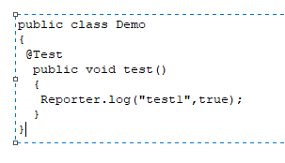
Test Ng Class:- It is a java class which contains test methods 1:Create User defined package and specify package name as module name 2:Never go for main method, use test methods (@Test) 3:To print the message in report we go for Reporter.log 4:For Individual Scripts we specify individual “@Test”

Slide 4
To Run Multiple Scripts we should testng.xml file To Generate :- Right click on package / project , click on test ng , click on convert test ng ,click on finish Steps to run xml file:- Right click on xml file, click on runas , click on test ng suit Steps to generate a reports:- Once after execution , refresh the project , it will generate the folder called test output expand the folder , select emailable html report , right click , click on web browser

Slide 5
Important Annotations of test ng :- 1:@Before Suit 2:@Before Test 3:@Before Class 4:@Before Method 5:@Test 6:@After Method 7:@After Class 8:@After Test 9:@After Suit In Realtime we always gofor before method, test method and after method , Based on the priority it will execute the annotations 1:@Before Method 2:@Test 3:@After Method

