Slide 1

ISEM-551-01
Assignment 2: AngularJS/Bootstrap
Jagan Sambandamoorthy (99868)

Slide 2
Harrisburg Food Lovers v2
Harrisburg Food Lovers is a team of fanatic foodies who have canvassed the length and breadth of the US, stamping different restaurants.
As part Assignment 1 of ISEM-551-01, Harrisburg Food Lovers app(v1) was created with HTML and JavaScript which can tell the user where to satisfy the food itch!
Harrisburg Food Lovers app was working in a way that it allowed the users to drag and drop their interested cuisine on the location where they are looking for .
As part Assignment 2 , Harrisburg Food Lovers app is enhanced by using AngularJS & Bootstrap to provide fluid user experience.
Based on the location and cuisine, Harrisburg Food Lover app will provide list of restaurants and their addresses serving best food in the selected cuisine.

Slide 3

Flow Chart
Food Lovers navigates to Harrisburg Food Lovers app
Users search their favorite cuisine by entering cuisine like Mexican on Search Box
Harrisburg Food Lovers App will provide a list of best restaurants based on pre-defined rules
User enjoy their meal!
Notes:
The above flow chart explains how the Harrisburg Food Lovers app works. Once the users navigates to the app, they search their favorite cuisine by entering cuisine like Mexican on Search Box. Based on the pre-defines rules which are set corresponding to location and cuisine, the Harrisburg Food Lovers app will provide a list of restaurants from which users can choose their best pick.

Slide 4
The app is built using HTML and Javascript.
The app works based on predefined rules which are set according to the location and cuisine
Harrisburg Food Lovers Knowledge Base
The app is built using HTML, AngularJS and Bootstrap. The app works based on predefined rules which are set according to the location and cuisine.
Location | Cuisine | Harrisburg Food Lovers Restaurant advice
New Jersey | Indian | Hot Peppers Saravana Bhavan Paradise Biryani Pointe
New Jersey | Chinese | Szechuan Ace Chinese Restaurant King's Palace Restaurant
New Jersey | Mexican | The Mexican Food Factory Tortilla Press Cantina
Notes:
The app works on pre-defined rule which is set based on location and cuisine. Eg. If the user chooses Cuisine as Indian, Harrisburg Food Lovers app lists below restaurant : Hot Peppers, Saravana Bhavan, Paradise Biryani Pointe

Slide 5
Location | Cuisine | Harrisburg Food Lovers Restaurant advice
Virginia | Indian | London Curry House Curry Mantra 2 Curry Mantra 3
Virginia | Chinese | Golden China Restaurant House of Dynasty
Virginia | Mexican | Pepe’s Mexican Restaurant
Pennsylvania | Indian | New Delhi Indian Restaurant The TaJ Mahal India Delight Restaurant
Pennsylvania | Chinese | Xin Ying Chinese Restaurant Hong Luck Restaurant
Pennsylvania | Mexican | Pepe’s Mexican Restaurant Las Margaritas

Slide 6
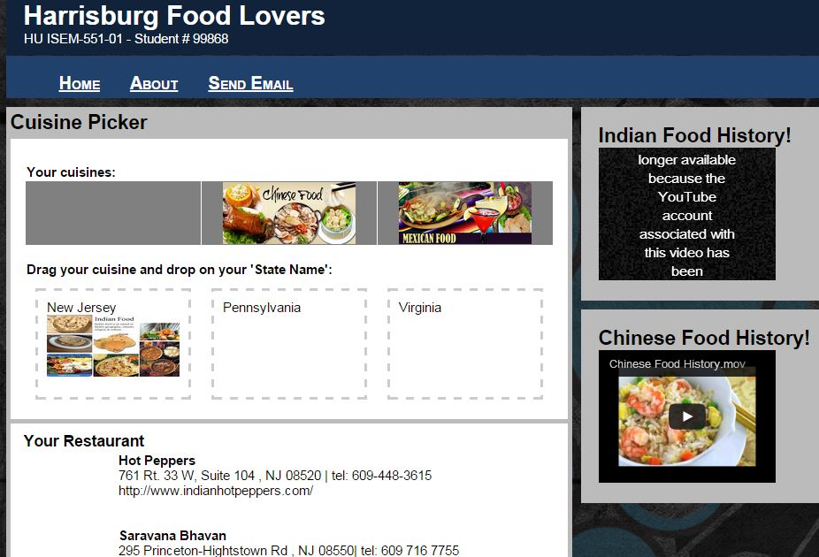
Harrisburg Food Lovers v1 (Assignment 1)
Notes:
This is a snapshot of Harrisburg Food Lovers v1 app developed using HTML, CSS & JAVA SCRIPT for Assignment 1

Slide 7
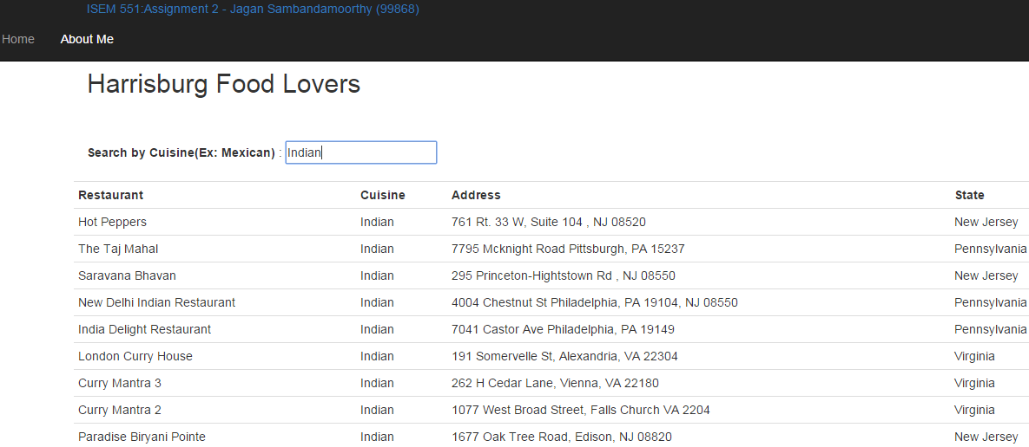
Harrisburg Food Lovers v2 (Assignment 2)
Notes:
This is a snapshot of Harrisburg Food Lovers v2 app developed using HTML, AngularJS and Bootstrap for Assignment 2

Slide 8
Appendix
Harrisburg Food Lover v2 app is packed with the Zip file for use and review.
Detailed tool usage instruction document "Tool Usage Guide" is also provided.

