Slide 1

21ECSC210
Exploratory Data Analysis Course Project: Phase - I Review
Predictive Modeling for HIV: Analyzing Health Indicator Data to Forecast Disease Progression and Patient Outcomes
Department of Computer Science and Engineering,
KLE Technological University’s Dr. M. S. Sheshgiri College of Engineering and Technology, Belagavi

Slide 2
Details of theTeam
Div: |  | B
Sl. No. | Name |  | SRN.
1 | Abhinandan Onjol |  | 02FE22BCI003
2 | Jagannath Malode |  | 02FE22BCI018
3 | Jagannath Magadum |  | 02FE22BCI019
4 | Varun Gani |  | 02FE22BCI056
Department of Computer Science and Engineering,
KLE Technological University’s Dr. M. S. Sheshgiri College of Engineering and Technology, Belagavi

Slide 3
SDG 3:
SDG 3 aims to prevent needless suffering from preventable diseases and premature death by focusing on key targets that boost the health of a country's overall population
Target 3.3: End the epidemics of AIDS, tuberculosis, malaria, and neglected tropical diseases and combat hepatitis, water-borne diseases, and other communicable diseases by 2030.
MOTIVATION:
Our project directly contributes to this target by predicting HIV diagnoses and related outcomes, potentially aiding in the control and management of the HIV epidemic.
By analyzing data on HIV diagnosis rates, care linkage, and viral suppression, Our project can provide insights into gaps in health coverage and access to care, which are critical for improving health services.
Department of Computer Science and Engineering,
KLE Technological University’s Dr. M. S. Sheshgiri College of Engineering and Technology, Belagavi

Slide 4
Using the HIV dataset to contribute towards achieving SDG 3 is not only relevant but also impactful.
Our analysis can provide crucial insights that drive progress in prevention, treatment, and care, ultimately leading to improved health outcomes and well-being for millions of people worldwide.
By focusing on HIV data, you are directly contributing to one of the most critical global health challenges of our time, aligning your work with the broader goals of sustainable development and human health improvement.
Department of Computer Science and Engineering,
KLE Technological University’s Dr. M. S. Sheshgiri College of Engineering and Technology, Belagavi

Slide 5
Background
HIV was first brought to humans by blood transfusions during hunting, and it originated from a virus that was specifle to chimpanzees in West Africa in the 1930s. The virus traveled throughout Africa and other parts of the world over the years. India has the second largest population of people living with HIV and AIDS (PLHA). The current national prevalence is about 0.26%, compared with a global average of 0.2%.
Problem Statement
Developing predictive models for HIV risk assessment using demographic, behavioral, and healthcare data to identify high-risk individuals and enable targeted interventions for HIV prevention and improved health outcomes.
Department of Computer Science and Engineering,
KLE Technological University’s Dr. M. S. Sheshgiri College of Engineering and Technology, Belagavi

Slide 6
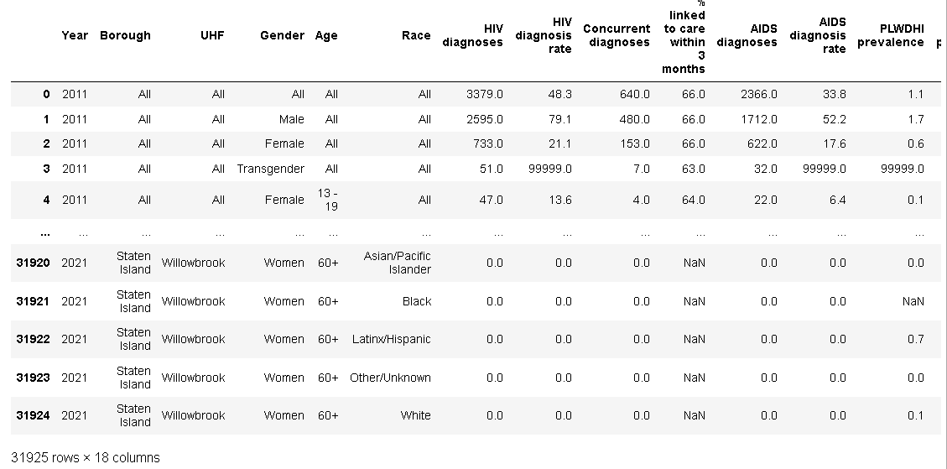
Dataset Details Exploratory Data Analysis Of Understanding HIV/AIDS Trends. There are 31926instances, i.e.,The Collection Of HIV/AIDS Cases From (2011-2021). Source URL: https://catalog.data.gov/dataset/dohmh-hiv-aids-annual-report
Department of Computer Science and Engineering,
KLE Technological University’s Dr. M. S. Sheshgiri College of Engineering and Technology, Belagavi

Slide 7
Knowing the Dataset
There are 18 Columns/Feature in The Dataset:
Year: The year of the data record.
Borough: The borough within New York City where the data was collected.
UHF: The United Hospital Fund (UHF) neighborhood within the borough.
Gender: Gender of the individuals in the dataset (e.g., Male, Female , Transgender).
Age: Age group of the individuals (e.g., 13 - 19, 20 - 29, etc.).
Race: Race or ethnic group of the individuals.
HIV diagnoses: Number of HIV diagnoses.
HIV diagnosis rate: Rate of HIV diagnoses per 100,000 people.
Concurrent diagnoses: Concurrent diagnoses of HIV and another condition.
% linked to care within 3 months: Percentage of HIV-diagnosed individuals linked to care within 3 months.
AIDS diagnoses: Number of AIDS diagnoses.
AIDS diagnosis rate: Rate of AIDS diagnoses per 100,000 people.
PLWDHI prevalence: Prevalence of people living with diagnosed HIV infection.
% viral suppression: Percentage of people with viral suppression among those diagnosed with HIV.
Deaths: Number of deaths.
Death rate: Death rate per 100,000 people.
HIV-related death rate: Death rate due to HIV-related causes per 100,000 people.
Non-HIV-related death rate: Death rate due to non-HIV-related causes per 100,000 people.
Department of Computer Science and Engineering,
KLE Technological University’s Dr. M. S. Sheshgiri College of Engineering and Technology, Belagavi

Slide 8
Feature Set Description
Features | Distinct/Missing Values | Type
Year | 10 distinct, 0 missing values | numeric
Borough | 5 distinct, 0 missing values | string
UHF | 42 distinct, 0 missing values | string
Gender | 3 distinct, 0 missing values | string
Age | 7 distinct, 0 missing values | string
Race | 7 distinct, 0 missing values | string
HIV diagnoses | 301 distinct, 416 missing values | numeric
HIV diagnosis rate | 1944 distinct, 416 missing values | numeric
Concurrent diagnoses | 99 distinct, 116 missing values | numeric
% linked to care within 3 months | 123 distinct, 13274 missing values | numeric
AIDS diagnoses | 212 distinct, 337 missing values | numeric
AIDS diagnosis rate | 1421 distinct, 337 missing values | numeric
PLWDHI prevalence | 149 distinct, 3553 missing values | numeric
% viral suppression | 149 distinct, 3553 missing values | numeric
Deaths | 264 distinct, 0 missing values | numeric
Death rate | 606 distinct, 1913 missing values | numeric
HIV-related death rate | 345 distinct, 1913 missing values | numeric
Non-HIV-related death rate | 446 distinct, 1913 missing values | numeric
Department of Computer Science and Engineering,
KLE Technological University’s Dr. M. S. Sheshgiri College of Engineering and Technology, Belagavi

Slide 9
Proposed Hypothesis
age group wise analysis of hiv diagnosis
In [60]:
​
age group wise analysis of hiv diagnosis
In [60]:
​
age group wise analysis of hiv diagnosis
In [60]:
​
age group wise analysis of hiv diagnosis
In [60]:
​
1. Analysis of causes of deaths accross all the cities
2. Which Age people have maximum deaths
3. Which gender people have maximum deaths
4. How HIV diagnosis rate is varing with time
5. Which age group has the higest and lowest rate of HIV diagnoses ?
6. Which age group have the higest HIV related deaths and non HIV deaths?
7. Which age group has the higest HIV diagnosis?
8 Which city has the higest AIDS diagnoses and Death rate?
9. From which location we have the highest data
10. ANALYSIS OF HIV / AIDS DIAGNOSES WITH PLWDHI PREVALENCE.
Department of Computer Science and Engineering,
KLE Technological University’s Dr. M. S. Sheshgiri College of Engineering and Technology, Belagavi
9
Notes:
9

Slide 10
Proposed Hypothesis
11. %viral suppression with HIV-related & non-hiv-related death rate by year
12 . Is there a negative association between the percentage of viral suppression, the percentage of PLWDHI linked to care within 3 months, and the AIDS diagnosis rate, and HIV-related death rates?
13.Year Wise Analysis of %linked to 3months with HIV related death rate.
14.Analysis of HIV Diagnoses with PLWDHI by age
15. Year wise analysis of %linked to within 3 months & %viral suppression with year
16.YEAR WISE ANALYSIS OF CONCURRENT / AIDS DIAGNOSES .
Department of Computer Science and Engineering,
KLE Technological University’s Dr. M. S. Sheshgiri College of Engineering and Technology, Belagavi
10
Notes:
10

Slide 11
Implement Framework
Based on the statistical analysis we will perform data pre-processing.
Based on the feature category, will be then perform univariate and multivariate analysis on the features to analyse and answer the hypothesis.
We will next perform feature engineering to find correlation between between different features.
Lastly, we will apply any one of the ML model to the dataset.
Department of Computer Science and Engineering,
KLE Technological University’s Dr. M. S. Sheshgiri College of Engineering and Technology, Belagavi

Slide 12
MOOC Course Details
Team No. : EDA-D12
Div: D
Sl. No. | Name | SRN. | Course Name | Course Link | Status
1 | Abhinandan Onjol | 02FE22BCI003 | Python 101 for Data Science | https://courses.cognitiveclass.ai/certificates/dee8eeb358e54a22a5d22f066ee46123 | Completed
2 | Jagannath Malode | 02FE22BCI018 | Python 101 for Data Science | https://courses.cognitiveclass.ai/certificates/dee8eeb358e54a22a5d22f066ee46123 | Completed
3 | Jagannath Magadum | 02FE22BCI019 | Python 101 for Data Science | https://courses.cognitiveclass.ai/certificates/dee8eeb358e54a22a5d22f066ee46123 | Completed
4 | Varun Gani | 02FE22BCI056 | Python 101 for Data Science | https://courses.cognitiveclass.ai/certificates/dee8eeb358e54a22a5d22f066ee46123 | Completed
Department of Computer Science and Engineering,
KLE Technological University’s Dr. M. S. Sheshgiri College of Engineering and Technology, Belagavi

Slide 13
Thank you !
Department of Computer Science and Engineering,
KLE Technological University’s Dr. M. S. Sheshgiri College of Engineering and Technology, Belagavi

