Slide 1
Result builder the combination OF RPS ( Result Processing System) and RDS (Result Distribution System)
Made by: Jagannath b. patta
ROLL NO: 438

Slide 2
1. Introduction
This project is a website build for generating the results of students, it includes storing data of each and every student according to their stream, department, subjects and teacher.
It also allows the feature of generating report card on the basis of the score the teacher will enter. It provides the soft copy of the result properly formatted according to the college report card layout and can be downloaded.
The report card generating process is only accessible by the authorised faculty members assigned by the admin of the database.

Slide 3
2. Objectives
To develop a system that will manage
Information about the various users
Information about subjects offered in various semesters
Marks obtain by students in different semesters
Generation of report cards

Slide 4


Software And Broad Areas Of Application
Front End Interaction | : Asp.net, CSS(Bootstrap) and HTML
Back End Database | : MS SQL (Microsoft Structured Query Language)
Languages used | : C#
Tools & Technologies used | : Visual Studio 2017 & Microsoft SQL server management Studio.
Areas of Application | : Educational

Slide 5
3. USER INTERFACES
Login screen for entering the username, password, type of user(HOD, Student, Teacher)will be provided. Access will be based upon the ole of user.
A screen showing the marks obtained by the student in each subject and semester.

Slide 6
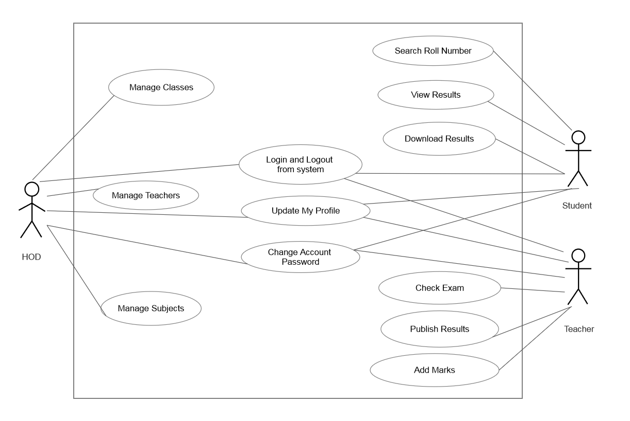
Use Case Diagram

Slide 7
4. Basic Modules
4.1 First one is the HOD module.
HOD Logins with the username and password that the Admin assigned at the time of adding this HOD into the database, at server side.
HOD creates new classes with subjects and assigns the teacher to class.
HOD adds, deletes and updates the Teacher to their specific department.
HOD adds, deletes and updates the Students to their specific department.

Slide 8
4.2 Second one is the teacher module.
Teacher Logins with the username and password that the HOD assigned at the time of adding this Teacher into the department.
Teacher has access to only those classes to which this teacher is been assigned.
Teacher adds Students in the class from the list of all the students in the department.
Teacher add, update and delete Marks for every student in that class.

Slide 9
4.3 lastly the student module.
Student logins with the username and password that the HOD or teacher assigned at the time of adding this student into the department.
Student chooses the semester to view the result of that semester.
Student module is still under development.

Slide 10
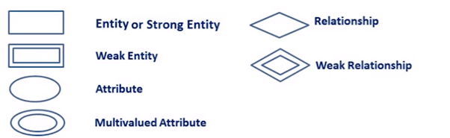
5. ER DIAGRAM
ER- diagram is a visual representation of data that describe how data is related to each other.
Rectangles: this symbol represent entity types
Ellipses : symbol represent attributes
Diamonds: this symbol represents relationship types
Lines: it links attributes to entity types and entity types with other relationship types
Primary key: attributes are underlined
Double ellipses: represent multi-valued attributes

Slide 11
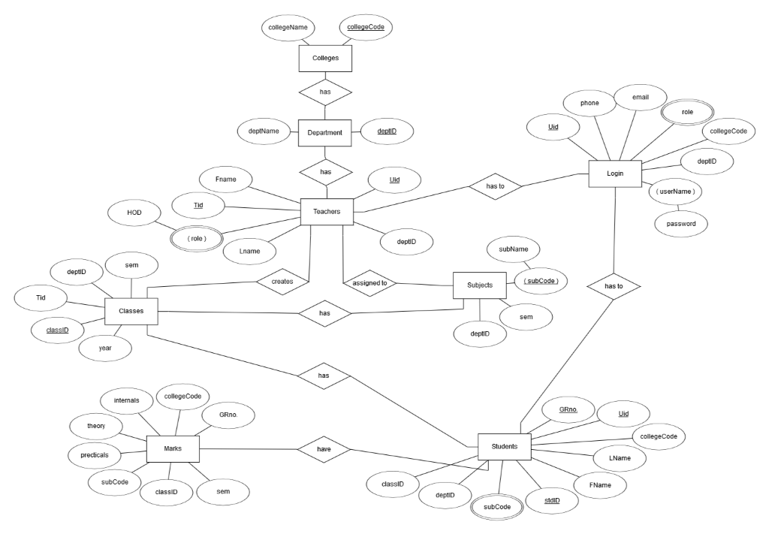
ER Diagram

Slide 12
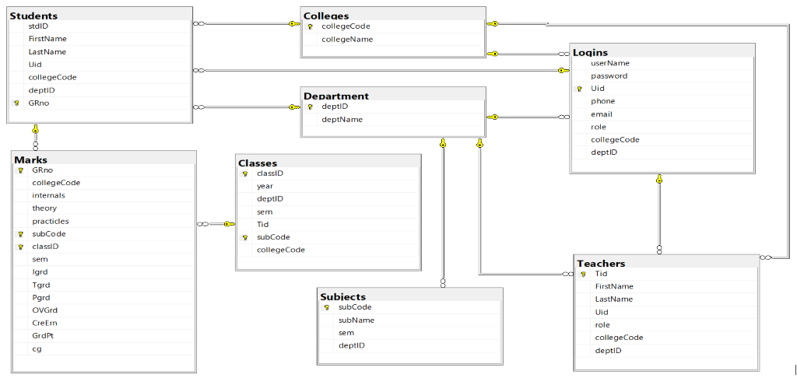
Database Diagram

Slide 13
6. Conclusion
This project is basically built to reduce the manual work done in the process of generating the results.
Using this project this whole process of generating the result becomes so fast.
So that the students get there results on time.
And the results will be stored into the database for long-long years.
Due to time constraints it was not possible to incorporate all the concepts related to the topic.
So the program created is just an instance of the combination of online result processing syste & result distribution system.

Slide 14

Thankyou

