Slide 1
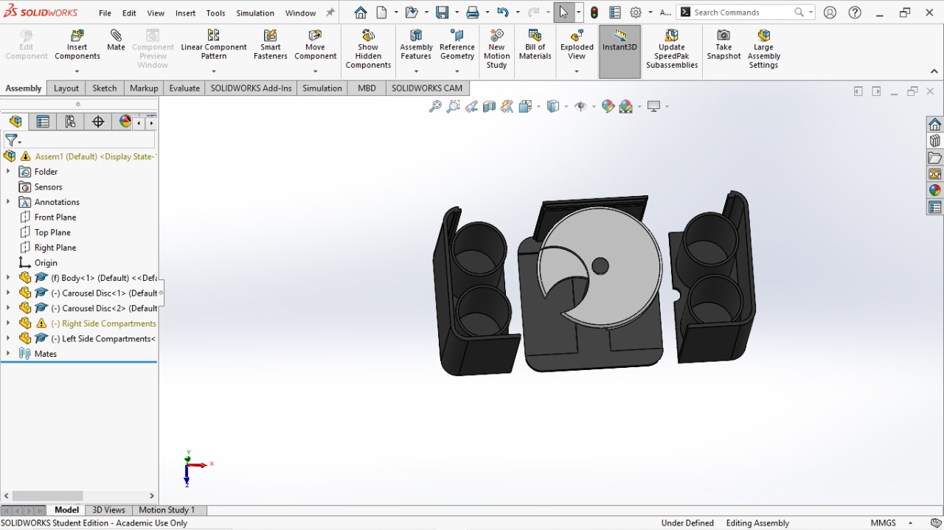
SMART WASTE • ENGINEERING DESIGN
BIN
GENIE
IoT-enabled waste segregation using a dual-carousel mechanism and AI-assisted vision
Conference presentation & prototype demonstration
Bhuvaneshwaran M • Jagan Babu R • Pravin M • Janardhanan R • Deepan A
Guide: Mr. V. Velmurugan | Sri Sairam Engineering College
IEOM CONFERENCE PAPER • PROJECT CAD IMAGES PROVIDED BY THE TEAM

Slide 2
01 • CONTEXT
Why source segregation needs a better system
Mixed waste undermines recovery before collection even begins.
CONTAMINATION
MANUAL BURDEN
SYSTEM GAP
Recyclables mixed with wet or residual waste become harder to recover and process.
Hand sorting is labour-intensive, inconsistent and can expose workers to unsafe mixed waste.
Many solutions sense, classify or report — but do not combine these with a practical sorting mechanism.
PROJECT CHALLENGE
Can one compact unit identify an item, confirm the decision with sensors, and physically route it to the right compartment?
BIN GENIE | CONFERENCE PRESENTATION
02

Slide 3
02 • PROJECT SCOPE
Research aim & objectives
AIM
Classify waste into four streams: biodegradable / wet, dry, electronic, and residual.
Automate waste identification and source-level routing in a modular smart-bin concept.
Fuse visual predictions with material-sensing signals to reduce ambiguous decisions.
Coordinate sensing, processing, actuation and optional IoT monitoring.
Evaluate classification, response and carousel positioning; improve readiness for field use.
BIN GENIE | CONFERENCE PRESENTATION
03

Slide 4
03 • SYSTEM AT A GLANCE
The BinGenie concept
Three jobs, one coordinated cycle: recognize → decide → route.
01 SENSE
Camera + material sensors inspect a newly inserted item.
02 DECIDE
Embedded controller combines model confidence and sensor evidence.
03 SORT
Motorized carousel aligns the waste path with a detachable collection compartment.
Design intent: reduce manual contact and keep collection modular.
BIN GENIE | CONFERENCE PRESENTATION
04

Slide 5
04 • HARDWARE + SOFTWARE
System architecture
The paper describes a hybrid vision-and-sensor loop coordinated by an embedded controller.
01
02
03
04
05
06
INPUT
SENSING
INFERENCE
CONTROL
ACTUATION
FEEDBACK
›
›
›
›
›
Waste at inlet
Camera + sensors
EfficientNet-B3 + fusion
Embedded controller
Carousel + gravity drop
Status / IoT log
Decision feedback: confidence level selects direct acceptance, sensor verification, or sensor-led fallback.
Paper implementation describes Raspberry Pi 4 + TensorFlow Lite; an attached Innovathon deck separately lists STM32. Confirm the final controller before presenting hardware claims.
BIN GENIE | CONFERENCE PRESENTATION
05

Slide 6
05 • CLASSIFICATION
Recognition: vision backed by physical evidence
VISUAL CHANNEL
SENSOR CHANNEL
RGB camera captures the item. EfficientNet-B3 extracts visual features and proposes a class with a confidence score.
Moisture → wet/organic • capacitive → material response • inductive → metal/e-waste. ToF / proximity and ultrasonic support detection and fill monitoring.
CONFIDENCE-AWARE FUSION
HIGH
MEDIUM
LOW
Accept model class
Verify / adjust with sensors
Rely primarily on sensor cues
Reported model: pre-trained EfficientNet-B3; images resized to 224×224 and normalized. Paper reports open datasets including TrashNet, Kaggle and TACO.
BIN GENIE | CONFERENCE PRESENTATION
06

Slide 7
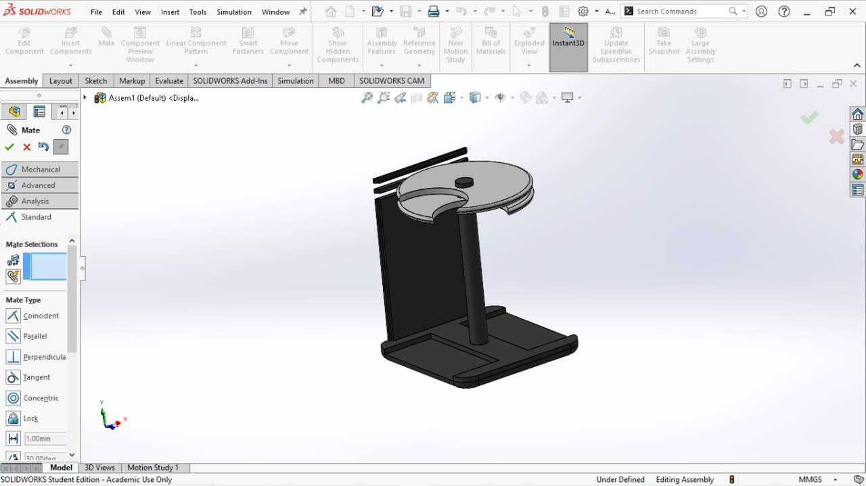
06 • MECHANISM
Mechanical concept: modular carousel routing
WHAT THE CAD SHOWS
Detachable side collection modules with cylindrical cups.
Central base and upright support structure.
Two-disc carousel assembly shown separately for access and explanation.
In the paper, the upper cup-like disc carries waste; the lower disc aligns to one of four outlets.
The project CAD views are the visual source for this demo.
BIN GENIE | CONFERENCE PRESENTATION
07

Slide 8
07 • REPORTED DESIGN SPECIFICATIONS
Design envelope & materials
Overall body
≈ 750 mm high × 450 mm wide
HDPE body / powder-coated mild-steel frame
Carousel discs
2 × 380 mm diameter; 18 mm thick
ABS in paper; ABS / PLA in project slide
Collection chambers
4 × 370 mm high; 156 mm diameter
HDPE; detachable for cleaning / emptying
Motion & feedback
NEMA 17 stepper, DRV8825, rotary encoder
Closed-loop alignment described in paper
Values above come from the conference paper; validate against the final manufactured prototype / CAD before issuing fabrication drawings.
BIN GENIE | CONFERENCE PRESENTATION
08

Slide 9
08 • CONTROL WORKFLOW
Operating sequence
01
02
03
04
05
06
Standby
→
Detect
→
Acquire
→
Classify
→
Align
→
Release & reset
Monitor inlet
Wake camera + sensors
Image + sensor readings
CNN + sensor fusion
Command carousel position
Gravity drop; log; return to idle
Control logic described as a state machine: initialize → detect → classify → actuate → standby, with encoder feedback and error handling.
Paper-reported mechanical test: 100 continuous cycles; angular deviation below 1.8°; average cycle time 3.2 s.
BIN GENIE | CONFERENCE PRESENTATION
09

Slide 10
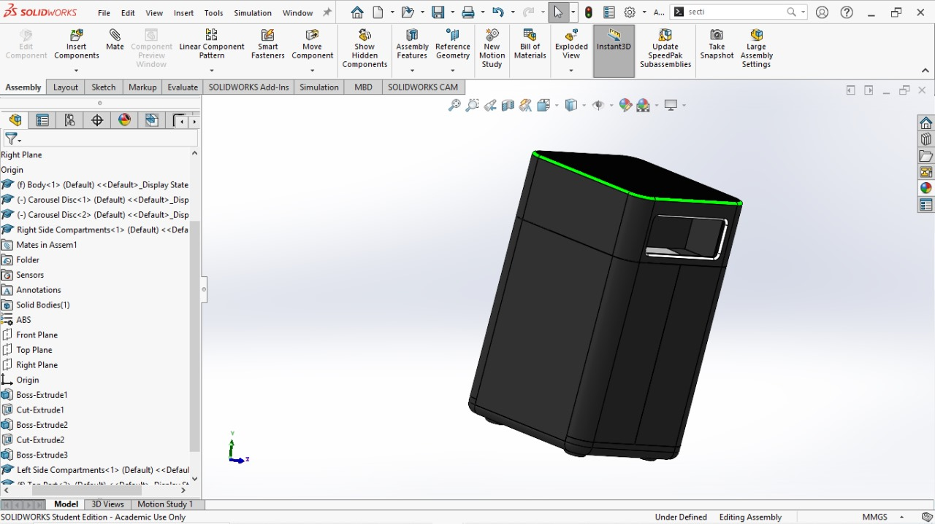
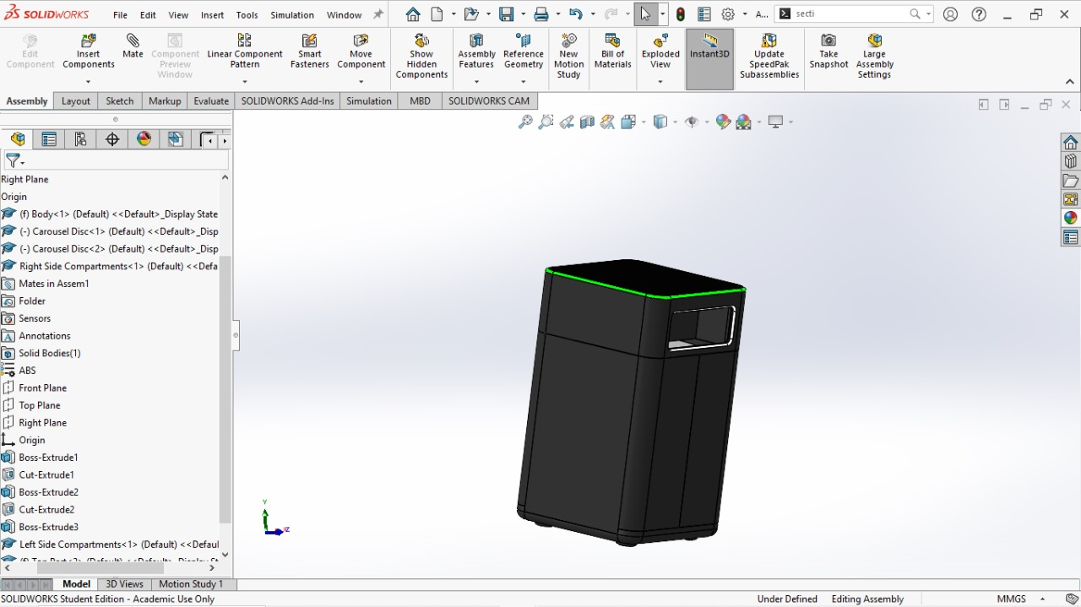
09 • CAD VISUALS
Prototype views supplied by the team
ASSEMBLED FORM
COMPARTMENT LAYOUT
CAROUSEL UNIT
Outer enclosure + inlet
Detachable collection modules
Disc, central post and base
Component appearance retained from the supplied SolidWorks / CAD images; no substitute bin geometry introduced.
BIN GENIE | CONFERENCE PRESENTATION
10

Slide 11
10 • PAPER-REPORTED RESULTS
Performance evidence — present carefully
The manuscript reports several datasets / evaluation contexts; do not combine these into one headline score.
97.7%
3.2 s
< 1.8°
up to; 2,000 samples, Pi 4 / TFLite validation
average mechanical cycle; 100 continuous cycles
carousel alignment deviation reported
Other manuscript values: 98.3% CNN confusion-matrix summary • 95.41% dataset table average • 93.8% / 65 ms architecture comparison • 1.92 s/image embedded validation.
Different class sets, test splits and timing definitions are presented; source does not reconcile them.
RECOMMENDED PRESENTATION
Say “the paper reports up to 97.7% in its validation section” and identify the evaluation setup. Before submission, reconcile accuracy, class labels, sample counts and inference-time figures with the final experiment log.
BIN GENIE | CONFERENCE PRESENTATION
11

Slide 12
11 • INTERPRETATION
What the results suggest
VISION ADDS VALUE
REAL-TIME TARGET
MECHANICAL REPEATABILITY
Sensor-only matrix reports weaker results for glass (80%) and e-waste (70%). The paper argues visual verification improves material discrimination.
Reported end-to-end cycle is around 3.2 s. CNN inference timings differ across manuscript sections and should be clarified.
Encoder feedback and sub-2° alignment are reported over a 100-cycle test; larger, longer-duration trials remain important.
Interpretation: hybrid classification is promising, but robustness must be demonstrated across lighting, mixed materials, and field conditions.
BIN GENIE | CONFERENCE PRESENTATION
12

Slide 13
12 • COST (FROM INNOVATHON DECK)
Indicative project budget
STM32 microcontroller
₹2,300
Servos / actuators
₹1,050
Camera module
₹550
Power + backup
₹850
Sensors (ultrasonic / capacitive / inductive)
₹250
Basic bin structure
₹1,200
Load cell + HX711
₹380
Misc. / PCB / wiring
₹400
TOTAL AS LISTED IN INNOVATHON SLIDE
₹6,580
Important: item values shown sum to ₹6,980, not ₹6,580. Recheck budget arithmetic and controller/actuator configuration before presenting.
BIN GENIE | CONFERENCE PRESENTATION
13

Slide 14
13 • SUSTAINABILITY
Impact pathway & SDG alignment
SDG 12
SDG 11
SDG 13
Responsible consumption & production
Enable cleaner sorting, reuse and recycling; support awareness at point of disposal.
Sustainable cities & communities
A modular smart-bin concept can support better public-space and institutional waste operations.
Climate action
Improved diversion can contribute to lower landfill dependence; quantify impact only after deployment data.
Impact chain: source-level separation → cleaner material streams → improved recovery potential → better-informed collection and waste planning.
This is a proposed contribution pathway, not a measured life-cycle or emissions result.
BIN GENIE | CONFERENCE PRESENTATION
14

Slide 15
14 • ROADMAP
Limitations & next steps
CURRENT RISKS
NEXT VALIDATION
Mixed-material packaging can trigger ambiguity.
Reconcile hardware bill of materials and architecture.
Lighting and occlusion may weaken visual recognition.
Publish one clearly defined test split and class mapping.
Reflective / transparent materials challenge both vision and sensors.
Run field trials across diverse lighting and contamination conditions.
Paper reports conflicting controller and metric details across sections.
Add dedicated illumination; consider NIR for difficult materials.
Tune closed-loop carousel control; log latency and failure rates.
BIN GENIE | CONFERENCE PRESENTATION
15

Slide 16
15 • TAKEAWAYS
Conclusion
THE PROJECT CONTRIBUTION
A smart-bin concept that connects AI-assisted identification to a modular physical sorting mechanism.
Hybrid sensing can support more robust classification than a single cue.
The dual-carousel concept provides a compact route to four waste streams.
Paper reports promising accuracy and mechanical alignment; independent, repeatable field validation is the next step.
DESIGN → VALIDATE → DEPLOY RESPONSIBLY
BIN GENIE | CONFERENCE PRESENTATION
16

Slide 17
16 • REFERENCES
Sources & reporting notes
Bhuvaneshwaran M, Jagan Babu R, Pravin M, Janardhanan R, Deepan A, and V. Velmurugan. “Development of IoT-Enabled Waste Segregation System Using Carousel Disc Mechanism and AI-Driven Image Recognition.” Proceedings of the 5th Indian International Conference on Industrial Engineering and Operations Management, Vellore, India, Nov. 6–8, 2025.
Project design / budget source: “INNOVATHON 4.0 PPT (BinGenie) Final” (team-provided PDF). Prototype imagery: team-provided SolidWorks screenshots and design renders.
Presentation note: metrics and specifications are transcribed as reported; where paper sections disagree, this deck explicitly flags the mismatch rather than resolving it by assumption.
TEAM / AFFILIATION
Department of Mechanical and Automation Engineering • Sri Sairam Engineering College • West Tambaram, Chennai
BIN GENIE | CONFERENCE PRESENTATION
17

