Slide 1
AWS Shared Responsibility Model
A brief overview
BY P. JAGATH KALYAN

Slide 2
Overview
AWS provides a secure infrastructure for hosting your applications and data.
However, you are responsible for the security of your data and applications.
AWS provides a number of tools and services to help you secure your environment.
You need to understand your security requirements and implement appropriate controls.

Slide 3
AWS responsibilities
AWS is responsible for the physical security of its data centers.
AWS is also responsible for the security of the underlying infrastructure.
This includes the operating system, hypervisor, and networking.
AWS provides a number of security features, such as encryption, intrusion detection, and firewalling.

Slide 4
Customer responsibilities
You are responsible for the security of your data and applications.
This includes the following:
Choosing the right services and features for your needs
Configuring your environment securely
Managing user access
Monitoring your environment for security threats

Slide 5
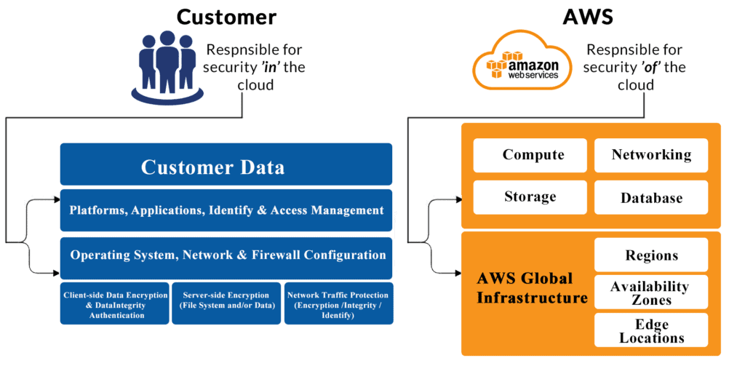

Slide 6
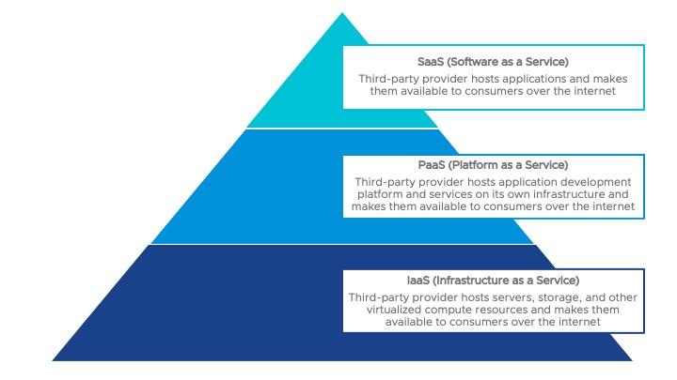

Slide 7
Conclusion
The AWS Shared Responsibility Model is a partnership between AWS and its customers.
AWS provides a secure infrastructure, but you are responsible for the security of your data and applications.
By understanding your security requirements and implementing appropriate controls, you can help to protect your data and applications in the cloud.

Slide 8

THANK YOU

