Slide 1
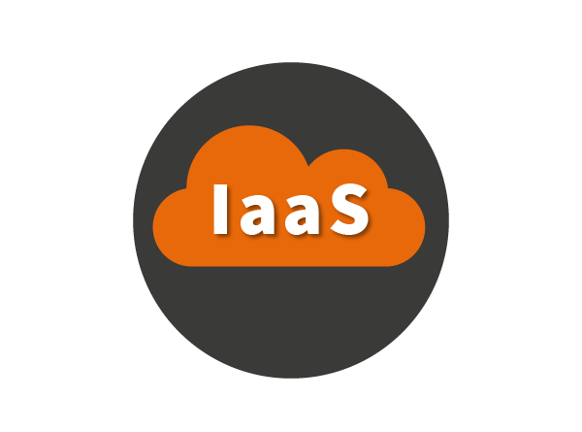
Infrastructure as a Service (IaaS)
A cloud computing service model
PPT BY JAGATH KALYAN

Slide 2
What is IaaS?
Infrastructure as a Service (IaaS) is a cloud computing service model that provides access to fundamental resources such as virtual machines, storage, and networking.
IaaS is a great choice for organizations that need to:
Quickly scale their IT resources
Reduce their IT costs
Improve their IT agility
Here are some examples of how IaaS can be used:
Hosting websites
Running applications
Storing data
Testing and development PPT BY JAGATH KALYAN

Slide 3
Benefits of IaaS
There are many benefits to using IaaS, including:
Scalability: IaaS makes it easy to scale your IT resources up or down as needed.
Cost savings: IaaS can help you save money on your IT costs by eliminating the need to purchase and maintain your own hardware and software.
Agility: IaaS gives you the agility to quickly deploy new applications and services.
Security: IaaS providers offer a wide range of security features to help protect your data.
PPT BY JAGATH KALYAN

Slide 4
Conclusion
IaaS is a powerful cloud computing service model that can help organizations improve their IT agility, scalability, and cost savings. If you are looking for a way to modernize your IT infrastructure, IaaS is a great option to consider.
PPT BY JAGATH KALYAN

Slide 5
THANK YOU
PPT BY JAGATH KALYAN

