Slide 1
CapEat Online Food Order Portal
Author (optional)
Department
Date
Notes:
Template version: 11/20/2012, for PowerPoint 2007 & 2010

Slide 2
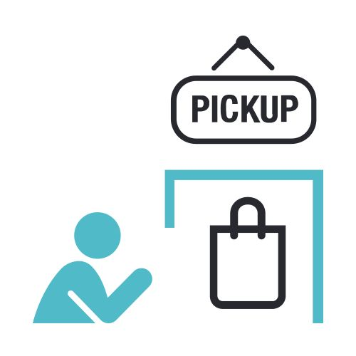

About CapEat…
This is an online portal only for Capital One Associate so that they can check the menu for all the Cafeteria around the Campus and also allow them to order the food online including pickup or delivery.

Slide 3
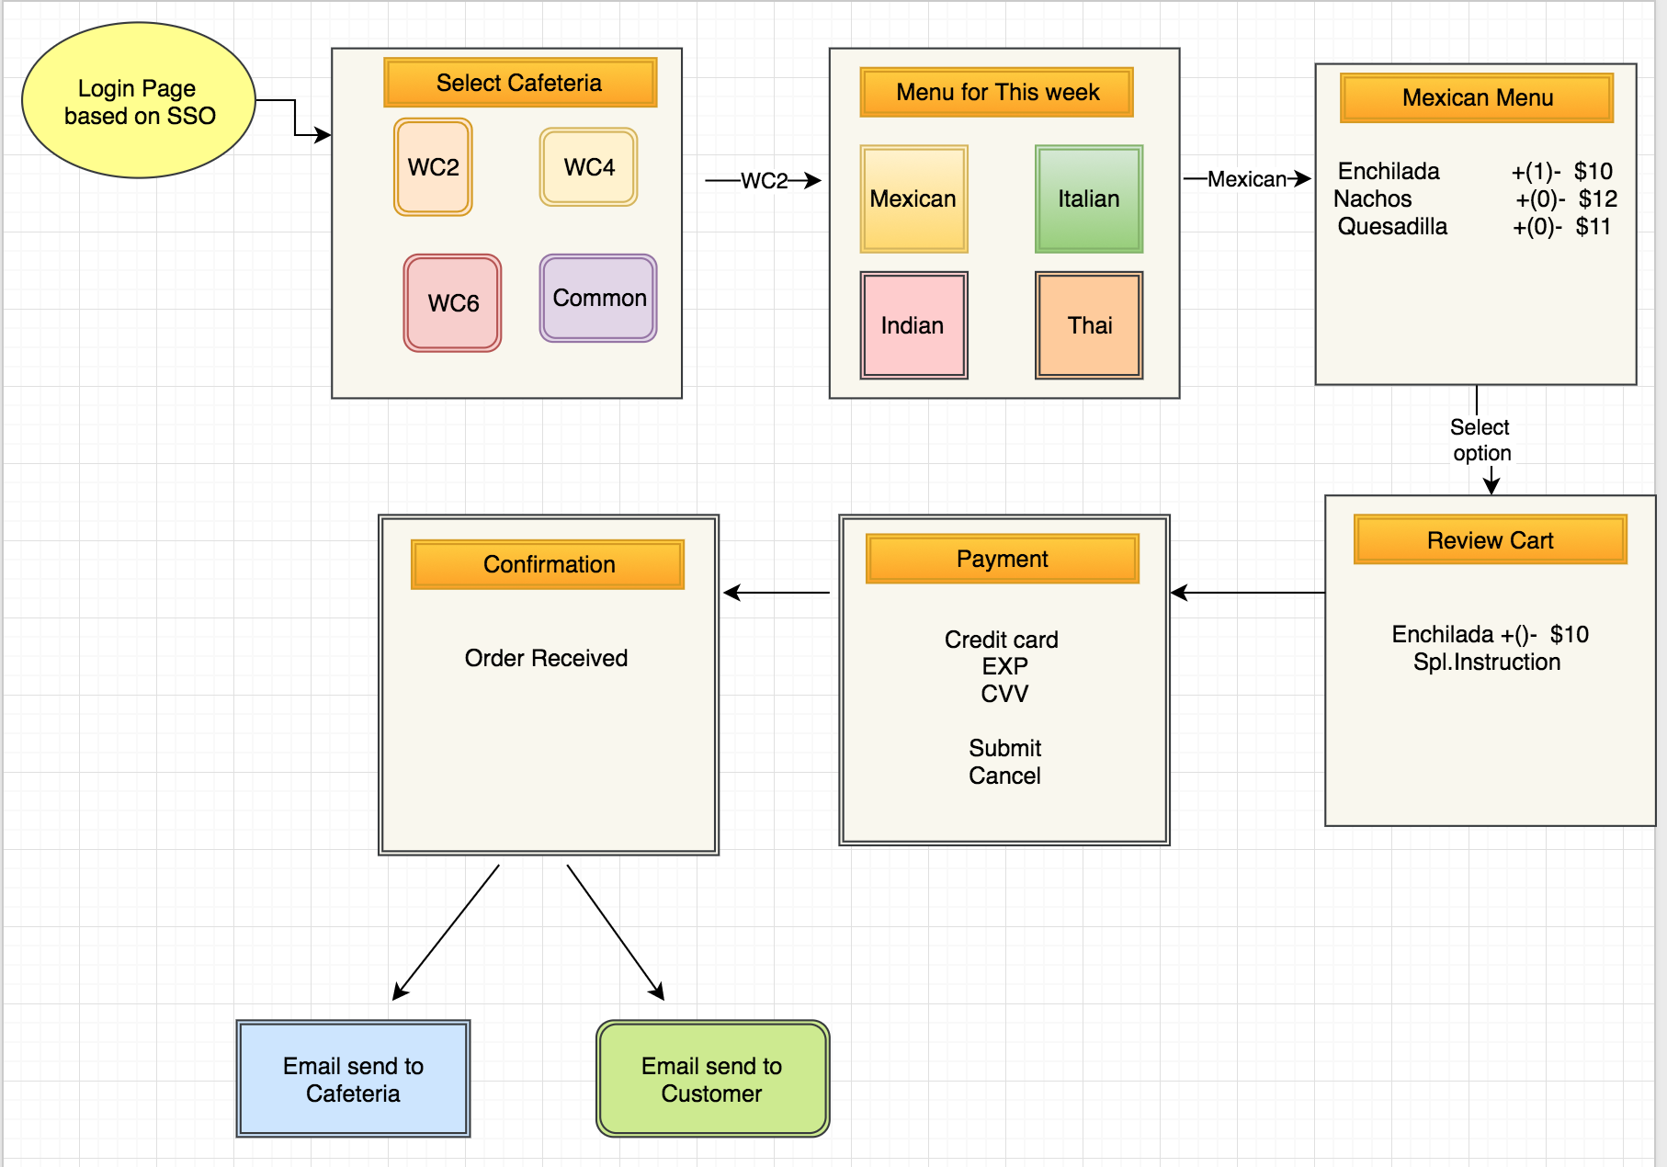
Activity Diagram

Slide 4
Technical Requirement
The back-end system shall use JDBC to connect to an Oracle 12c EE database.
The application shall deploy onto Tomcat Server.
The middle tier shall use Servlet technology for dynamic Web application development.
The front-end view can use JavaScript or AngularJS to make a single page application that uses AJAX to call server-side components.
Passwords shall be encrypted in Java and securely stored in the database.
Users can upload a document or image of their receipt when submitting reimbursements.

