Slide 1

Project Title – Seasonal Agricultural performance Analysis
Student Name - Jagatha Teja Sai Ram
College Name – Kakinada Institute of Engineering and Technology
AICTE STU ID : STU6688efa48ecb01720250276

Slide 2

PROBLEM STATEMENT
Agricultural activities are influenced by seasonal variations in environmental conditions, farming practices, resource availability and market conditions. As a result, agricultural performance may differ from one season to another.
However, raw agricultural data does not clearly explain how agricultural performance changes across seasons or what patterns can be observed in different seasonal conditions.
The problem is to analyze the given agricultural dataset and investigate seasonal differences in agricultural performance by identifying meaningful patterns, trends, relationships and variations within the available data.

Slide 3
Project Description
Seasonal Agriculture Performance Analysis is a data analytics project that studies agricultural activities across different seasons and farming conditions.

Slide 4

WHO ARE THE END USERS?
Farmers – to understand seasonal performance and make better farming decisions.
Agricultural planners – to support seasonal planning using data.
Agricultural researchers – to study seasonal trends and relationships.
Government and agricultural organizations – to understand regional and seasonal variations.
Data analysts – to analyze agricultural performance and identify useful patterns.

Slide 5

Technology Used
  Python
  Pandas
  NumPy
  Mathplotlib
  Seaborn

Slide 6
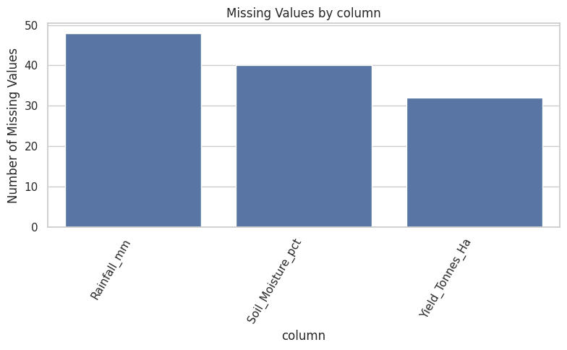
RESULTS
Data Quality Analysis
Checked the dataset structure and available variables.
Identified missing or inconsistent values.
Checked duplicate records.
Reviewed data types and categorical values.
Prepared the data for further analysis.
Ensured the dataset was suitable for seasonal comparison.

Slide 7
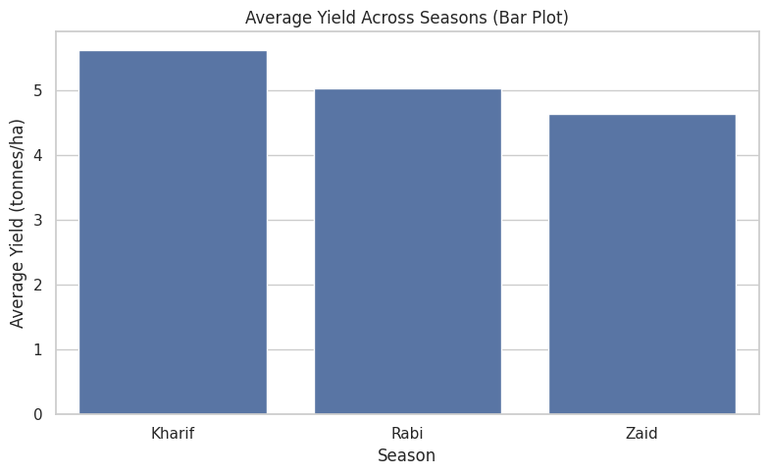
RESULTS
Seasonal Performance Comparison
Compared agricultural performance across different seasons.
Studied how important agricultural characteristics change between seasons.
Identified seasons showing higher or lower performance.
Used visualizations to make seasonal differences easier to understand.

Slide 8
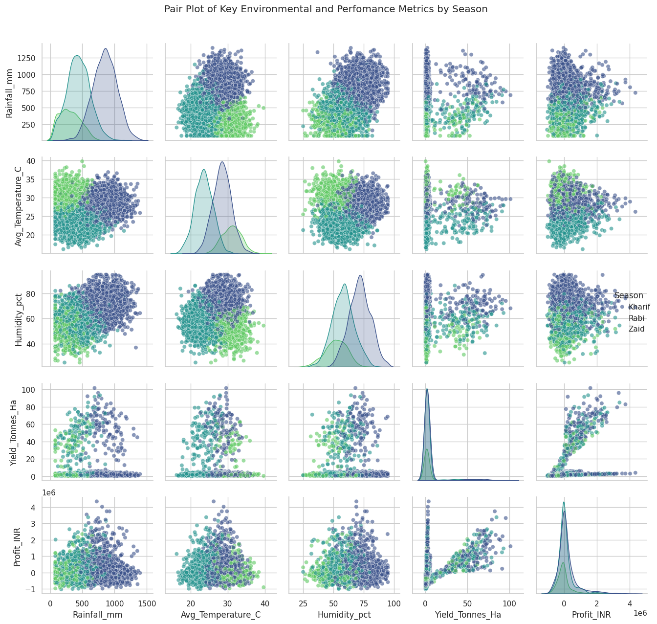
RESULTS
Environmental and Resource Analysis
Examined differences in environmental conditions between seasons.
Compared resource usage across seasons.
Investigated whether changes in seasonal conditions are associated with agricultural performance.
Identified noticeable variations that may require further investigation.

Slide 9
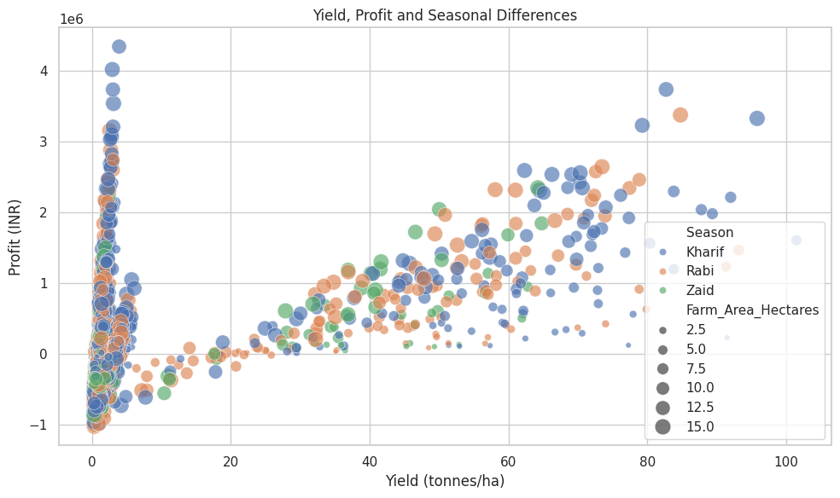
RESULTS
Economic Performance Analysis
Compared economic outcomes across different seasons.
Studied variations in agricultural performance and economic indicators.
Identified noticeable seasonal differences.
Used data visualization to make the comparison easier to interpret.

Slide 10
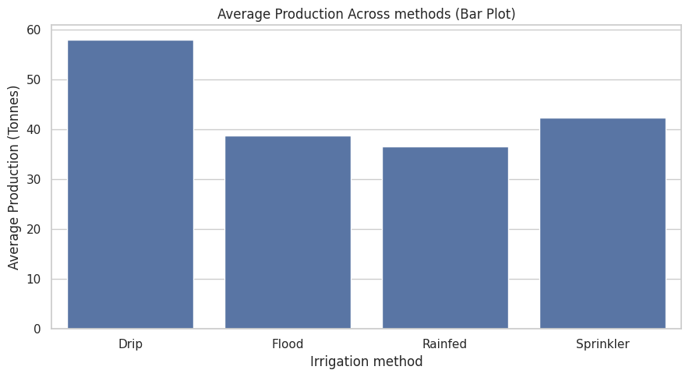
RESULTS
Average Production by Irrigation
Method
The chart compares the average production achieved using different irrigation methods.
Drip irrigation shows the highest average production, at around 58 tonnes.
Sprinkler irrigation follows with about 45 tonnes, while flood and rainfed methods show lower production

Slide 11
Future scope
Include data from more years and seasons.
Expand the analysis to more geographical regions.
Study additional environmental and economic factors.
Build an interactive dashboard for easier analysis.
Use predictive analytics to forecast agricultural performance.
Provide more detailed recommendations for seasonal agricultural planning.

Slide 12
GitHub Link
https://github.com/Jagathateja/Seasonal_Agriculture_Performance.git

Slide 13

VOIS Course completion certificate -
Course name- Data Visualization

Slide 14
Thank you
Thanks to VOIS & Edunet Foundation for giving me to this oppurtunity
.
.

