Slide 1
Deep Learning
Hyperparameter Optimization
for IPL Match Winner Prediction
Jagdeep | AI & Applied ML | Fanshawe College
Deep Learning Optimization Project | April 2026
Notes:
Title slide. Deep learning hyperparameter optimization applied to IPL match prediction. TensorFlow/Keras MLP, comparing Random Search vs Bayesian Optimization (Optuna).

Slide 2



Problem Statement & Motivation
Why IPL Prediction?
Why Optimization?
Why Compare Methods?
High-profile T20 league with complex match dynamics. Outcome depends on team form, venue, toss, and seasonal patterns — a challenging tabular classification task.
Neural networks are sensitive to hyperparameters. Default settings often leave performance on the table. Systematic tuning can shift the precision-recall tradeoff significantly.
Random Search samples broadly. Bayesian Optimization (Optuna) learns from prior trials. Comparing them reveals whether guided search outperforms brute-force exploration on this problem.
Notes:
Motivation. IPL as a challenging tabular prediction task. Why hyperparameter tuning matters for neural nets. Value of comparing Random Search to Bayesian Optimization.

Slide 3

Dataset & Prediction Setup
328
Working Sample
Data Overview
Source: (Kaggle) IPL match-level dataset spanning seasons(2008-2024)
328 matches retained as the working sample after filtering incomplete records and building historical features
Binary target: predict match winner (team1 win = 1)
Pre-match features only — no in-match or post-match columns used
Features: season year, month, toss winner/decision, city/venue, team prior win rates, head-to-head records
Post-match columns (winner, MOTM, result margin) excluded from feature set to avoid data leakage
51.8%
Majority Class
Pre-Match
Features Only
Seed 42
Reproducibility
Notes:
328 matches is the working sample after filtering, not the full IPL dataset. Pre-match features only. Majority class ~51.8%, so baseline accuracy is near coin-flip.

Slide 4
Preprocessing & Feature Engineering
1
2
3
4
Clean
Encode
Scale
Split
Handle missing values, remove post-match columns, standardize franchise names across seasons
One-hot encode categoricals (teams, city, venue, toss decision). Numeric features kept as-is
StandardScaler on numeric features for stable gradient descent and fair regularization
Chronological split: oldest 70% train, next 15% validation, newest 15% test — simulates real forecasting
Why preprocessing matters for optimization:
Proper scaling ensures gradient-based optimizers converge reliably across different learning rates and architectures. Without it, hyperparameter search results become noisy and unreproducible.
Notes:
Chronological split, NOT random. Oldest 70% train, next 15% val, newest 15% test. Seed 42 is for model reproducibility, not for the data split.

Slide 5
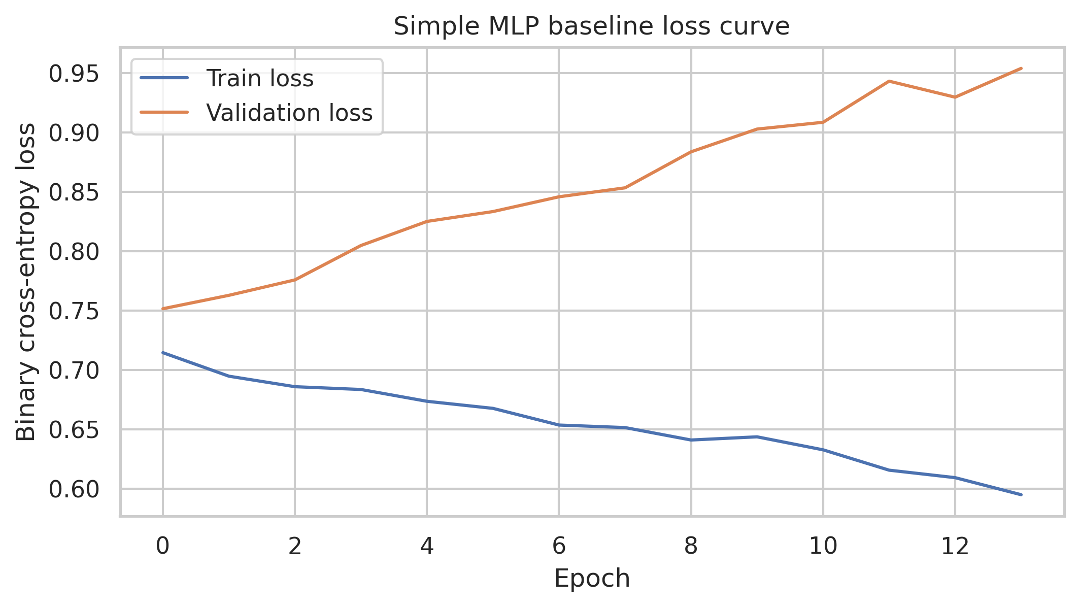
Baseline Model & Architecture
Keras MLP Architecture
Input → Dense(64, ReLU) → Dropout(0.2)
→ Dense(32, ReLU) → Dropout(0.2)
→ Dense(1, Sigmoid)
Loss: Binary Cross-Entropy
Optimizer: Adam (lr = 1e-3)
Epochs: up to 60 with Early Stopping
Early stop monitor: Validation AUC
Evaluated on: Acc, F1, ROC-AUC,Precision, Recall, Log Loss
Baseline training / validation loss curve
Why MLP for tabular data?
MLPs are a standard deep learning baseline for tabular classification. They are fast to train, easy to tune, and serve as a fair substrate for comparing optimization methods.
Notes:
Baseline: 2-layer MLP. Dropout=0.2 (NOT 0.3). Epochs=60 (NOT 50). Early stopping on val_auc. Evaluation uses 6 metrics. This is the reference model.

Slide 6
Hyperparameter Optimization Setup
Hyperparameter | Search Range | Type
Learning Rate | 1e-4 — 3e-2 | Log-uniform
Batch Size | {16, 32, 64, 128} | Categorical
Dropout Rate | {0.0, 0.1, 0.2, 0.3, 0.4, 0.5} | Categorical
Hidden Units | {32, 64, 128, 256} | Categorical
Optimizer | {adam, rmsprop, sgd} | Categorical
Random Search
50 trials
Samples hyperparameters uniformly at random from the search space. Simple, embarrassingly parallel, provides broad coverage.
Bayesian Optimization
50 trials (Optuna TPE)
Fixed seed = 42 for model reproducibility. Both methods share the identical search space and trial budget.
Uses a Tree-structured Parzen Estimator to model promising regions. Each trial informs the next — guided, sequential search.
Notes:
Search space corrected: LR up to 3e-2, batch includes 16, dropout is categorical not continuous. Seed 42 for model reproducibility.

Slide 7
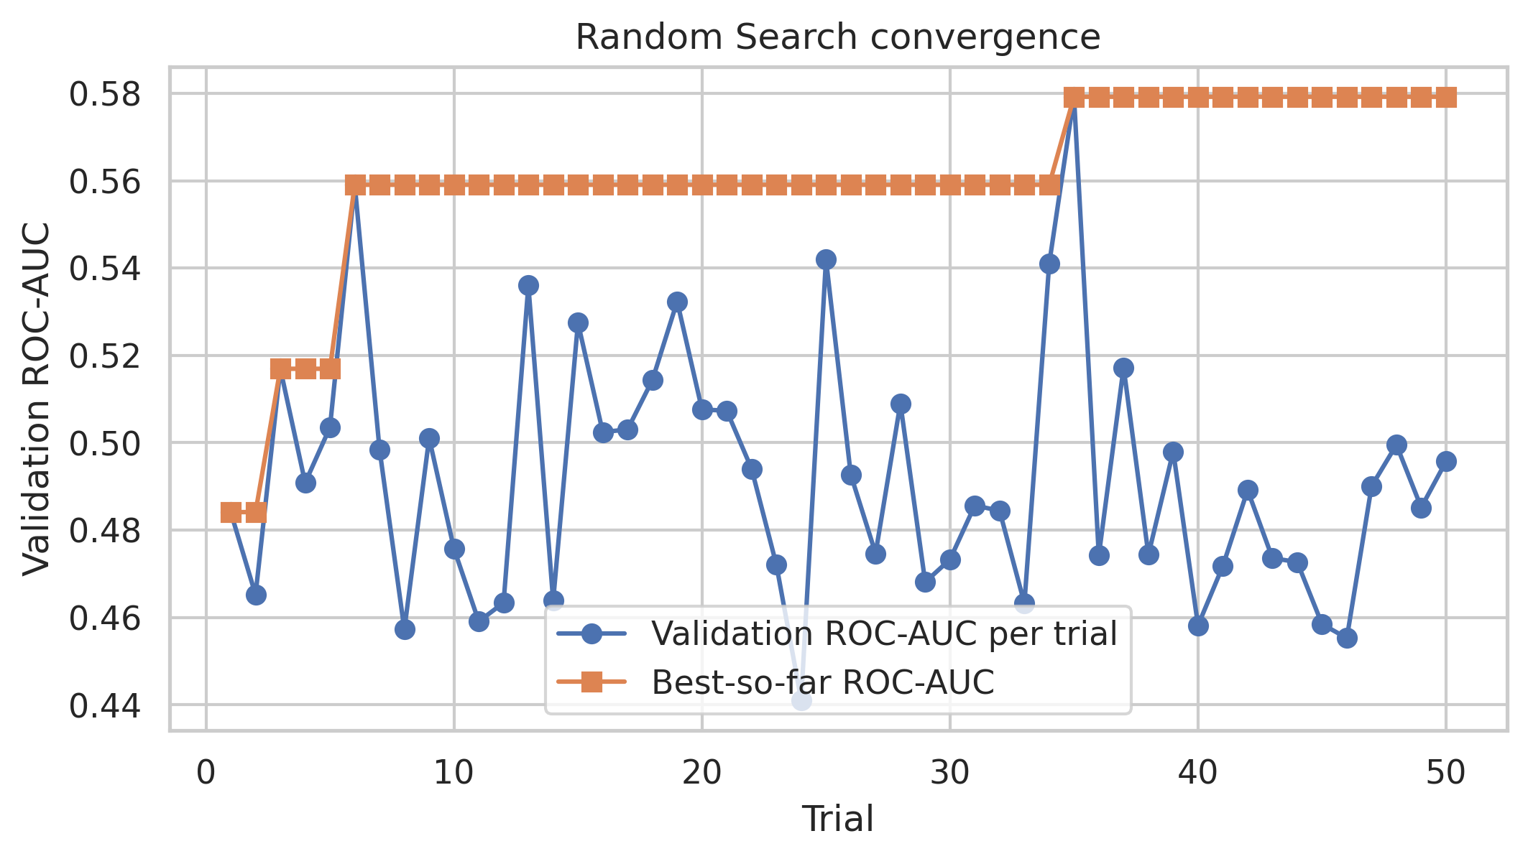
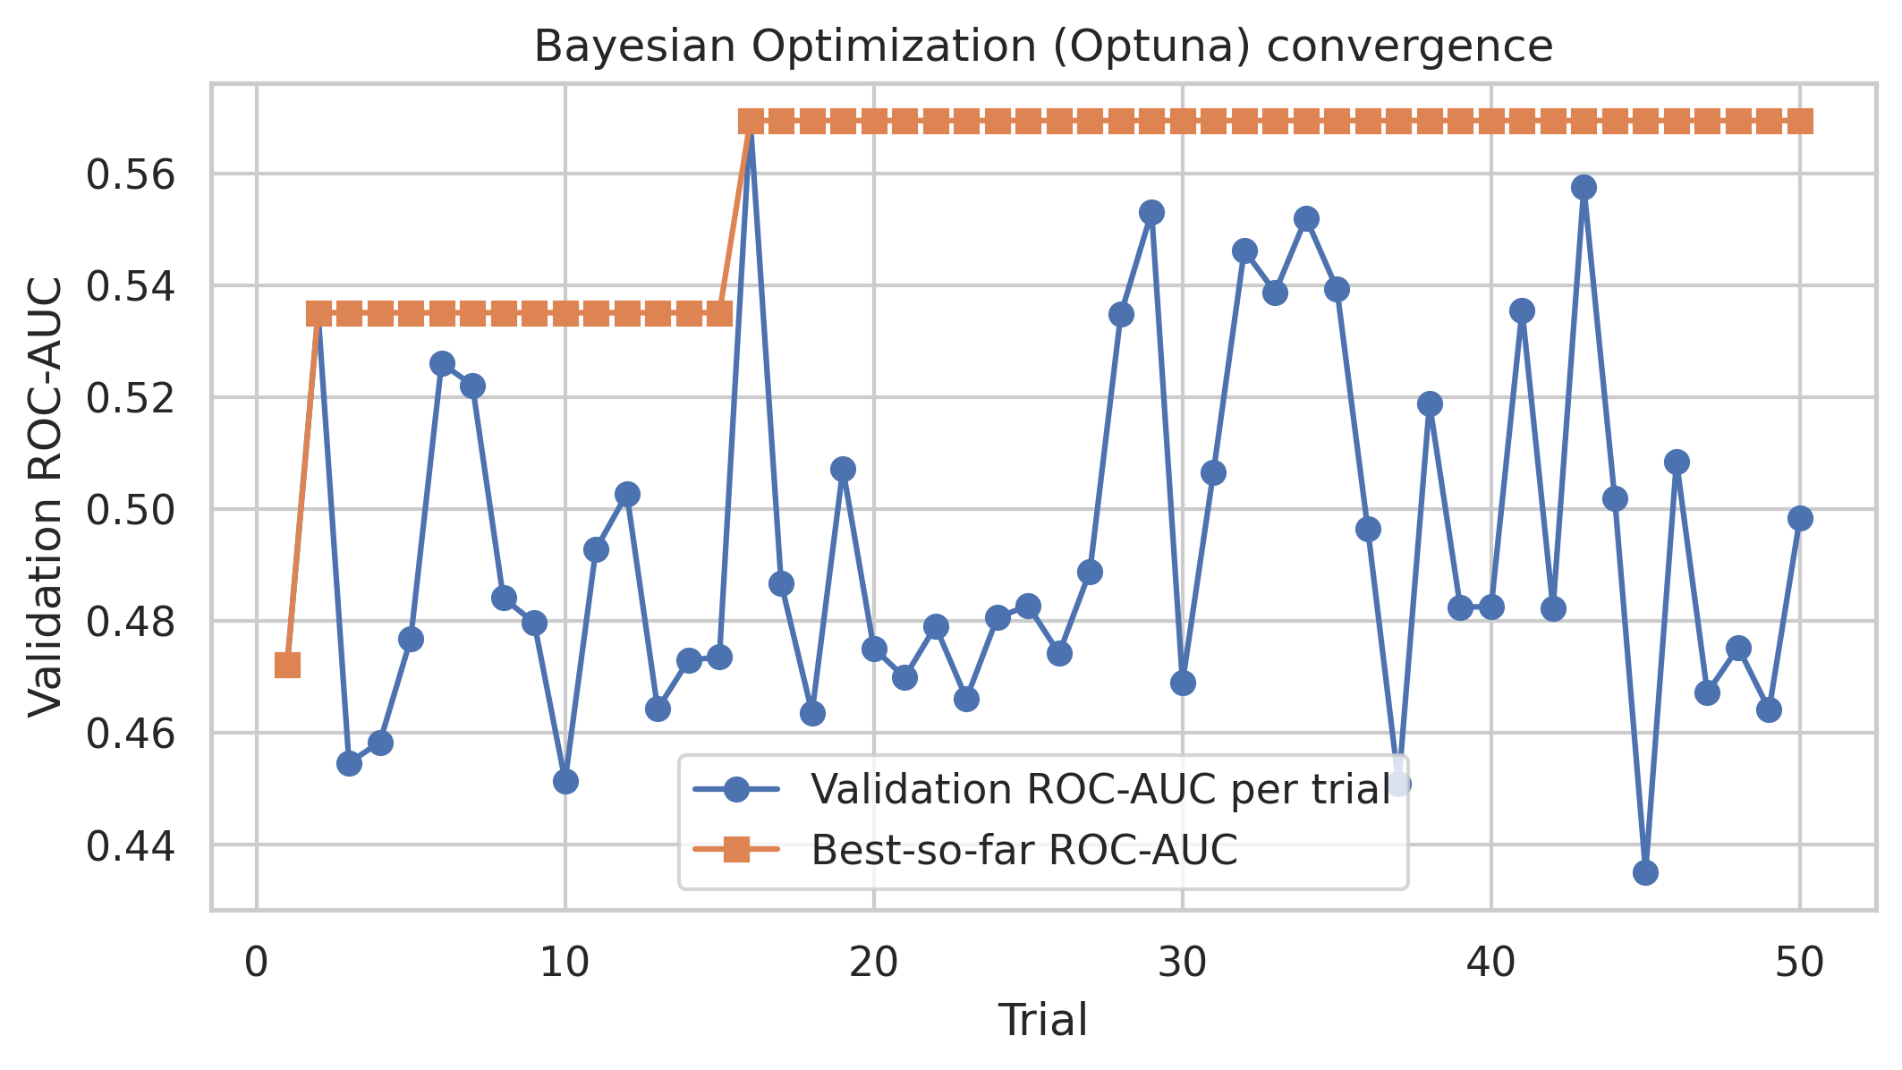
Random Search vs Bayesian Optimization
Random Search — validation ROC-AUC convergence
Optuna (Bayesian) — validation ROC-AUC convergence
 | Random Search | Bayesian (Optuna)
Trials | 50 | 50
Runtime | 173.2 s | 188.0 s
Best Val Accuracy | 0.6012 | 0.5644
Best Val ROC-AUC | 0.5792 | 0.5694
Notes:
Random Search slightly faster (173s vs 188s) and achieved better validation accuracy (0.6012 vs 0.5644) and ROC-AUC (0.5792 vs 0.5694). With only 50 trials on a small search space, Random Search's broad sampling found a strong configuration early.

Slide 8
Best Hyperparameters Found
Hyperparameter | Random Search | Bayesian (Optuna)
Learning Rate | 4.56 × 10⁻⁴ | 1.97 × 10⁻⁴
Batch Size | 128 | 128
Dropout Rate | 0.50 | 0.20
Hidden Units | 64 | 256
Optimizer | RMSProp | SGD
Random Search Strategy
Optuna Strategy
Higher LR + heavier dropout (0.5) + smaller network (64 units). A lean, regularized model with RMSProp — favors conservative predictions.
Lower LR + lighter dropout (0.2) + larger network (256 units). A capacity-heavy model with SGD — predicts more aggressively, higher recall.
Notes:
Two fundamentally different strategies. Random Search: lean/regularized. Optuna: large/aggressive. Both agreed on batch size 128.

Slide 9
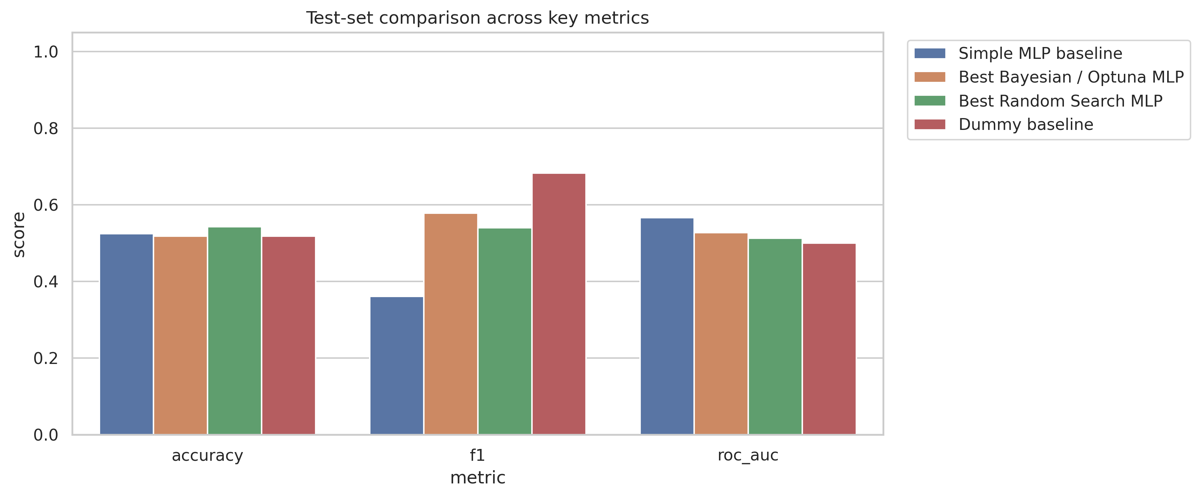
Test Set Results
Test set performance across four models and six metrics
Key Findings
Best Accuracy (54.3%): Random Search MLP
Best ROC-AUC (0.566) & Log Loss (0.689): Simple MLP Baseline — best ranking and calibration
Best F1 (0.578) & Recall (63.5%): Optuna MLP — most aggressive positive-class detection among tuned models
Takeaway: Optimization shifted the precision-recall tradeoff rather than producing a universally superior model
Notes:
No single model wins everything. Random Search best on accuracy, baseline best on ROC-AUC and log loss, Optuna best on F1/recall. Optimization shifted tradeoffs, not absolute quality.

Slide 10
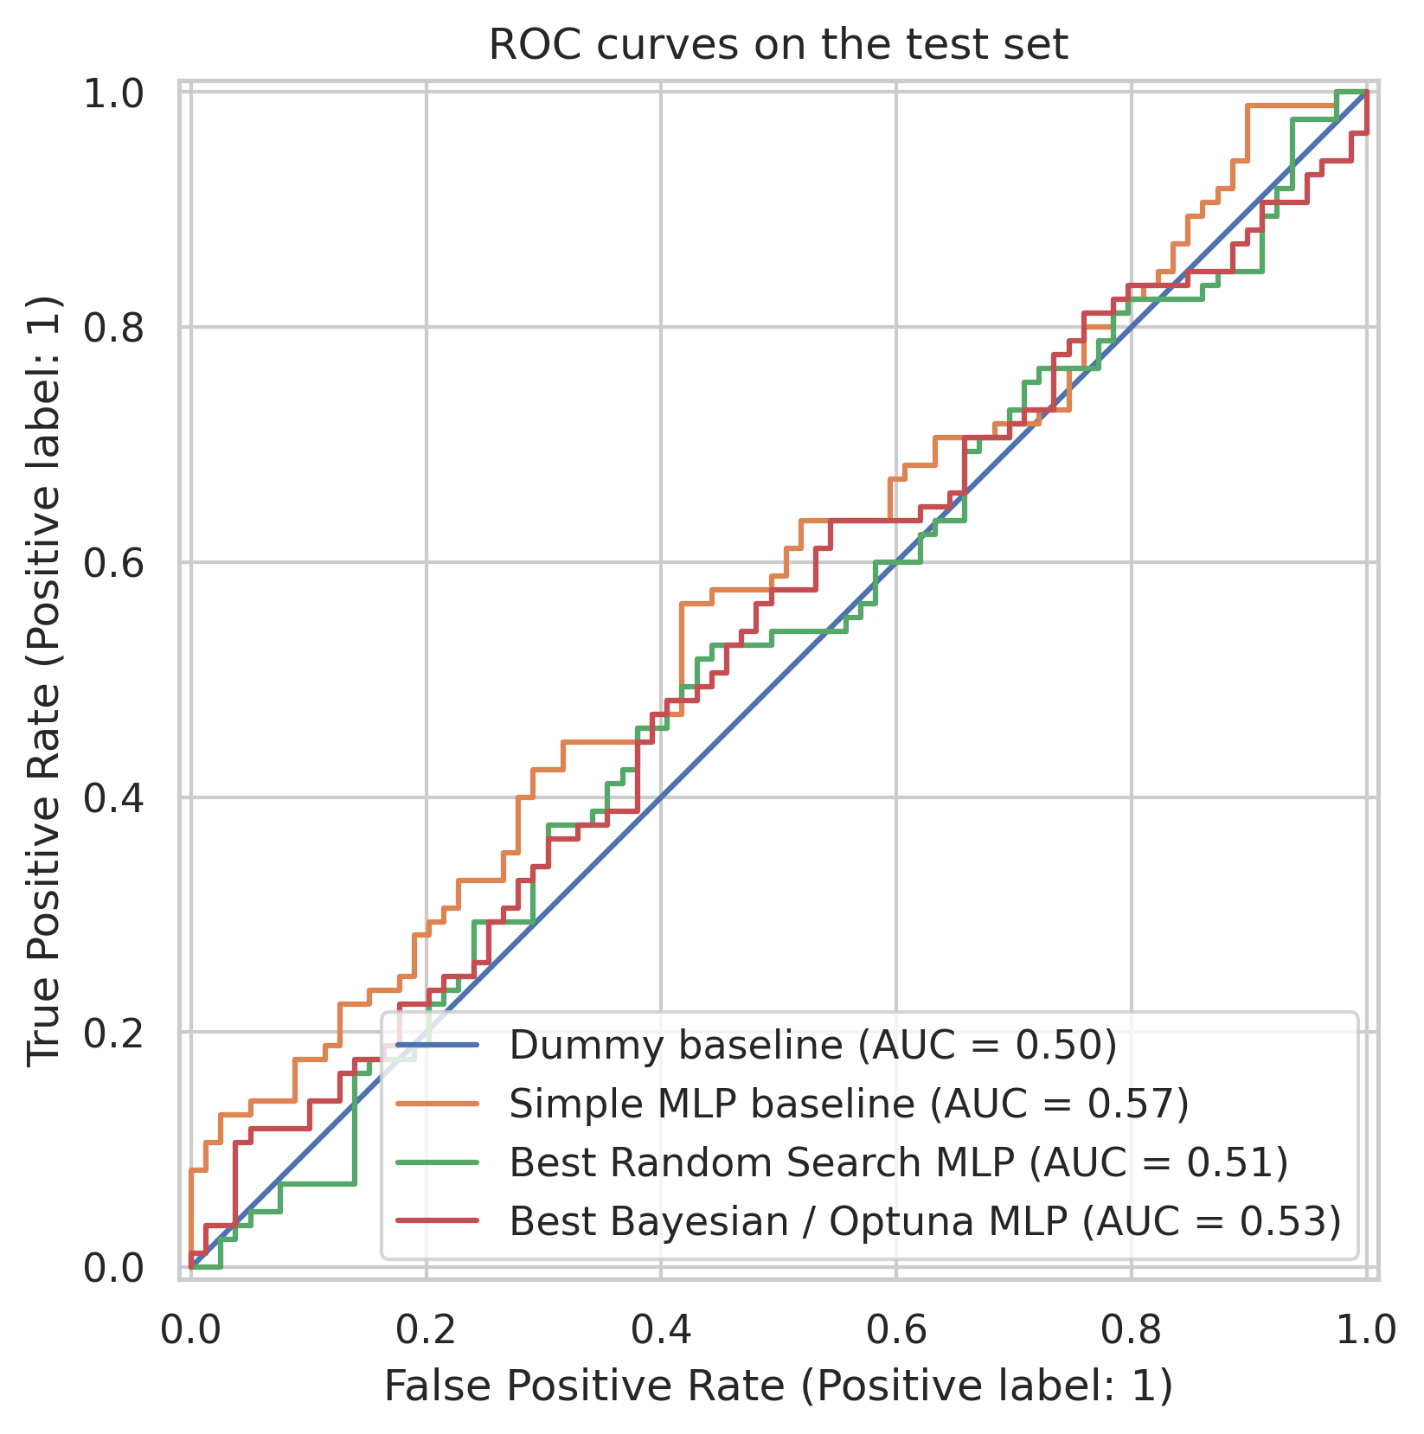
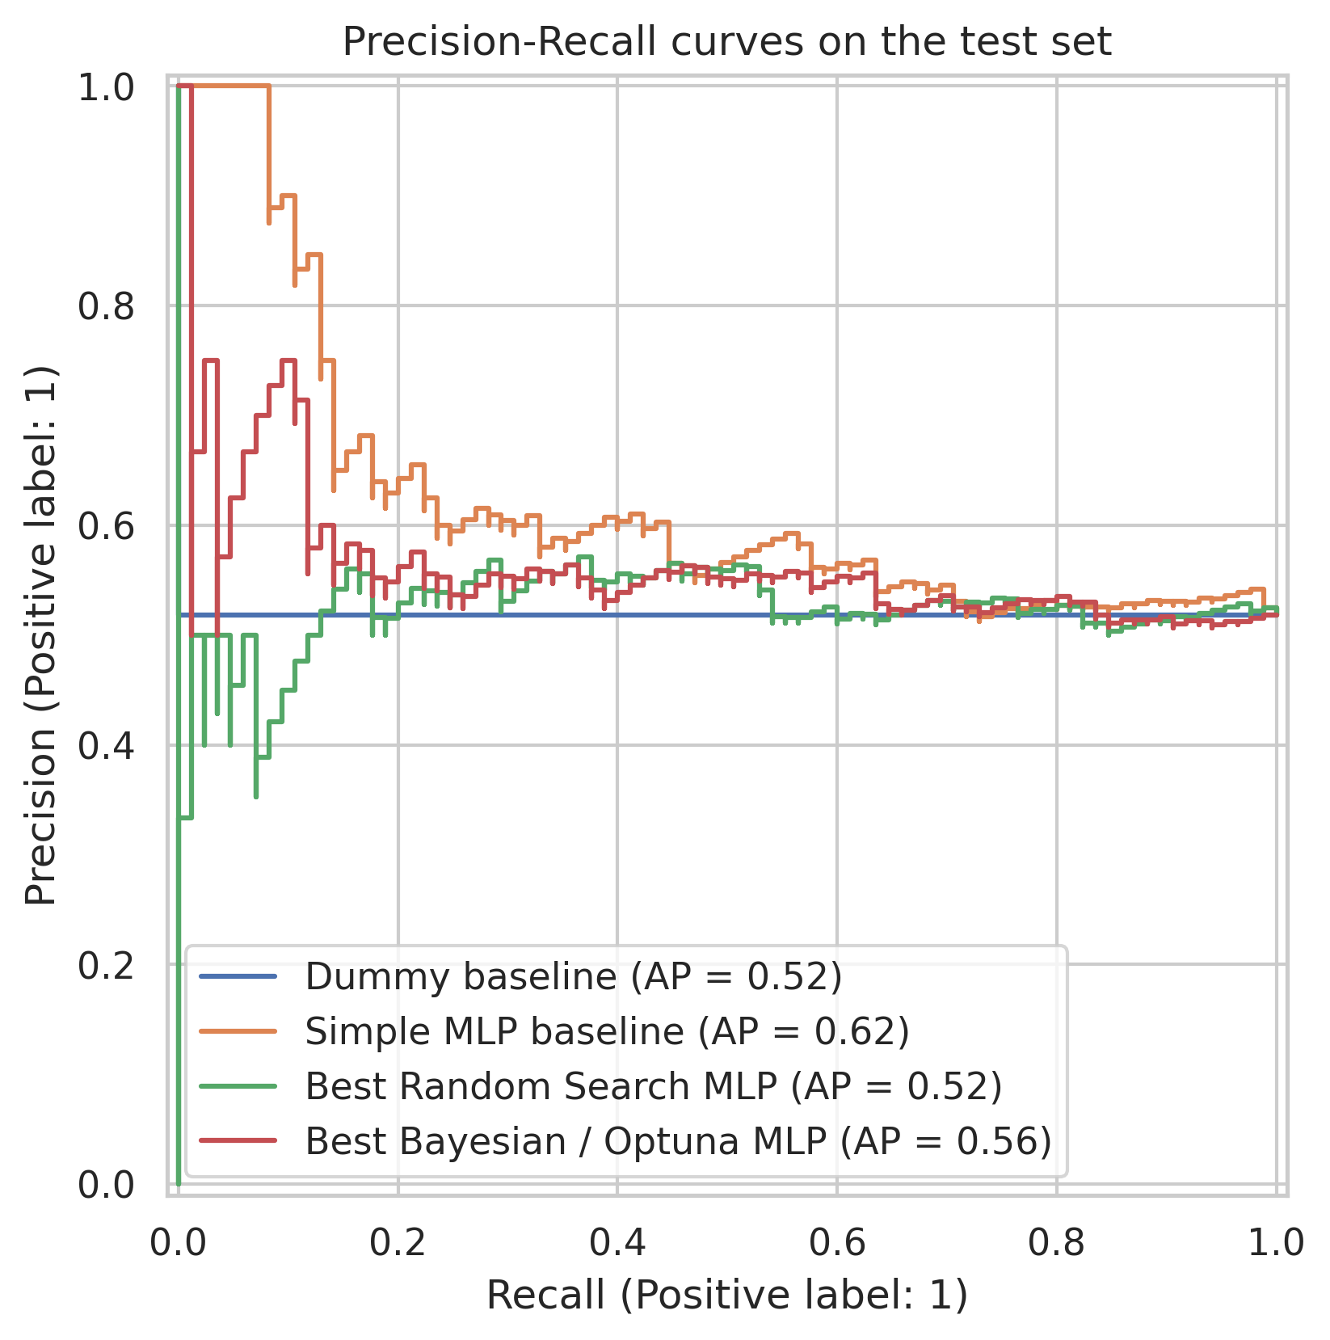
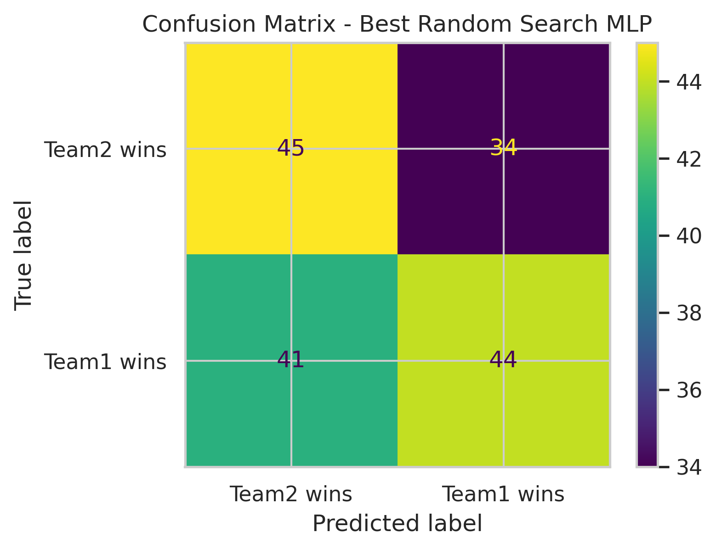
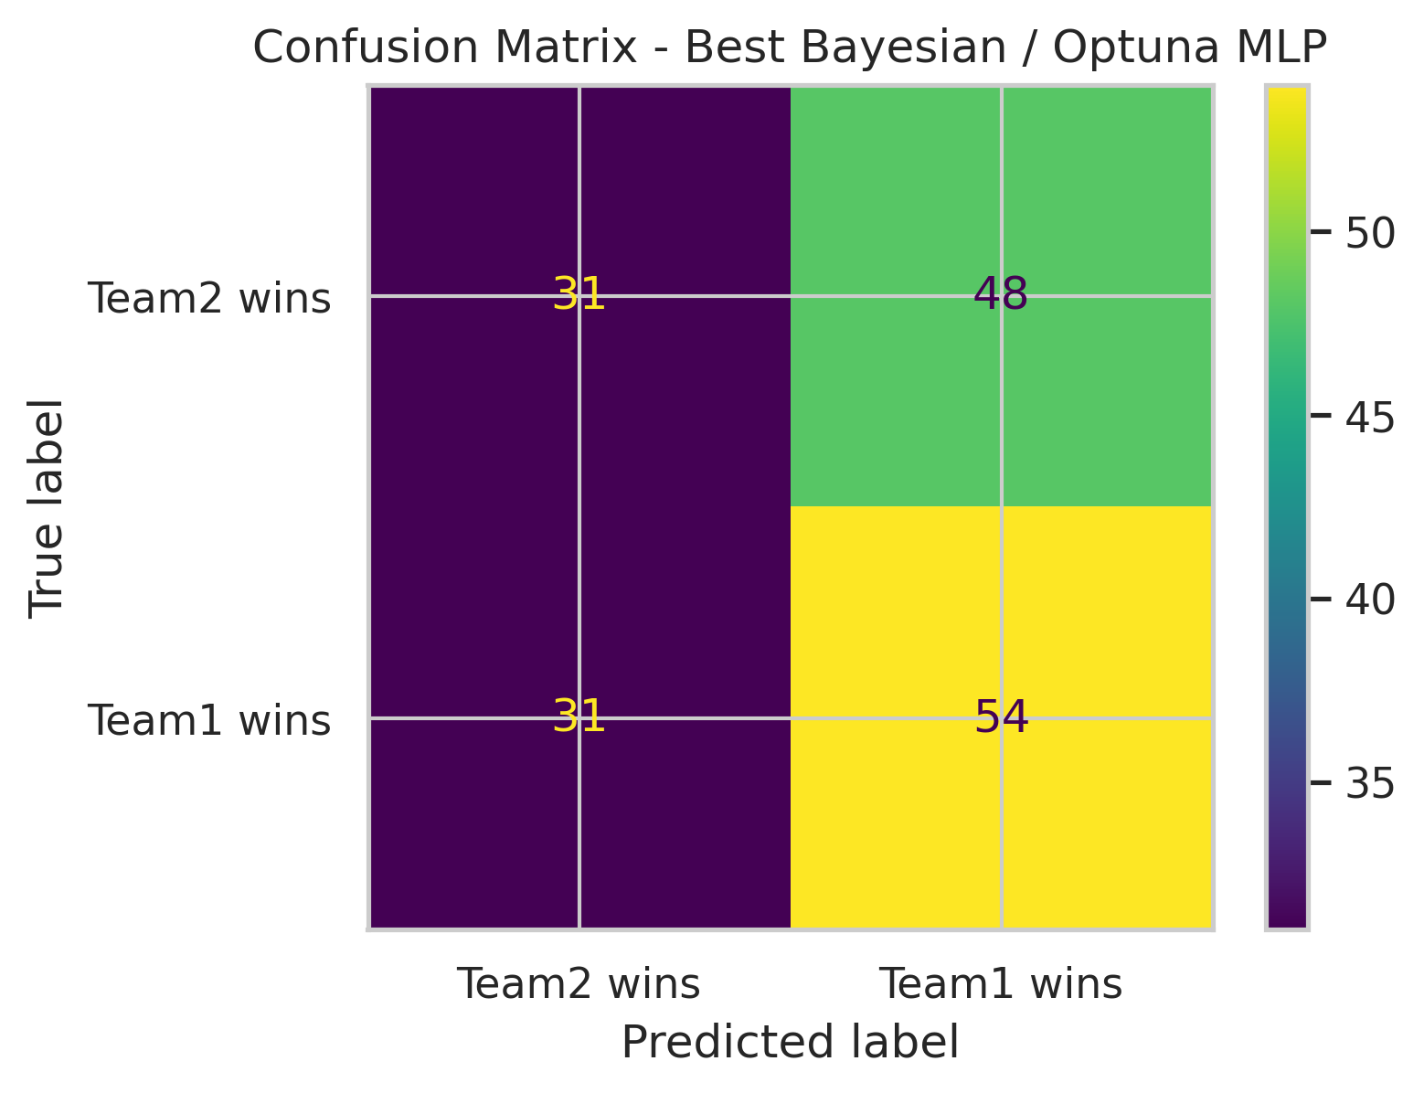
Evaluation Visuals
Random Search CM
ROC Curves — ranking performance
Precision-Recall Curves
Optuna MLP predicts positives more aggressively (higher recall). Random Search MLP is more balanced but misses more positives. Baseline shows strongest ROC separation despite lower recall.
Optuna CM
Notes:
ROC, PR, and confusion matrices. Baseline best at ranking. Optuna most aggressive at positive detection. Random Search most balanced.

Slide 11
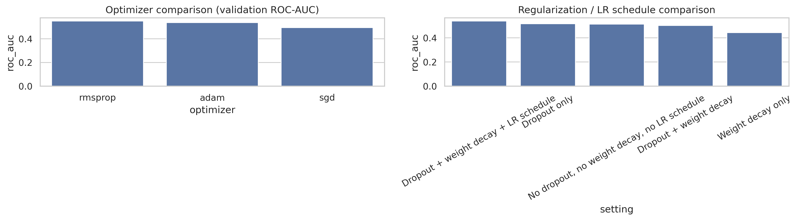
Optimizer & Regularization
Optimizer comparison (left) and regularization (right) on validation set
Optimizer Comparison
Regularization
Without any regularization, recall spikes to 91.7% but accuracy drops to 47.2%. Dropout alone restores balance. Adding weight decay and LR schedule further shifts behavior. Regularization acts as a precision-recall lever.
Adam achieved the best validation accuracy (0.564). SGD had the highest recall (0.653) but lowest accuracy (0.485). RMSProp sat between the two. Optimizer choice strongly affects the precision-recall tradeoff.
Notes:
Ablation: optimizer and regularization fundamentally change model behavior, not just accuracy. SGD without regularization → near-all-positive predictor.

Slide 12
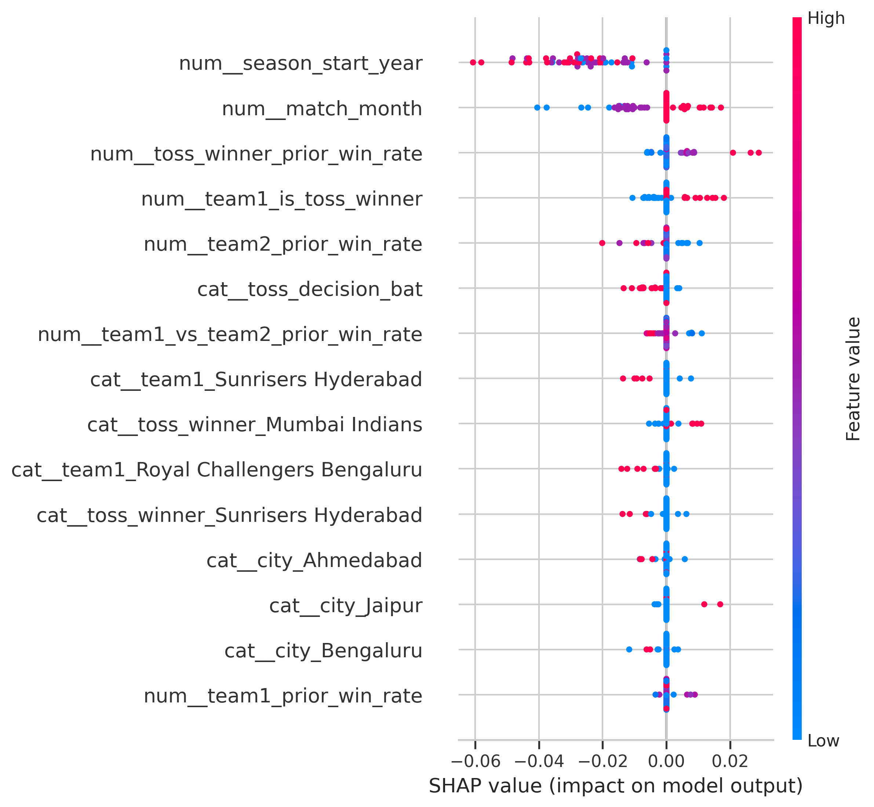
Model Explainability (SHAP)
Rank | Feature | Mean |SHAP|
1 | season_start_year | 0.0248
2 | match_month | 0.0090
3 | toss_winner_prior_win_rate | 0.0031
4 | team1_is_toss_winner | 0.0030
5 | team2_prior_win_rate | 0.0019
6 | toss_decision_bat | 0.0016
Top features by mean |SHAP| value
Key Insights
season_start_year dominates — acts as a strong temporal proxy in this dataset
match_month ranks 2nd — may reflect scheduling or seasonal effects
toss_winner_prior_win_rate is the top cricket-domain feature — prior form appears most relevant
Red/blue dots in beeswarm show directional impact of high vs low feature values
Global SHAP Feature Importance
Notes:
SHAP language softened. 'Captures temporal evolution' → 'acts as a strong temporal proxy.' 'Team form matters most' → 'prior form appears most relevant.' No causal claims.

Slide 13
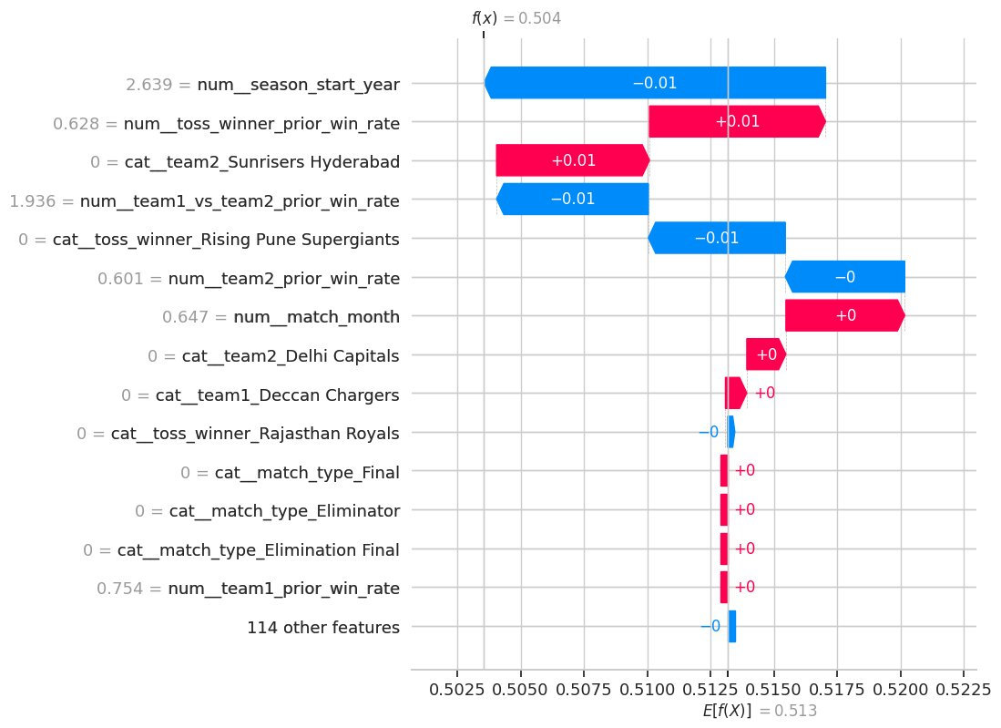
Model Explainability (SHAP)
Key Insights
Local: For this match, f(x)=0.504 (near coin-flip). Season year pushed prediction down (−0.01) while toss winner form pushed it up (+0.01) — features nearly cancel out, producing high uncertainty.
Top features by mean |SHAP| value
Global SHAP Feature Importance
Notes:
SHAP language softened. 'Captures temporal evolution' → 'acts as a strong temporal proxy.' 'Team form matters most' → 'prior form appears most relevant.' No causal claims.

Slide 14
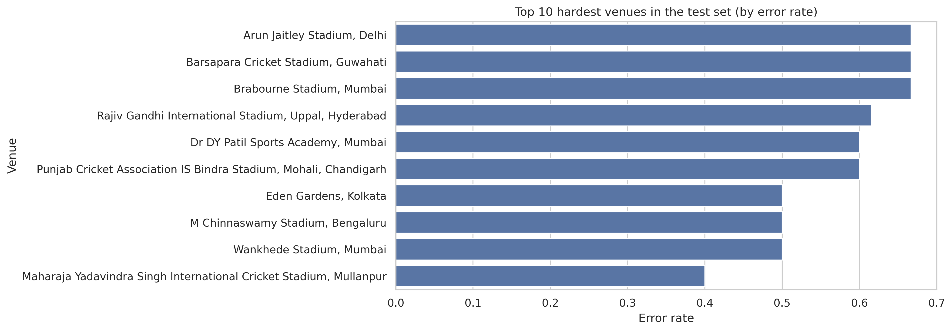

Error Analysis & Practical Insights
Error rate by venue — higher bars indicate harder-to-predict venues in this test split
Observations
Delhi (Arun Jaitley Stadium) has the highest error rate (66.7% over 12 test matches) — appears harder for the model to predict in this split
Venues with fewer test matches (Guwahati, Brabourne: 3 each) show high error rates but with low statistical confidence
Model achieved highest accuracy at Dharamsala (75%, 4 matches) and Jaipur (70%, 10 matches)
Notes:
Venue analysis based on test split only. No speculation about venue characteristics. Delhi hardest to predict (66.7% error, 12 matches). Small-sample venues noted for low confidence.

Slide 15

Conclusion & Future Work
Project Summary
Compared Random Search (50 trials) and Bayesian Optimization via Optuna (50 trials) for tuning a Keras MLP on IPL match prediction
Both methods found fundamentally different architectures — optimization changes model behavior, not just accuracy
No single model dominated all test metrics: the simple baseline led on ROC-AUC and log loss; tuned models shifted the precision-recall tradeoff
It is a hard prediction task with limited features, tuning reveals tradeoffs rather than guaranteeing universal improvement
Future Work
Richer pre-match features — player-level stats, recent form, weather, pitch reports
Stronger tabular models — XGBoost, TabNet, FT-Transformer for comparison
Better handling of class balance and probability calibration
More domain-specific cricket features — head-to-head at specific venues, home advantage metrics
Larger hyperparameter budgets and multi-objective optimization (accuracy + calibration jointly)
Notes:
Honest conclusion. Baseline still leads on some metrics. Optimization changed tradeoffs, not absolute quality. Future: richer features and stronger model families.

