Slide 1

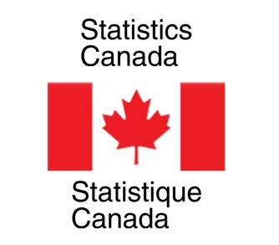


Nowcasting Macroeconomic Indicators
using Google Trends
Presented By:
Aishwarya Sharma
Harpreet Kaur
Jagdeep Brar
Date: 31st May, 2022
IMAGE: https://wallpapersafari.com/w/swTjG4

Slide 2








OUTLINE
INTRODUCTION TO TEAM AND CLIENT
OVERVIEW OF PROJECT
DATA SET
METHODOLOGY
OBTAINED RESULTS
ROADBLOCKS
LEARNINGS AND FUTURE PLANS
Image link: https://cleanfax.com/science-and-technology/trends-restoration-technology/

Slide 3


Introduction
To Team
Image: https://elearning.ihtsdotools.org/mod/book/view.php?id=1772

Slide 4

AISHWARYA SHARMA
Bachelors in Computer Science
Former Software Developer in Hewlett Packard Enterprise (HPE)
Passion for data and loves to play guitar in free time
Image : https://www.american.edu/programs/shared/data-science/

Slide 5
JAGDEEP BRAR
Ph.D. in Applied Mathematics
Worked on Credit Risk Management Projects as
a Postdoc
Likes model fitting and cooking!!

Slide 6
HARPREET KAUR
Gold Medalist in Applied Mathematics
Former Software engineer
Love hiking, making and tinkering

Slide 7
Introduction
To Clients
Statistics
Canada
Image: https://elearning.ihtsdotools.org/mod/book/view.php?id=1772

Slide 8
NICK NEWSTEAD
Economist, Sociologist
Data Exploration and Integration
Strong Data Science Background

Slide 9
MARINA SMAILES
Senior Analyst
Data Exploration and Integration Lab
Microdata, Demographic Analysis

Slide 10

OVERVIEW OF PROJECT
Economic indicators are crucial indicators for a country`s policy and decision making but information contains a lag.
Aim to develop a model for Statistics Canada to nowcast macroeconomic factors in real time using Google search trends.
Economic indicators: Retail trade sales, E-commerce sales and
Gross Domestic Product
Use related queries, topics, keywords of different industrial categories to capture business cycles for economic factors.

Slide 11
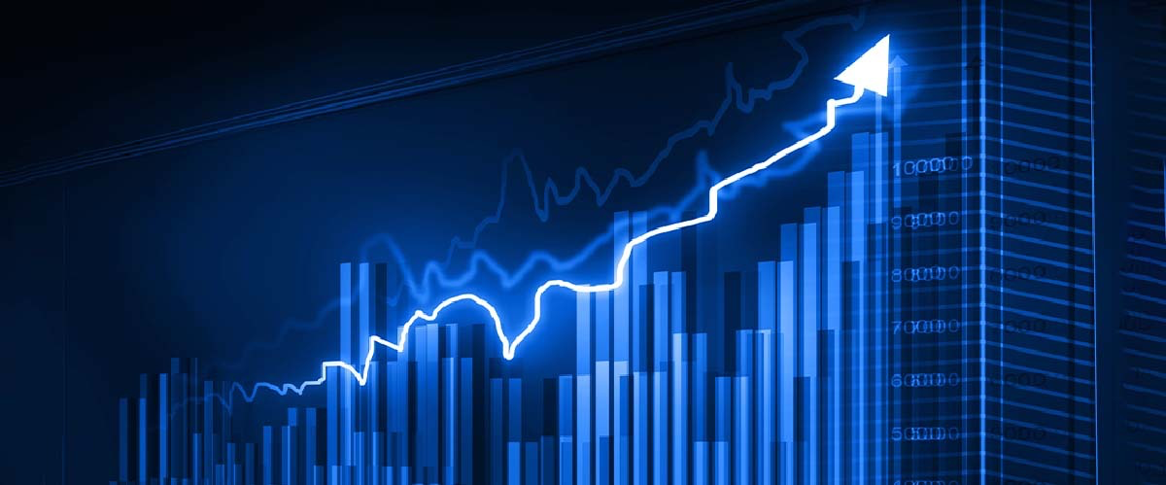
RESEARCH QUESTIONS
Nowcast quarterly Gross Domestic Product (GDP)
Nowcast monthly retail trade sales
Nowcast monthly retail E-commerce sales
Nowcast: “predicting the present”
Image: https://www.etmoney.com/blog/how-to-invest-when-stock-market-is-at-all-time-high/

Slide 12
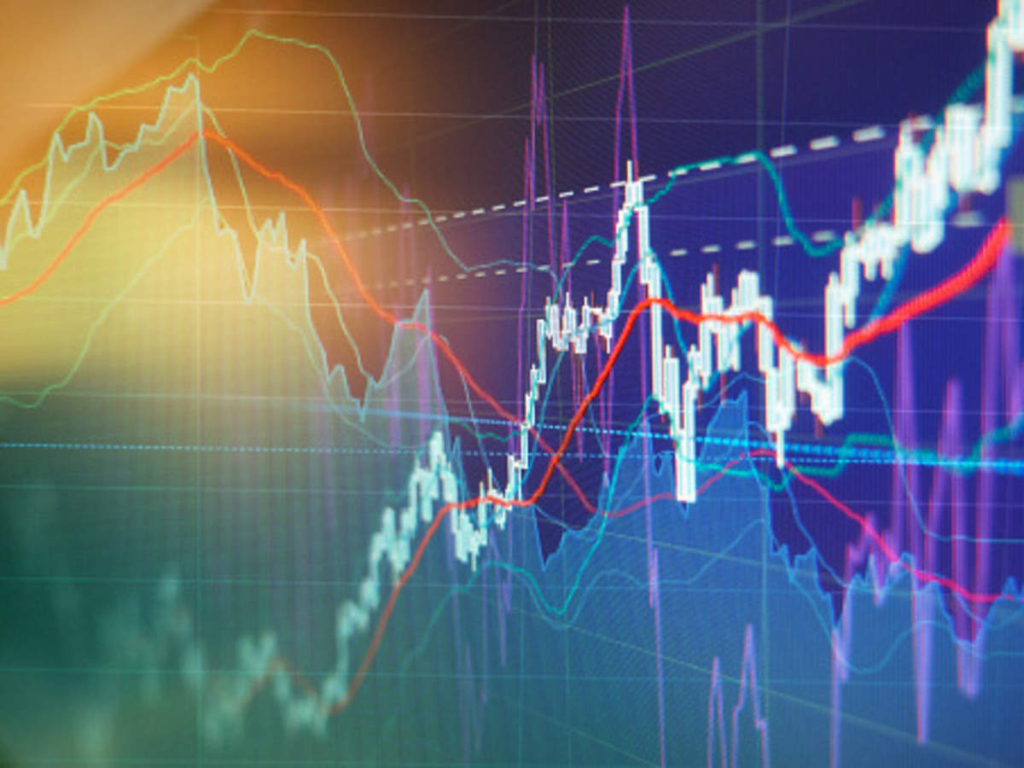
DATASET
Statistics Canada’s historical time series data for the indicators.
Google Trends extract in real time for different macroeconomic indicators as per the related queries, topics, and keywords.
Google Trends data available from the year 2004 onwards.
Image: https://economictimes.indiatimes.com/markets/stocks/news/share-market-update-infra-stocks-slide-indigo-slips-6nbspnbspbr/articleshow/74607083.cms?from=mdr

Slide 13
Statistics Canada Data
Economic Indicator | Timeline | Frequency
Retail trade sales | 1991-2022 | Monthly
E-commerce sales | 2016-2022 | Monthly
GDP | 1997-2021 | Quarterly
Selected Data for Analysis
Economic Indicator | Timeline | Frequency | Num. of observations | Num. of predictors (trends)
Retail trade sales | 2004-2022 | Monthly | 217 | 396
E-commerce sales | 2016-2022 | Monthly | 74 | 31
GDP | 2004-2022 | Quarterly | 72 | 446

Slide 14
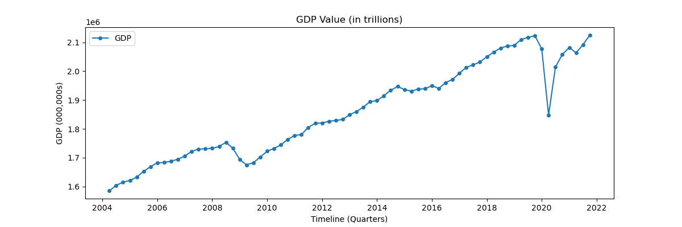
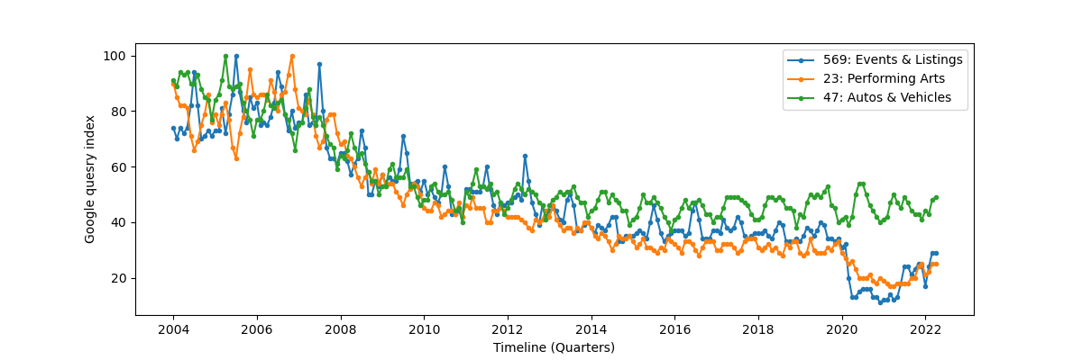
GDP time series
Google Trends time series

Slide 15
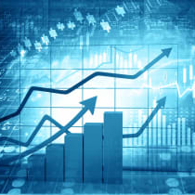
METHODOLOGY
STATIONARY TIME SERIES
MODELLING
ECONOMETRIC
MODELS
MACHINE LEARNING MODELS
IMAGE: https://www.kiplinger.com/investing/stocks/604003/stock-market-today-122921-dow-up-6-days-sp-500-record

Slide 16
Time Series Stationary
Normalized Data
Removed Trend
Removed Seasonality
Image: https://www.etmoney.com/blog/how-to-invest-when-stock-market-is-at-all-time-high/

Slide 17
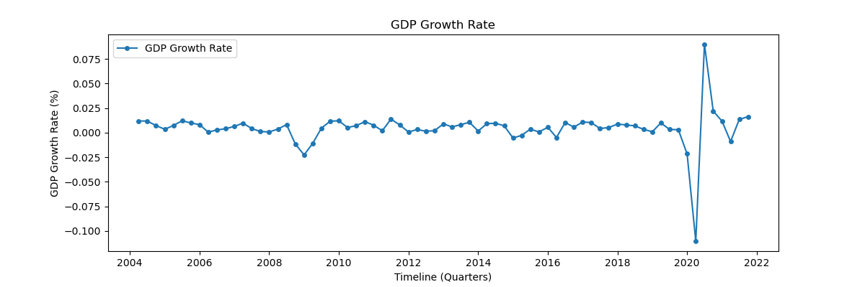
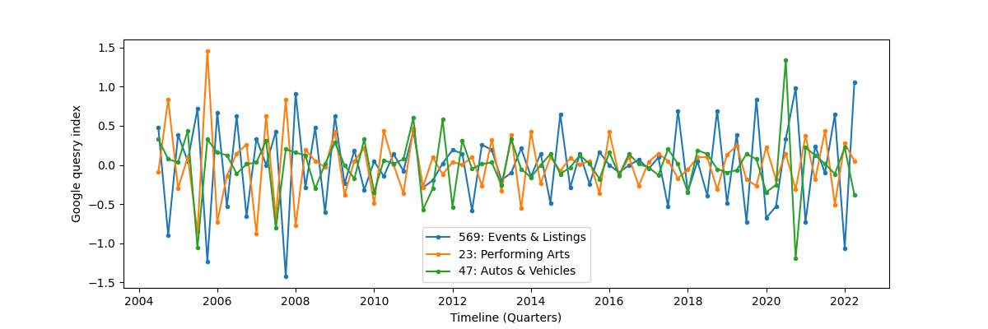
Stationary time series (GDP Growth rate)
Stationary Google Trends time series

Slide 18

ECONOMETRIC MODELS
Dynamic Factor Model (DFM)
Best suited model for time series when predictors are more than samples
Reduces dimensionality of time series data
Resultant factors work as efficient predictors for ARIMA model
Image: https://economictimes.indiatimes.com/markets/stocks/news/share-market-update-infra-stocks-slide-indigo-slips-6nbspnbspbr/articleshow/74607083.cms?from=mdr

Slide 19


Autoregressive Integrated Moving Average (ARIMA)
Widely used model for time series data
Lag selection for AR and MA order by using PACF and ACF plots
Used factors of Google Trends data as predictors
Implemented one-step ahead rolling prediction
Image: https://www.bigstockphoto.com/image-328633948/stock-photo-conceptual-temporal-realm

Slide 20
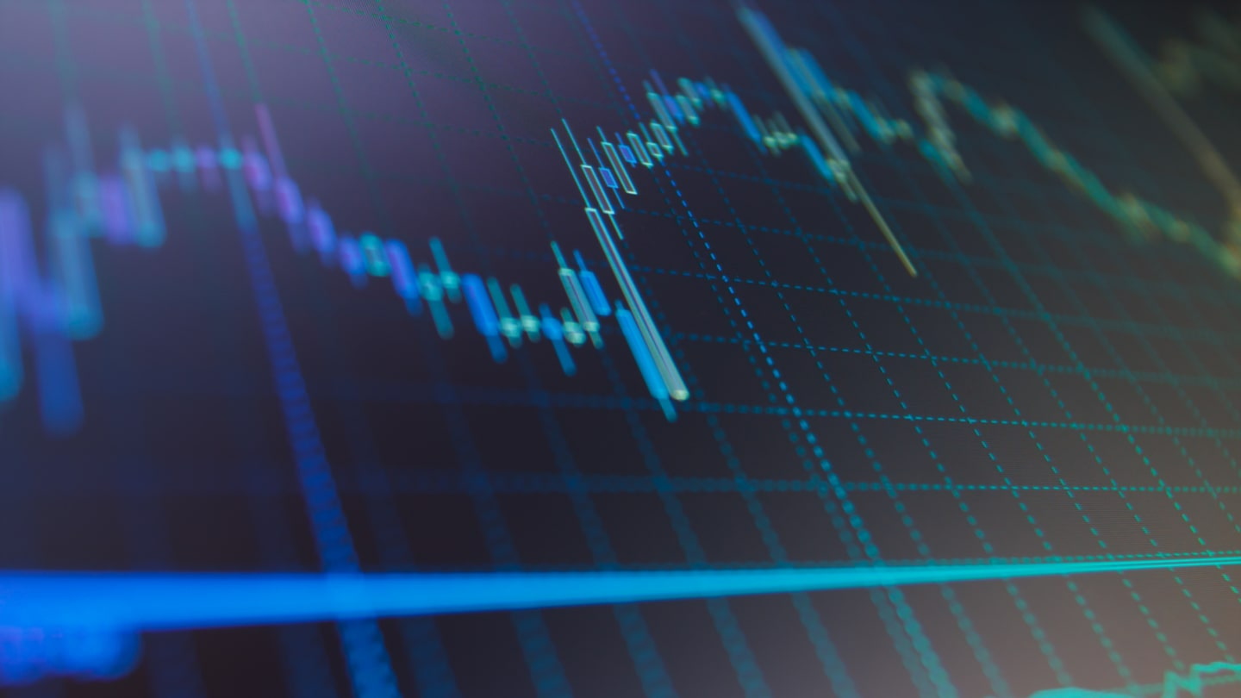
MACHINE LEARNING MODELS
LASSO
Fitted model on growth rate for three economic indicators
Rolling predictions to predict growth rate
Calculated original values by using predicted growth rate
Used cross validation to tune parameter
Image: https://admiralmarkets.com/education/articles/forex-basics/forex-predictions-how-to-predict-the-forex-market

Slide 21

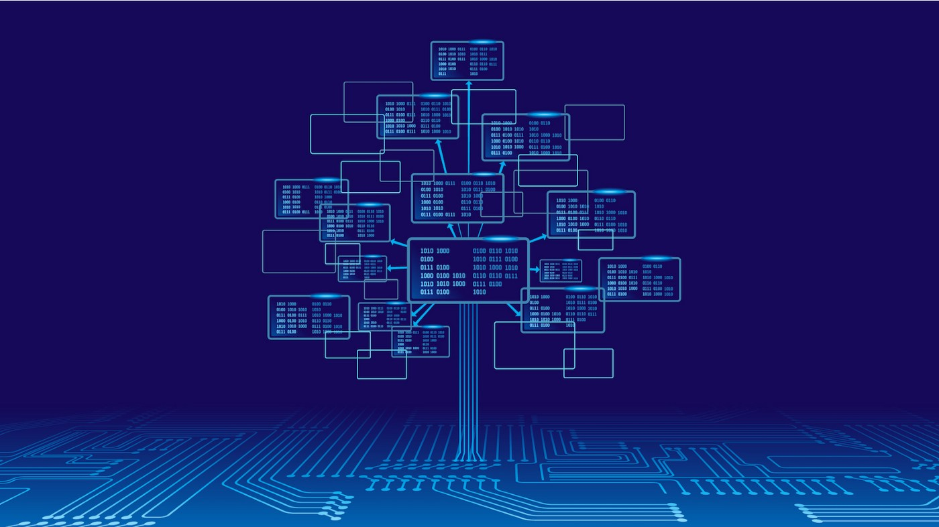
Random Forest
Applied PCA on Google Trends data to get components
Fitted model on components to predict growth rate
Calculated original values using predicted growth rate
Cross validation to get appropriate number of trees
Image: https://medium.com/analytics-vidhya/random-forest-simplified-98da251c7522

Slide 22
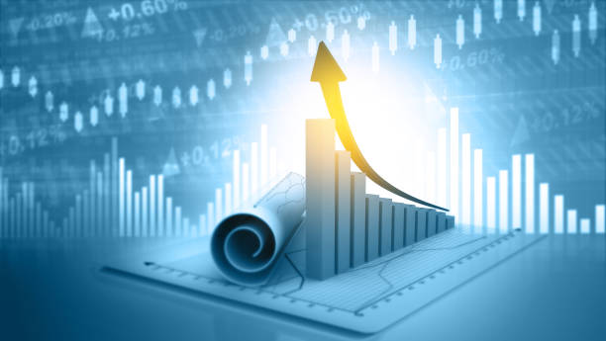

XG Boost
Applied PCA on Google Trends to get components
Fitted model on components to predict growth rate for three economic indicators
Calculated original values by using predicted growth rate
Cross validation to tune number of trees and penalty parameter (in progress)
Image : https://www.istockphoto.com/photos/gross-domestic-product

Slide 23
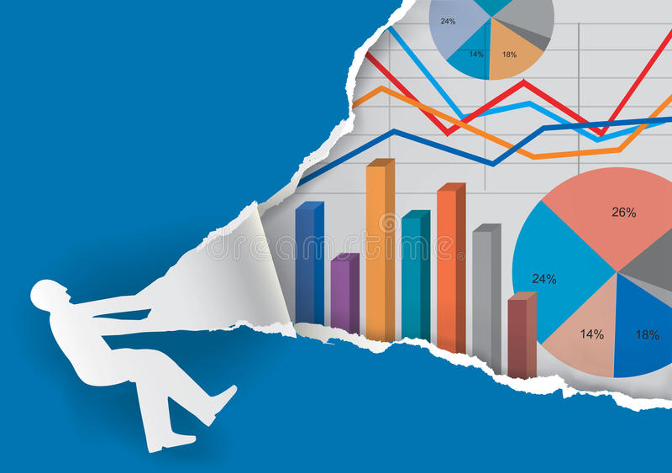
OBTAINED RESULTS
Image : https://www.dreamstime.com/stock-illustration-annual-report-torn-paper-background-man-silhouette-ripping-charts-numbers-presenting-economic-results-vector-available-image83554513

Slide 24
Retail Trade Sales
Response: Monthly retail trade sales growth rate
Predictors: Categories & Keywords
Method | Prediction Error (RMSE) | Parameter Tuning
DFM + ARIMA | 2,828,358 | Number of factors
LASSO | 2,379,342 | Penalty parameter
PCA + Random Forest | 2,281,435 | Number of trees
PCA + XGBoost | 3,410,734 | In progress
24

Slide 25
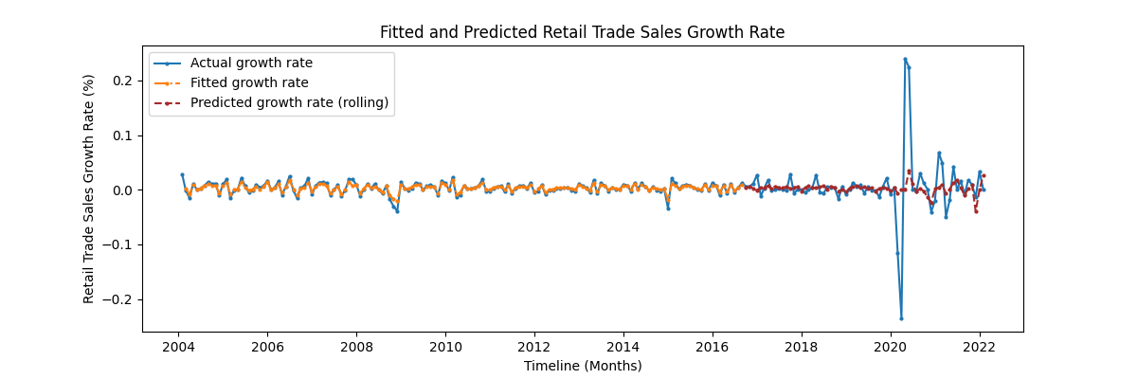
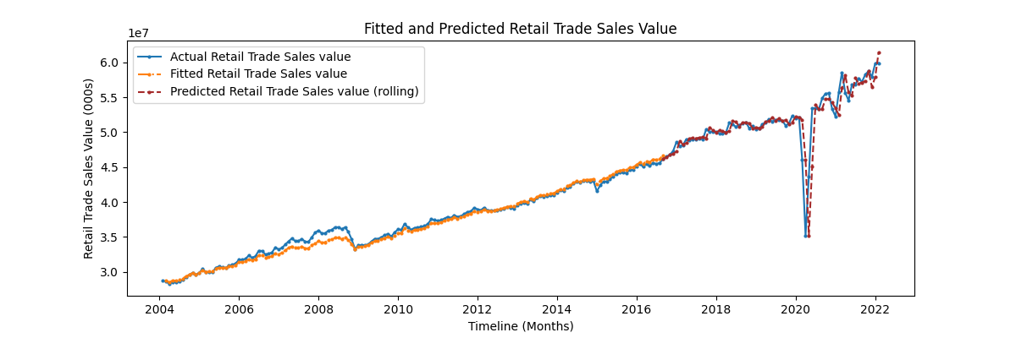
Retail Trade Sales
Growth Rate
Prediction
Retail Trade Sales Value Prediction

Slide 26
E-Commerce Retail Trade Sales
Response: Monthly e-commerce retail trade sales growth rate
Predictors: Category & Keywords
Method | Prediction Error (RMSE) | Parameter Tuning
ARIMA | 390,077 | --
LASSO | 246,766 | Penalty parameter
Random Forest | 260,128 | Number of trees
XGBoost | 212,289 | In progress
26

Slide 27
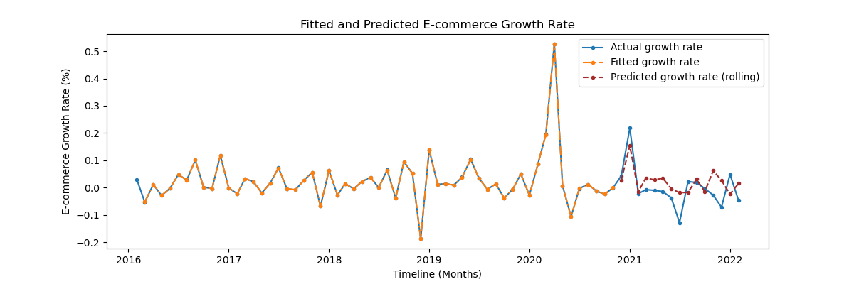
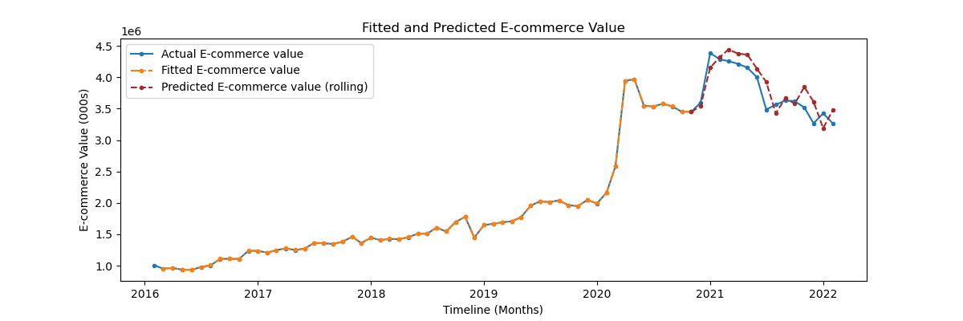
E-commerce
Growth Rate
Prediction
E-commerce Value Prediction

Slide 28
Gross Domestic Product (GDP)
Response: Quarterly GDP growth rate
Predictors: Categories & Keywords
Method | Prediction Error (RMSE) | Parameter Tuning
DFM + ARIMA | 65,511 | Number of factors
LASSO | 84,146 | Penalty parameter
PCA + Random Forest | 78,651 | Number of trees
PCA + XGBoost | 83,641 | In progress
28

Slide 29
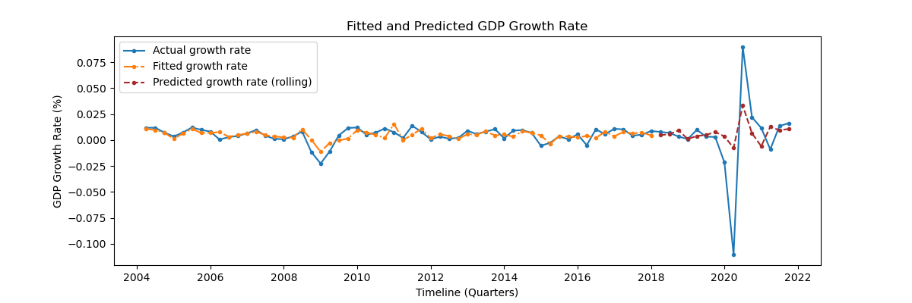
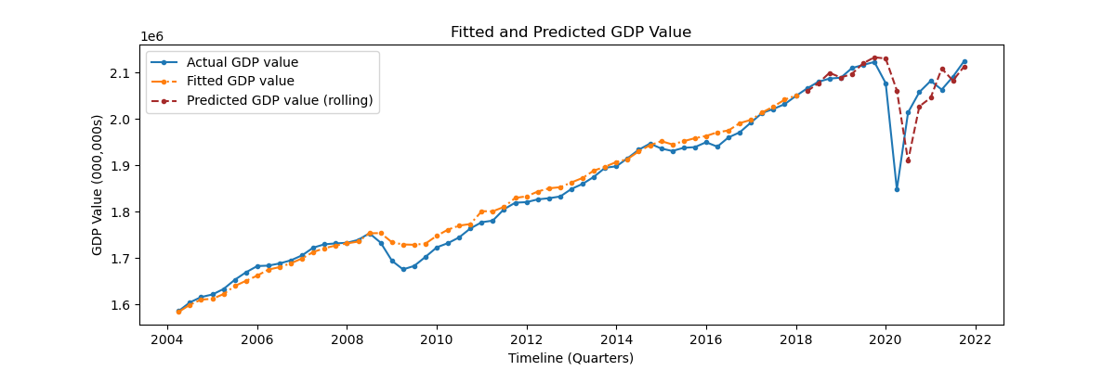
GDP
Growth Rate
Prediction
GDP Value
Prediction

Slide 30
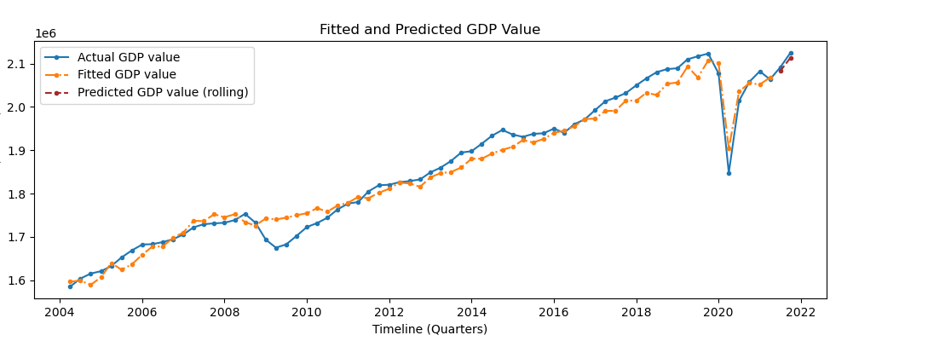
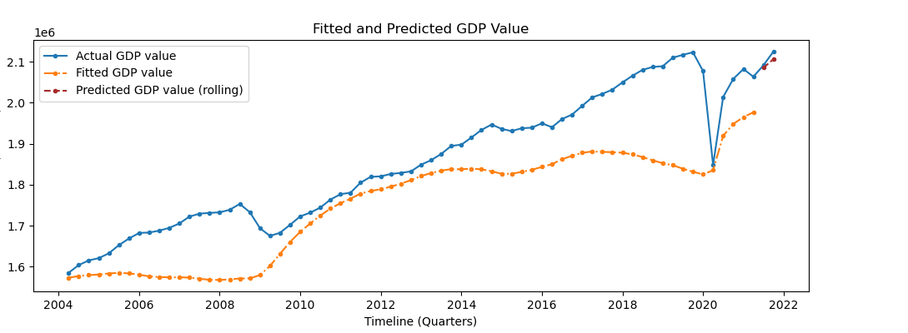
Does Google Trends really help?
Model fit using Google Trends
Model fit without using Google Trends
30

Slide 31
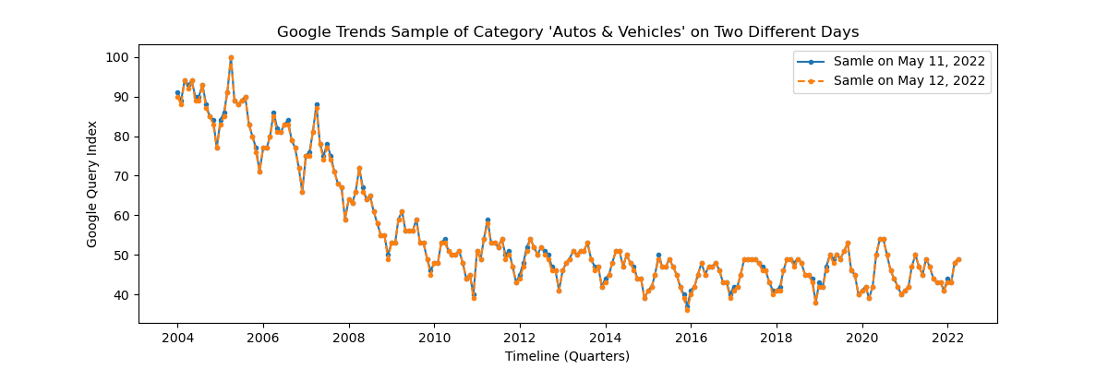
Roadblock
API Calls on different days to extract trends data
Issue: Many API calls, Require time
Solution: Move forward with one sample

Slide 32
Learnings
Use of Google Trends/pytrends for nowcasting
DFM for dimensionality reduction of time
series data
Machine learning models for time series analysis
Image : https://www.istockphoto.com/photos/gross-domestic-product

Slide 33
Future Plan
Cross Validation of XGBoost
Bootstrap to get prediction interval
Visualizations and dashboard
A detailed report
Image: https://www.bigstockphoto.com/image-328633948/stock-photo-conceptual-temporal-realm

Slide 34
References
H. Choi, H. Varian, Predicting the present with Google Trends, Economic record, 88 (2012), 2-9.
Stock, J.H. and Watson, M.W., 2016. Dynamic factor models, factor-augmented vector autoregressions, and structural vector autoregressions in macroeconomics. In Handbook of macroeconomics (Vol. 2, pp. 415-525). Elsevier.
Woloszko, N. (2020). Tracking activity in real time with Google Trends, OECD Economics Department Working Papers, No. 1634, OECD Publishing, Paris.
Dauphin, M.J.F., Dybczak, M.K., Maneely, M., Sanjani, M.T., Suphaphiphat, M.N., Wang, Y. and Zhang, H., 2022. Nowcasting GDP-A Scalable Approach Using DFM, Machine Learning and Novel Data, Applied to European Economies. International Monetary Fund.
Richardson, A., van Florenstein Mulder, T. and Vehbi, T., 2021. Nowcasting GDP using machine-learning algorithms: A real-time assessment. International Journal of Forecasting, 37(2), pp.941-948.
Logo source: UBC Logo, Statistics Canada, Google Trends

Slide 35

THANK YOU !!
QUESTIONS

