Slide 1


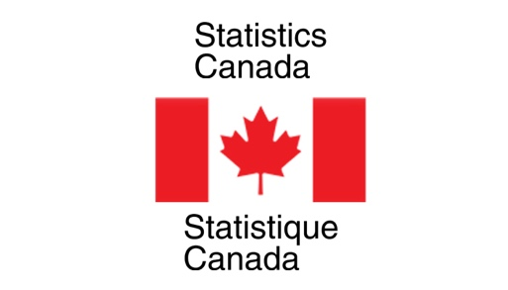

Nowcasting Macroeconomic Indicators using Google Trends
Presented By:
Aishwarya Sharma
Harpreet Kaur
Jagdeep Brar

Slide 2
Background:
Main aim is to nowcast macroeconomic factors ( GDP, Retail Trade Sales and E- Commerce) using Google Trends Data
Using Pytrends package of python for fetching Google trends data
Need to present dashboard, report and presentation at the end.

Slide 3


Overall Progress
Data Cleaning and Wrangling done
Time series for all the three factors made stationary
Econometric Model fitting ( DFM, ARMA Model)
Machine Learning Model fitting ( LASSO, Random Forest,
Boosting)
Model Finalized for all the three indicators
Created Dashboard

Slide 4
previous week progress
Scheduled Task for Last week : Bootstrap and Dashboard creation.
Work Progress:
Created script files for whole code
Finalized the rough sketch for dashboard
Created dashboard and deployed it on heroku

Slide 5
results
Dashboard created and deployed on heroku
Link for dashboard:
https://nowcasting-indicators-canada.herokuapp.com/

Slide 6
Roadblocks:
Calling Google Trends API multiple times blocks
Solution as discussed with Partners : To use only single sample rather than working with multiple

Slide 7
Next week plan
Dashboard demo to the partners
Create final report and presentation
Prepare for presentation
Enjoy completion of MDS degree 😀

Slide 8
Are we on track? Meeting with the partners:
On Track as mentioned in the proposal document
Scheduled weekly meetings on Thursday
Partners are satisfied with what we have done so far
Clear all the doubts as soon as we ask them over MS teams/ mails

Slide 9
Individual and team efforts
Work assigned equally
Divided segment of the dashboard.
Timings for work: Monday to Friday, 9:30 AM – 5: 30 PM

Slide 10
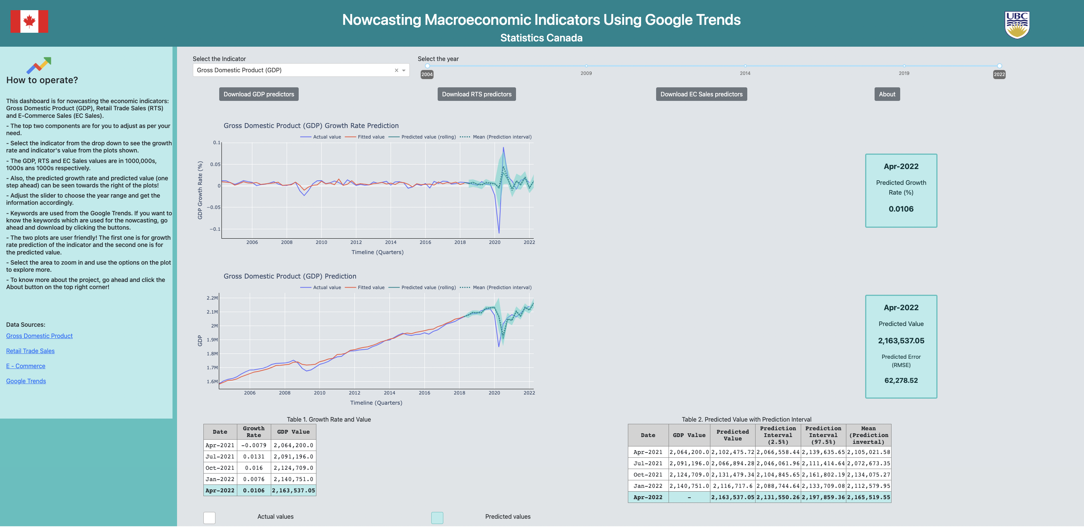
Dashboard demo
The demo for our dashboard over deployed application

