Slide 1


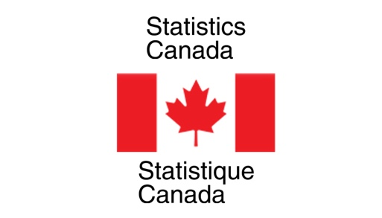

Nowcasting Macroeconomic Indicators using Google Trends
Presented By:
Aishwarya Sharma
Harpreet Kaur
Jagdeep Brar

Slide 2
Background:
Main aim is to nowcast macroeconomic factors ( GDP, Retail Trade Sales and E- Commerce) using Google Trends Data
Using Pytrends package of python for fetching Google trends data
Need to present dashboard, report and presentation at the end.

Slide 3

Overall Progress
Data Cleaning and Wrangling
Time series for all the three factors made stationary
Econometric Model fitting ( DFM, ARMA Model)

Slide 4
previous week progress
Scheduled Task for Last week : Making Data stationary and fitting econometric models
Work Progress:
Time Series for all three factors are made stationary
Did rolling predictions to the time series data
Splitted data into training and testing sets
Fitted DFM models and ARMA model
Added Diagnostic plots to check accuracy

Slide 5
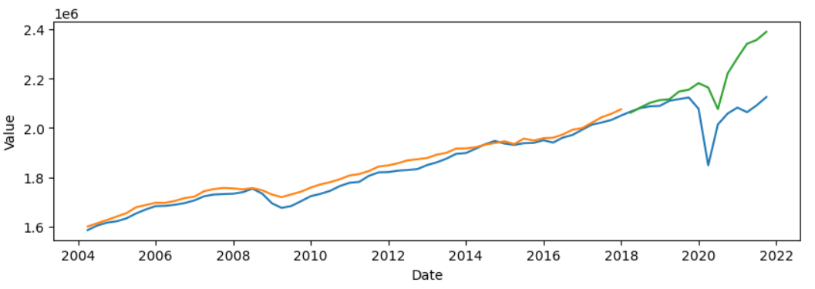
results
Did predictions using testing and training data sets
Predictions are overfitted and will have to improve it further

Slide 6
Roadblocks:
Calling Google Trends API multiple times blocks
Solution as discussed with Partners : To use only single sample rather than working with multiple

Slide 7
Next week plan
Implement machine Learning Models
Comparative study/ analysis for all the applied models
Finalize accurate predictions with appropriate chosen model

Slide 8
Are we on track? Meeting with the partners:
On Track as mentioned in the proposal document
Scheduled weekly meetings on Thursday
Partners are satisfied with what we have done so far
Clear all the doubts as soon as we ask them over MS teams/ mails

Slide 9
Individual and team efforts
Work assigned equally
Three macroeconomic factors divided among three contributors
Aishwarya Sharma Retail Trade Sales
Harpreet Kaur E- Commerce
Jagdeep Brar GDP
All three factors have different data sets, keywords (Queries and Topics), categories and need different efforts but with similar goal.
Timings for work: Monday to Friday, 9:30 AM – 5: 30 PM

Slide 10

Brief explanation via code
Brief Overview about the code we are doing is explained using jupyter notebook
Link for image: https://technology.amis.nl/data-analytics/quickest-way-to-try-out-jupyter-notebook-zero-install-3-cli-commands-and-5-minutes-to-action/

