Slide 1


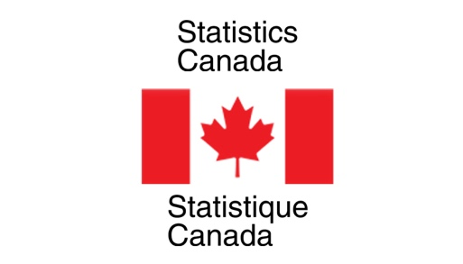

Nowcasting Macroeconomic Indicators using Google Trends
Presented By:
Aishwarya Sharma
Harpreet Kaur
Jagdeep Brar

Slide 2
Background:
Main aim is to nowcast macroeconomic factors ( GDP, Retail Trade Sales and E- Commerce) using Google Trends Data
Using Pytrends package of python for fetching Google trends data
Need to present dashboard, report and presentation at the end.

Slide 3


Overall Progress
Data Cleaning and Wrangling done
Time series for all the three factors made stationary
Econometric Model fitting ( DFM, ARMA Model)
Machine Learning Model fitting ( LASSO, Random Forest,
Boosting)
Model Finalized for all the three indicators
Nowcasting for the indicators and bootstrap

Slide 4
previous week progress
Scheduled Task for Last week : Finalizing the model and applying bootstrap to that. Nowcast the indicators.
Work Progress:
Fitted machine learning models
Used cross validation for tunning the parameters
Finalized the models with approval from the partners
Nowcasted the indicators
Applied bootstrap to the models

Slide 5
results
Finalized the models for all the three indicators
Nowcasted the data and have done bootstrap on them.
Macroeconomic Indicators | Selected Model
GDP | ARIMA
Retail Trade Sales | Random Forest
E- Commerce | XG Boost

Slide 6
Roadblocks:
Calling Google Trends API multiple times blocks
Solution as discussed with Partners : To use only single sample rather than working with multiple

Slide 7
Next week plan
Share the sketch for the dashboard with the partners and get it approved
Create the dashboard
Modify the selected model code and try to improve its efficiency, if time permits

Slide 8
Are we on track? Meeting with the partners:
On Track as mentioned in the proposal document
Scheduled weekly meetings on Thursday
Partners are satisfied with what we have done so far
Clear all the doubts as soon as we ask them over MS teams/ mails

Slide 9
Individual and team efforts
Work assigned equally
Three macroeconomic factors divided among three contributors
Aishwarya Sharma Retail Trade Sales
Harpreet Kaur E- Commerce
Jagdeep Brar GDP
All three factors have different data sets, keywords (Queries and Topics), categories and need different efforts but with similar goal.
Timings for work: Monday to Friday, 9:30 AM – 5: 30 PM

Slide 10

Brief explanation via code
Brief Overview about the code we are doing is explained using jupyter notebook
Link for image: https://technology.amis.nl/data-analytics/quickest-way-to-try-out-jupyter-notebook-zero-install-3-cli-commands-and-5-minutes-to-action/

