Slide 1



FLIGHT DASH
Jagdish Khandelwal

Slide 2

Contents
Outline
01
Game Introduction
03
Github Code Link
02
Goal of the Game
04
Snap Shots of Game

Slide 3
Intro
Introduction
This game is named “Flight Dash”
The player have to dodge obstacles using key bind
if a player falls or fails to dodge obstacles then the game is over
The game is Endless

Slide 4
Goal of the game
Dodge the obstacles
Make sure not to fall
Dodge the obstacles
Make sure not to fall

Slide 5
Github Code link
https://github.com/Jagdish918/GreenFootGame_FlightDash

Slide 6
Keys and Instructions
Space bar - To jump , Dodge
Enter - To try again

Slide 7
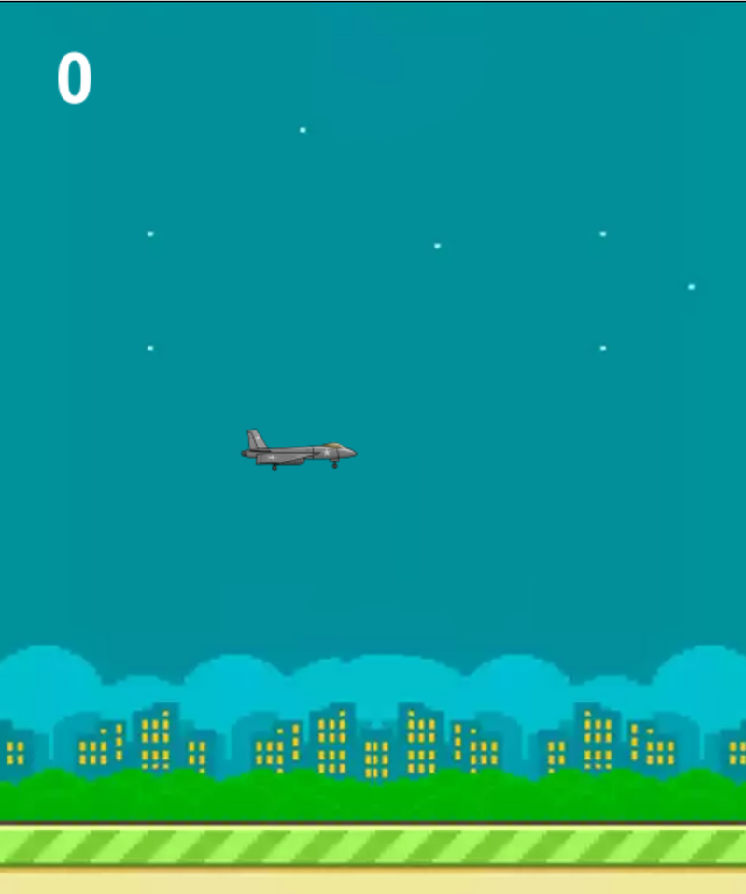
Snapshots

Slide 8
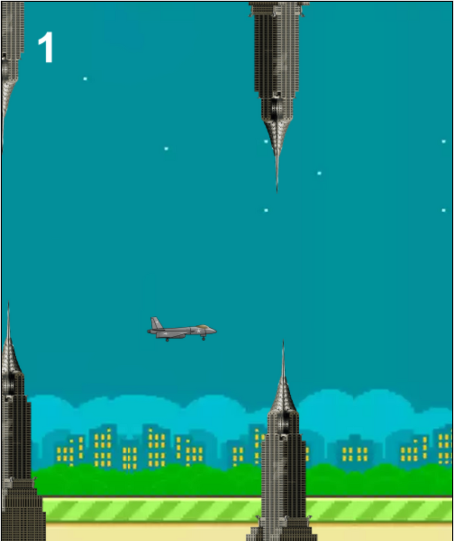
Snapshots

Slide 9
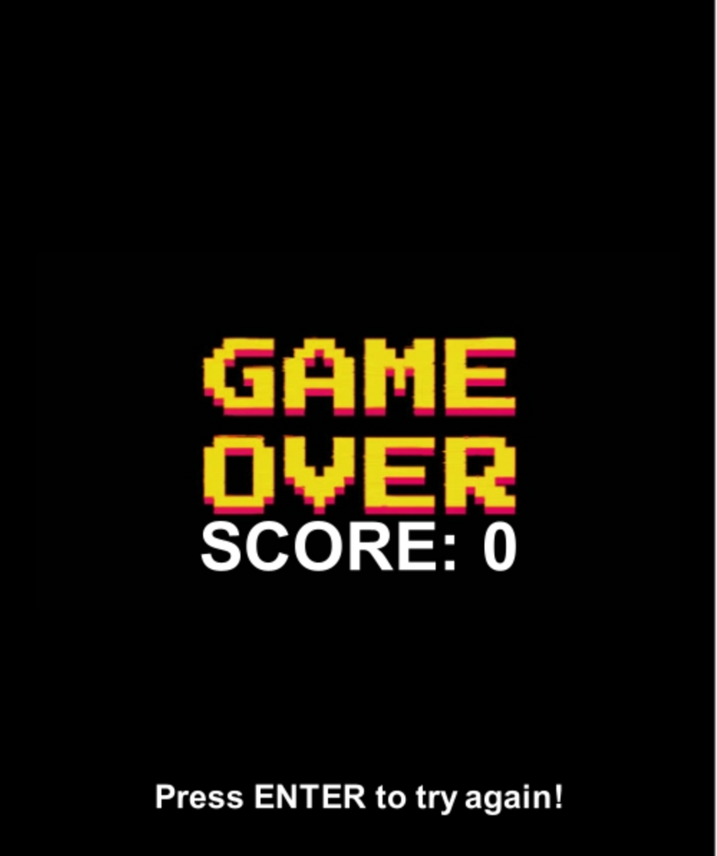
Snapshots

Slide 10
THANK YOU

