Slide 1
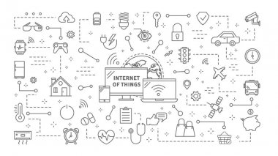
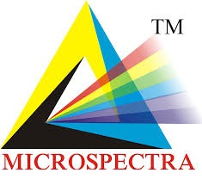
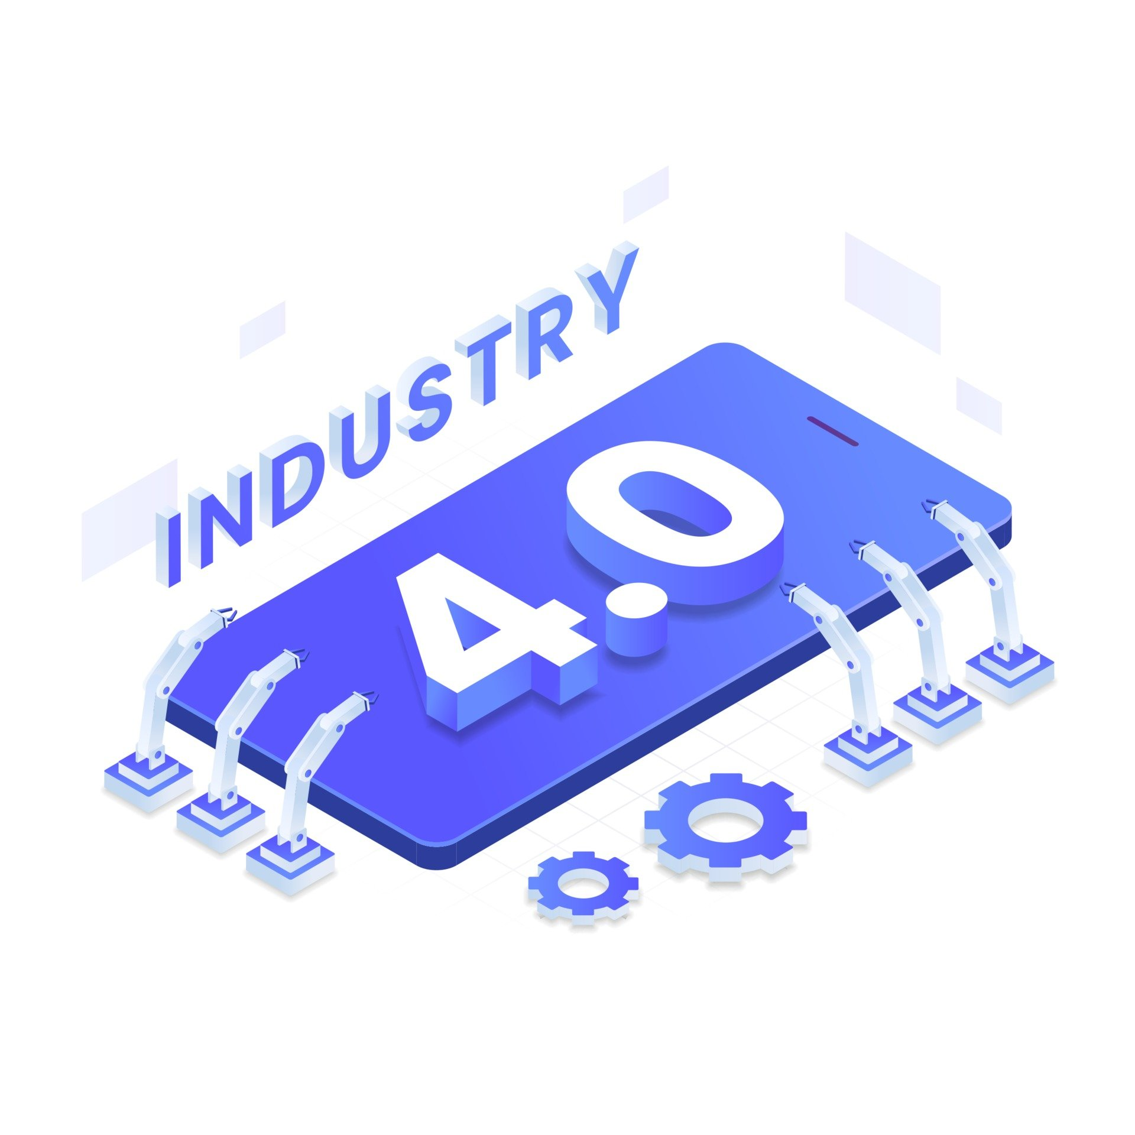
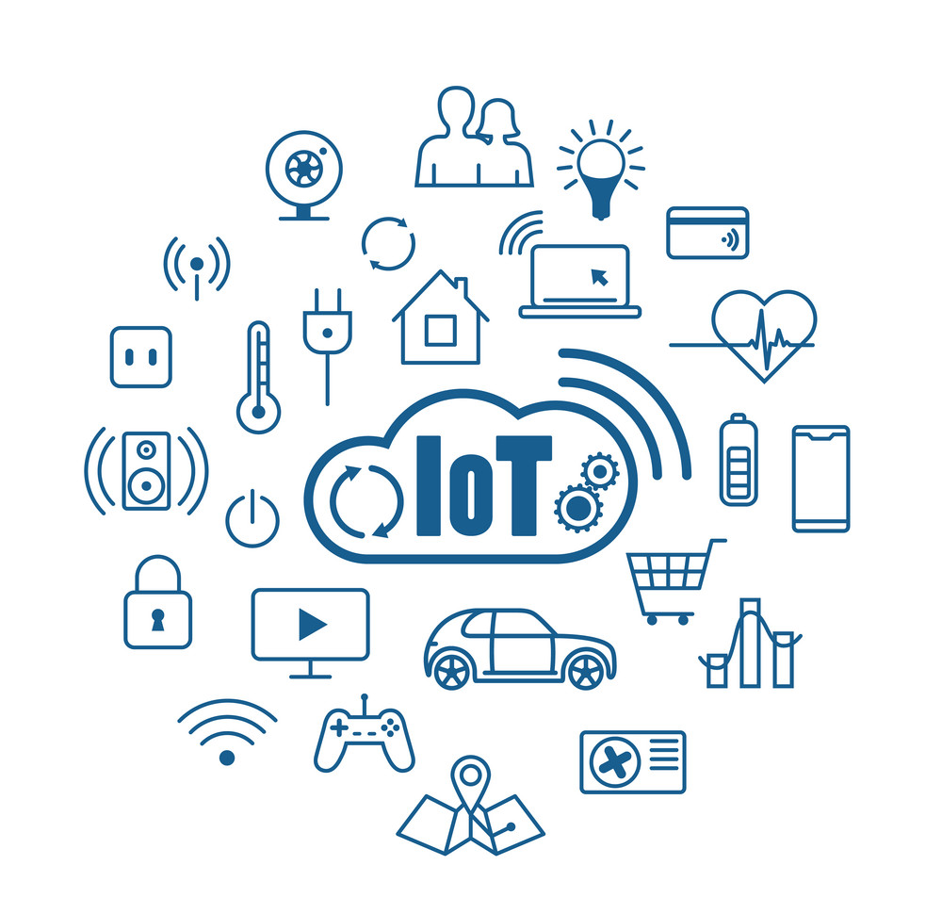
MICROSPECTRA SOFTWARE TECHNOLOGIES Pvt.Ltd
Workshop On
INTERNET OF THINGS(IoT)
&
INDUSTRIAL INTERNET OF THINGS

Slide 2
About us
Microspectra Software Technologies is a Software development company Private Company incorporated on 26 August 2015.
Well known for Software Solutions to Customized Software Applications such as ERP, CRM, Web Development, Mobile APP Development, IoT Solution, Data Science, Artificial Inteligence, Machine Learning, Deep Learning.
Microspectra is providing successful solutions to the clients and we are proud to say that our solutions are successfully installed to our direct or indirect clients. First To Start IT Hub in Vidharbha Region.
We are technically well versed with Industry Requirements and do proper analysis for the successful and reliable solutions for Clients. Microspectra aim is “Delivered quality solutions and customer satisfaction". We have happy and satisfied clients spread all over the world.

Slide 3
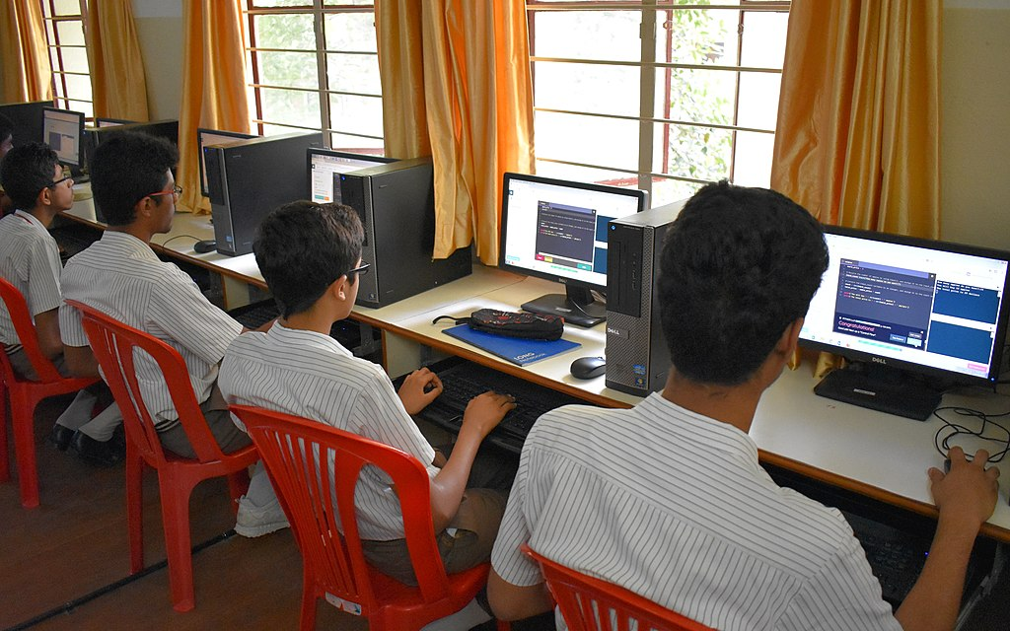
About us
Pioner of Industry Graded Quality Technical Eduaction for betterment and Development of Students via Microspectra IT Academy.
Intrnational Certification
Cloud Certifications Azure, AWS, Google
Web Development Certifications
Mobile App development Certifications
Programming Language Certifications
Part Time/Full Time Internships
Research level Internship
Degree Level Internship
Diploma Level Internship
Jobs
Workshops and Seminars

Slide 4
WHAT IS
INTERNET OF THINGS ?
To Understand IoT lets dive into History of Industrial Revolution

Slide 5
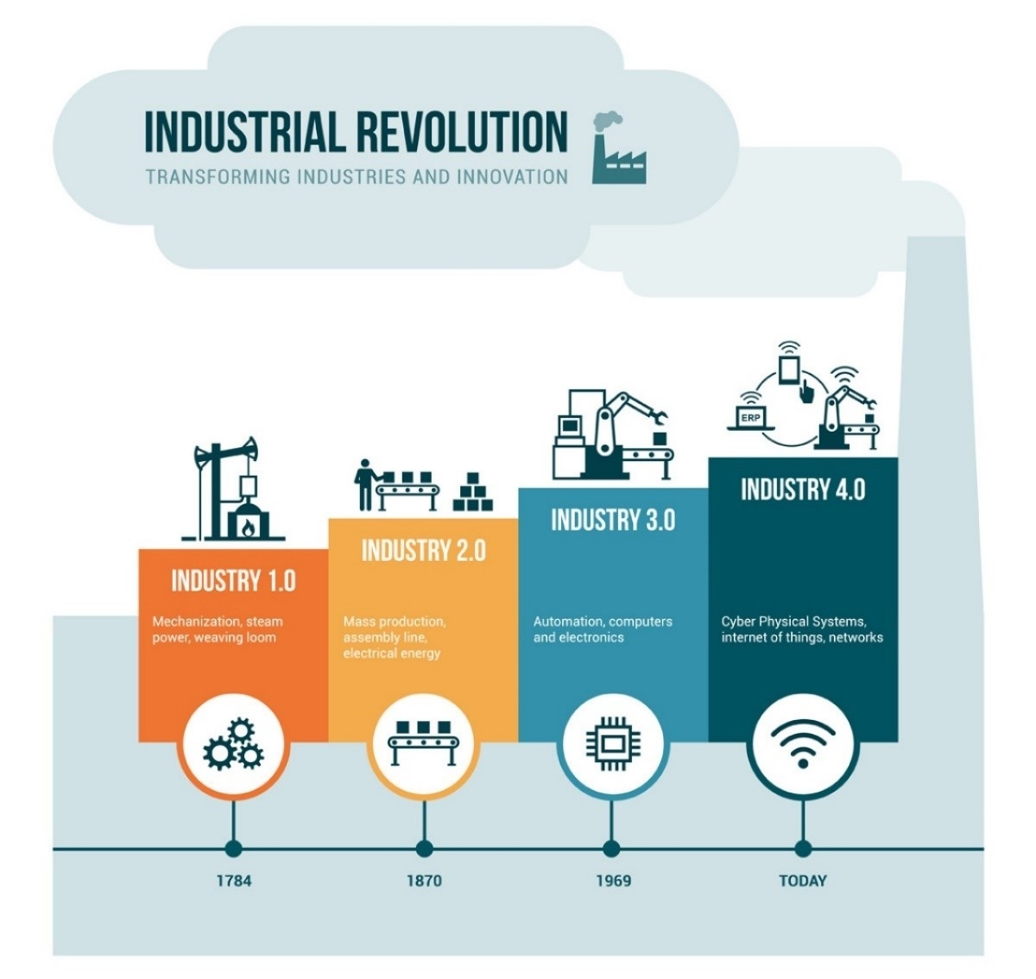

Slide 6
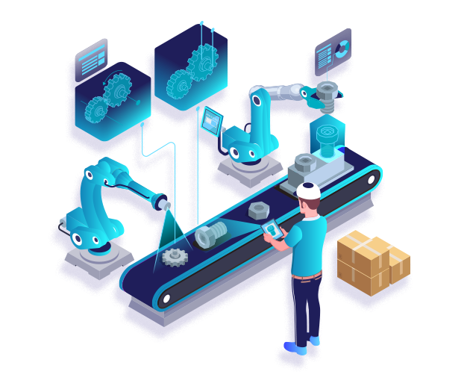

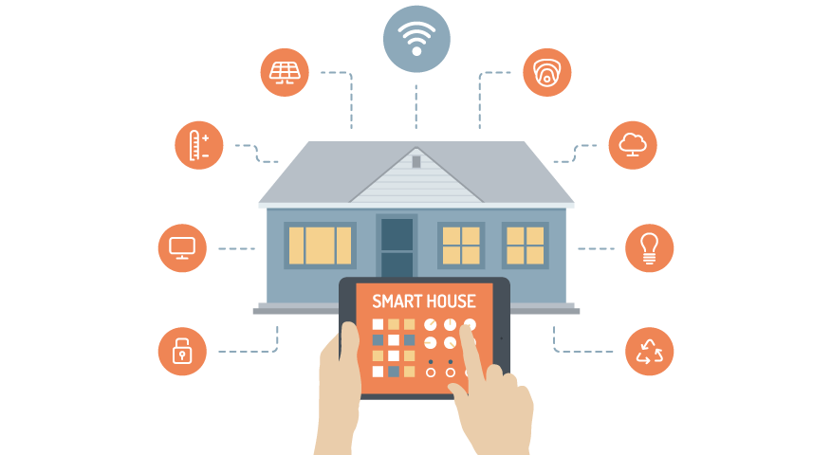
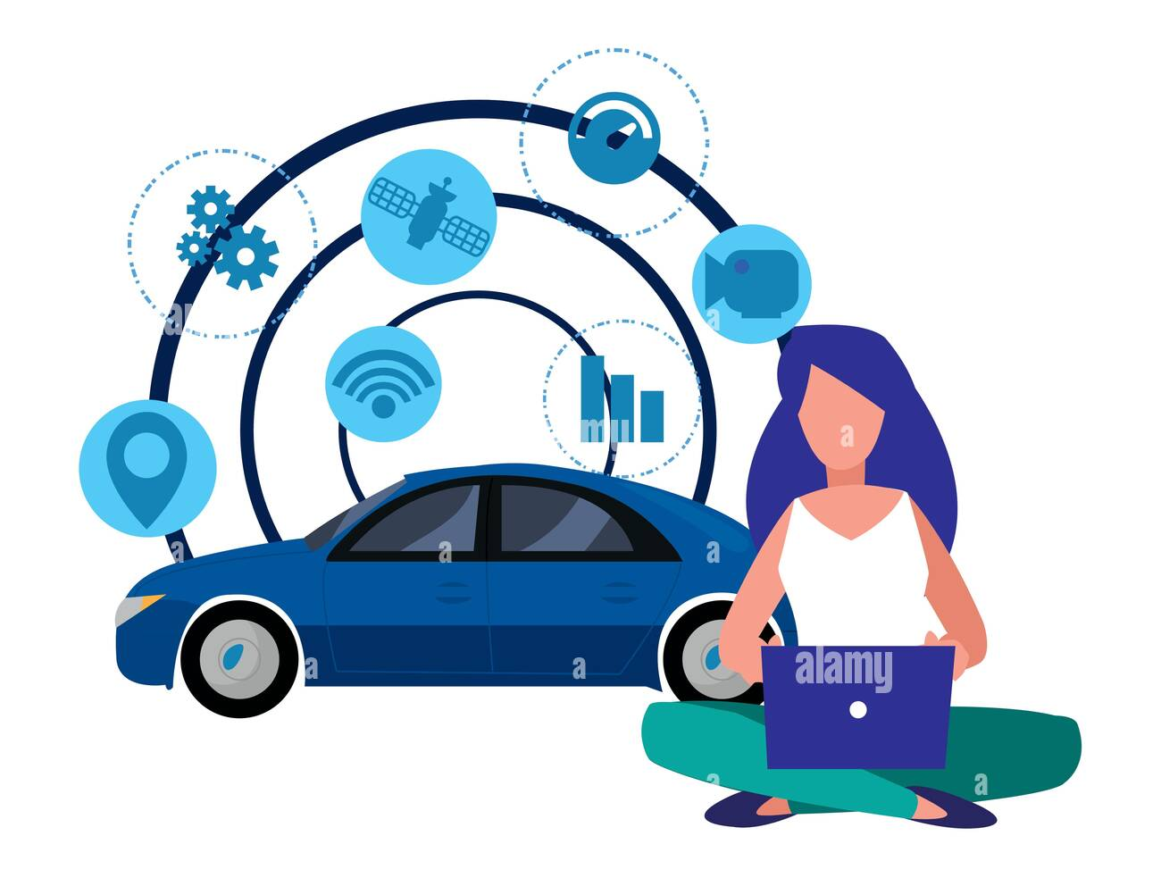
Ubiquitous Information is available
Our life are deeply affected by many new Technologies which have reached sufficient level of SMARTNESS.
Information is available “Anywhere, Anytime, any Content for any USER using any DEVICE ”
Industry 4.0 is SMART DEVICE, Turning Into SMART PRODUCT, turning into SMART FACTORY.

Slide 7
Benifites OF INDUSTRY 4.0
Help to Keep Production In INDIA.
Help INDIAN companies to Compete in International Market.
Bring Leadership on World Market.
Contenious need of Skilled Engineers/Developers and Generate Employment.
Speed up the production setup Process.
A Knowledge based high tech approach.

Slide 8
The Ultimate Goal of Industry 4.0 is to establish a system with Adapbality, Resource Efficiency and Ergonomics, as well as integration in Day-to-day life.
Based on
INTERNET OF THINGS

Slide 9
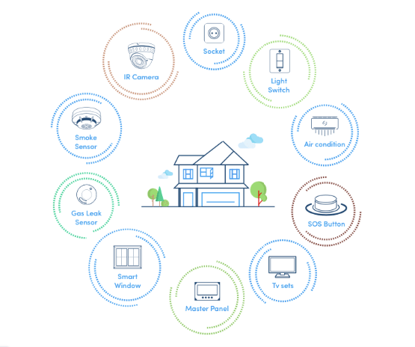
Defination of IoT
the Internet of Things (IoT) is how we describe the digitally connected universe of everyday physical devices. These devices are embedded with internet connectivity, sensors and other hardware that allow communication and control via the web, increasing quality and experience.
Devices gather and share data about how they are used and environment in which they operate.

Slide 10
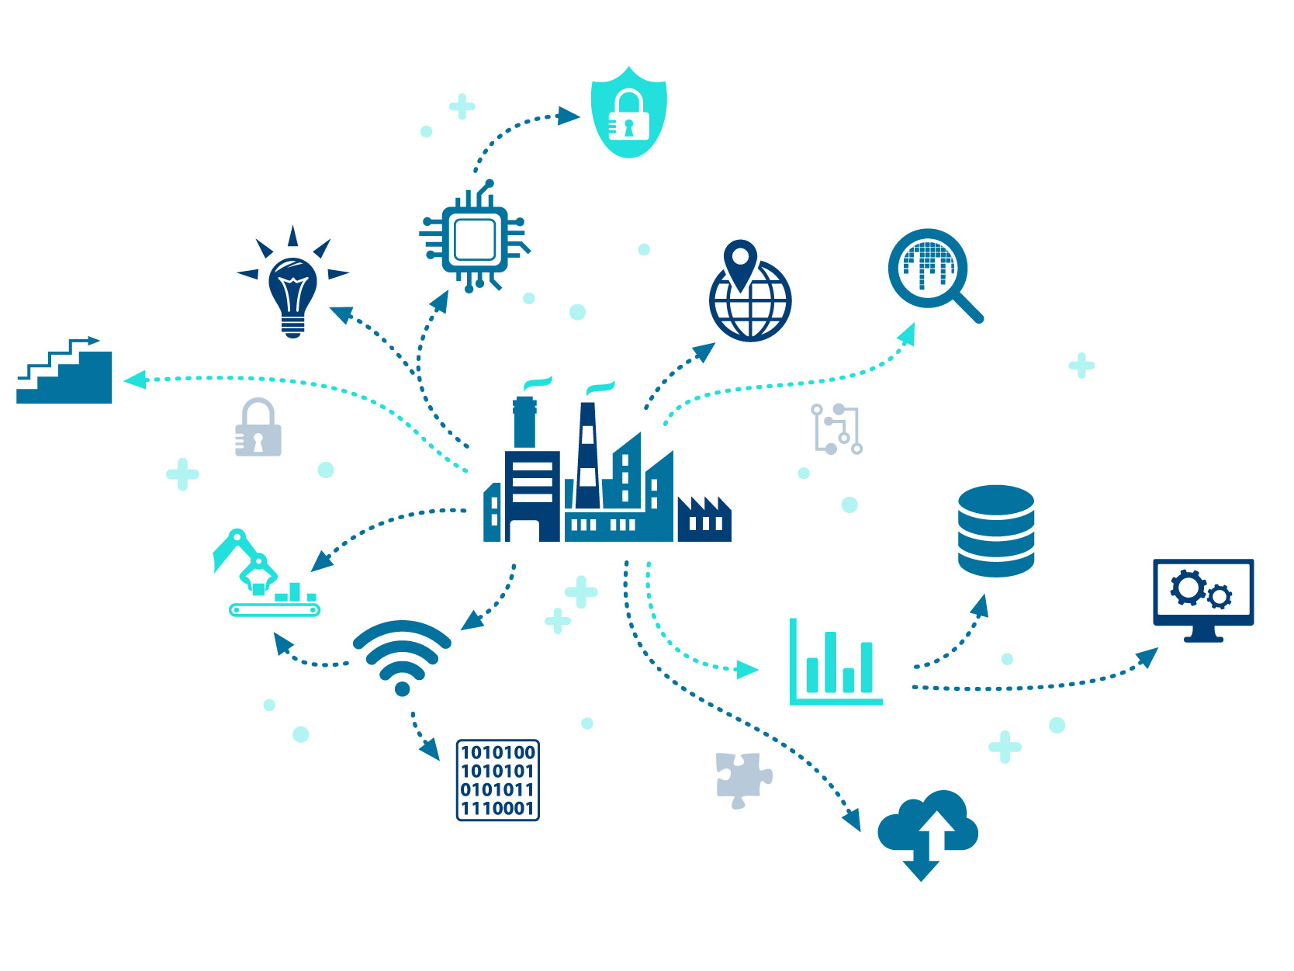
Defination of IIoT
The industrial internet of things (IIoT) refers to interconnected sensors, instruments, and other devices networked together with computers' industrial applications, including manufacturing and energy management. This connectivity allows for data collection, exchange, and analysis, potentially facilitating improvements in productivity and efficiency as well as other economic benefits

Slide 11
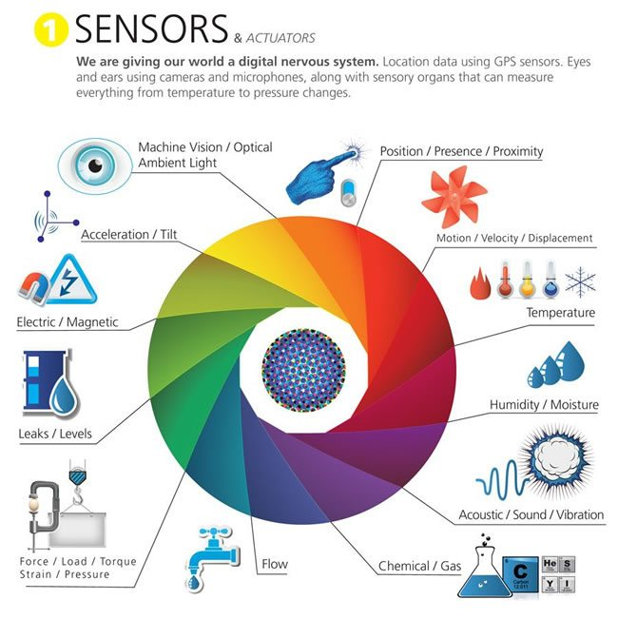
How Does IoT Work ?
Consider a small example of watching video, which ever device you use is connected to internet and that means you are already using IoT device.
Sensors are becomming end point of IoT network.
What exactly is a sensor ?
Sensors are devices collecting and increasing amount of context-aware data such as location, images, weather conditions and inject them into the networks, actuators and application in real-time.

Slide 12
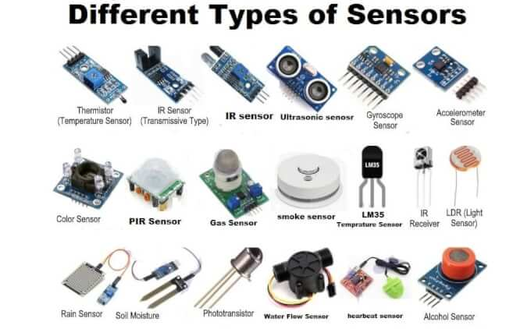

Slide 13
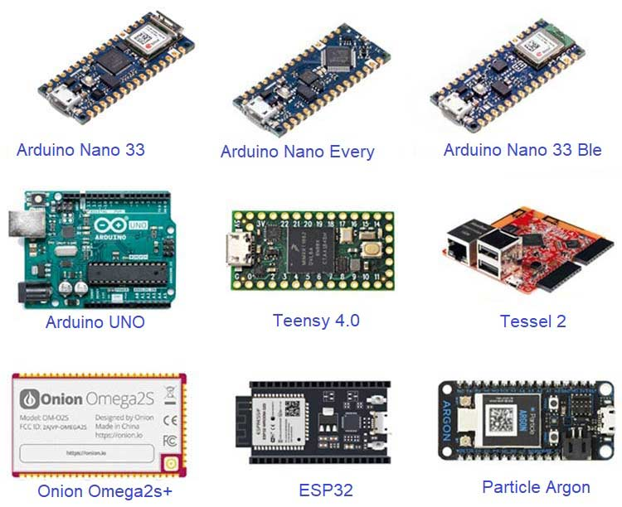
What is a Development Board?
A development board is a printed circuit that contains a microcontroller or a microprocessor with a hardware to assist your experimentation. It can contain a variety of peripherals, from sensors to a power source.
This board will abstract and implement some features that makes you only focus on the programming and application side, not on the hardware itself. It is a great help for the development phase of a product, specially if you want to discover the capabilities or want to learn about a technology.
Features you have to consider:
Sensors: some development boards come with sensors embedded, already connected to the main controller. This can save you some time trying to figure out all the necessary connections.
Connectivity: which are the options that you have to connect with world, such as WiFi, Cellular, Ethernet, etc.
Interfaces: the protocols or pins you have to connect with other components and hardware, like I2C, GPIO, SPI, etc.
Software: the options you have to develop your program, like OS, IDE, programming languages, etc.
Controller: what are the capabilities of the main processor, such as memory, storage, speed, etc.

Slide 14
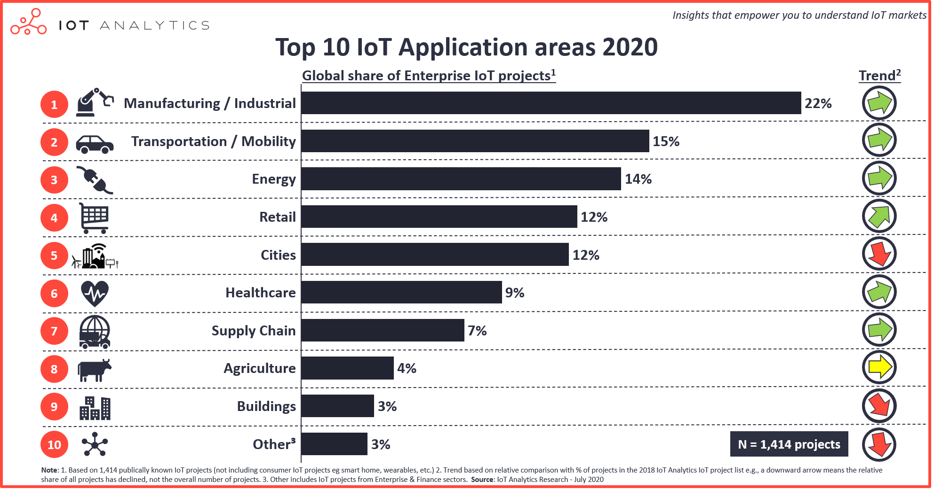

Slide 15
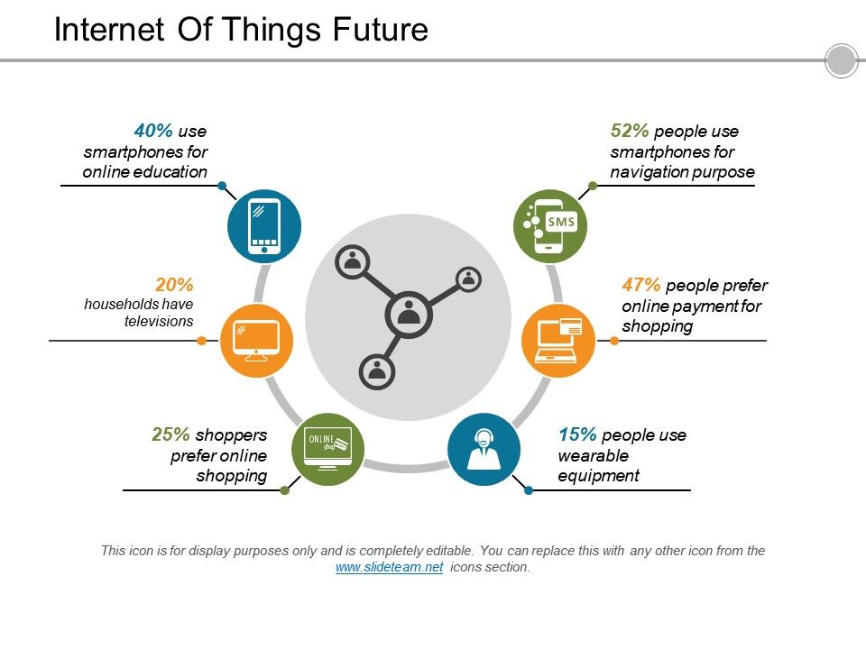
FUTURE OF IoT
By 2025, it is estimated that there will be more than to 21 billion IoT devices A quick look back shows where IoT devices are going. Consider: In 2016, there were more than 4.7 billion things connected to the internet, according to IOT Analytics. Fast-forward to 2021? The market will increase to nearly 11.6 billion IoT devices.
More cities will become “smart” Consumers won’t be the only ones using IoT devices. Cities and companies will increasingly adopt smart technologies to save time and money.
94% of businesses will use IoT by the end of 202 According to a new report from Microsoft, almost all businesses will use some form of IoT by the end of next year. The core IoT industries such as manufacturing, retail, transportation, government and healthcare continue to introduce new IoT applications and solutions to their daily operations.

Slide 16
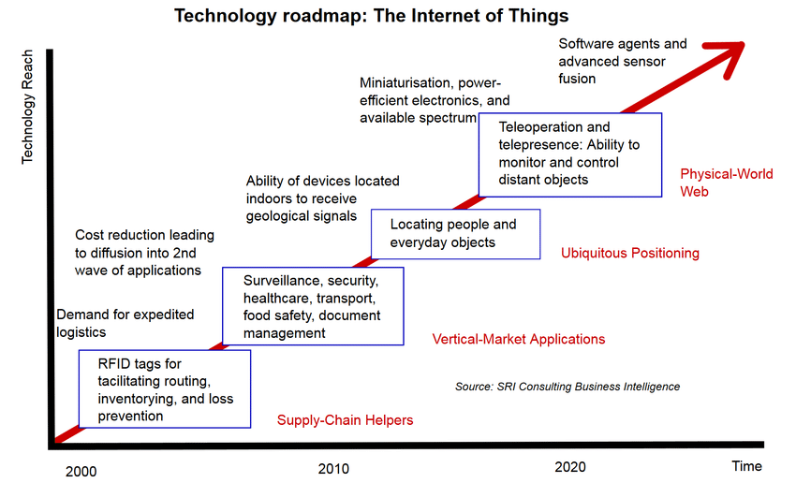

Slide 17

IoT Careers
Jobs and Salaries
With increase in number of connected devices IoT has ventured Successfully in different domains and seen rapid progression.
There have been exceptional effort by the government of INDIA and privateCorporations to establish a smart city
Resulting in demand of IoT professionals.

Slide 18
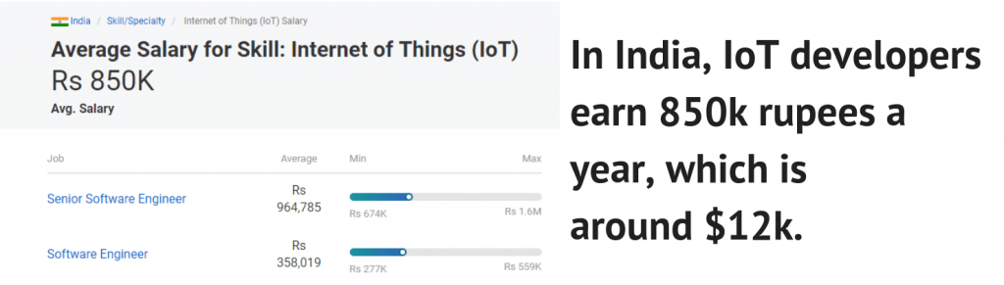
IoT Careers
Jobs and Salaries

Slide 19
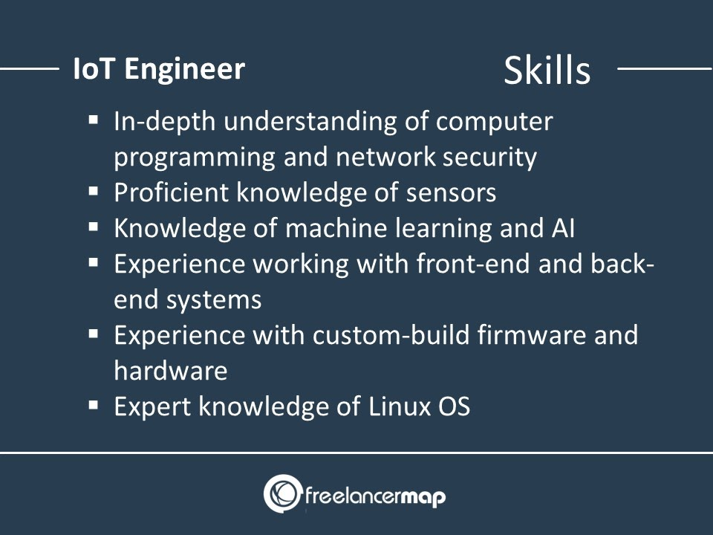

Slide 20
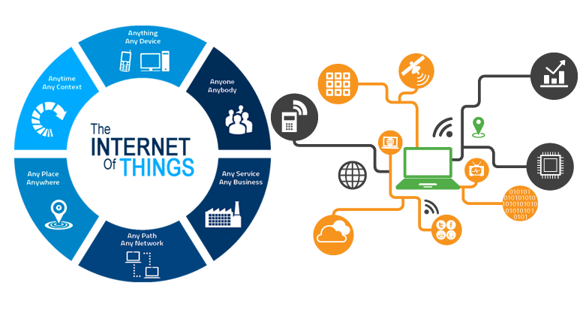
IOT Certification, Internship & Jobs
with Microspectra Software Technologies Pvt.Ltd
Industry Authorised Certification.
Letter of Internship Complition
One on One Interaction with Trainers
Capstone Projects
Full Time/Part Time Jobs opportunity
Work From Home flexibility

