Slide 1

MICROSPECTRA SOFTWARE TECHNOLOGIES PVT.LTD
INTODUCTION TO
DATA SCIENCE
Certification & Internship Program

Slide 2
INTRO TO DATA SCIENCE
WHAT IS DATA SCIENCE?
TURNING DATA INTO
INFORMATION
ANALYZING
DATA TO
GET INSIGHTS
IDENTIFYING
TRENDS, PATTERNS
& CORRELATIONS
CONTEXTUALIZING, APPLYING AND UNDERSTANDING THEM
MICROSPECTRA SOFTWARE TECHNOLOGIES PVT. LTD.

Slide 3

INTRO TO DATA SCIENCE
WHAT DOES A DATA SCIENTIST DO ?
Get and process data to convert it from its raw format to cleaner format.
Calculate and interpret statistical variable.
Create visualizations and draw conclusions for the analysis.
Suggest applications from the information and develop machine learning implementations.
www.microspectra.in

Slide 4
ESSENTIALS OF
DATA SCIENCE
International Certifications

Slide 5

ESSENTIALS OF DATA SCIENCE
STATISTICS
Understand the different type of Data you can encounter.
Understand key statistical term
Types of means
Fluctuations in Data
Splitting up, grouping, and segmenting data points
Internship Programs

Slide 6

ESSENTIALS OF DATA SCIENCE
DATA VISUALIZATION
Why data visualization is a key skill for data scientists
Graphs for showing and comparing different numbers of variables
One variable graphs
Two variable graphs
Three variable graphs
Research and Development

Slide 7

ESSENTIALS OF DATA SCIENCE
PROGRAMMING
Why knowing how to program makes your life so much easier ?
Ease of automation
Being able to customize, explore, prototype and test
Essential packages to use in Python
Pandas for data analysis
Matplotlib & Seaborn for data visualization
Numpy for mathematical calculations
Microsoft Technology Associate Certification in Python

Slide 8
STATISTICAL
DATA TYPES
MICROSOFT TECHNOLOGY ASSOCITE CERTIFICATION IN WEB DEVELOPMENT

Slide 9
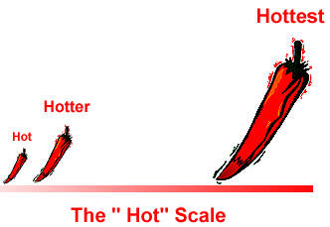
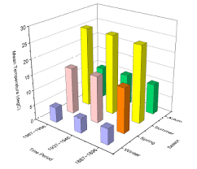
TYPES OF DATA
1. NUMERICAL 2.CATEGORICAL 3.ORDINAL
MOBILE APP DEVELOPMENT

Slide 10
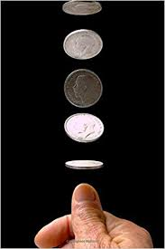
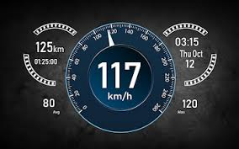
TYPES OF DATA
NUMERICAL
Numerical data is also known as quantitative data
Discrete
value only taken on distinct numbers
example :- IQ numbers after 20 coin tosses
Continuous
values can take on any number, not limited
by any decimal place-usually rounded of
example:- amount of water in water bottle
speed of a car
WEBSITE DEVELOPMENT

Slide 11
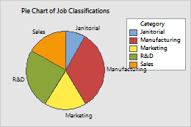
TYPES OF DATA
CATEGORICAL
Dosen’t have mathematical meaning
Also know also qualitative data
Describes Characteristics
Example
Gender
Ethnicity
Nationality
Can assign numbers to them but can’t compare them
mathematically
Cloud Technology

Slide 12


TYPES OF DATA
ORDINAL
Mixing numerical and categorical
Example
Hotel Rating
Can Compare, but not as straightforward
Three star hotels may be very different
Taking average on larger samples has a meaning
[Not in the case of categorical]
International Certification In Cloud Technology

Slide 13
IMPORTANCE OF
DATA VISUALIZATION
INTERNET OF THINGS

Slide 14
DATA VISUALIZATION
OVERVIEW
ROLL OF THE
COMPUTERS
ROLES OF THE
HUMAN
PRESENTING
DATA
INTERPRETING
DATA
BLOCKCHAIN TECHNOLOGY

Slide 15

DATA VISUALIZATION
THE ROLE OF THE COMPUTER
Much faster at calculating than human
Great for crunching numbers
Great for doing many repetitive tasks quick
Carrying out tasks that we gave it based on logical thinking
ARTIFICIAL INTELLIGENCE

Slide 16
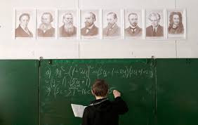
DATA VISUALIZATION
THE ROLE OF THE HUMAN
We’ve developed to identify patterns
Creativity
Bringing in or remembering outside knowledge
Understanding summary values and Images
ROBOTICS

Slide 17

DATA VISUALIZATION
PRESENTING DATA
You can’t just show spreadsheets with a bunch of number
Sometimes even the statistical values aren’t good enough summary
or they don’t really help bring the point across.
Visualizations allow easy communication and understanding of the data.
Machine Learning

Slide 18

DATA VISUALIZATION
INTERPRETING DATA
Using our understanding of the system and reason
Using outside knowledge
Seeing(potential!) trends and patterns
Considering the context of the data
Deep Learning

Slide 19
QUESTIONS ?
DO WE NEED ANY DOMAIN EXPERTIES?
TYPE OF DATA Scientist ?
Salary?
NUMBER OD DATA SCIENTIST INDIA REQUIRES NOW ?
ANY THING ELSE?

Slide 20


