Slide 1


API Gateway
August 21, 2021

Slide 2
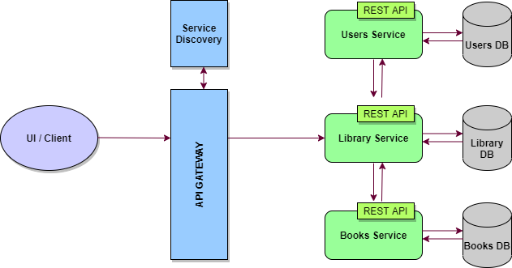
What is API Gateway?
An API gateway is an API management tool that sits between a client and a collection of backend services.
An API gateway acts as a reverse proxy to accept all application programming interface (API) calls, aggregate the various services required to fulfill them, and return the appropriate result.
Notes:
A reverse proxy is a server that sits in front of web servers and forwards client (e.g. web browser) requests to those web servers. Reverse proxies are typically implemented to help increase security, performance, and reliability.

Slide 3
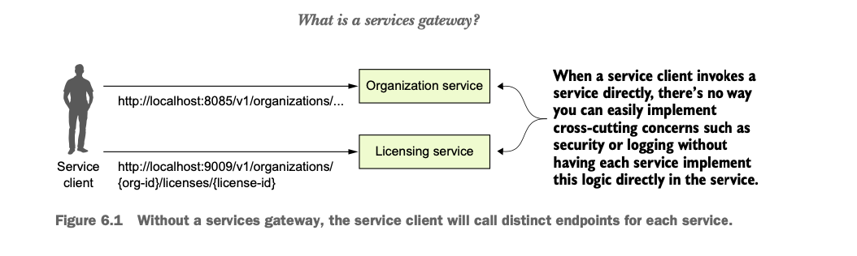
Without Gateway

Slide 4
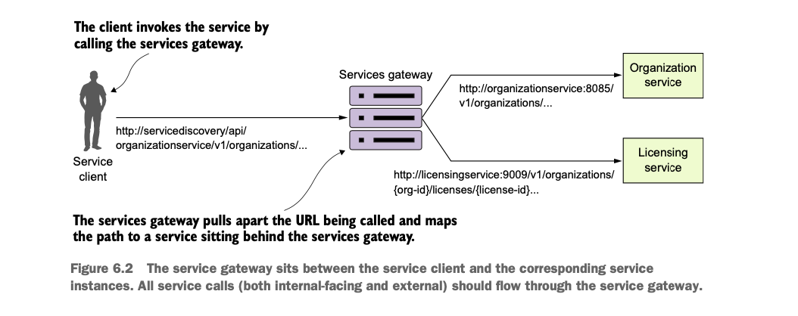
With Gateway

Slide 5
Why API Gateway?
Insulates the clients from how the application is partitioned into microservices
Insulates the clients from the problem of determining the locations of service instances
Provides the optimal API for each client
Reduces the number of requests/roundtrips.
For example, the API gateway enables clients to retrieve data from multiple services with a single round-trip. Fewer requests also means less overhead and improves the user experience. An API gateway is essential for mobile applications.
Simplifies the client by moving logic for calling multiple services from the client to API gateway
Security
Abstraction
Auditing
Routing
Loose Coupling

Slide 6
API Gateway Drawbacks
Increased complexity
The API gateway is yet another moving part that must be developed, deployed and managed
Latency
Increased response time due to the additional network hop through the API gateway - however, for most applications the cost of an extra roundtrip is insignificant.

Slide 7
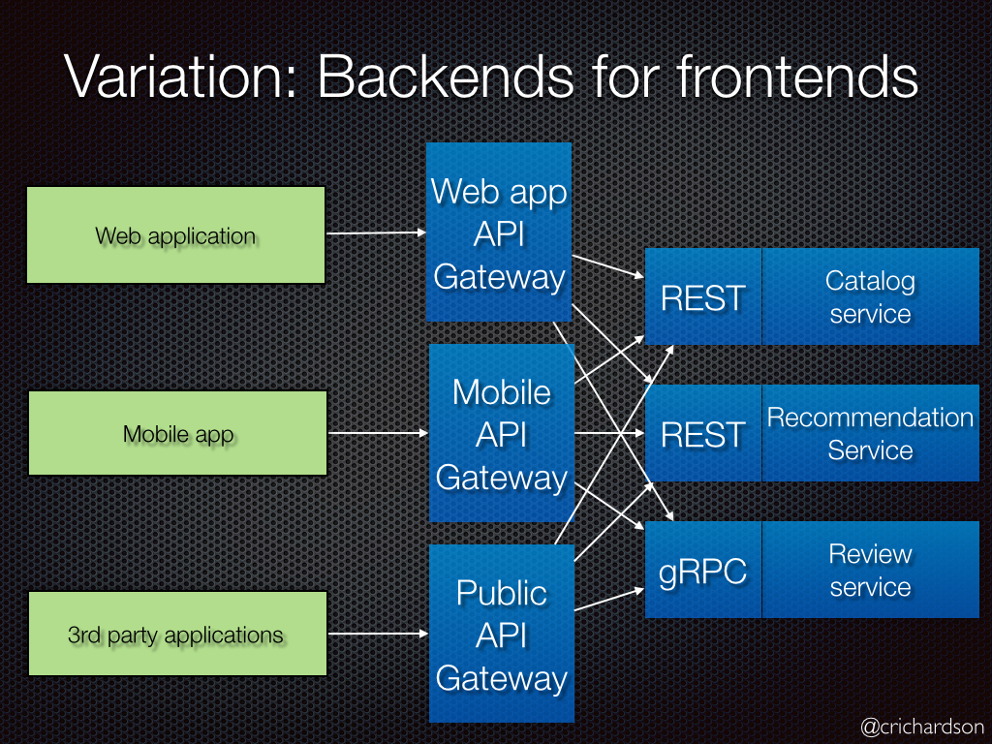
Variation : Backends for Frontends
A variation of this pattern is the Backends for frontends pattern. It defines a separate API gateway for each kind of client.

Slide 8

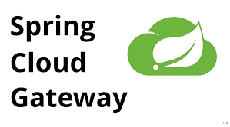
API Gateway Providers
Zuul is a blocking API.
A blocking gateway API makes use of as many threads as the number of incoming requests. So, this approach is more resource intensive.
If no threads are available to process the incoming request, then the request has to wait in queue.
Spring Cloud Gateway is a non blocking API.
A thread is always available to process the incoming request. These requests are then processed asynchronously in the background and once completed the response is returned.
So, incoming requests never gets blocked when using Spring Cloud Gateway.

Slide 9
Spring Cloud Gateway
Spring Cloud Gateway is an implementation by Spring Cloud team on top of Spring reactive ecosystem.
It has the following building blocks
Route: Route the basic building block of the gateway. It consists of
ID
destination URI
Collection of predicates and a collection of filters
Predicate: This is similar to Java 8 Function Predicate. Using this functionality we can match HTTP request, such as headers , url, cookies or parameters.
Filter: These are instances Spring Framework Gateway Filter. Using this we can modify the request or response as per the requirement.

Slide 10
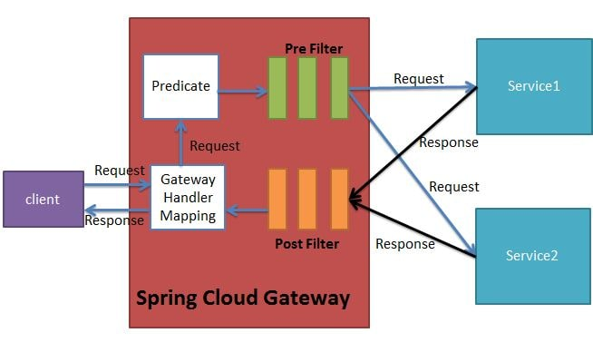
Spring Cloud Gateway Architecture
Notes:
When the client makes a request to the Spring Cloud Gateway, the Gateway Handler Mapping first checks if the request matches a route. This matching is done using the predicates. If it matches the predicate then the request is sent to the filters.

Slide 11
Spring Cloud Gateway Implementation
Maven Dependency:
<dependency>
<groupId>org.springframework.cloud</groupId>
<artifactId>spring-cloud-starter-gateway</artifactId>
</dependency>
Properties:
spring.cloud.gateway.routes[0].id=emp-service
spring.cloud.gateway.routes[0].uri=lb://EMP-SERVICE/
spring.cloud.gateway.routes[0].predicates[0]=Path=/employee/**

Slide 12
References
https://cloud.spring.io/spring-cloud-gateway/reference/html/

