Slide 1
RESTful Web Services

Slide 2
WHAT IS A WEB SERVICE?
A Web Service can be defined by following ways:
is a client server application or application component for communication.
method of communication between two devices over network.
is a software system for interoperable machine to machine communication.
is a collection of standards or protocols for exchanging information between two devices or application.

Slide 3
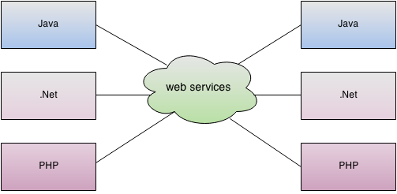
As you can see in the figure, java, .NET or PHP applications can communicate with other applications through web service over the network. For example, java application can interact with Java, .NET and PHP applications. So web service is a language independent way of communication.

Slide 4
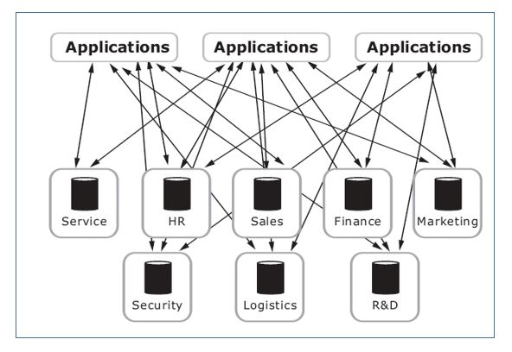
Sample Enterprise application

Slide 5
Types of Web Services
There are mainly two types of web services.
SOAP web services.
RESTful web services.

Slide 6
What is REST?
REST stands for REpresentational State Transfer. REST is a web standards based architecture and uses HTTP Protocol for data communication. It revolves around resources where every component is a resource and a resource is accessed by a common interface using HTTP standard methods. REST was first introduced by Roy Fielding in year 2000.
In REST architecture, a REST Server simply provides access to resources and the REST client accesses and presents the resources. Here each resource is identified by URIs/ Global IDs. REST uses various representations to represent a resource like Text, JSON and XML. JSON is now the most popular format being used in Web Services.

Slide 7
REST defines 6 architectural constraints/Guiding Principles which make any web service – a true RESTful API.
Uniform interface
Client–server
Stateless
Cacheable
Layered system
Code on demand (optional)
Notes:
REST is not an architecture; rather, it is a set of constraints that creates a software architectural style, which can be used for building distributed applications.
Often, an enterprise demands simplified access and updates to data residing in different systems. Fielding arrived at REST by evaluating all the networking resources and technologies available for creating distributed applications. He observed that without any constraints, one may end up developing applications with no rules or limits that are hard to maintain and extend. After considerable research on building a better architecture for a distributed application, he ended up with the following constraints that define a RESTful system:

Slide 8
Uniform interface – The uniform interface constraint defines the interface between clients and servers. It simplifies and decouples the architecture, which enables each part to evolve independently. REST is defined by four interface constraints: identification of resources; manipulation of resources through representations; self-descriptive messages; and, hypermedia as the engine of application state.
Client–server – The uniform interface separates clients from servers. This separation of concerns means that, for example, clients are not concerned with data storage, which remains internal to each server, so that the portability of client code is improved. Servers are not concerned with the user interface or user state, so that servers can be simpler and more scalable. Servers and clients may also be replaced and developed independently, as long as the interface is not altered.
Stateless – RESTful Web Service should not keep a client state on the server. This restriction is called Statelessness. It is the responsibility of the client to pass its context to the server and then the server can store this context to process the client's further request. For example, session maintained by server is identified by session identifier passed by the client.
RESTful Web Services should adhere to this restriction.
Notes:
Identification of resources - You use the URI (IRI) standard to identify a resource. Each resource must have a specific and cohesive URI to be made available
Manipulation of resources through these representations - You use the HTTP standard to describe communication. So for example GET means that you want to retrieve data about the URI identified resource. You can describe an operation with a HTTP method and an URI.
Self-descriptive messages
Each message includes enough information to describe how to process the message. For example, which parser to invoke may be specified by an Internet media type
Hypermedia as the engine of application state (A.K.A. HATEOAS) - We use hyperlinks and possibly URI templates to decouple the client from the application specific URI structure. A REST client enters a REST application through a simple fixed URL. All future actions the client may take are discovered within resource representations returned from the server. The media types used for these representations, and the link relations they may contain, are standardized. The client transitions through application states by selecting from the links within a representation or by manipulating the representation
Hypermedia as the Engine of Application State
Hypermedia as the Engine of Application State (HATEOAS) is an important principle of the REST application architecture. The principle is that the model of application changes from one state to another by traversing the hyperlinks present in the current set of resource representations (model). Let's learn this principle in detail.
In a RESTful system, there is no fixed interface between the client and the server, as you may see in a conventional client-server communication model such as Common Object Request Broker Architecture (CORBA) and Java Remote Method Invocation (Java RMI). With REST, the client just needs to know how to deal with the hypermedia links present in the response body; next, the call to retrieve the appropriate resource representation is made by using these dynamic media links. This concept makes the client-server interaction very dynamic and keeps it different from the other network application architectures.
Client-server: This constraint keeps the client and server loosely coupled. In this case, the client does not need to know the implementation details in the server, and the server is not worried about how the data is used by the client. However, a common interface is maintained between the client and server to ease communication.
Stateless: There should be no need for the service to keep user sessions. In other words, each request should be independent of the others. This improves scalability, as the server does not need to manage the state across multiple requests, with some trade-off on the network performance.
Cacheable: This constraint has to support a caching system. The network infrastructure should support a cache at different levels. Caching can avoid repeated round trips between the client and the server for retrieving the same resource.
Uniform interface: This constraint indicates a generic interface to manage all the interactions between the client and server in a unified way, which simplifies and decouples the architecture. This constraint indicates that each resource exposed for use by the client must have a unique address and should be accessible through a generic interface. The client can act on the resources by using a generic set of methods.
Layered system: The server can have multiple layers for implementation. This layered architecture helps to improve scalability by enabling load balancing. It also improves the performance by providing shared caches at different levels. Being the door to the system, the top layer can enforce security policies as well.
Code on demand: This constraint is optional. This constraint indicates that the functionality of the client applications can be extended at runtime by allowing a code download from the server and executing the code. Some examples are the applets and the JavaScript code that get transferred and executed at the client side at runtime.

Slide 9
Cacheable – Caching refers to storing the server response in the client itself, so that a client need not make a server request for the same resource again and again. A server response should have information about how caching is to be done, so that a client caches the response for a time-period or never caches the server response.
Layered system – The layered system style allows an architecture to be composed of hierarchical layers by constraining component behavior such that each component cannot “see” beyond the immediate layer with which they are interacting.
A client cannot ordinarily tell whether it is connected directly to the end server, or to an intermediary along the way. Intermediary servers may improve system scalability by enabling load balancing and by providing shared caches. They may also enforce security policies.
Code on demand (optional) – REST allows client functionality to be extended by downloading and executing code in the form of applets or scripts. This simplifies clients by reducing the number of features required to be pre-implemented.

Slide 10
Advantages of RESTful Web Services
REST is an architectural style and not a protocol.
Fast: RESTful Web Services are fast because there is no strict specification like SOAP.
Language and Platform independent: RESTful web services can be written in any programming language and executed in any platform.
Permits different data format: RESTful web service permits different data format such as Plain Text, HTML, XML and JSON.
REST requires less bandwidth and resource than SOAP.
REST is more preferred than SOAP.

Slide 11
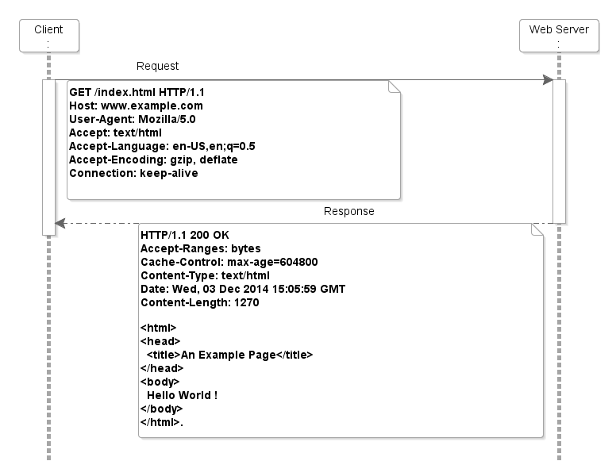
RESTful Web Services make use of HTTP protocols as a medium of communication between client and server. A client sends a message in form of a HTTP Request and the server responds in the form of an HTTP Response. This technique is termed as Messaging. These messages contain message data and metadata i.e. information about message itself.
Notes:
HTTP works in a request-response manner

Slide 12
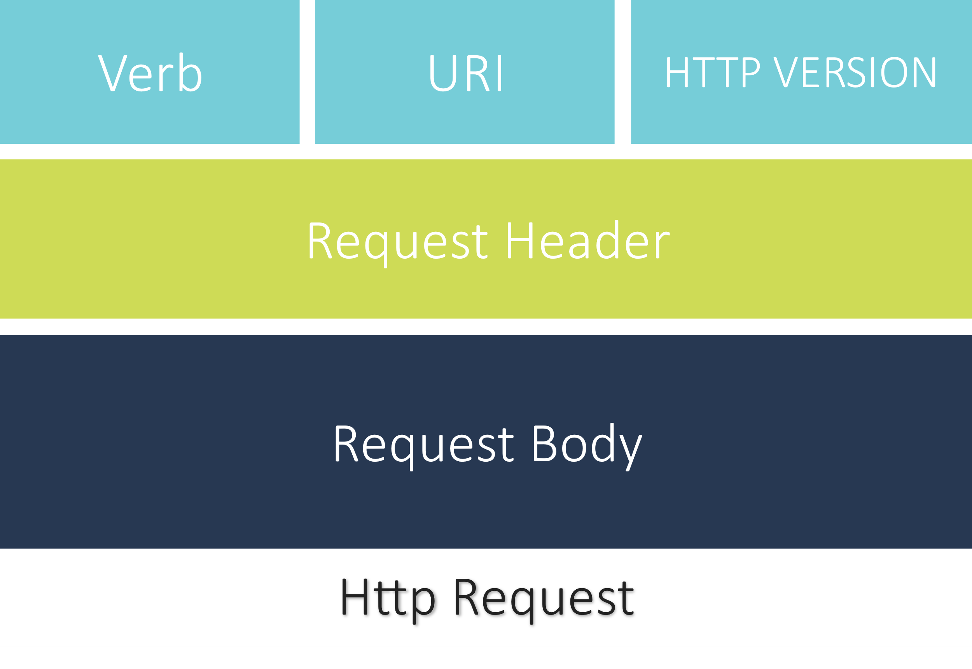
HTTP Request
An HTTP Request has five major parts −
Verb − Indicates the HTTP methods such as GET, POST, DELETE, PUT, etc.
URI − Uniform Resource Identifier (URI) to identify the resource on the server.
HTTP Version − Indicates the HTTP version. For example, HTTP v1.1.
Request Header − Contains metadata for the HTTP Request message as key-value pairs. For example, client (or browser) type, format supported by the client, format of the message body, cache settings, etc.
Request Body − Message content or Resource representation.

Slide 13
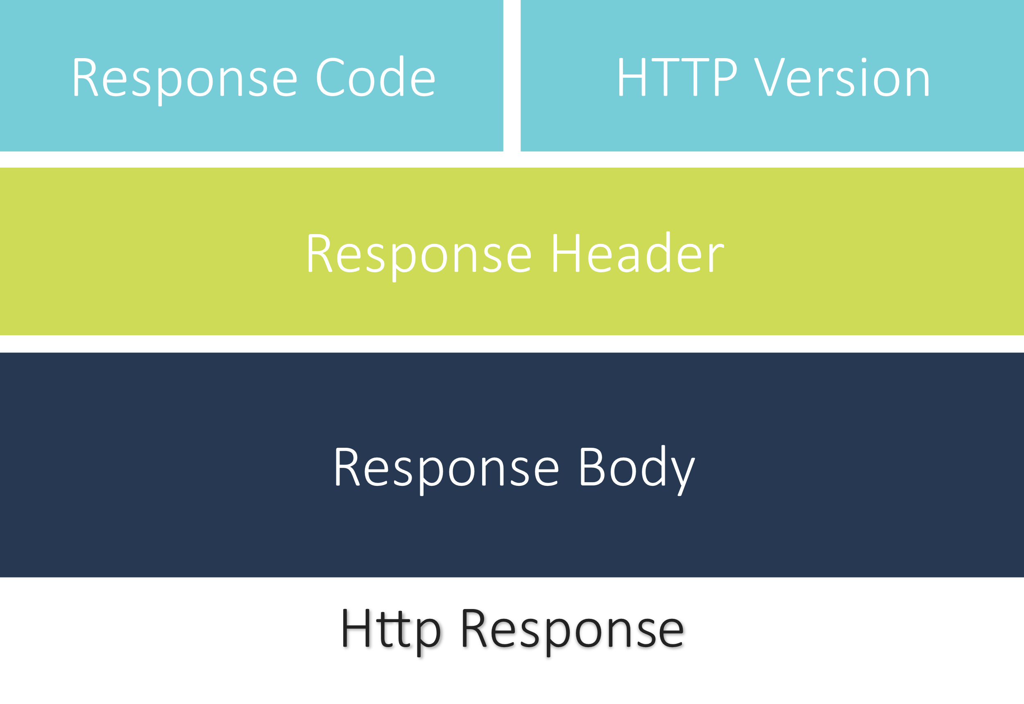
HTTP Response
An HTTP Response has four major parts −
Status/Response Code − Indicates the Server status for the requested resource. For example, 404 means resource not found and 200 means response is ok.
HTTP Version − Indicates the HTTP version. For example, HTTP v1.1.
Response Header − Contains metadata for the HTTP Response message as key/value pairs. For example, content length, content type, response date, server type, etc.
Response Body − Response message content or Resource representation.
Notes:
HTTP request, the server returns a status code indicating the processing status of the request.

Slide 14
HTTP Methods
The following HTTP methods are most commonly used in a REST based architecture.
GET − Provides a read only access to a resource.
PUT − Used to update an existing resource
DELETE − Used to remove a resource.
POST − Used to create a new resource.
Notes:
Method Description
GET
This method is used for retrieving resources from the server by using the given URI.
HEAD
This method is the same as the GET request, but it only transfers the status line and the header section without the response body.
POST
This method is used for posting data to the server. The server stores the data (entity) as a new subordinate of the resource identified by the URI. If you execute POST multiple times on a resource, it may yield different results.
PUT
This method is used for updating the resource pointed by the URI. If the URI does not point to an existing resource, the server can create the resource with that URI.
DELETE
This method deletes the resource pointed by the URI.
TRACE
This method is used for echoing the contents of the received request. This is useful for the debugging purpose with which the client can see what changes (if any) have been made by the intermediate servers.
OPTIONS
This method returns the HTTP methods that the server supports for the specified URI.
CONNECT
This method is used for establishing a connection to the target server over HTTP.
PATCH
This method is used for applying partial modifications to a resource identified by the URI.

Slide 15
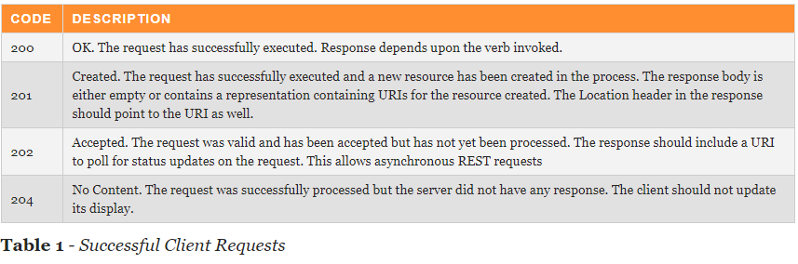
Response Codes
HTTP response codes give us a rich dialogue between clients and servers about the status of a request. Most people are only familiar with 200, 403, 404 and maybe 500 in a general sense, but there are many more useful codes to use.

Slide 16
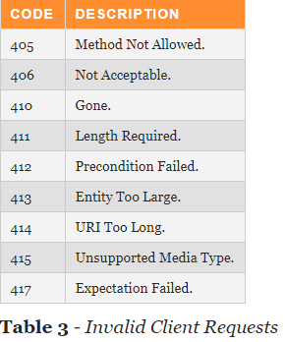
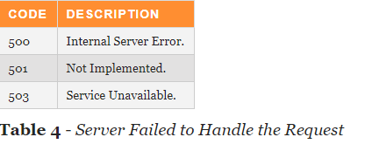

Slide 17
Constructing a Standard URI
The following are important points to be considered while designing a URI −
Use Plural Noun − Use plural noun to define resources. For example, we've used users to identify users as a resource.
Avoid using spaces − Use underscore (_) or hyphen (-) when using a long resource name. For example, use authorized users instead of authorized%20users.
Use lowercase letters − Although URI is case-insensitive, it is a good practice to keep the url in lower case letters only.
Maintain Backward Compatibility − As Web Service is a public service, a URI once made public should always be available. In case, URI gets updated, redirect the older URI to a new URI using the HTTP Status code, 300.
Use HTTP Verb − Always use HTTP Verb like GET, PUT and DELETE to do the operations on the resource. It is not good to use operations name in the URI.
Example
GET http://localhost:8080/UserManagement/rest/UserService/users/1

Slide 18
Is this API Full Restful ?

Slide 19
Richardson Maturity Model

Slide 20
Richardson Maturity model is a model developed by Leonard Richardson.
It grades APIs by their Restful maturity.
There are 4 levels. Only when the APIs reach level 4, we can talk about a RESTful API. The levels are
Level 0
Level 1
Level 2
Level 3

Slide 21
Level 0
Level 0, Plain Old Xml.
Http is used only as a Transport protocol. Http is used for remote interaction.
To get the data and to post the data we send request to the same URL, only POST request may be used.
To get the data,
POST http://localhost:8080/products
To post the data,
POST http://localhost:8080/products

Slide 22
Level 1
In Level 0, there was only one URI.
In Level 1, each resource is mapped to a specific URI.
For example, the URI to get the products
POST http://localhost:8080/products
To get URI for a specific product
POST http://localhost:8080/products/1
Still, only one HTTP method POST is used for retrieving and creating data.

Slide 23
Level 2
In Level 2, correct HTTP verbs are used with each request.
For each of those requests, correct HTTP response code is provided.
Example : GET http://localhost:8080/products
Response code : 200 OK

Slide 24
Level 3
At Level 3, the APIs support HATEOAS.
Example : GET http://localhost:8080/customers
For this, the response we get is
Customer Json + Self-documenting Hypermedia
Helps in Self-documentation.

Slide 25
Spring Rest Architecture
Model
Client
Database
Controller
Service
DAO

Slide 26
References
https://restfulapi.net/rest-architectural-constraints/

