Slide 1
Adaptive Cluster Rendering
Milestone 1
A Nanite-inspired renderer in C++ and Vulkan
Goal: choose geometry detail and visibility at cluster level
Yingxuan Hu Qingyao Tian Sau Lok Li
CIS 5650 · Group 16 · November 11, 2026
1
Notes:
Suggested timing: 0:00–0:35, Speaker 1. Rehearse with a timer.
We are Group 16, and our project is Adaptive Cluster Rendering. We want to avoid processing geometry that contributes little to the image. We divide a mesh into small groups called clusters, then eventually let the GPU choose their visibility and level of detail. This milestone establishes a working Vulkan viewer and the first cluster representation.
Source: team pitch, Final_Pitch_Group16.pptx, slides 1–3. Future GPU selection is a project goal, not an M1 result.

Slide 2
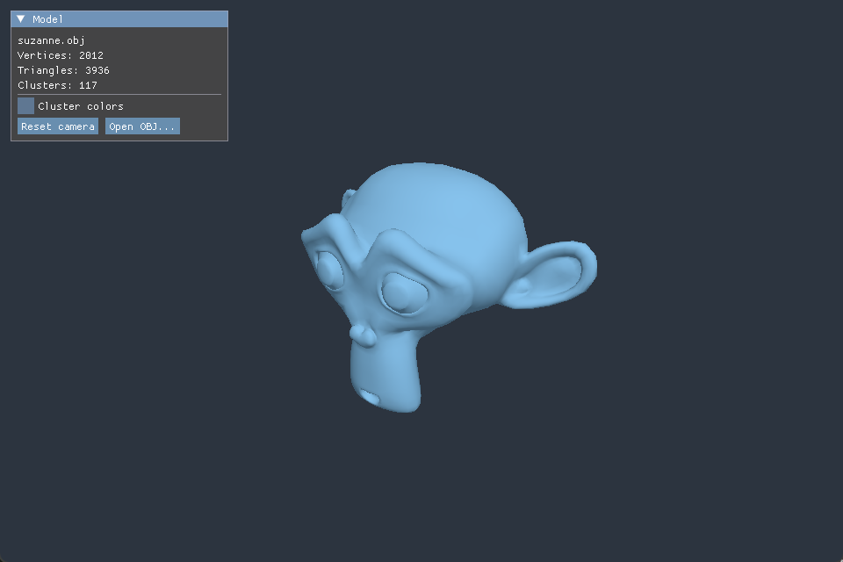
Progress since the pitch
Working Vulkan viewer
OBJ import and GPU upload
Indexed drawing with depth
and basic directional lighting
Orbit, zoom and model loading
through a simple ImGui panel
Suzanne in the M1 viewer
2
Notes:
Suggested timing: 0:35–1:25, Speaker 1. Rehearse with a timer.
Since the pitch, we have a working path from an OBJ file to a Vulkan image. The CPU loads the mesh, then we upload its vertices and indices to GPU memory. Vulkan renders it with depth testing and a directional light. We kept the shading simple to focus on geometry. The viewer supports orbiting, zooming and loading another OBJ. The panel reports model statistics. This gives us a baseline image for checking later algorithms. I will hand over to explain clustering.
Evidence: actual viewer screenshot, model-panel-Debug.png. Implementation: ObjLoader, VulkanRenderer, Viewer, OrbitCamera. Suzanne source: https://github.com/KhronosGroup/glTF-Sample-Assets/tree/main/Models/Suzanne . Geometry credits UX3D and Norbert Nopper (2017), CC0 1.0. Libraries: GLFW, GLM, TinyObjLoader, Dear ImGui, as credited in the repository.

Slide 3
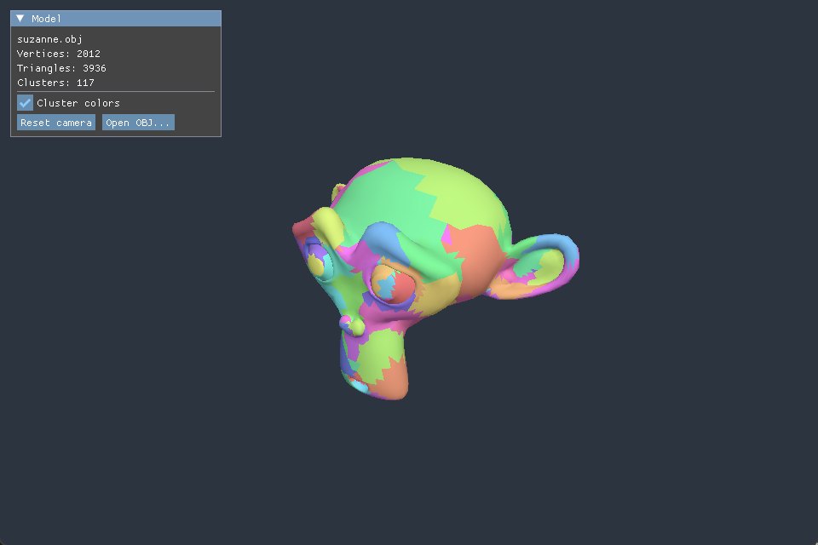
Initial triangle clustering
CPU preprocessing
Group triangles by shared edges
Up to 64 triangles per cluster
Each cluster stores:
index range and bounding box
3,936 triangles / 117 clusters
Colors identify clusters. All triangles still draw.
3
Notes:
Suggested timing: 1:25–2:40, Speaker 2, including up to 15 seconds for demo. Rehearse with a timer.
Here is the same mesh colored by cluster. We start with an unassigned triangle and add neighbors that share an edge. A group stops at 64 triangles or when no more neighbors are available. We reorder the indices so each cluster occupies a continuous range, and store a bounding box. The original triangles stay unchanged. Suzanne produces 117 clusters from 3,936 triangles. Patch sizes differ because we limit triangle count, not screen area, and some groups stop early. This is an initial partitioning method with room to improve cluster quality. In the demo, we can toggle colors and rotate the model. All triangles still draw.
Demo: toggle colors, orbit briefly, press R, return to slides. Use the screenshot if switching is slow.
Evidence: ClusterBuilder.cpp and actual screenshot cluster-colors-Debug.png. Same Suzanne source and CC0 attribution as slide 2.

Slide 4
Checks and current limits
Checks
Current limits
Triangle coverage and cluster bounds
CPU clustering and draw submission
Shaded image before and after
index reordering
All geometry remains resident
and all clusters draw
Debug / Release builds
Vulkan validation and viewer controls
LOD hierarchy and GPU selection
remain the main work for M2
4
Notes:
Suggested timing: 2:40–3:30, Speaker 3. Rehearse with a timer.
We checked the geometry separately from the rendered image. The clustering checks cover triangle assignment, valid index ranges and bounding boxes. We compared the shaded image before and after reordering indices, because grouping should not change the surface. We also checked Debug and Release builds, Vulkan validation and viewer controls. Currently, the CPU creates clusters and submits draws, and we still draw everything. We have not demonstrated a speedup yet. The main remaining work is the hierarchy and GPU selection.
Evidence: M1 development verification, repository README and implementation. No benchmark or speedup claim.

Slide 5
Next milestone: GPU geometry core
November 18
Offline geometry
GPU selection
Rendering and debug
Simplify cluster groups
Build the LOD hierarchy
Record geometric error
Upload hierarchy data
Select LOD by screen error
Add frustum culling
Draw selected clusters
Report selected counts
Compare with drawing all
M2 goal: GPU selection changes the drawn geometry as the camera moves
Later: Hi-Z visibility, basic tessellation / displacement and light-view shadows
5
Notes:
Suggested timing: 3:30–4:30, Speaker 3. Rehearse with a timer.
For November 18, we will divide the work around data interfaces. Offline geometry will group and simplify clusters, then build a hierarchy with approximation errors. GPU selection will choose detail using screen error and start with frustum culling. Rendering will consume the selected list and report counts for comparison with drawing everything. We will first test with a small two-level hierarchy and a fixed draw list so we can work independently. Our M2 demonstration should show camera movement changing the actual geometry that the GPU selects and draws. Later work includes Hi-Z, basic tessellation and displacement, and a separate light-view shadow path.
Sources: Latest_Feature_Comparison.pdf and Parallel_Development_Roadmap_V01.pdf. These are future targets. Presenter allocation is a suggested presentation split, not a claim about individual implementation contributions.

