Slide 1







Data Analysis and Insights on Emerging Skills
Jagger Hollister
July 29, 2024

Slide 2



OUTLINE
Executive Summary
Introduction
Methodology
Results
Visualization – Charts
Dashboard
Discussion
Findings & Implications
Conclusion
Appendix

Slide 3

EXECUTIVE SUMMARY
Overview of data analysis process and findings
Key insights on emerging skills
Collected data using APIs and web scraping
Cleaned and wrangled data for analysis
Performed exploratory data analysis to uncover trends
Created visualizations to highlight key findings
Developed a comprehensive dashboard

Slide 4

INTRODUCTION
Purpose of the project:
To identify emerging skills and trends in demand
Importance of analyzing current and future technology trends
Overview of data collection and analysis process

Slide 5

METHODOLOGY
Data Collection:
APIs and web scraping techniques
Data Wrangling:
Cleaning, deduplication, imputation, and normalization
Exploratory Data Analysis:
Distribution analysis, outlier detection, and correlation analysis
Data Visualization:
Creating various plots to highlight trends
Dashboard Creation:
Assembling visualizations into an intuitive dashboard

Slide 6
RESULTS
Current Technology Usage:
Top languages: Bash/Shell, HTML/CSS, C#
Top databases: MySQL, Microsoft SQL Server, PostgreSQL
Top platforms: Windows, Linux, Docker
Top web frameworks: React, Angular, Vue.js
Future Technology Trends:
Top desired languages: JavaScript, Python, SQL
Top desired databases: PostgreSQL, MongoDB, Redis
Top desired platforms: Linux, MacOS, Docker
Top desired web frameworks: React, Angular
3. Demographics:
Majority: Men
Regions: North America, Europe
Common age: Late 20s to early 30s
Common Education: Bachelor’s degree

Slide 7
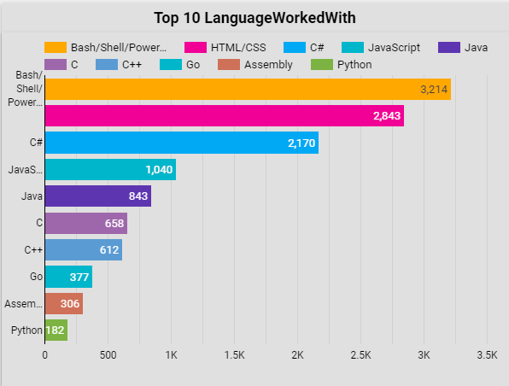
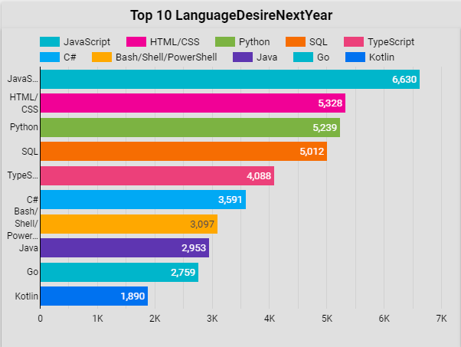
PROGRAMMING LANGUAGE TRENDS
Current Year
Next Year
<Bar chart of top 10 programming languages for the current year goes here.>
< Bar chart of top 10 programming languages for the next year goes here.>

Slide 8
PROGRAMMING LANGUAGE TRENDS - FINDINGS & IMPLICATIONS
JavaScript's Continued Reign
JavaScript is the top language both currently and for next year.
Implication: Keep investing in JavaScript projects and training.
Steady Popularity of HTML/CSS and Python
HTML/CSS and Python remain popular choices.
Implication: Focus on these skills for web development and data science.
Growing Interest in TypeScript and SQL
TypeScript and SQL are becoming more desired.
Implication: Consider adopting these technologies for better project scalability and database management.

Slide 9
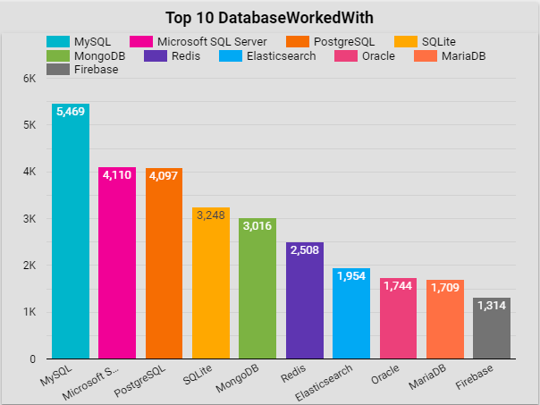
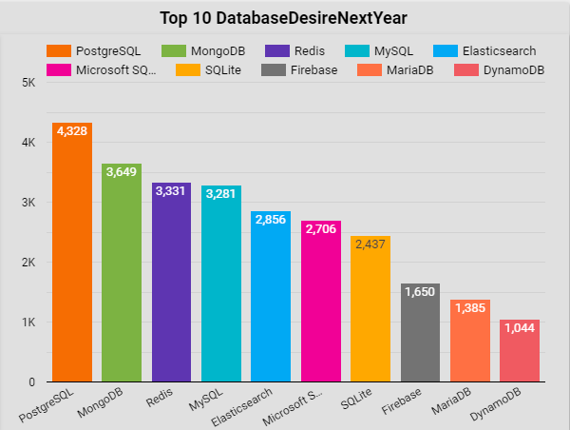
DATABASE TRENDS
Current Year
Next Year
< Bar chart of top 10 databases for the current year goes here >
< Bar chart of top 10 databases for the next year goes here.>

Slide 10
DATABASE TRENDS - FINDINGS & IMPLICATIONS
Shift to PostgreSQL and MongoDB
Increasing preference for PostgreSQL and MongoDB.
Implication: Adopt these databases for their flexibility and scalability.
Ongoing Use of MySQL and Microsoft SQL Server
MySQL and Microsoft SQL Server are widely used.
Implication: Continue leveraging these databases but stay open to new trends.
Interest in Redis and Elasticsearch
Rising interest in Redis and Elasticsearch.
Implication: Integrate these for real-time data processing and enhanced search capabilities.

Slide 11

DASHBOARD
https://lookerstudio.google.com/s/m6dLn1a5Jds

Slide 12
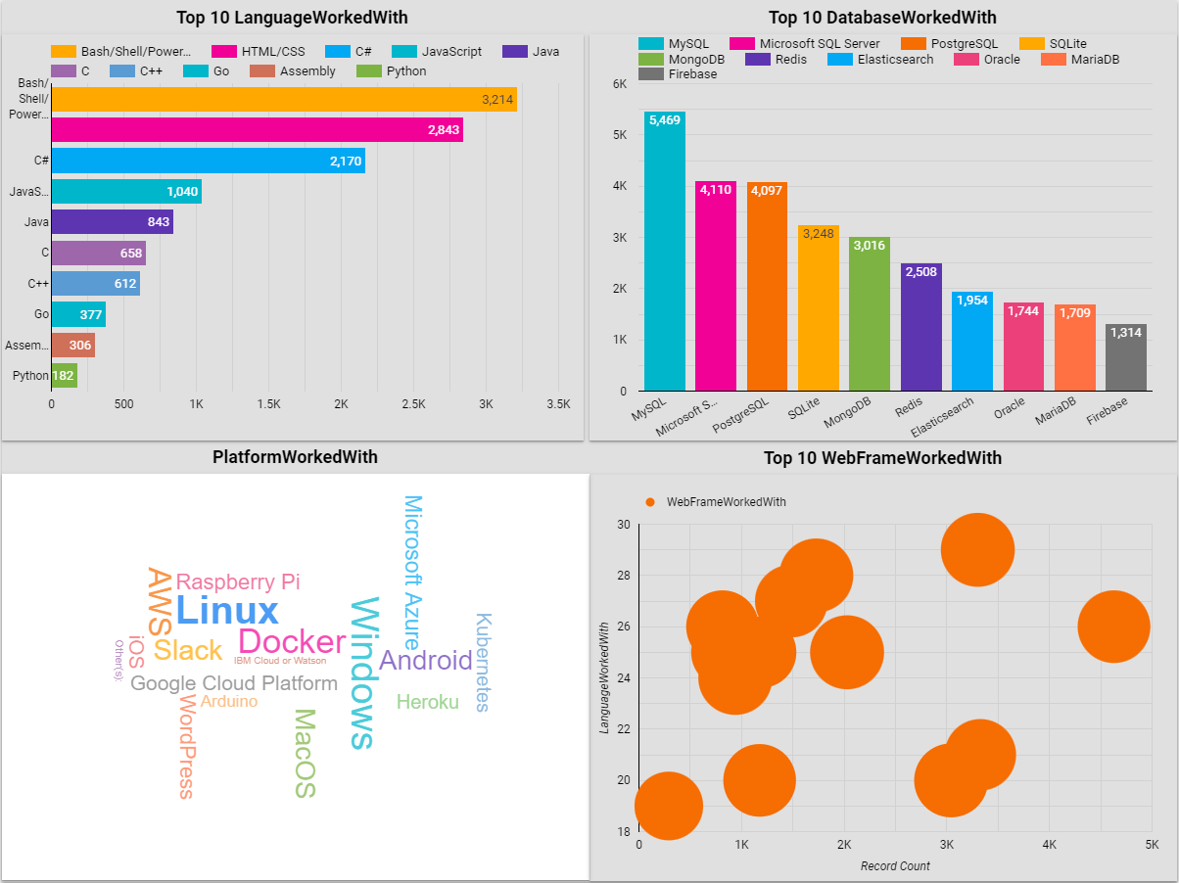
DASHBOARD TAB 1
Screenshot of dashboard tab 1 goes here

Slide 13
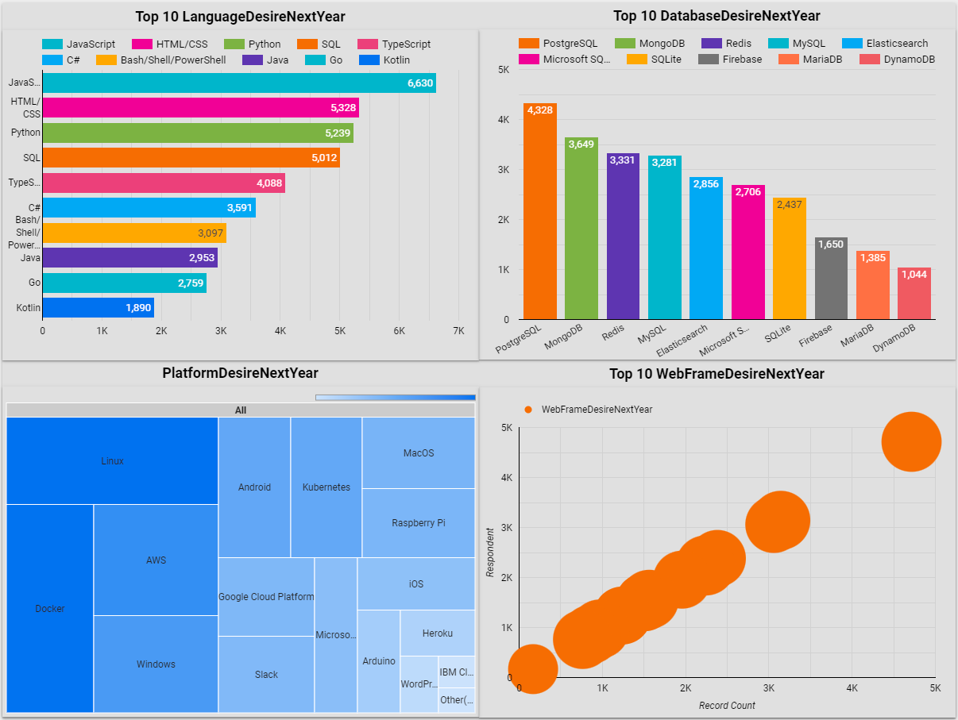
DASHBOARD TAB 2
Screenshot of dashboard tab 2 goes here

Slide 14
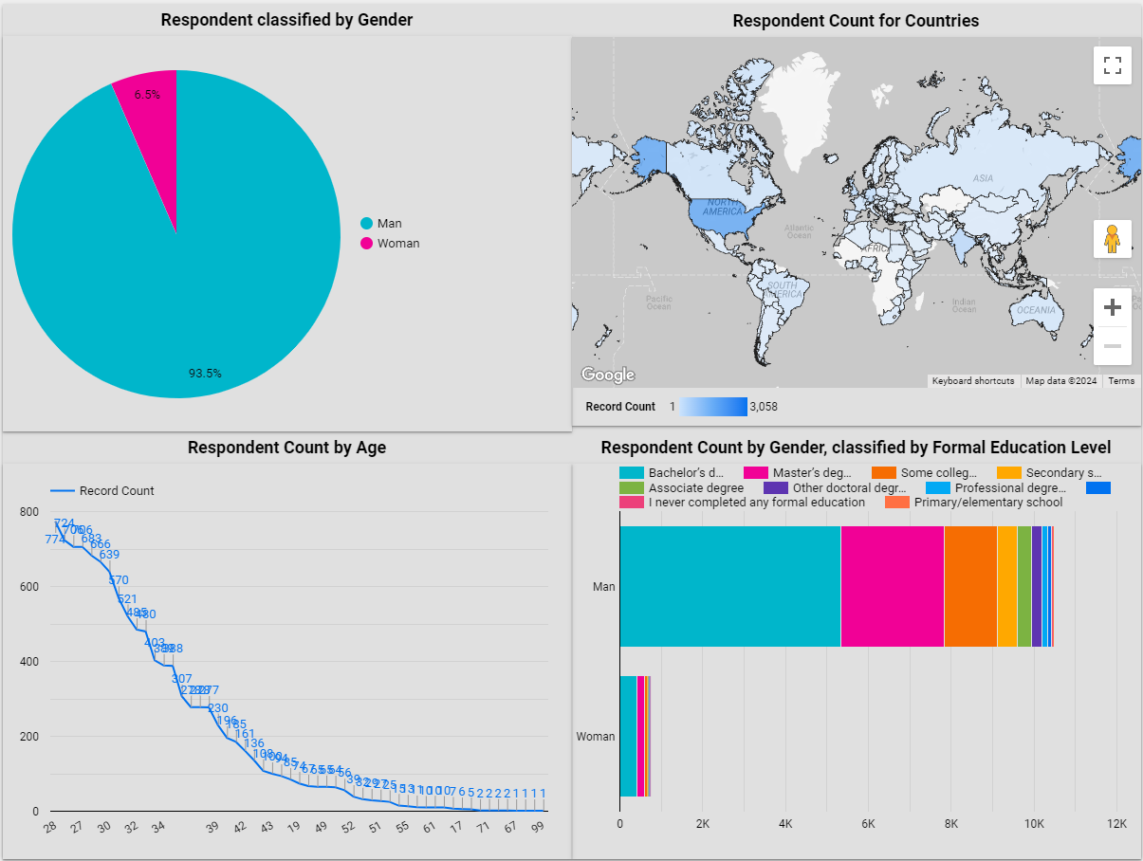
DASHBOARD TAB 3
Screenshot of dashboard tab 3 goes here

Slide 15
DISCUSSION
Emerging Technology Trends: The analysis reveals a shift towards emerging technologies like TypeScript, PostgreSQL, and MongoDB. Organizations should consider integrating these technologies to stay competitive and meet future demands.
Skill Development Focus: Consistent interest in languages like JavaScript and Python underscores the need for ongoing skill development in these areas. Investing in training programs for these technologies will ensure the workforce remains adept and versatile.

Slide 16
OVERALL FINDINGS & IMPLICATIONS
Adoption of Modern Technologies
Technologies like JavaScript, Python, PostgreSQL, and MongoDB are both popular now and desired for the future.
Implication: Invest in these technologies to stay competitive.
Focus on Real-Time Data and Cloud Integration
Growing interest in real-time data processing (e.g., Redis, Elasticsearch) and cloud platforms (e.g., AWS, Google Cloud).
Implication: Develop strategies for real-time data and cloud integration to enhance decision-making and scalability.
Web Development and Data Security
Web development technologies (e.g., HTML/CSS, JavaScript) and data security remain critical.
Implication: Prioritize web development skills and invest in robust data security measures to protect sensitive information.

Slide 17

CONCLUSION
Adopt Modern Technologies
Invest in versatile technologies like JavaScript, Python, PostgreSQL, and MongoDB to stay competitive.
Focus on Cloud and Real-Time Data
Implement cloud-native databases and real-time analytics for better decision-making and scalability.
Strengthen Web Development and Security
Maintain strong web development skills and invest in data protection practices.
Stay Informed and Adapt
Keep up with tech trends to make informed decisions and stay competitive.

Slide 18
JOB POSTINGS

Slide 19
POPULAR LANGUAGES

