Slide 1
Special Parallel Devices.
IDEA & Presented By.
Jaggesher Mondal.
ID: 14025423.
CSE RU

Slide 2
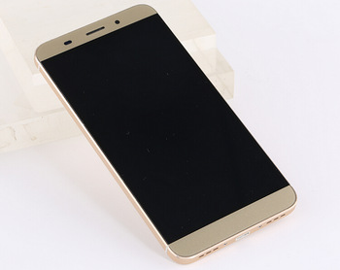
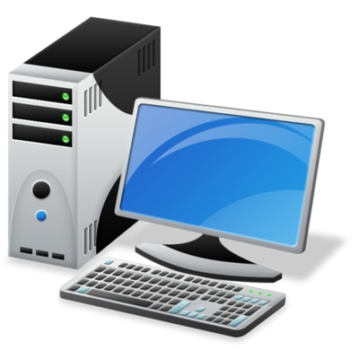
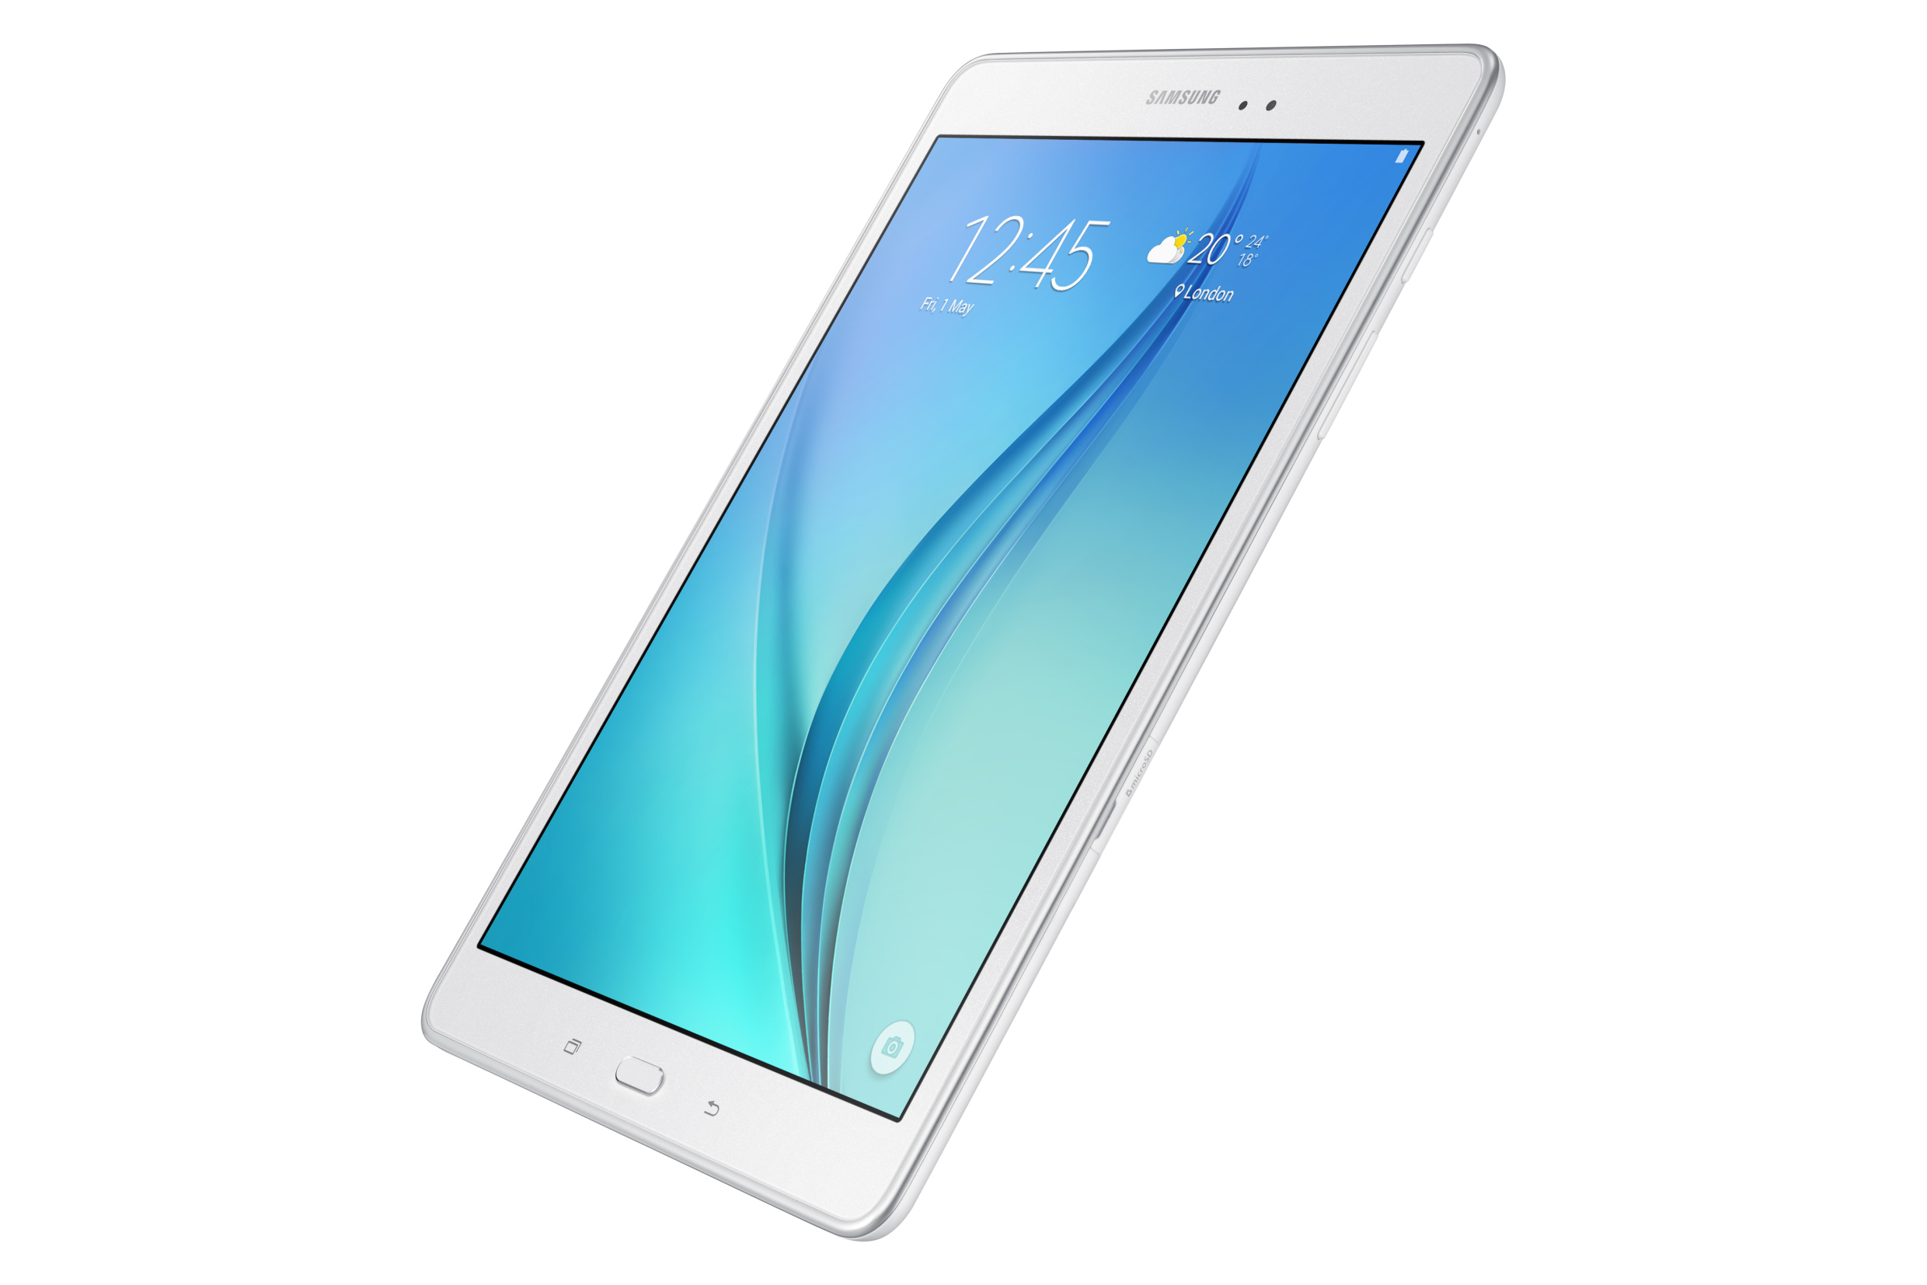
Common Personal Gadgets.
Mobile
Computer
Tablet

Slide 3
Common Devices Use Style
If we study only most common use style, related with two devices Mobile And Computer. Then we see.
At a time only device is Up.
At a time only one device is busy other is in almost identical mood.
Gamming with mobile, and only playing music or doing very simple work with powerful computer.
Performing very powerful work with computer and mobile is in just stand by mood.

Slide 4

Some Considerable Points
Program size is growing too high day by day. Which slow down our currently used devices in near future. And we are facing.
Loading……..
Hanging Device.
Too slow.
Aren’t capable of running latest programs always.
Can we reduce these pains, using currently used multiple devices?

Slide 5
Proposed High Speed Computing
So when a process is too big for a device then, why not we distribute some task between other devices if possible.
For example when we gamming on mobile then we use our computer to do some jobs, so that mobile can easily handle the process.
To do this we can use remote method execution technique.
Why this technique?
We just need parallel computing only for some special process which is too big for a device, not always.
And we can do it by our existing hardware working principles. We just need to implement some identical methods of that big process in different platform.
And when master device executing it, then it just communicate with other related devices.

Slide 6
Simulation For Mobile
Big Process. (Too big For mobile)
Divide It
Big Process.
Master Part
Identical Part1
Identical Part2
Implement On Mobile
Implement on Tablet
Implement on Computer
Identical Part1
Identical Part2
Done
Execute
Master Part

Slide 7


Slide 8
Thanks To Everyone..

