Slide 1
PREDICTING THE FUTURE
EMPOWERING SMARTER BUSINESS DECISIONS FOR TOP4SPORT
JAGVIR DHESI
Notes:
Good morning everyone! My name is Jagvir, and I am excited to be here today to discuss one of the most fascinating aspects of data science: predicting the future.
In this presentation, I will share with you how I empowered Top4Sport, my client, with the power of data-driven insights, enabling them to make smarter business decisions.

Slide 2
WHAT IF YOU COULD PREDICT THE FUTURE OF YOUR BUSINESS?
Notes:
When we were younger, many of us dreamed of having superpowers. Personally, I always wished I could see into the future.
But what if I told you that today, with the latest advancements in technology, we can help predict and shape the future of businesses?

Slide 3

THE OBJECTIVE
Notes:
I was recently approached by Top4Sport to help them predict sales for various countries and products, and enable them to manage and allocate resources more efficiently

Slide 4
ABOUT ME :)
JAGVIR DHESI
Data scientist/analyst with an accounting
background
Statistical modeling
Tech Stack: SQL, Python: pandas, numpy, matplotlib, seaborn, sklearn, AWS
Financial analysis
dhesijagvir@gmail.com
linkedin.com/in/jagvirdhesi/
Notes:
And here's where I come in.
I'm a data scientist with an accounting background.
I analyze complex data using statistical modeling and programming to provide valuable insights for informed decision-making. My financial analysis skills and business acumen help me understand industry challenges and opportunities, making me a valuable asset for clients.

Slide 5
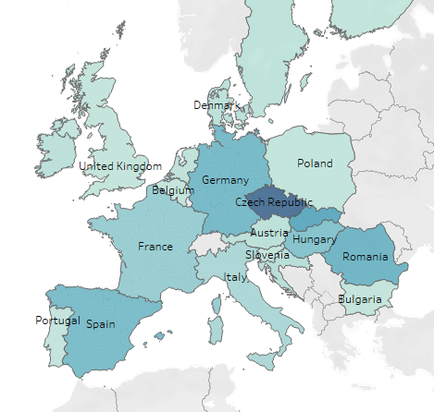

Online e-commerce business based out of Czech Republic
Sell sports equipment to 21 European Countries
Total Sales Revenue (2019 - 2022) =
€ 63,841,995.50
Notes:
My client, sells sports equipment across the EU and operates out of the Czech Republic.
They sell equipment in 21 European countries
Their total sales revenue from June 2019 to January 14th of 2022 was almost 64 million euros
Now that we know a little bit about my client’s background, lets see how we can use the latest advancements in technology to help them make smarter decisions and shape their future success.

Slide 6
WHAT ARE THESE LATEST ADVANCEMENTS?
Notes:
Sooooo… I know what you guys must be wondering, what are these latest advancements? Well this is done through time series analysis.

Slide 7
TIME SERIES ANALYSIS
WHAT?
HOW?
WHY?
Is a statistical technique used to analyze patterns and trends in data over time.
Breaking down data into components, such as trend and seasonality.
These components are then analyzed to identify patterns for predictions.
Businesses can optimize their operations and resources to better meet the needs of their customers and improve their bottom line.
Notes:
One way I like to think about time series analysis is like watching your favorite TV show. Each episode is a data point, and the entire series is a time series. When you watch a show you pick up certain trends and patterns in the plot, which you can use to make predictions about the show.
Time series analysis can help predict future trends in a business based on past trends and historical data.

Slide 8
PROJECT FLOW
Exploratory Data Analysis
01
TIME SERIES MODELS
02
FORECASTING & VISUALIZATION
03
RESULTS
04
Notes:
These are the steps I took:
Firstly, I loaded in the historical data into my jupyter notebook and performed EDA by looking at the shape of the dataset, checking the column data types, and checking for missing values
For example, the payment column in the dataset had a lot of missing values on one specific day. I was able to infer that the payment systems might have been down for that day, so I decided to remove these columns from the dataset.
I then explored multiple different time series models and ended up choosing the prophet model in the end because of superior results.
Thirdly, I used the prophet time series model to forecast sales revenue and create meaningful visuals that I will explore later
And lastly, I compared the forecasted results with previous historical data to get a better sense of where my client’s business is heading

Slide 9
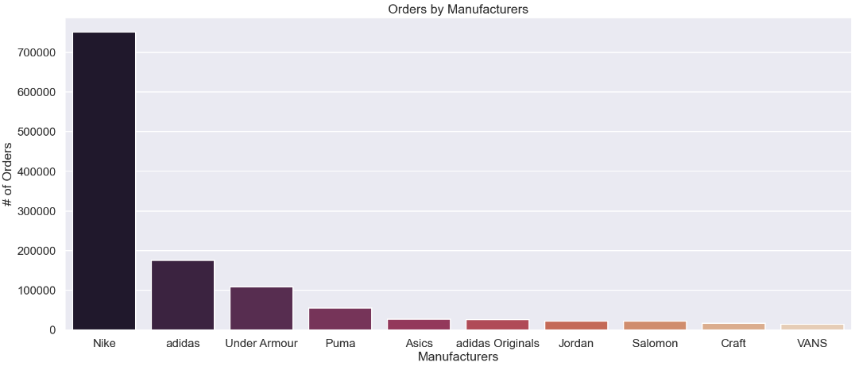
EDA FINDINGS
Notes:
Here, we can see the number of orders by manufacturers, where Nike has the biggest volume of orders from Top4Sports

Slide 10
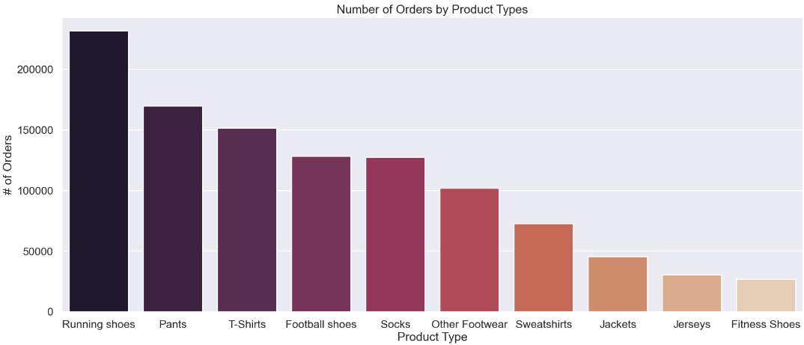
EDA FINDINGS CONT…
Notes:
Here, we can see the number of orders for specific product types, where running shoes, pants, and t-shirts are the top 3 most highest selling

Slide 11
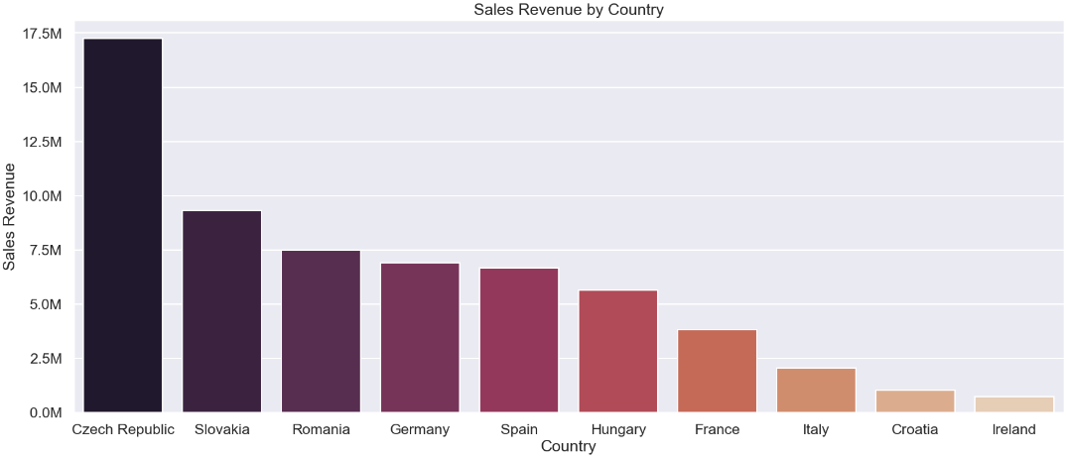
EDA FINDINGS CONT…
Notes:
And here, we can see the sales revenue by country where the Czech Republic is the highest sales generator for Top4Sports, which makes sense since they are based from there

Slide 12
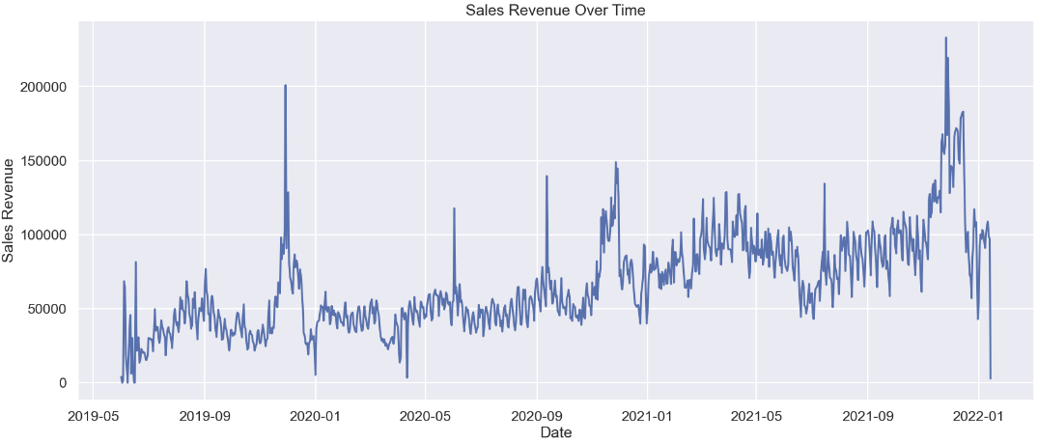
EDA FINDINGS CONT…
Notes:
Lastly, for the EDA, this is the total sales revenue from the historical sales data plotted over time with seasonal peaks around the ending of each of the years

Slide 13
PROPHET
TIME SERIES MODEL
Prophet model is known for its flexibility, ease of use, and accuracy
Advantage of handling seasonality and holidays in the data
80% accuracy of model
Notes:
For my workflow, I decided to use the prophet time series model, since it has the advantage of handling seasonality and holidays in the historical data, and also because it provided the best accuracy at about 80%.
I will now shift focus to the forecasting and visualizations that were made from this model

Slide 14
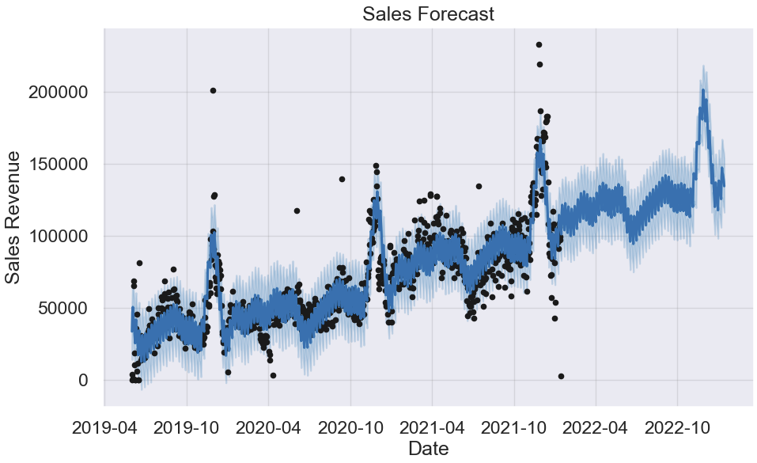
MODEL FORECAST
Notes:
This graph shows the forecasted one year sales revenue from the historical data which is shown as the black dots, and we see that the business is poised for growth.

Slide 15
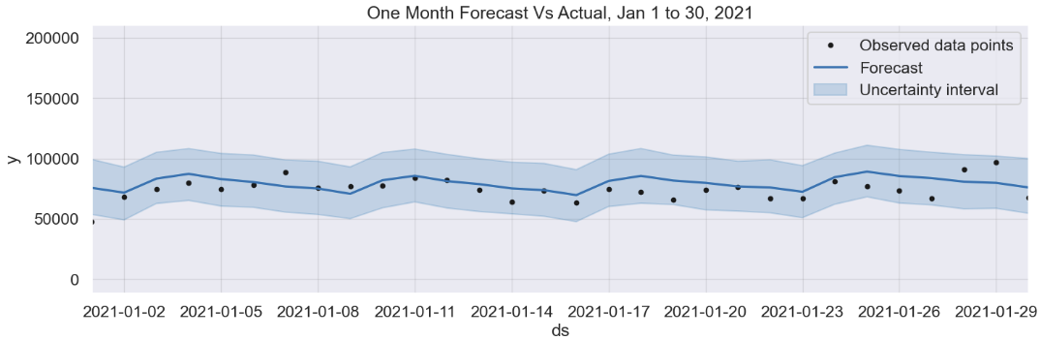
MODEL FORECAST CONT…
One Month March 2021 Forecast
Notes:
This graph shows the one month forecast on the historical data from Mar 1st to to the 30th of 2021 and we can see the the forecast line is very accurate

Slide 16
RESULTS
Notes:
I will now talk about the results and observations made

Slide 17
73.57 % FOR CZECH REPUBLIC
50.04% FOR ALL COUNTRIES
SALES FORECAST BY COUNTRY
SALES REVENUE INCREASE IN ONE YEAR
Notes:
In one year, the sales revenue for the country of Czech Republic is predicted to increase over 73.57%.
When looking at all European countries the sales revenue is projected to increase by over 50.04%.
This will improve the cash flow for Top4Sports and provide my client with additional flexibility in managing day-to-day operations and pursuing growth opportunities.

Slide 18
181.11 % FOR CZECH REPUBLIC
80.46% FOR ALL COUNTRIES
SALES FORECAST BY RUNNING SHOES & COUNTRY
SALES REVENUE INCREASE FOR RUNNING SHOES IN ONE YEAR
Notes:
From our EDA we were able to see that the running shoes are the most popular product sold my Top4Sports, for that reason I decided to forecast this item category
Using time series model I was able to forecast the predicted sales revenue that these products would bring in one year
In one year the sales for running shoes in the Czech Republic will increase by 181.11% and for all the countries together the sales will increase by 80.46%
These results are highly insightful since they will help Top4Sport to manage inventory levels and prepare for demand increase
In conclusion, these results will help my client in making informed decisions related to accounting, financial planning, investment, and taxation.

Slide 19
THANKS!
Does anyone have any questions?
dhesijagvir@gmail.com
403-702-4230
github.com/Jaghs/demand-prediction-project
linkedin.com/in/jagvirdhesi/
Notes:
Before I end I would also like to touch on what I would like to improve and work on in the future for my client:
I would like to further improve model accuracy through pulling in addition data from external sources such as weather APIs and social media platforms
With that said, Thank you so much for listening!

