Slide 1
Tuberculosis
Tableau
Project
Jagvir Dhesi
Notes:
Hi my name is Jagvir and this is my Tuberculosis Tableau Project presentation

Slide 2
01
Project Flow
Notes:
I will start with my simple project workflow that I followed

Slide 3
Steps Taken
Connecting Dataset to Tableau
Detecting Different Data Types and Categories (EDA)
Building Visualizations
Creating a Dashboard
Notes:
Firstly, I connected the Tuberculosis dataset to Tableau
I then performed exploratory data analysis on the imported csv, where for example I renamed columns for readability, familiarized myself with specific terms such as low bound and high bound and also completed missing information for longitude and latitude.
Thirdly, I made 10 different visualizations in Tableau to Learn More about the Tuberculosis Dataset
And then made a dashboard to summarize my results

Slide 4
Features of the TB Dataset
Method to Derive
Number of Deaths & Mortality Rates
Case Detection Rate
Prevalence of TB
Notes:
This dataset had 47 different features which is alot. I mainly used 7- 10 for my visuals in Tableau which helped me in answering my question. To save time I will share 4 of them :
Firstly the Case Detection Rate: Which shows the percentage of TB cases that are detected in a population
Next the Method to Derive: This ensures the accuracy and validity of the data used in the analysis through surveys and prediction models
Then we have the Number of deaths & Mortality of TB cases
And finally Prevalence of TB: Prevalence shows the proportion of individuals in a population who have tuberculosis.

Slide 5
What I Want to Know & Answer…
Is there a correlation between detection and mortality rates on a country by country basis?
Notes:
My main data question was, is there a correlation between detection and mortality rates on a country by country basis?

Slide 6
02
Results
Notes:
I will now talk about my visuals

Slide 7
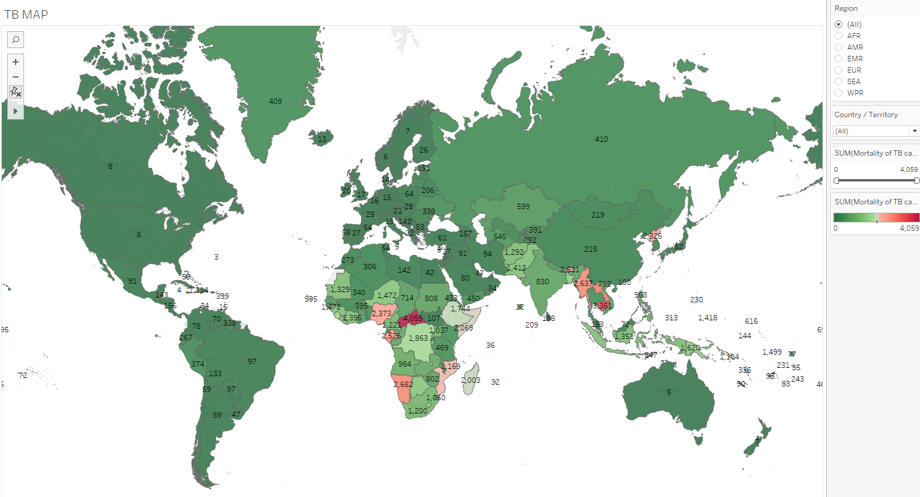
Tuberculosis Around the Globe
Notes:
Here I chose to create a map visual in Tableau as it allows us to see the geographical distribution of Tuberculosis by country. We can see that the highest concentration of TB mortalities are in Africa. With the most in the Central African Republic. I believe this is mostly due to the fact that the health systems in Africa are very weak.

Slide 8
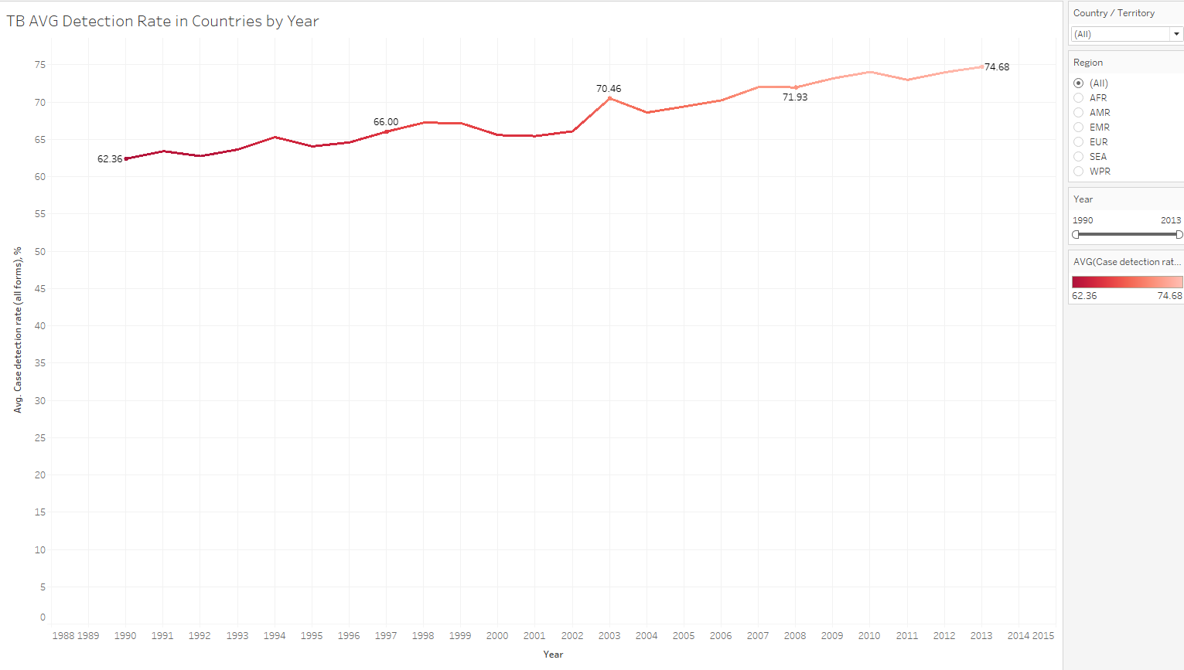
Detection Rates
Notes:
For the detection rates of Tuberculosis I chose to create a line graph as it is effective at showing trends over time. We can see that the average detections rates have been on a steady increase over the years.
However with the rise in detection rates why are there still so many cases of tuberculosis, especially in Africa?

Slide 9
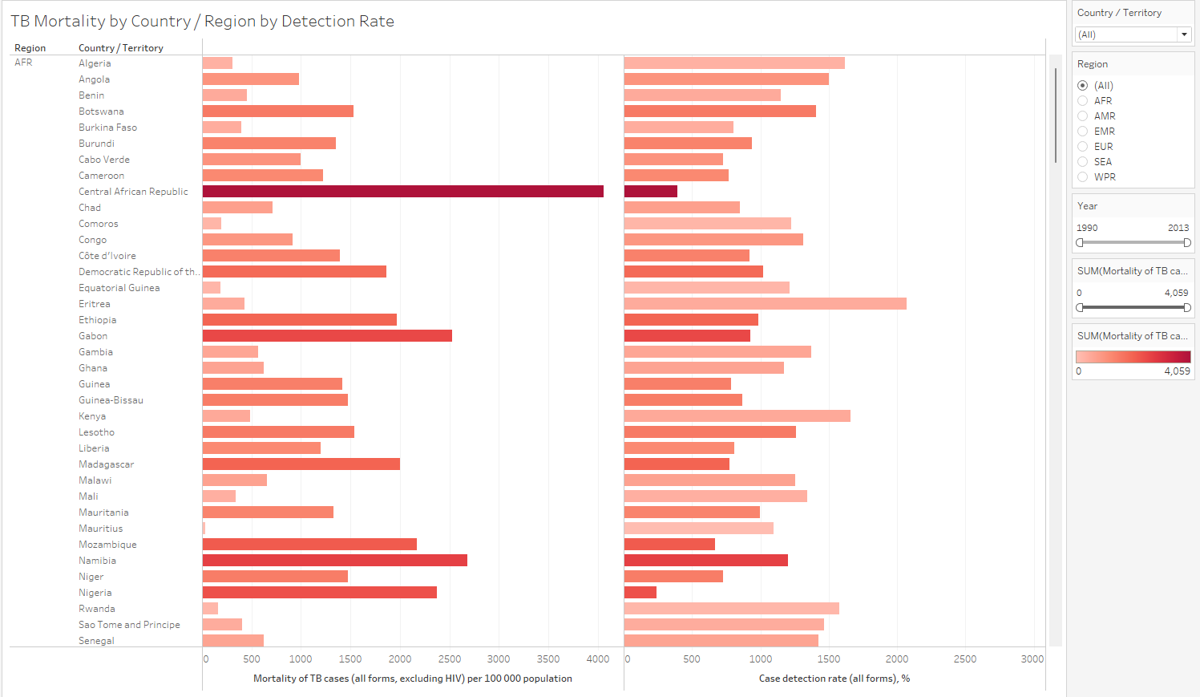
Mortality and Detection Rates
Notes:
Interesting point in this bar chart is that the Central African Republic in dark red has the highest mortality but has one of the lowest detection rates. The bar chart here helps to easily visualize the size differences between the two variables of mortality and detection rates.

Slide 10
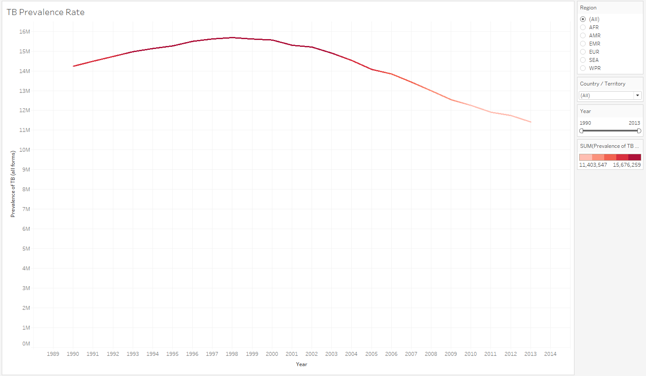
Prevalence Rate
Notes:
Here we can see that the prevalence rate has been on a steady decline worldwide. The line graph once again displays this perfectly showing the change in trend over the years.

Slide 11
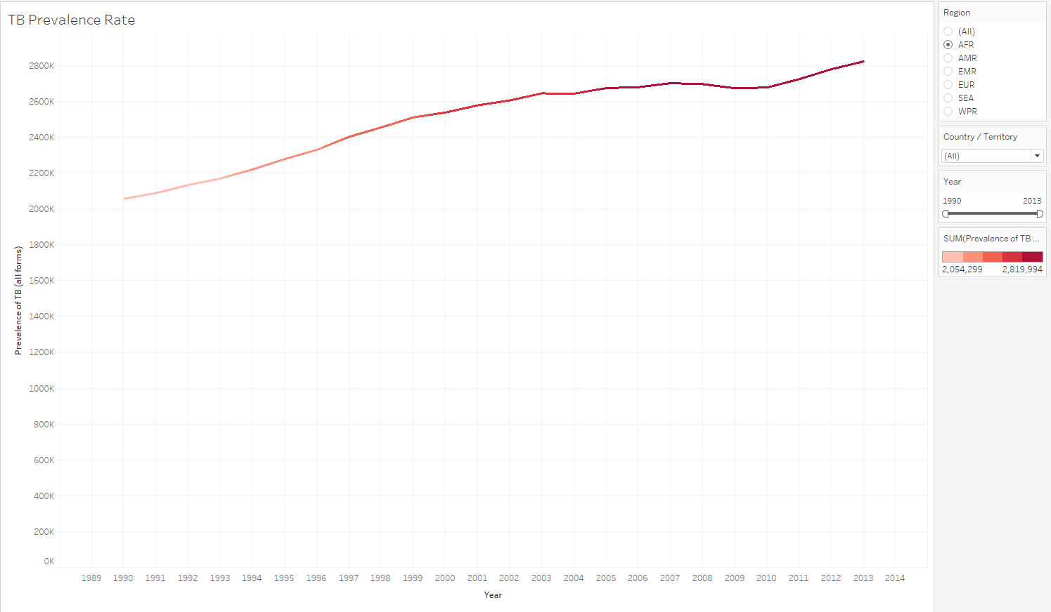
Prevalence Rate (AFR)
Notes:
However in Africa for example, the prevalence rate has been going up.
A high prevalence rate of Tuberculosis is considered bad since it means a significant portion of the population has the disease

Slide 12
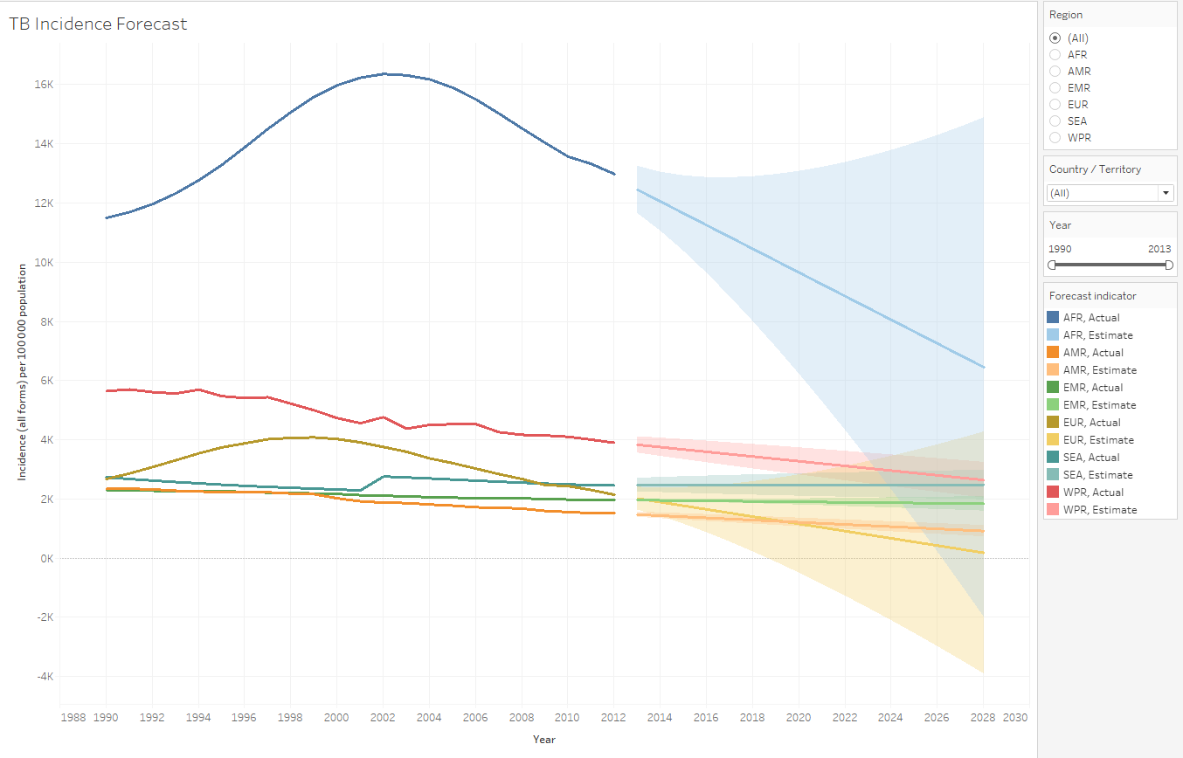
Does the Forecast Look Good?
Notes:
Incidence refers to the number of new cases of TB that occur within a population
Here, we can see that the projected forecast of incidence in the regions is predicted to decrease steadily and dramatically for Africa.

Slide 13
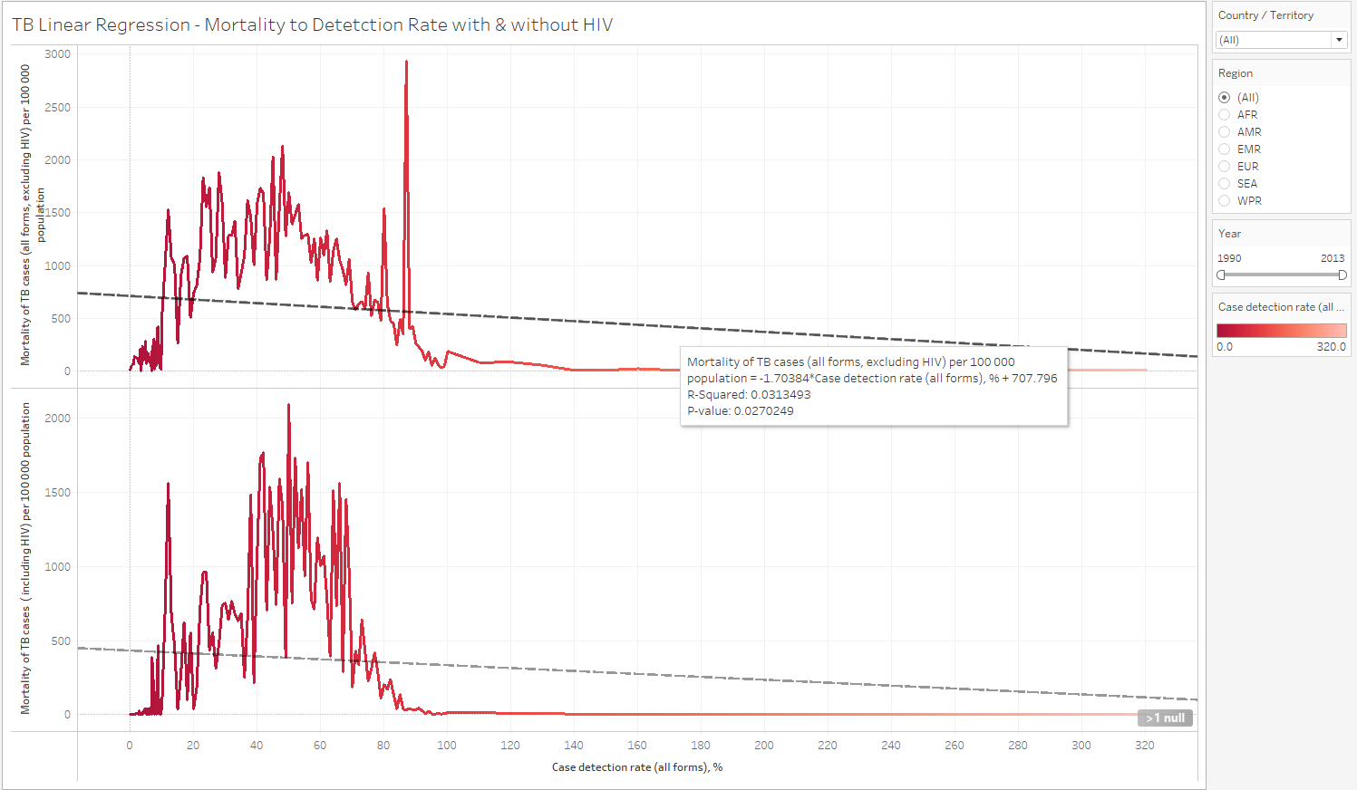
Is There a Correlation?
Notes:
From this linear regression model we can see that both charts have a low p-value meaning that the evidence is strong. As detection rates increase, the mortality rates decrease. This answers our main question as these two variables are indeed correlated.

Slide 14
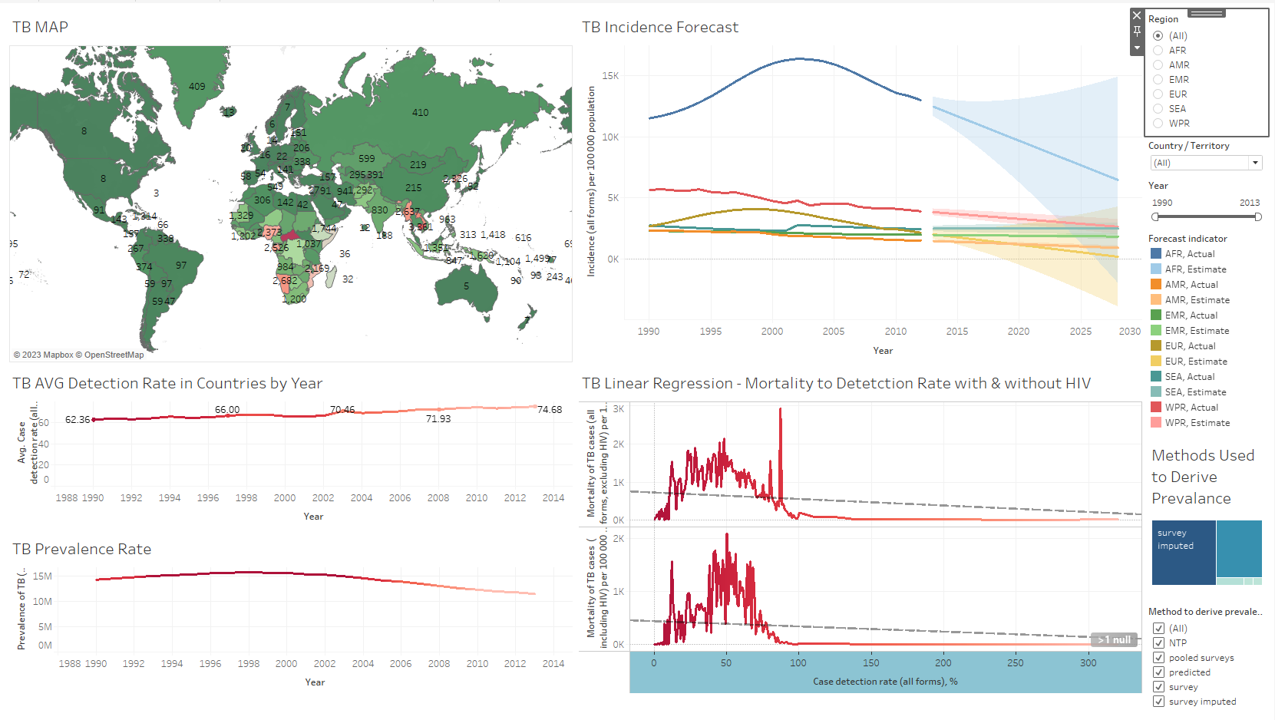
Dashboard Summary
Notes:
Here is the dashboard I created in Tableau showcasing the main visualizations to answer my question. I also included the Methods used to Derive Prevalence in the bottom right of the dashboard. There were 5 different methods such as pooled surveys, predicted, and survey imputed that were used to gather this data.

Slide 15
03
Challenges & Future
Notes:
One challenge I had early on was that there were some countries that did not have longitude and latitude values entered. So I had to go online and find these and import them myself.
A negative of the dataset I found was that it didn't showcase age and sex of the populations. I could have found more trends if this data was included.
For the future I would like to compare my visualizations with research online to see any similarities.

Slide 16
Thanks!
Notes:
Thanks for listening!

