Slide 1
NLP
Project
Jagvir
Notes:
Hi my name is Jagvir and this is my NLP project presentation on building a classifier model on duplicate Quora questions

Slide 2
01
Project Flow
Notes:
I’ll start with the project flow first

Slide 3
Steps Taken
EDA
Cleaning
Feature Engineering
Model
Evaluation / Results
Notes:
Firstly, I loaded in the data set and performed EDA by looking at the shape of the dataset, checking the column data types, and checking for missing values
I was able to find 3 missing values which were insignificant to the total pool of data, so I decided to drop them.
I then made features such as vectorizing the questions, finding the number of unique words with word2vec, and also the word counts for each of the questions
For the model I created a simple logistic regression
And then finally evaluated the results of the model

Slide 4
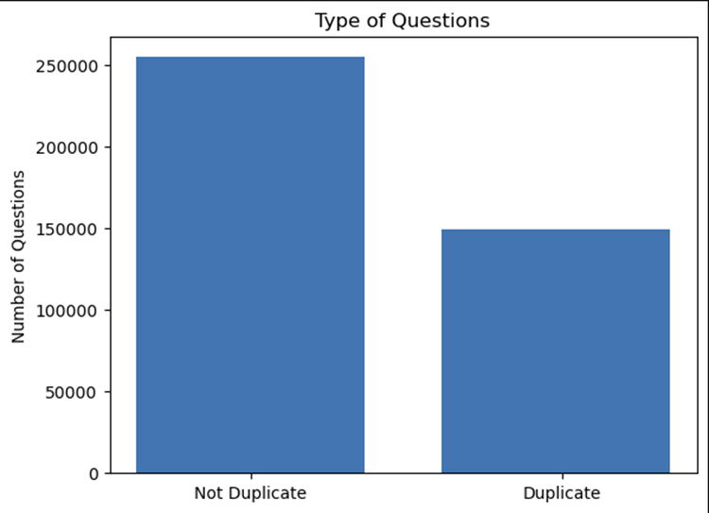
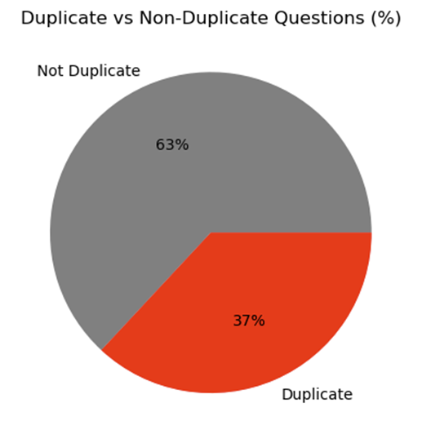
EDA Findings
Notes:
Here we can see that there are less duplicate questions then non-duplicates.
There are about 255,000 non duplicate questions and 150,000 duplicate question which translates to 63% and 37% respectively

Slide 5
Cleaning
Tokenization
Stopwords
Removing Punctuation
Stemming
Notes:
To make the cleaning process easier I decided to create a function which takes both of the questions as inputs to apply the various preprocessing steps to them.
The function starts with iterating through each question and tokenizing the question into individual words.
The function then converts all the words into lowercase, removes punctuation, removes non-alphabetical characters and also uses stemming to get the base root of each of the words.

Slide 6
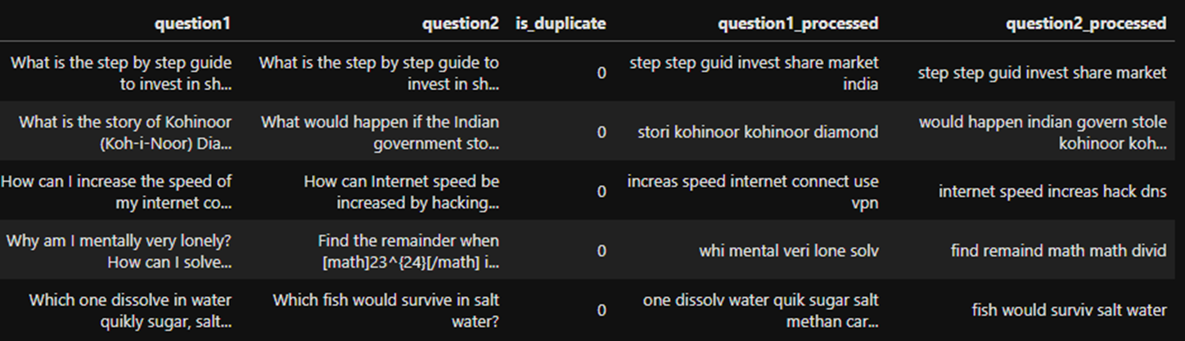
Before & After Processing
Notes:
Here we can see how questions 1 and 2 have been altered after going through the cleaning process
Off the bat it's quick to see that everything is lowercase and that all the stopwards are gone

Slide 7
02
Results
Notes:
I will now talk about my model results and evaluations

Slide 8
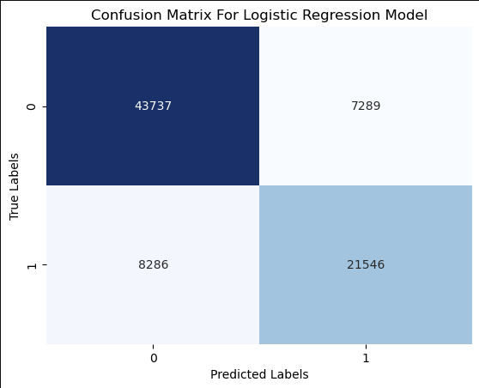

Logistic Regression Model
Notes:
The model I had time to include was the logistics regression model. This model type best fits sentiment analysis tasks that involve binary classification just like ours. As we are trying to predict the binary outcome of either duplicate or non duplicate.
From the confusion matrix we can see a lot of the questions were classified as true positives or duplicates and the other majority were true negatives or non-duplicates
Looking into more detail the evaluation metrics tell us much more about this model:
For example the accuracy score of 0.80 means the model was able to predict 80% of the questions with a precision score of 74%
The recall score shows us the percentage the model correctly identified as positives which is around 72%

Slide 9
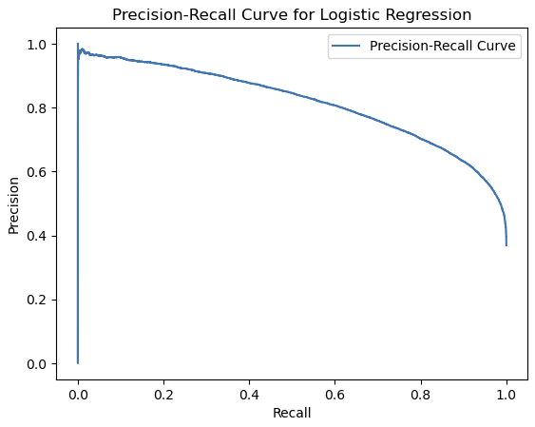
Notes:
And here we can see the precision-recall curve which is decent
This curve shows us the probability at which the model predicts the positive class depending on the tradeoff between recall and precision

Slide 10
03
Challenges & Future
Notes:
For challenges, i found it hard to vectorize the questions and combine them into my dataframe as I had to compress the data since my computer could not store it within my RAM capacity
And for the future I would like to test out more models and create some more unique features within the dataset

Slide 11
Thanks!
Notes:
Thanks for listening!

