Slide 1

Air and Fire: A study of California
Project 1 Team
Jagjeet, Jon, Robert, and Alex

Slide 2
The Questions Asked….
Comparing national fire data with California fire data
Comparing California fire data with California air quality data
Looking at the correlation of counties with the worst air quality and fires
Projecting fires into the future

Slide 3
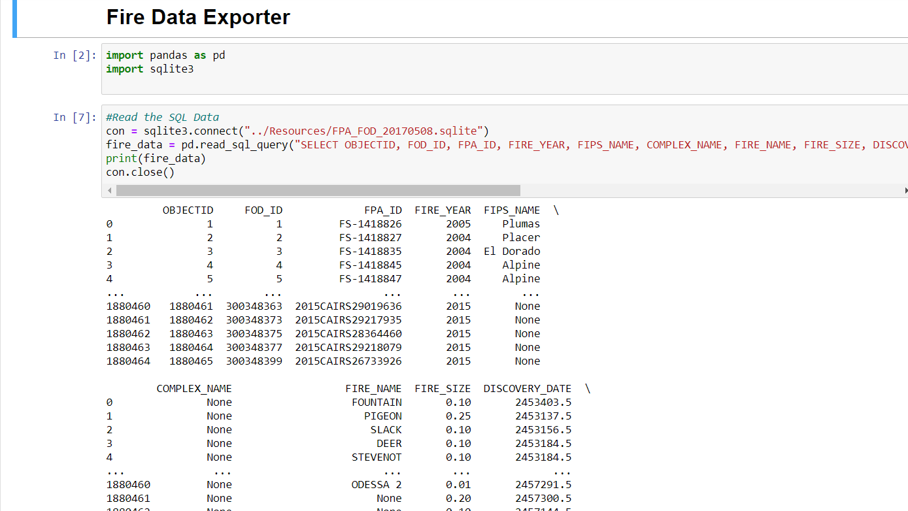
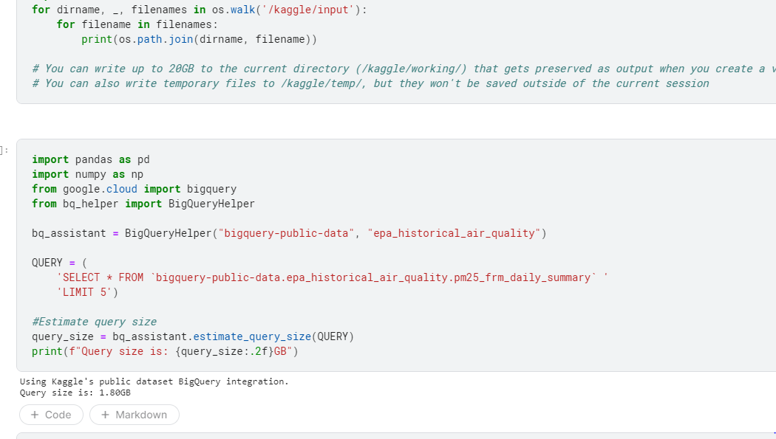
Data Collection Methods and creation of our Datasets
Fire Data
To obtain the fire data, we used a previously untaught method of SQLlite.
Air Quality
Used Kaggle to pull data using BigQuery, a Google product that is a serverless data warehouse.
Notes:
Both - Both use standard SQL queries to query the data from the SQLlite 3
Kaggle - Emphasize using ‘estimate_query_size’ in Kaggle Notebook before running queries to reduce data usage (share Kaggle page)

Slide 4
Analysis
Fire Data:
Total Acres Burned, and Number of Fires and Duration of Fire were used as measurement standards in our analysis
Air Quality
PM 2.5 Max value for the year was captured
Limitations
No trending of causes
Pollution: Cars/Buses/Planes do exist (we have to account for them but they are an unknown variable)
Not all locations in California are air monitored

Slide 5
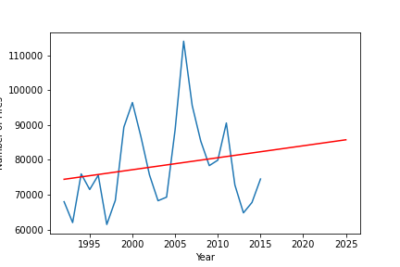
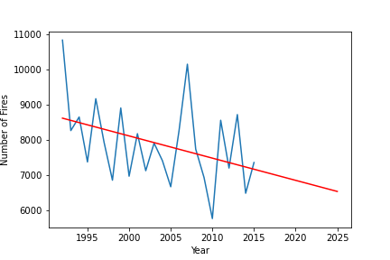
Fire Data- Total Number of Fires
National
California
Notes:
Data is through 2015 (Drought and Wet years in ‘16-20)

Slide 6
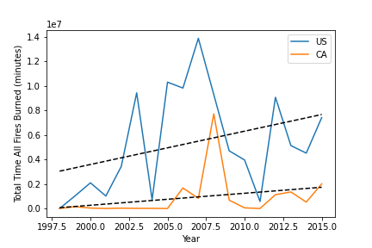
Total Fire Duration
Notes:
California and US

Slide 7
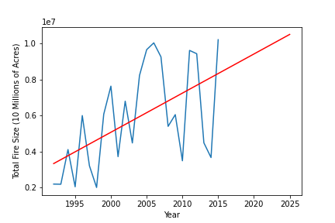
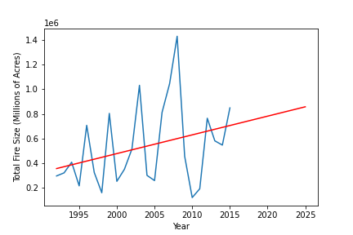
Fire Data- Total Fire Size (Acres)
National
California

Slide 8
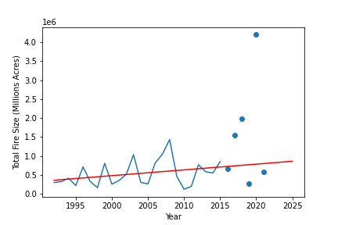
Fire Data- CA Total Fire Size (Acres) Predicted vs Actual (CalFire)
Notes:
-Comparing how good our projection was
-Scatter plot points correspond to 2016-2021 (year to date)

Slide 9
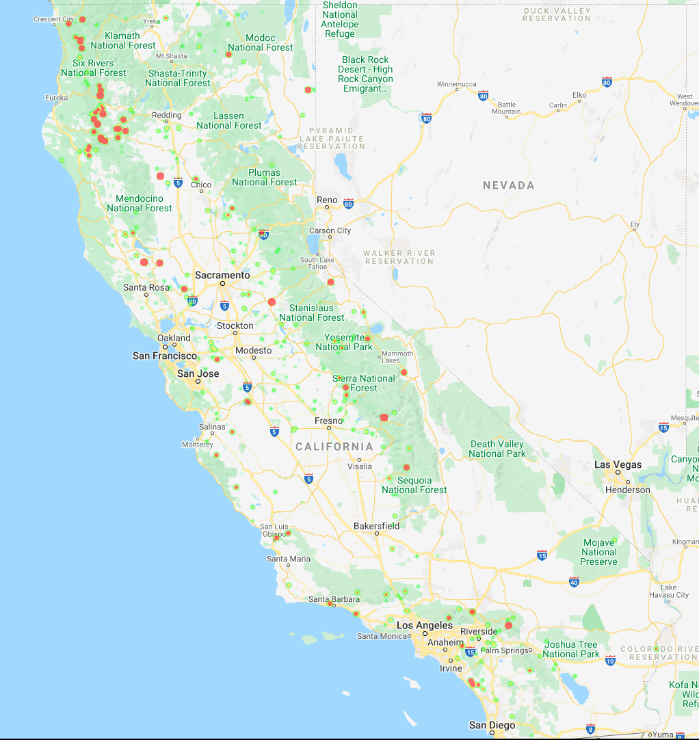
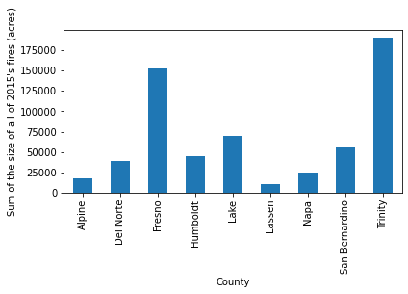
Fire Data
Heat map of fires in 2015 with the weight being based on the fire size (total acres burned)
Notes:
-Bar Chart = Create a group based on the values in the 'fips_county' column with more than 10,000 total acres in 2015 - Bar Chart

Slide 10
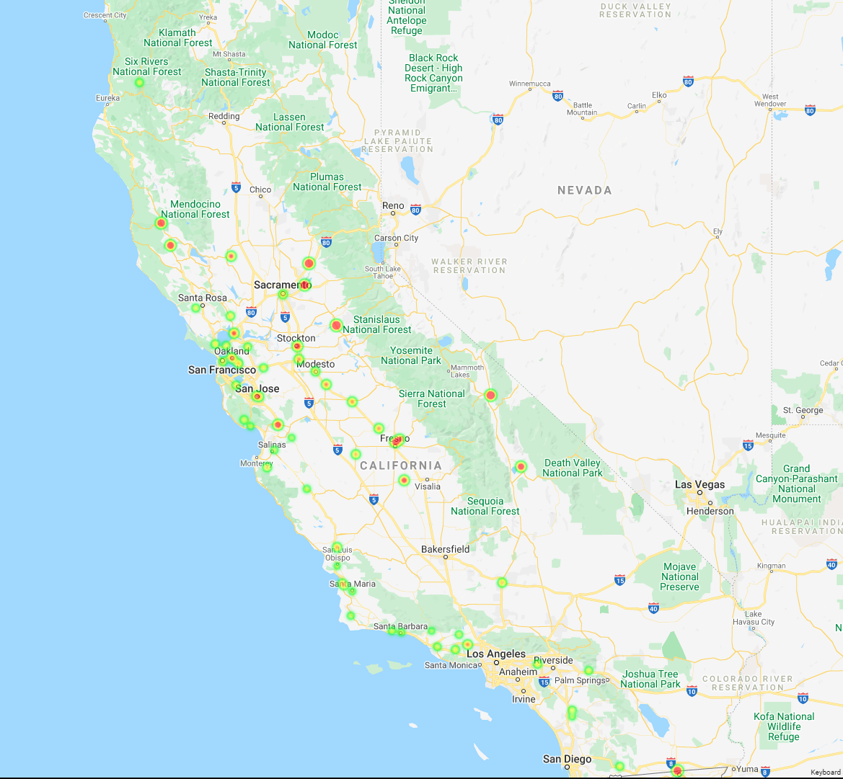
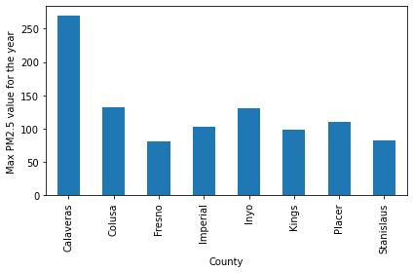
Air Quality Data
Map of max PM2.5 values for the year of 2015
Notes:
-filter air quality data for 2.5 PM /24 hr duration/2015
-chart shows only counties with max value > 75 PM2.5

Slide 11
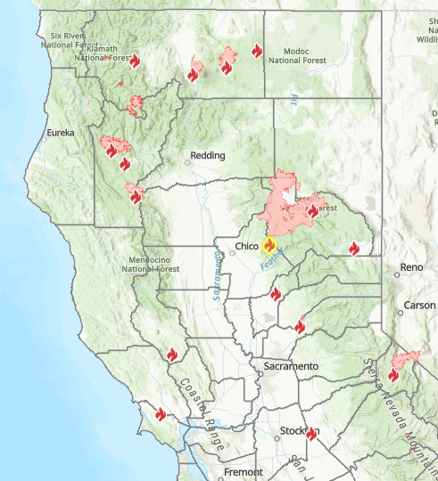
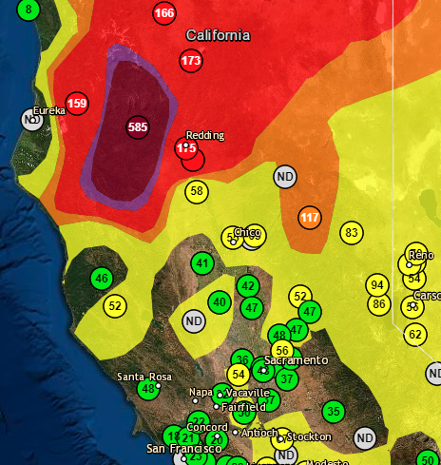
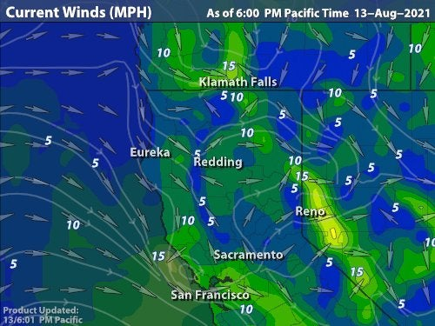
Conclusion:What goes up in the air, must come down, but where is the question?
The data shows that while fires are concentrated in only a few counties (Fresno, Lake, San Bernardino, Trinity) the worst Air Quality numbers were in other counties (Calaveras, Placer, Inyo)
Notes:
Wind is a major factor in how and why air quality numbers end up where they are…
All three maps pulled 8/13/2021 - Focus on Dixie Fire Area

Slide 12
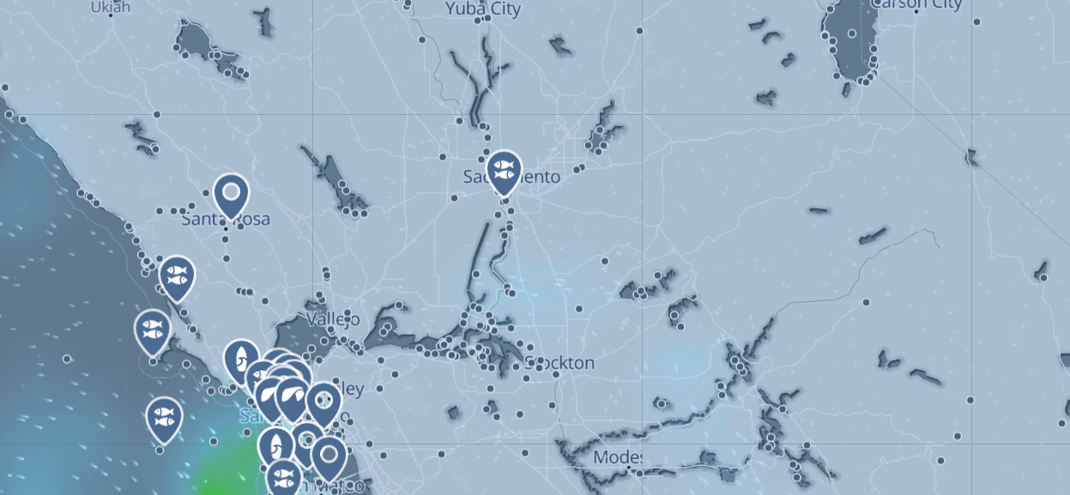
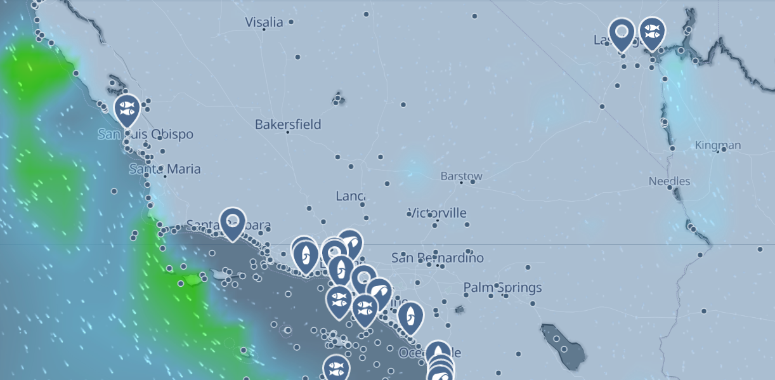
Conclusion:What goes up in the air, must come down, but where is the question?
Wind patterns throughout California when examined, play a major part in pushing smoke and ash in some cases hundreds of miles from where a fire takes place.
For example, Trade winds from San Francisco routinely push air debris into Stockton/Sacramento, and further into the Sierras.
Similarly, Wind patterns in Southern California push air debris from Los Angeles Northeast into San Bernardino, Lancaster, Bakersfield and Inyo County.

Slide 13
Questions?

