Slide 1

C.V. RAMAN GLOBAL UNIVERSITY BHUBANESWAR, ODISHA
LLM-Based RAG Chatbot in AI&DS
Team Members
NAME | REGD. NO.
Jagjeet Moharana | CL2025010601900462
Shreyasi Utthasanee | CL2025010601962876
Soubhagya Kumar Pradhan | CL2025010601883012
Sai Shiva | CL2025010601902684
Sumitra Pradhan | CL2025010601870614
Bhumika Rani Das | CL202501060186964

Slide 2
Contents
Sl no. | Topics
1. | Introduction
2. | Problem Statement
3. | Literature Review
4. | System Architecture
5. | Implementation
6. | Results & Evaluation
7. | Applications
8. | Limitations
9. | Future Enhancements

Slide 3
Introduction
Recent advances in AI and NLP have made chatbots smarter, but most still give generic answers and rely on the internet, raising privacy concerns. Our offline chatbot solves this using Retrieval-Augmented Generation (RAG), which lets it search your own documents—PDFs, text files —and give accurate, context-based answers without needing the internet, ensuring full privacy and security.

Slide 4
Problem Statement
Information Overload
Users often deal with huge documents (e.g., research papers, contracts) and struggle to find exact answers quickly.
Limitations of Traditional Chatbots
Most existing chatbots:
Give generic responses, not tailored to specific documents.
Depend on cloud services, leading to data privacy risks.
Need for an Offline, Secure Solution
A chatbot is needed that:
Works offline – no internet needed.
Keeps data private – nothing is sent to external servers.
Understands user-uploaded documents and gives accurate, context-aware answers.

Slide 5
Literature Review
Key Concepts
Technologies Used
Large Language Models (LLMs)
Examples: GPT, BERT, LLaMA
→ Trained to understand and generate human-like language.
Retrieval-Augmented Generation (RAG)
→ Retrieves relevant text from documents and generates answers based on that context.
→ Ensures more accurate and document-specific responses.
FAISS (Facebook AI Similarity Search)
→ Fast and efficient search for similar chunks of text using vectors.
Sentence-Transformers
→ Turns document text into semantic vector embeddings (understandable by the model).
LangChain
→ Helps connect LLMs with tools like document loaders and memory systems.
llama.cpp
→ Allows running LLaMA models locally, even on GPUs – no need for internet.

Slide 6
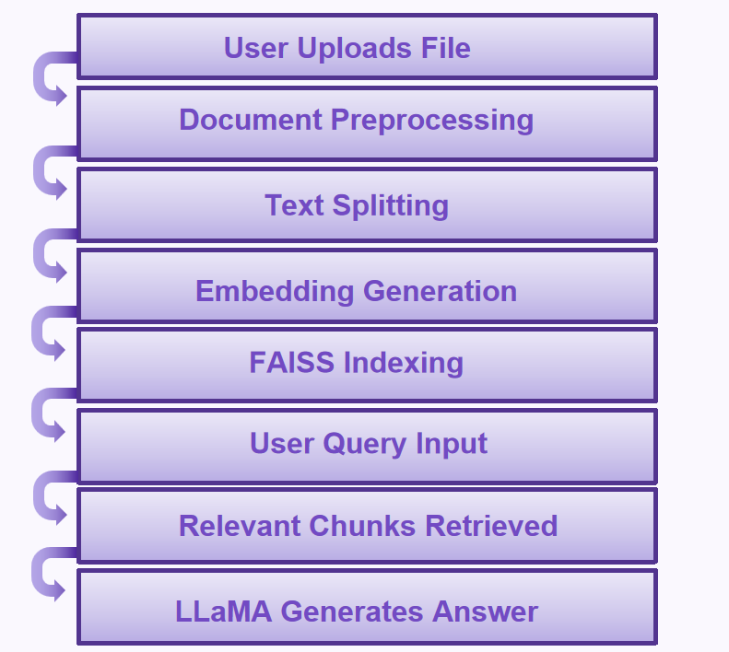
System Architecture

Slide 7
Implementation
Frontend (app.py) – Built with Streamlit
User-Friendly Interface
Streamlit provides a simple web interface where users can upload PDF/TXT files and enter their queries easily.
Live Interaction
The user’s input and chatbot’s response are shown in real time, making it visually clean and easy to read.
No Coding Knowledge Required
Anyone can use the chatbot just by uploading documents and typing queries—no technical skills needed.

Slide 8
Backend (chatbot.py) – Core Processing
RecursiveCharacterTextSplitter
To enable efficient retrieval and question-answering over large documents, the chatbot first splits documents into manageable text chunks using a smart text splitter from LangChain.
Breaks document into chunks of 1000 size (characters)
Adds overlap of 200 (characters) between chunks to preserve context continuity
Recursively splits on preferred boundaries to maintain semantic structure.
SentenceTransformer for Embedding
Converts chunks of the document into numerical vectors that represent semantic meaning, allowing the system to understand the content. We use a pretrained model – all-MiniLM-L6-v2 that creates 384-dimensional embeddings that work well for tasks like semantic search and RAG.
FAISS for Similarity Search
These embeddings are stored in FAISS, which quickly retrieves the most relevant parts of the document based on the user’s query.
LLaMA via llama-cpp-python
This is the language model that runs locally (on CPU) and generates human-like, context-aware answers without any internet dependency.
LLM Model used: Mistral 7B Instruct v0.1

Slide 9
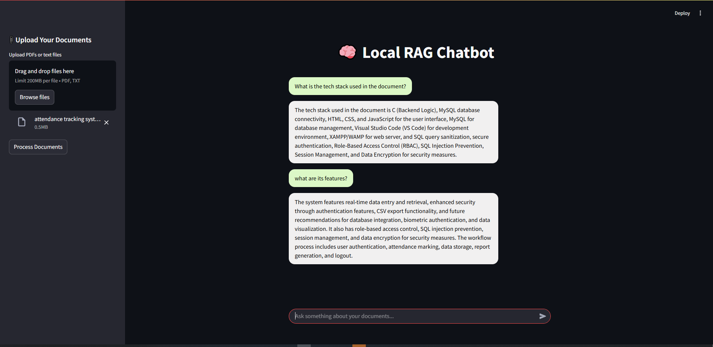
Result

Slide 10
Applications
01
02
03
Academic and Research Assistance:
Query research papers, journals, and theses.
Summarization and keyword extraction.
Healthcare and Medical Records:
Extract relevant patient data from reports.
Analyze hospital records while maintaining privacy.
Corporate Knowledge Base Assistant:
Query internal company documents without cloud reliance.
Increase productivity by reducing manual searches.

Slide 11
Limitations & Future Enhancements
We’re using pure vector similarity (FAISS). It works well, but there is no keyword-based filtering or re-ranking using LLMs or confidence scores.
Implement session memory so the bot remembers previous interaction. Use LangChain's ConversationBufferMemory or a custom context tracker.
We’re only having support for .pdf & .txt files only. We can add support for more file types like .doc, .html, .csv, etc and also for images. Fine tuning the model for domain-specific use cases like for lawyers (case files), doctors (patient reports), students (notes + textbooks) Turning this into an application that can be installed and used directly.

Slide 12
Thank You

