Slide 1
Finding Similarity between Toronto and New York

Slide 2
This prediction is valuable for People across various walks of life.
This Analysis is very useful for anyone who is trying to analyze the two cities in terms of the diversity of avenues these two cities offer. This is one of the problem we can try to research through this.
We can also infer the Business Idea which would flourish the best in two cities.
Assumption:
The neighborhoods which have the maximum number of venues would be the most visited and most popular place to live

Slide 3
Data acquisition and Cleaning
The Data for the two cities will be taken from a New York Data set here
We will scrapping the Wikipedia Page https://en.wikipedia.org/wiki/List_of_postal_codes_of_Canada:_M, for Toronto and will be combining the Geo-spacial data for Toronto from the link here.
In addition we are going to use data from Four-Square which is going to give us the details of the venues.
Some neighbor hoods have same names across boroughs, so will be concatenating them with borough.
Using only first 100 neighborhoods for comparison from each city, New York has huge data.

Slide 4
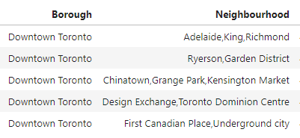
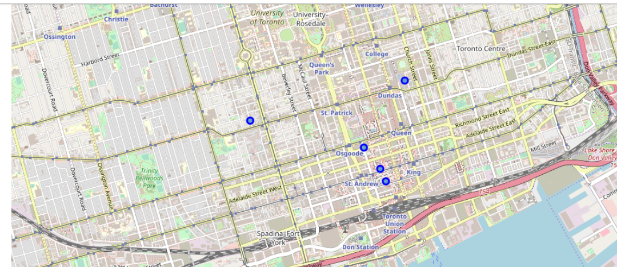
Most famous 5 neighborhoods in Toronto

Slide 5
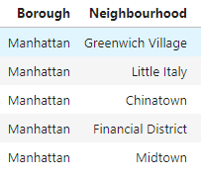
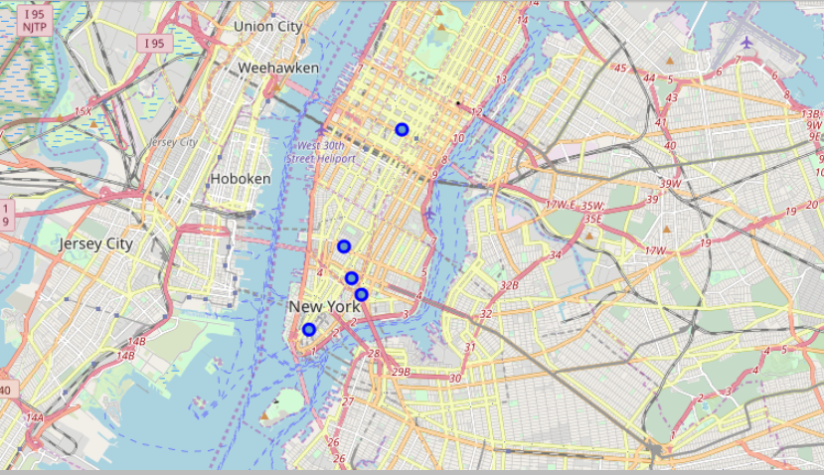
Most famous 5 neighborhoods in New York

Slide 6
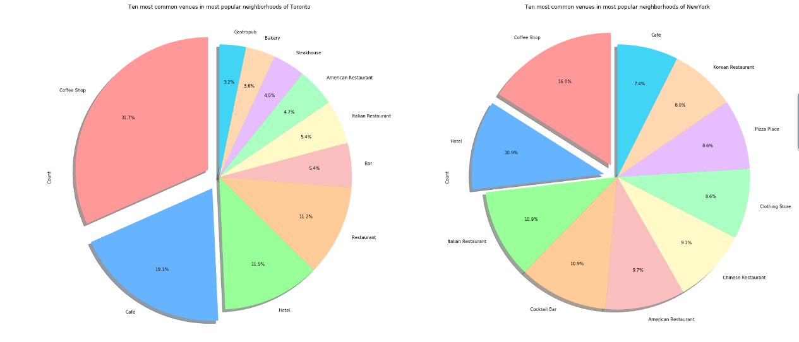
Ten most popular Venues in Toronto and New York

Slide 7
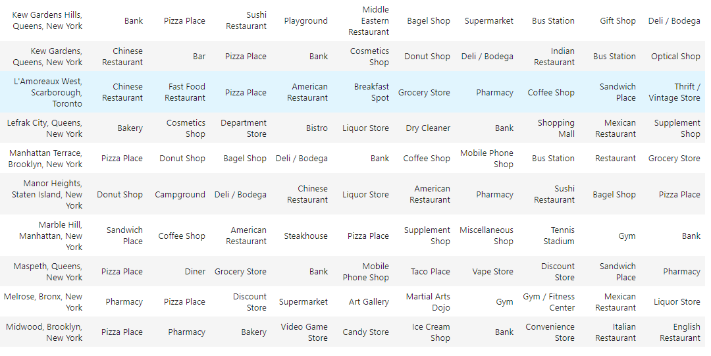
Clusters of Similar Neighborhoods in Toronto And New York
Data is divided into 11 Clusters, which will group the similar neighborhoods of both cities. One of the cluster is below where We can see above that L’Amoreaux West in Scarborough, Toronto is similar to various neighborhoods of New York like Marble Hill, Maspeth, Lefrak City.

Slide 8
Conclusion and Future Directions
Captured the similar neighborhoods in Toronto and Canada.
Data gives us the overview of most popular venue categories in both cities.
Manhattan and Downtown are the most venue rich in New York and Toronto respectively.
Improvement includes:
Large Data disparity is there for two cities, if that could be covered up we can have more intense comparison.

