Slide 1
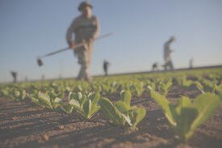
AED FINAL PROJECT 2018
HELPING HAND FOR FARMERS
Team name: Pheonix

Slide 2
Problem Statement
Agriculture is one of the important economic sectors in any country.
As the agriculture sector is booming, commodity prices are also increasing which makes it harder for the next-generation farmers to enter the business because of certain issues.
Firstly, with prices as they are today, it’s difficult for them to secure the financing they need. Only the established farmers can secure a loan easily. The young farmers find it difficult to enter the business with financing issues.
Secondly, staying in remote areas it gets difficult for them to go and buy supplies from different suppliers.
Finally, in order for the new farmers to be successful, they should have good knowledge on the business and well- educated.
With so much to handle, it becomes hectic and time-consuming for a farmer to carry out the farming.

Slide 3
Providing a helping hand to the farmers
Integrate all related systems at one place and offer an application to the farmers.
This application offers a platform where the farmers can register themselves and apply for a loan easily while tracking the status of the loan and notified on e-mail about the final status.
Also, the farmers can order supplies required for farming at reasonable price on the same application.
If the farmers are not able to register themselves, a NGO will help them through the entire process of applying for a loan or ordering supplies. It will also educate them and teach about the new technologies in agricultural sector.
This application is also connected to the bank enterprise who will evaluate and notify the farmers about the final status.

Slide 4
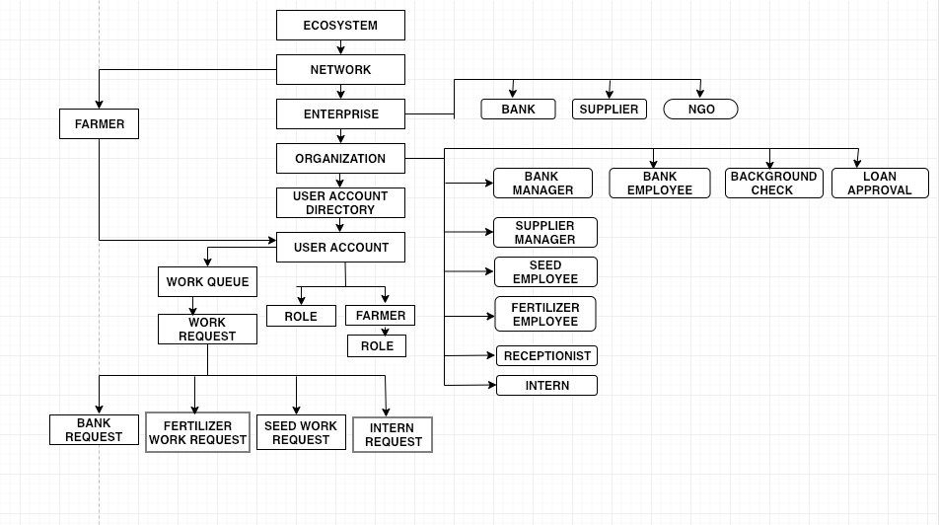
Object Model

Slide 5
Roles included:
System admin:
Sets up the system at the first login. It creates a Network, Enterprises and Enterprise admin.
Enterprise admin:
Manages the enterprise and the associated organisations with it. It can create employees and their respective user accounts.

Slide 6
Enterprise admins
Bank Enterprise admin:
Sets up the employee, Background check department, Loan approval Department and Manager Organizations. Creates a respective User Account for each organization and manages the workflow between multiple organizations.
Supplier Enterprise admin:
Sets up the Manager, Fertilisers and Seeds organization along with a different User Account for each.
NGO Enterprise admin:
Sets up the Receptionist and Intern organization to help farmers educate and raise requests for them. Manages the workflow between bank and supplier organization.

Slide 7
Active Users/Roles
Farmer
Bank employee
Bank Manager
Background check bank role
Loan Approval department role
Supplier Manager
Seed Organization Employee
Fertilizer Organization Employee
Receptionist
Intern

Slide 8
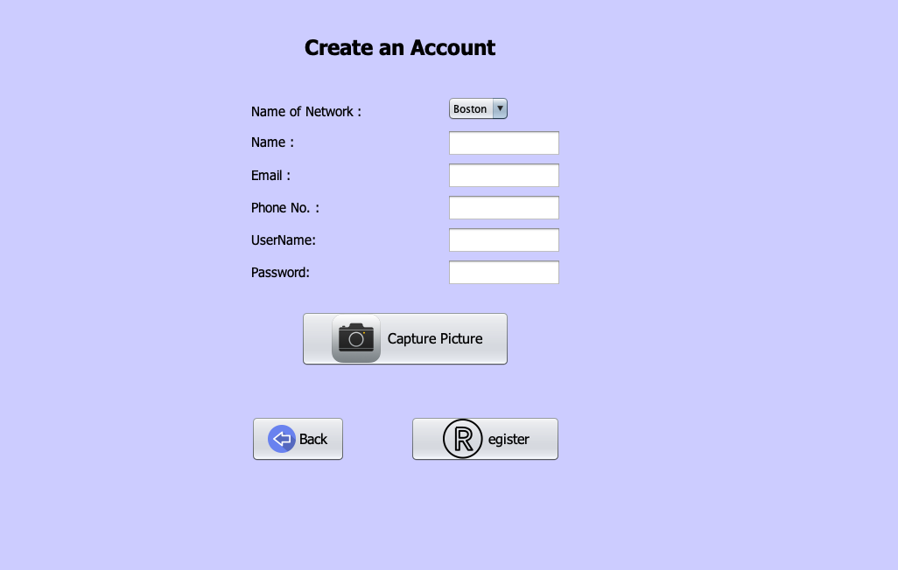
Farmer Register Screen
Farmer needs to login the application to use the features. The farmer creates a Username and Password along with a picture to register.

Slide 9
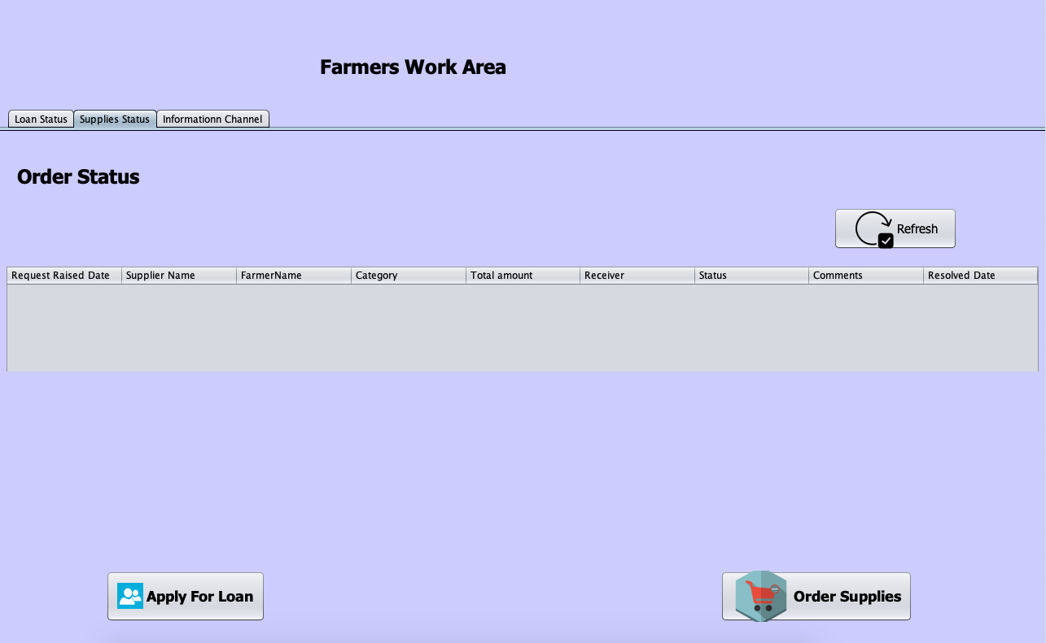
Farmer Login Screen
After the farmer logs in, he can choose to either apply a loan, order supplies or learn educative videos.

Slide 10
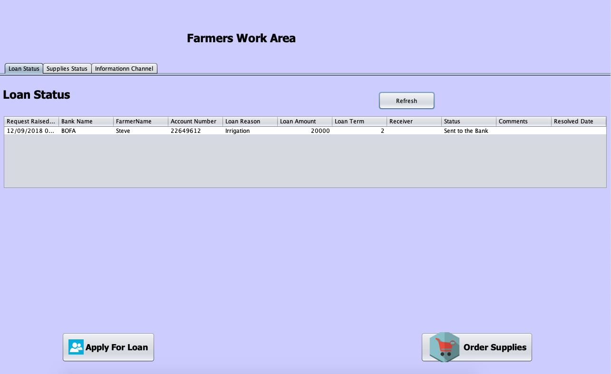
Checking the status
Farmers can check the status of the applied loan, ordered supplies or even watch productive videos.

Slide 11
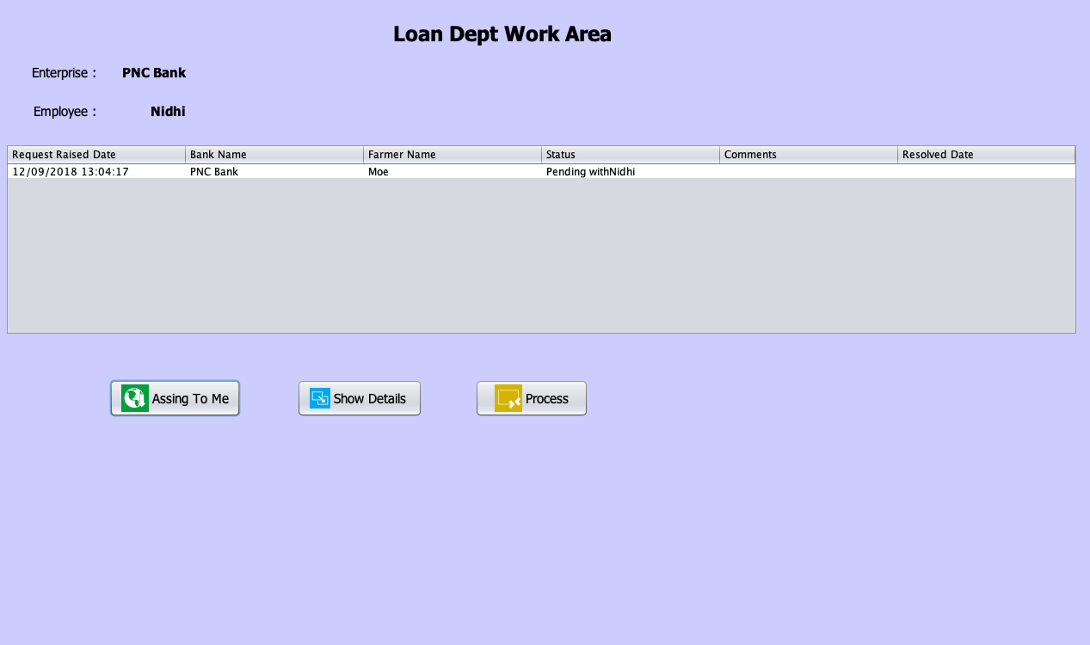
Bank Login Screen
When the bank employee opens his work area, he can see a loan raised by a farmer and assign to himself.

Slide 12
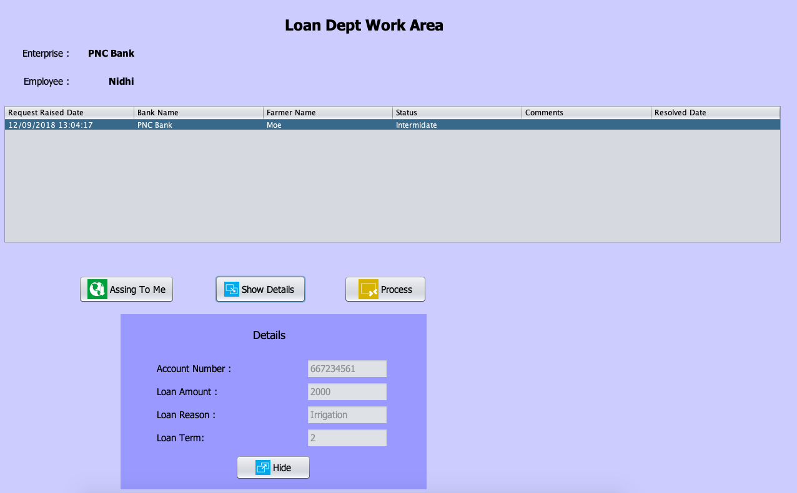
Bank Login Screen
The employee can view the details of the farmer and also process the request. The status changes to “Intermediate” now.

Slide 13
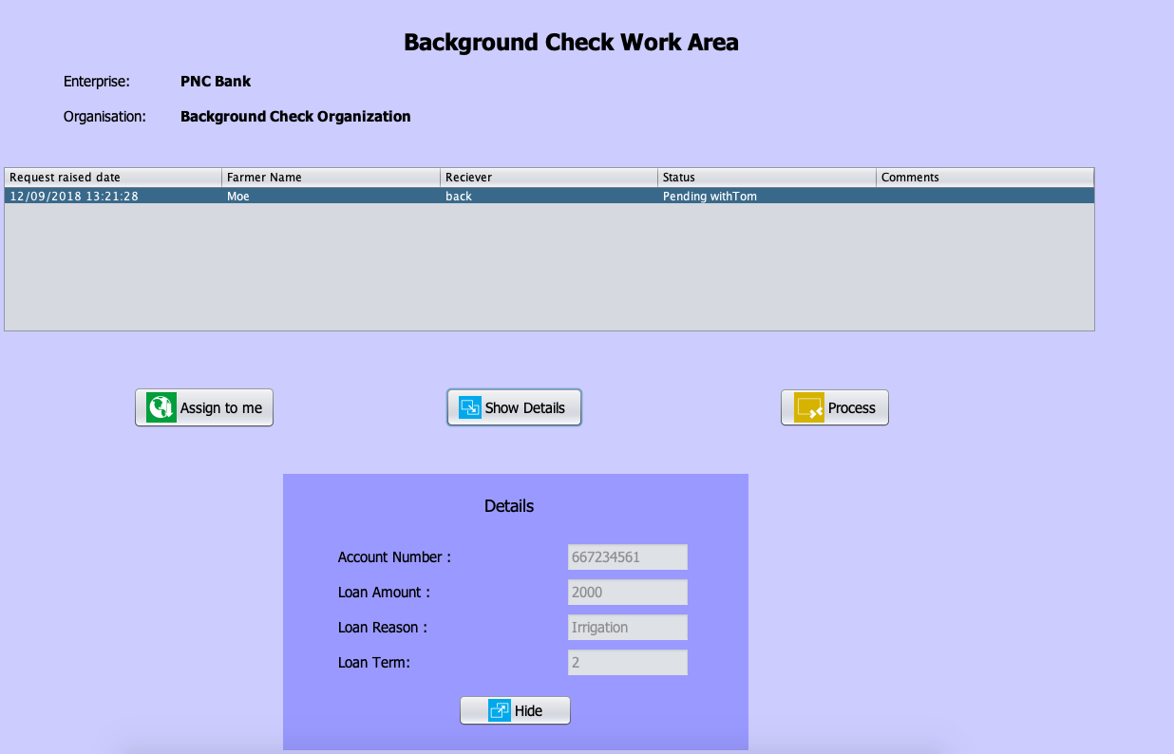
Background Check Login Screen
There is a request in the Background work area where they can view or hide details and when the employee assigns it to himself, he can process the request further.

Slide 14
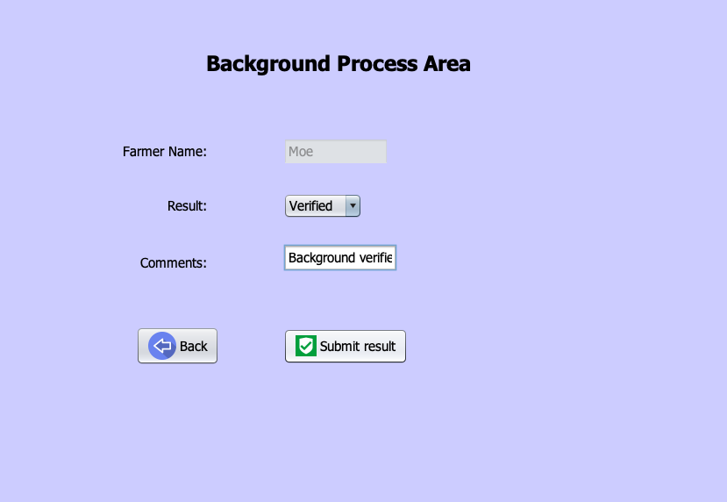
Background Check Process Screen
The employee can verify it or reject it along with optional comment section.

Slide 15
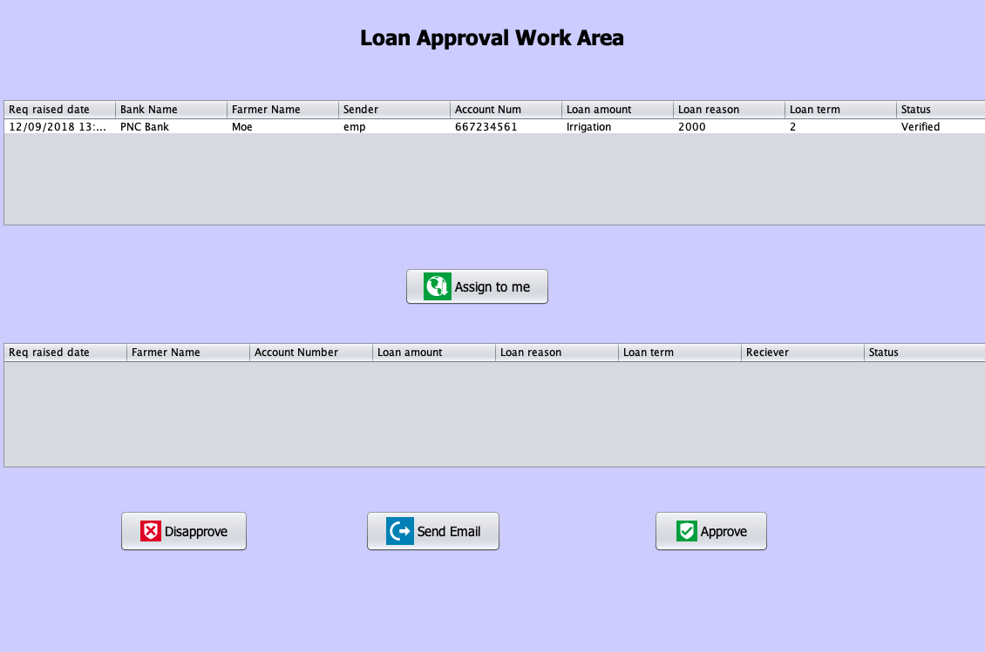
Loan Approval department Login Screen
When the employee logs in the work area, he can view request in the work area and can assign to himself to complete the process and send the farmer an email about the same.

Slide 16
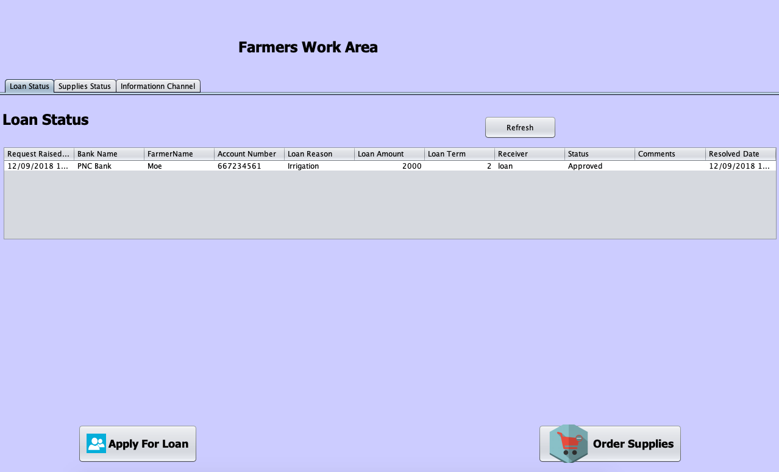
Farmer Work Area
When the farmer checks his work area, he can see the status of the loan as “Approved”

Slide 17
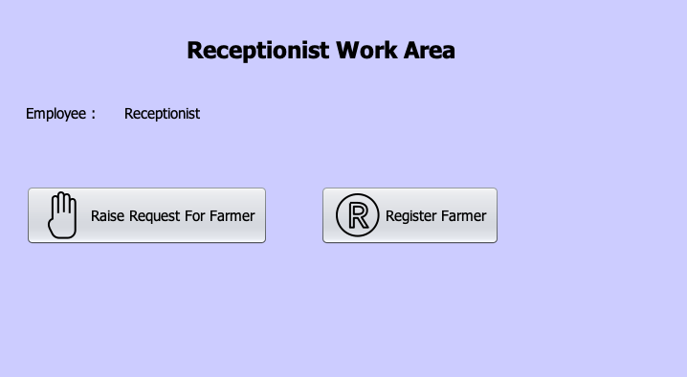
NGO Organization
The login screen of the receptionist working at NGO

Slide 18
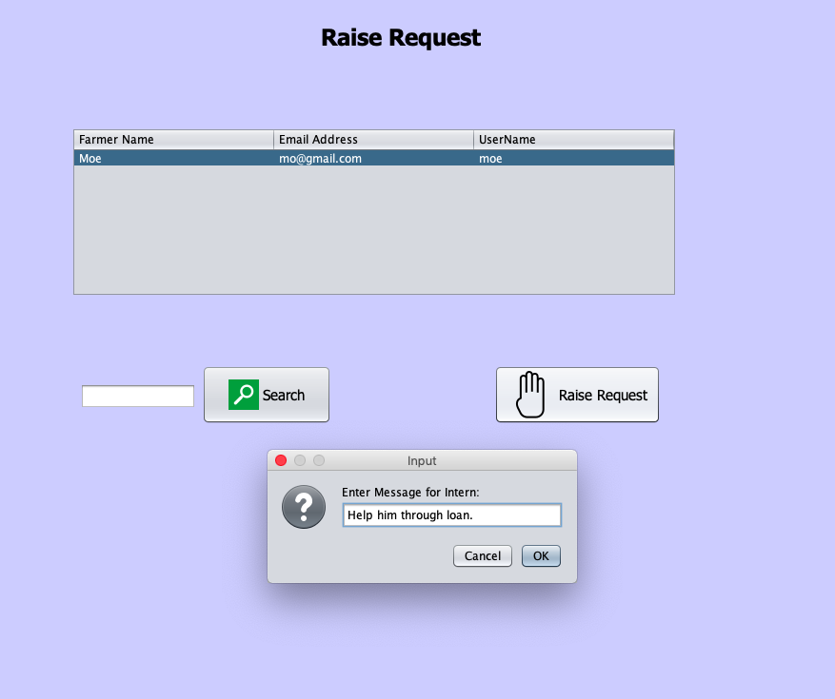
The receptionist can either register the farmer or raise a request to the Intern along with a message. If the farmer is already registered, intern can carry out the further process.

Slide 19
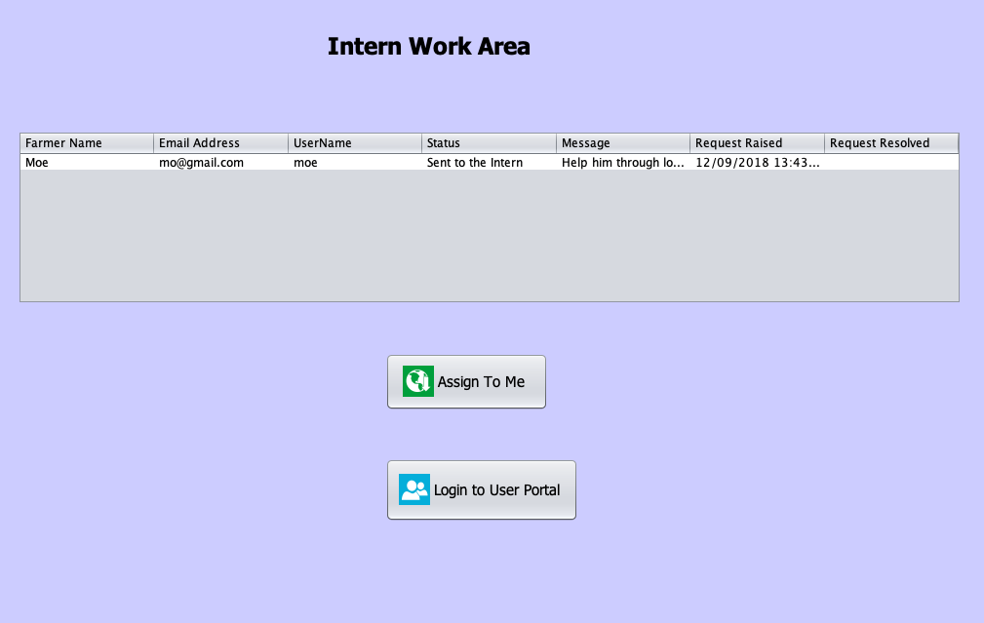
Intern Work Area
There is a request in the work area of Intern. He can assign it to himself and apply for a loan or order supplies on farmer’s behalf.

Slide 20
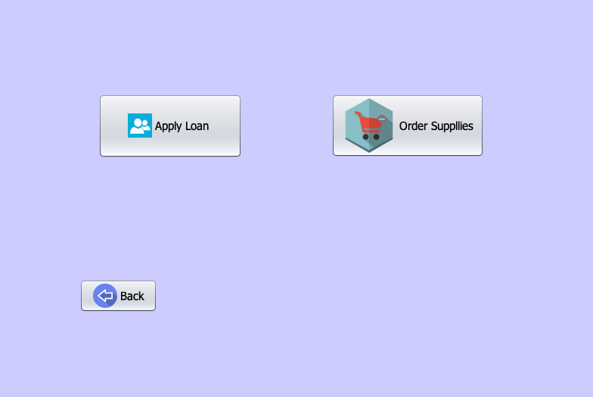
The intern can assign the request to himself and process it further by clicking on “Login to User Portal”

Slide 21
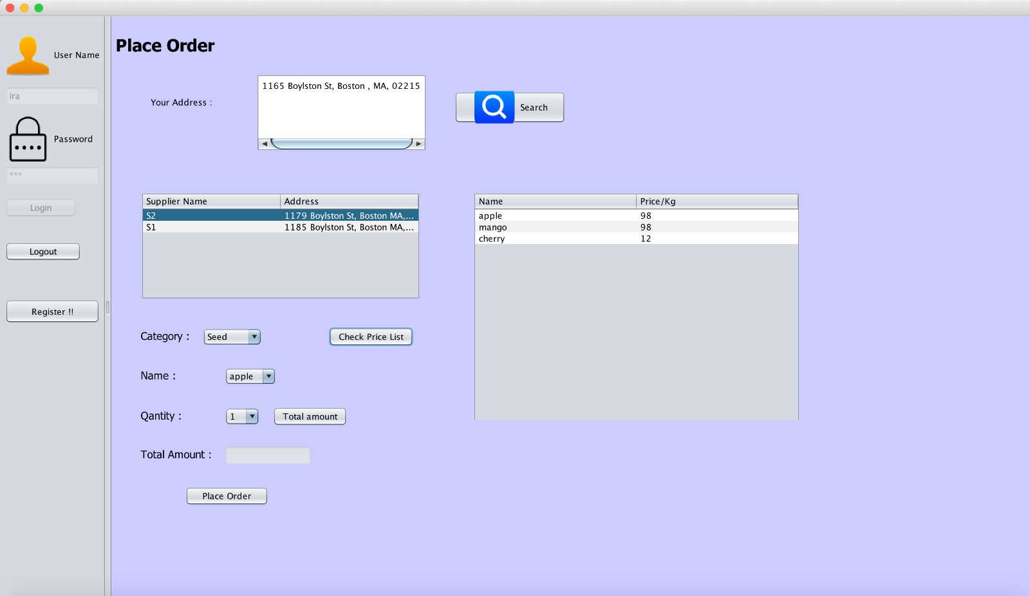
Farmer Work Area to order Supplies
Farmer can choose the closest location of the Supplier to place an order.

Slide 22
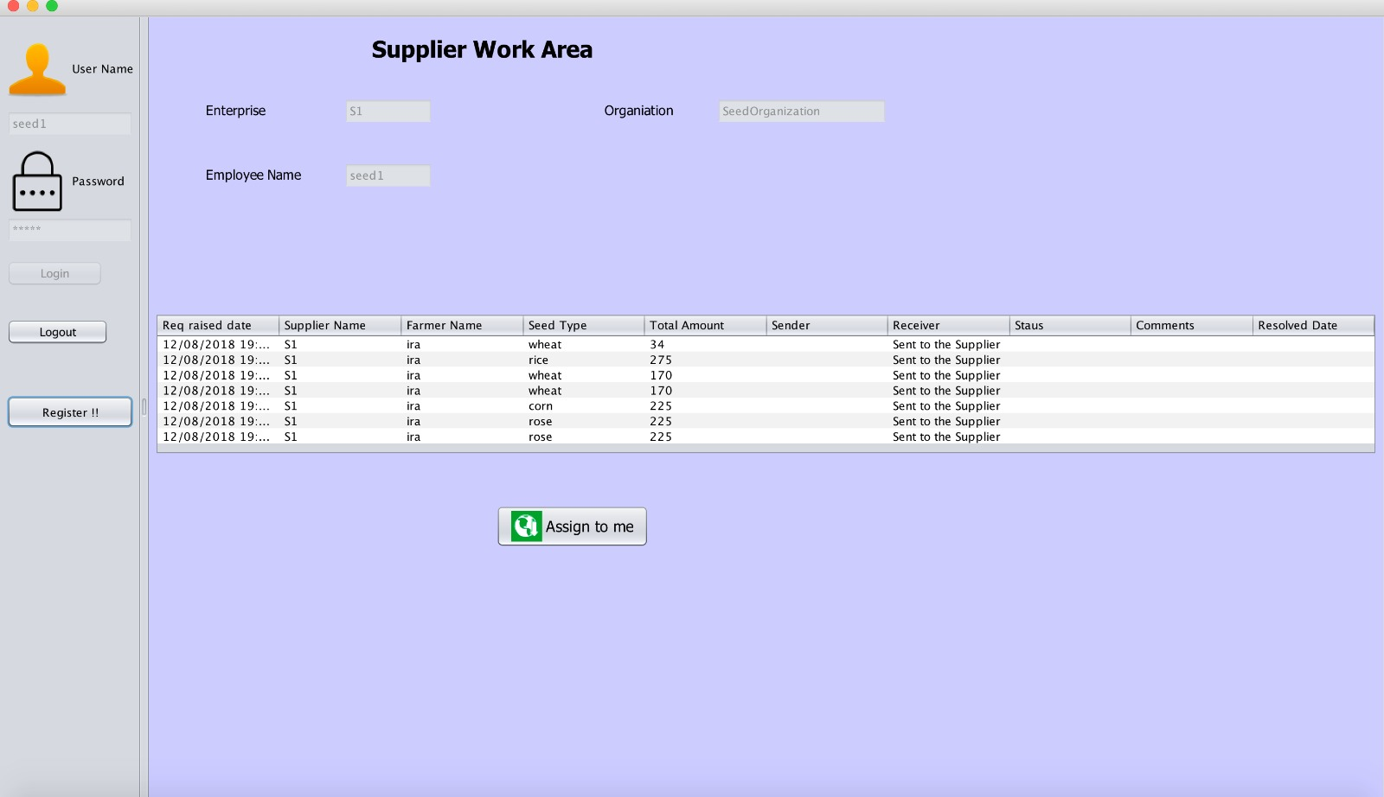
Supplier Work Area
The supplier can check the orders received and also assign them to process the order further.

Slide 23
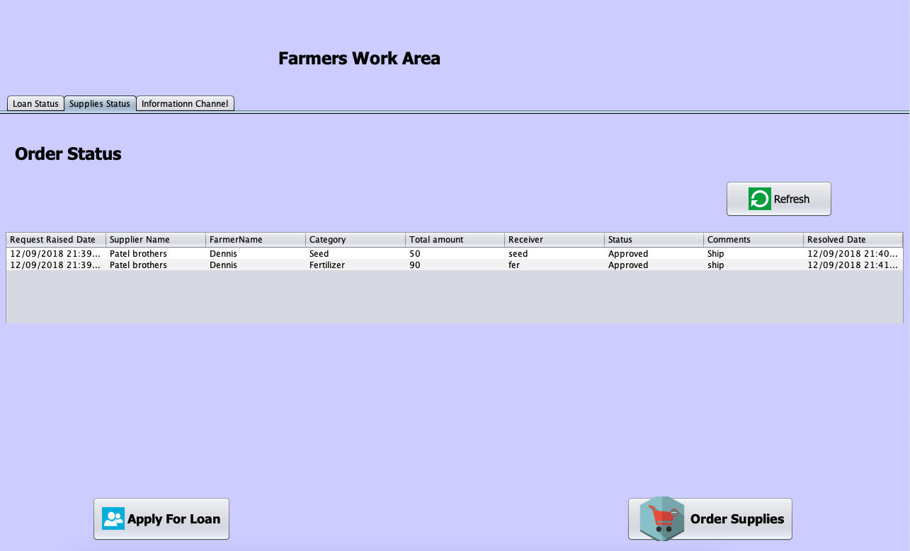
The farmers are notified when the product is approved and ready to ship.

Slide 24
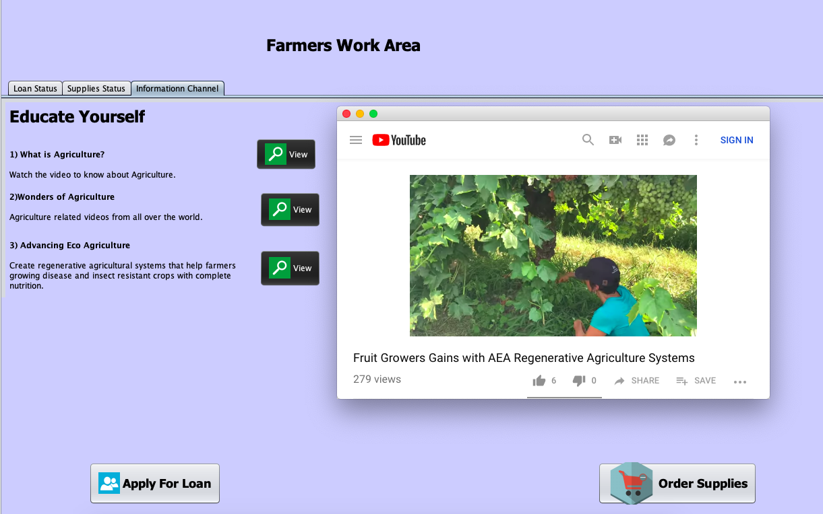
Additional Features
Online Video lessons
The farmer can view educative videos on the application itself to improve the productivity.

Slide 25
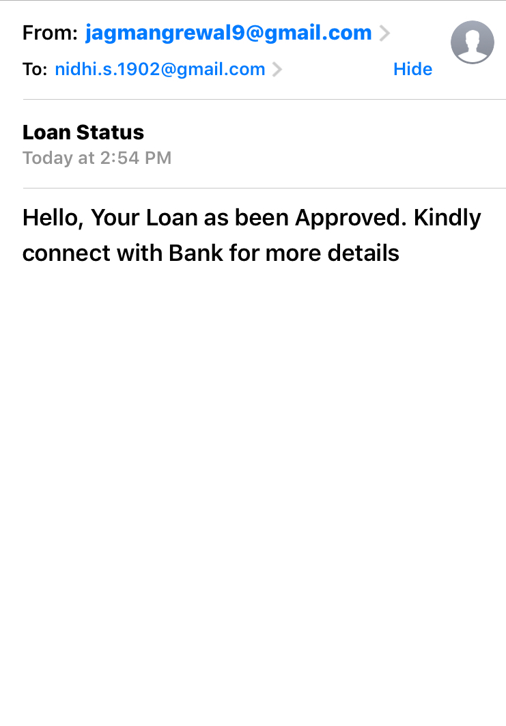
E-mail notification to the farmer
When the loan is processed, the final decision is e-mailed to the farmer.

Slide 26
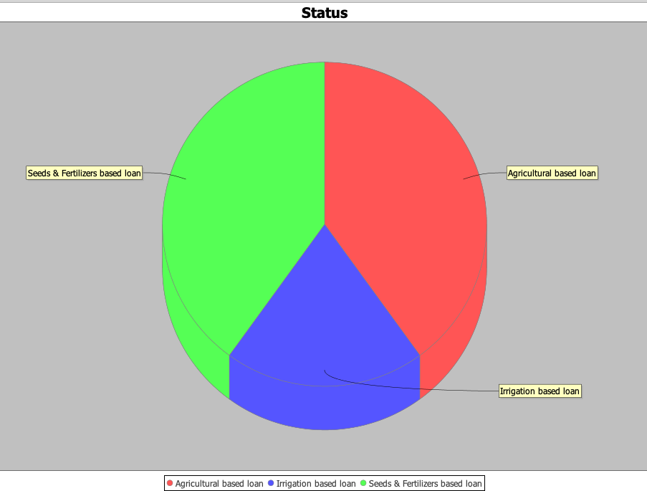
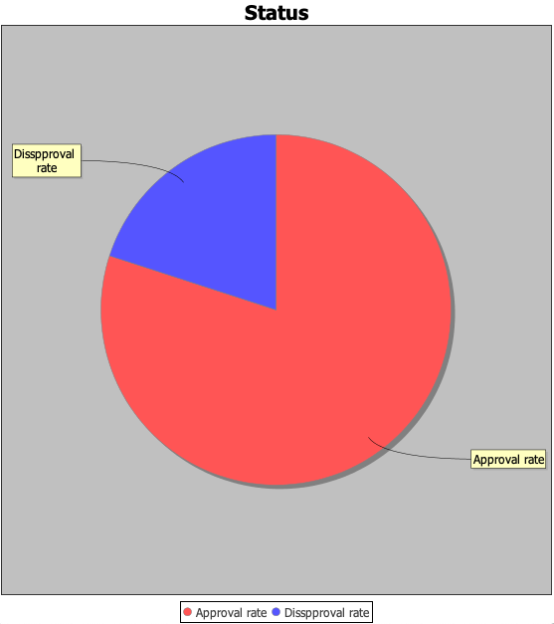
Analysis of Bank requests
Manager can analyse to determine different Loan Reasons and the Approvals out of all loans.

Slide 27
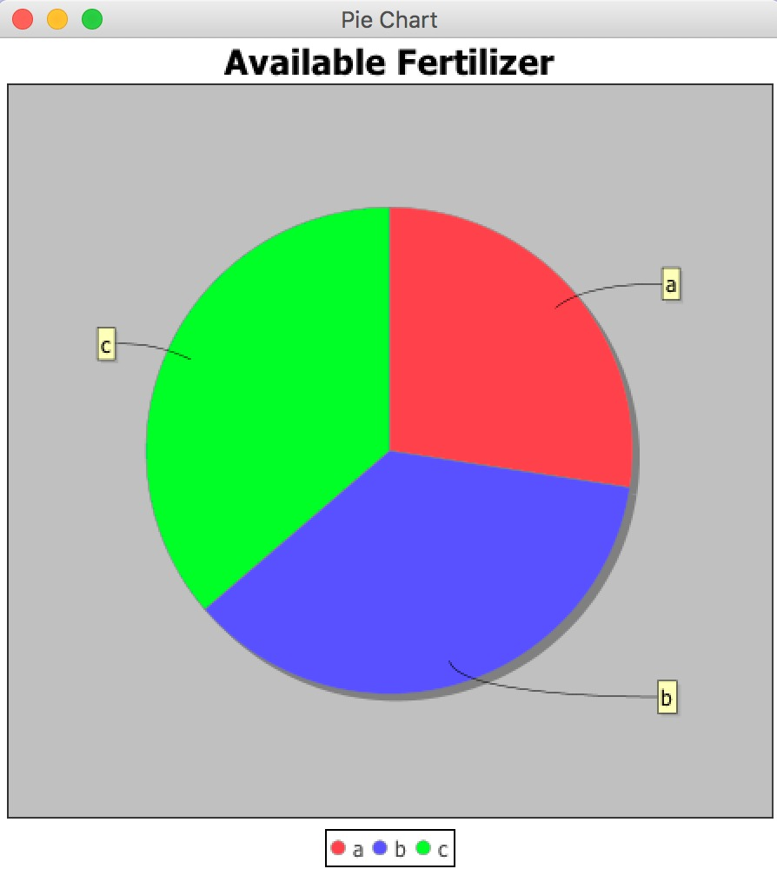
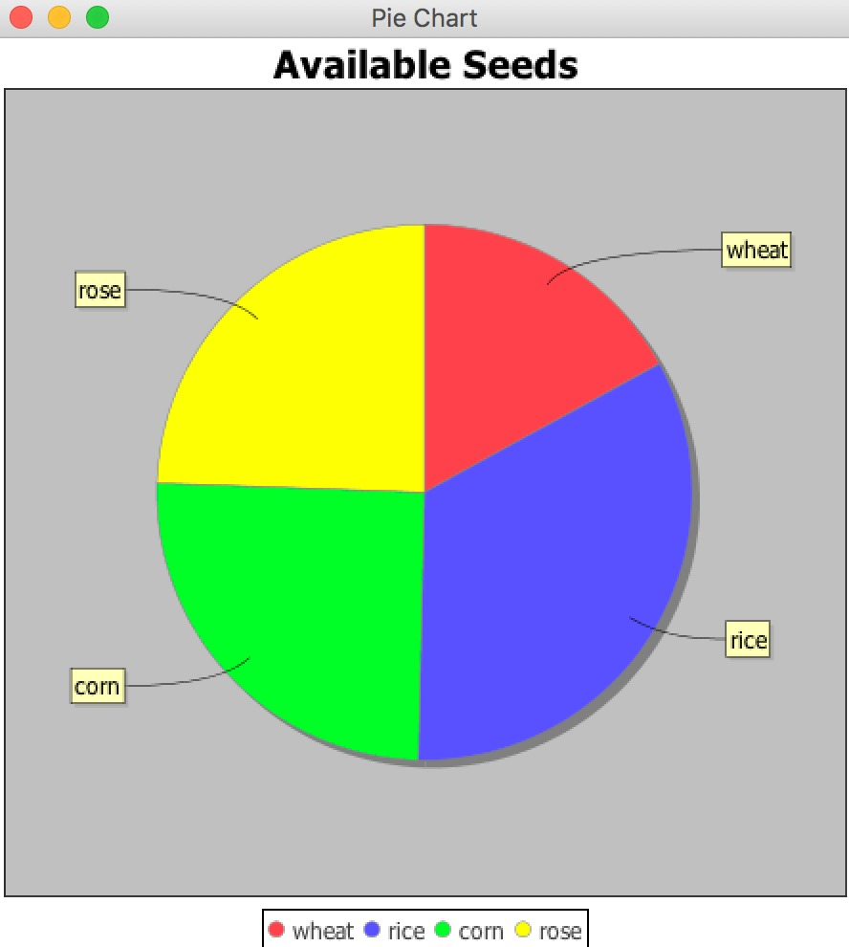
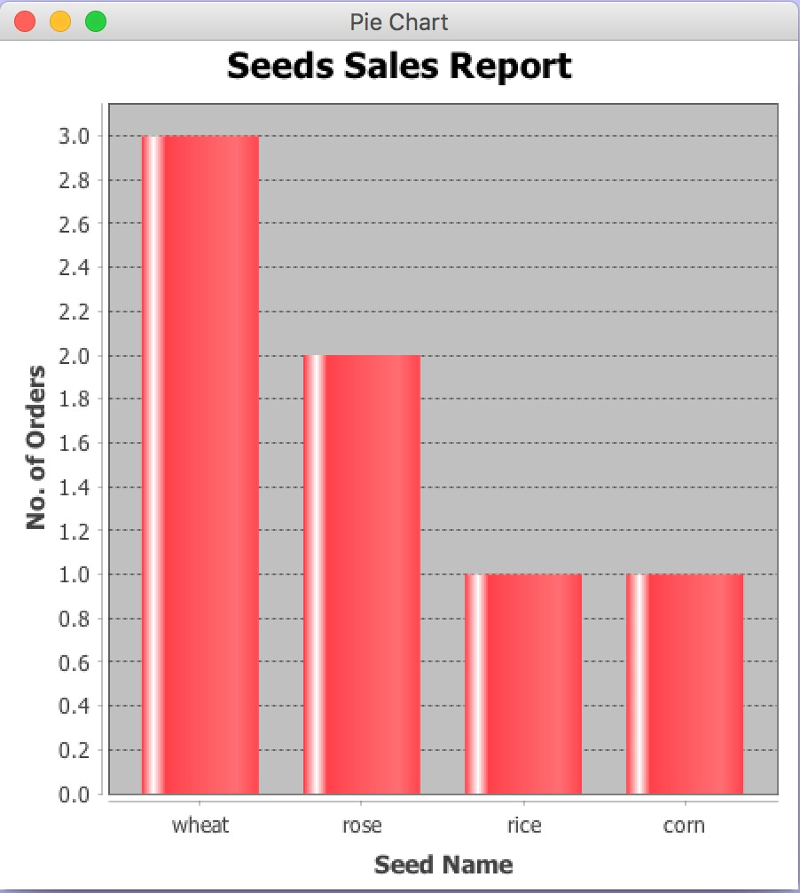
Supplies Analysis

Slide 28
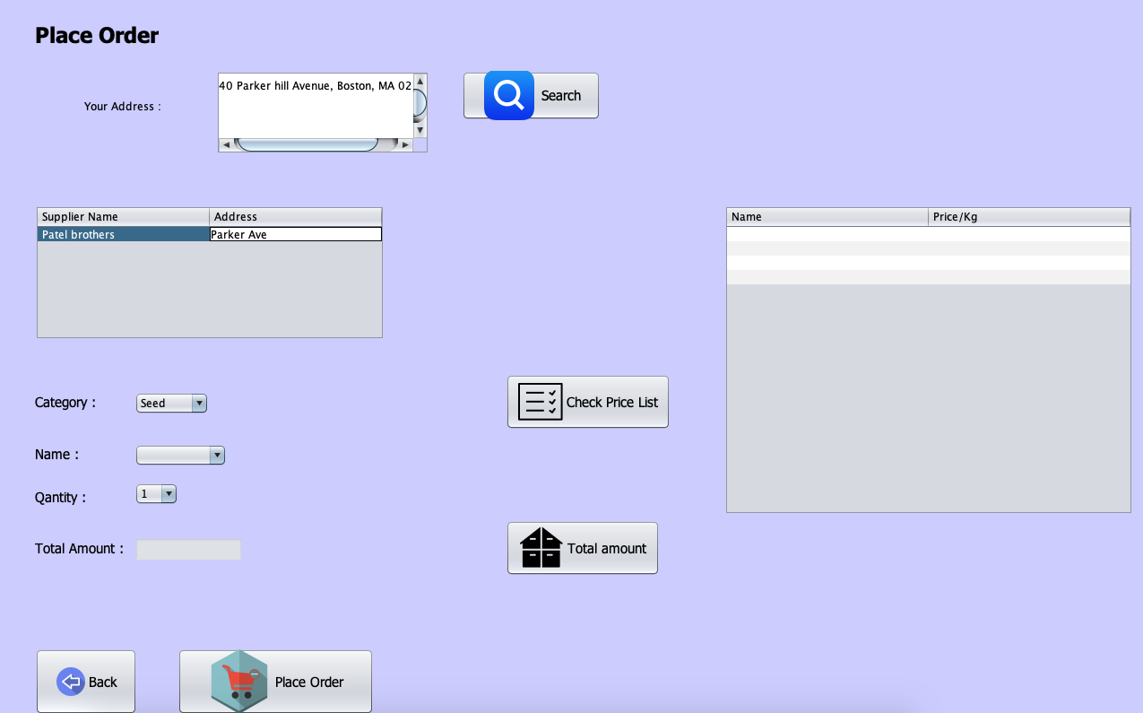
Determining shortest distance
Based on the farmer’s address, the application finds the nearest supplier who can deliver the supplies quickly.

Slide 29
THE END.

