Slide 1








OptiRoute
A multi-agent travel architecture powered by the Cline SDK and deterministic routing
Transforming natural language constraints into mathematically optimized, conflict-free itineraries.// ps

Slide 2







The Problem and Why Current Solutions Fail ?
The Problem: Planning multi-variable trips is a fragmented nightmare. Current LLMs treat trip planning as a creative writing exercise, frequently hallucinating spatial distances and ignoring hard user constraints.
Traditional Platforms (e.g., MakeMyTrip, Expedia): Highly Disconnected. Excellent for a single booking, but incapable of understanding contextual constraints across a whole trip timeline.
Generic AI Chatbots (like ChatGPT) forget your rules. If you give an AI a strict limit, like a strict budget or a strict "pure vegetarian only" diet, it often forgets that rule halfway through planning the trip.
They don't understand maps: AI generates text, not directions. It will happily suggest an impossible daily schedule that has you driving back and forth across a city for hours.
Popularity over Accuracy: They will suggest a famous steakhouse to a pure vegetarian simply because the restaurant is highly rated on the internet, completely ruining the usefulness of the itinerary.

Slide 3






Target Audience and market segment
Diet-Strict Travelers: (e.g., Pure Vegetarian Jain) who cannot risk AI hallucinations sending them to a steakhouse.
Budget-Strict Backpackers: Who need guaranteed price caps, not estimates.
Logistics-Heavy Planners: Families or business travelers who need strict timeboxing.
The Business Sprinter: Corporate travelers who have 24 hours to hit three client meetings, a dinner, and a hotel.

Slide 4



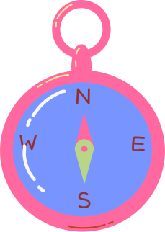
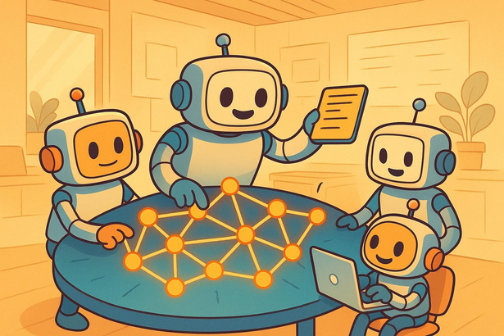
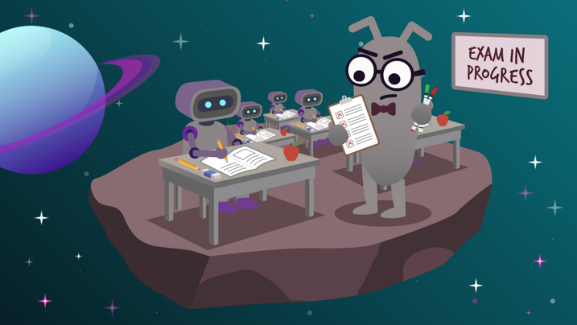
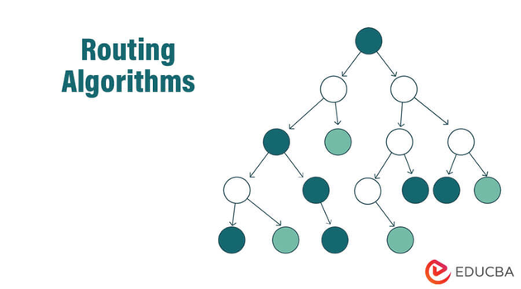
Our Solution:
The Orchestration Engine
MULTI-AGENT DELEGATION | STRICT CONSTRAINT SATISFACTION | ALGORITHMIC ROUTING | DELIVERABLES
Specialized AI agents handle distinct verticals (Transit, Accommodation, Attractions,compil-ation) simultaneously. | A validation layer programmatically rejects and re-prompts agent outputs that violate user parameters. | Hybridizing AI discovery with dynamic programming to guarantee geographically optimal daily schedules. | An interactive 3D WebGL map for spatial orientation and an exportable PDF for offline execution

Slide 5

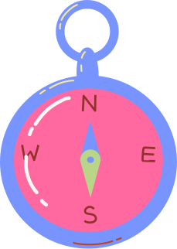

Control Flow & Systems Architecture
The State: A Coordinator Agent maintains the master memory of user constraints on a Shared Task Board
The Flow: The system delegates tasks to parallel agents simultaneously. Using Zod schemas, it forces these agents to reply with strict, predictable JSON data rather than conversational text.
The Check: Agents use internal self-reflection loops (up to 3 iterations) to fix their own mistakes locally. A final Strict Validation Layer then catches any remaining hallucinations and forces a re-computation if rules are broken
The Math: Instead of letting the AI guess distances, a Deterministic Engine uses shortest-path algorithms to optimally order the itinerary based on real-world geography..

Slide 6
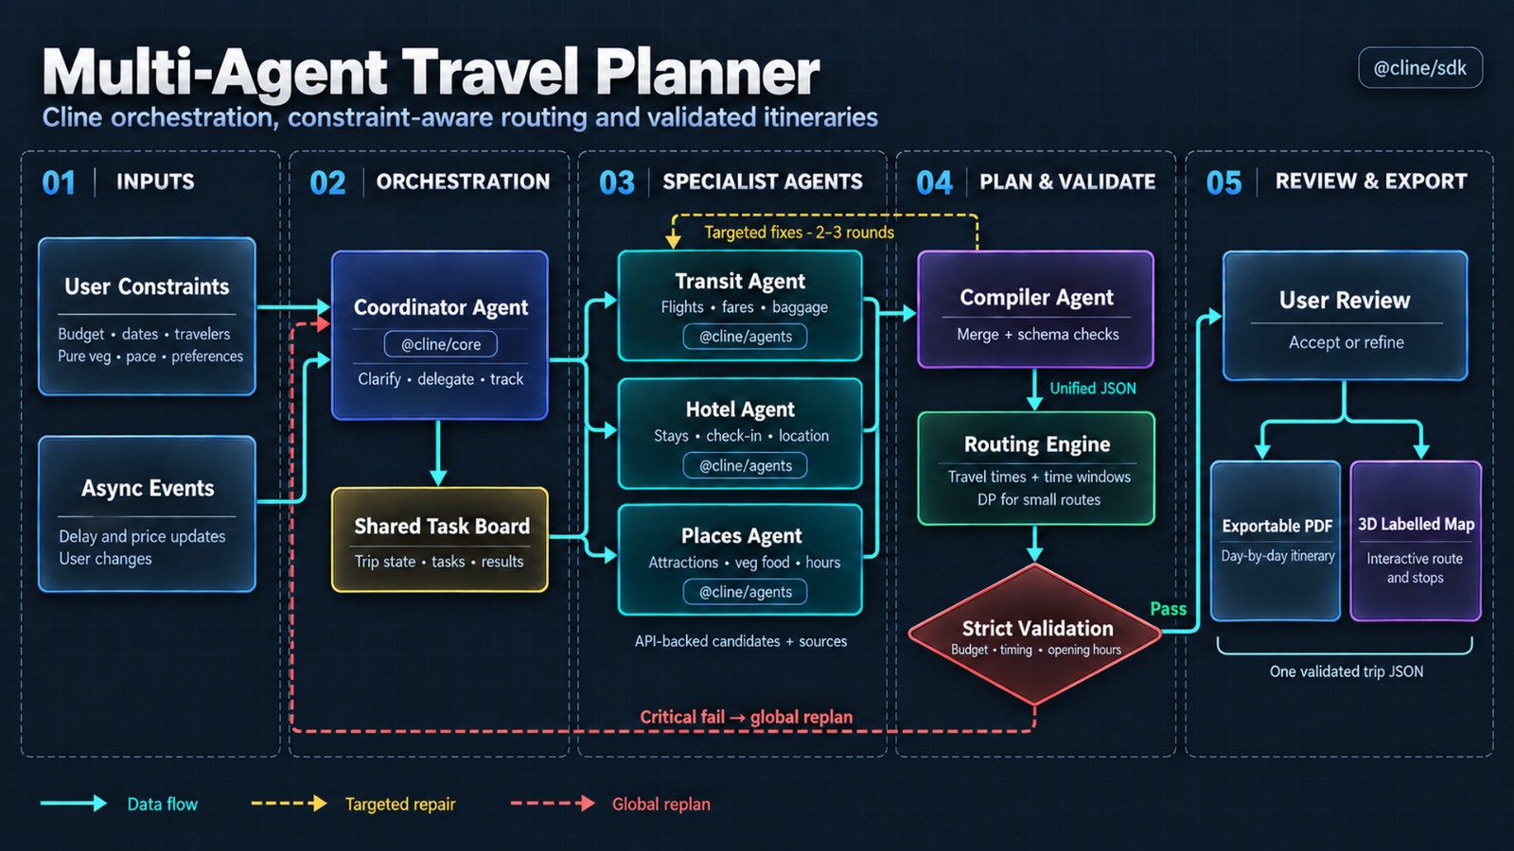

Slide 7






Powering the Backend with Cline
@cline/agents: Executes the stateless worker swarm (Flight, Hotel, Places) to hit APIs, return structured JSON, and terminate immediately to save memory.
@cline/core: Powers the stateful Coordinator Agent, maintaining master memory and managing the token budget.
Model Routing: Using @cline/llms to strategically route complex planning to heavier models while offloading simple data-fetching to faster, cheaper models.

Slide 8
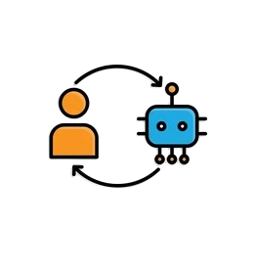

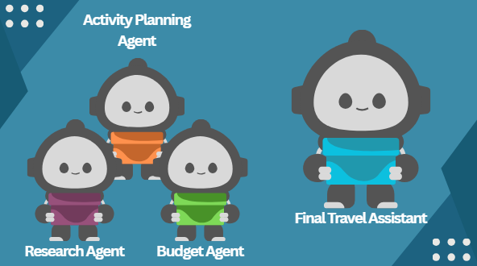

Core Features
Interactive Human-in-the-Loop: Agents autonomously pause and query the user for clarification if critical data is missing, completely eliminating the need for AI guesswork or assumptions.
Constraint-First Engine: Translates natural language into unbreakable rules (e.g., locking in 100% Pure Vegetarian dining or strict budget caps).
Parallel Multi-Agent Planning: Dedicated worker agents (Transit, Hotel, Places) process itinerary components simultaneously for maximum speed.
Actionable Outputs: Generates a ready-to-use, day-by-day exportable PDF and an interactive 3D mapped route.
Deterministic Route Optimization: Uses graph algorithms to mathematically sequence locations, eliminating inefficient "zigzagging" across the city.

Slide 9
MVP Scope for Stage 2
Milestone 1: Core Orchestration & Ingestion
  Initialize the @cline/core Coordinator Agent.
  Build the "Zero-UI" NLP parser to silently extract and lock in rigid constraints (e.g., Budget caps, Pure Veg requirements).
Milestone 2: The Agent Fleet & HITL Integration
  Deploy parallel Worker Agents (Places & Hotel) using @cline/agents.
  Enforce strict data structures using Zod-schema APIs to eliminate text-based hallucinations.
  Implement the Human-in-the-Loop (HITL) trigger so agents can autonomously ask clarifying questions for ambiguous prompts.
Milestone 3: Validation & Algorithmic Routing
  Code the Strict Validation Layer to programmatically reject outputs that violate user constraints.
  Integrate the Deterministic Engine (TSP logic) to geographically sort locations and eliminate inefficient zigzagging.
Milestone 4: Synthesis & Visualization
  Render the validated JSON output into a clean, functional Day-by-Day Itinerary UI.
  Connect the data to a basic interactive map view (e.g., Mapbox or Google Maps) to visually prove the optimized routing.

Slide 10





Scalability & Competitive Edge
Compute Efficiency: Utilizing stateless worker agents avoids the exponential token-cost explosion typical of continuous multi-agent frameworks.
Extensibility: The modular SDK architecture means adding a new vertical (like a "Rental Car Agent") requires zero changes to the underlying Coordinator logic.
Deterministic Reliability: Offloading the Traveling Salesperson Problem dynamic programming algorithm guarantees 100% routing accuracy.

