Slide 1

ArangoDB NoSQL DATABASE
By:
Manasi Burange:1021128
Jagrithi P Chittiappa: 1033162

Slide 2
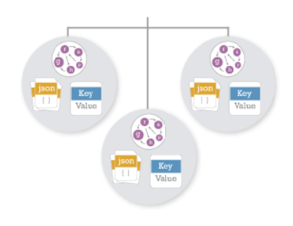
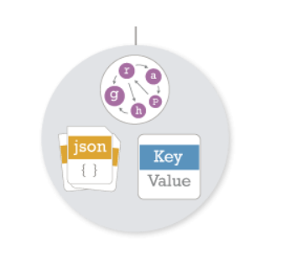
Introduction:
Multi-model Database (Document, Graph, Key/Value)
Flexible
Single core, single query language
AQL language

Slide 3
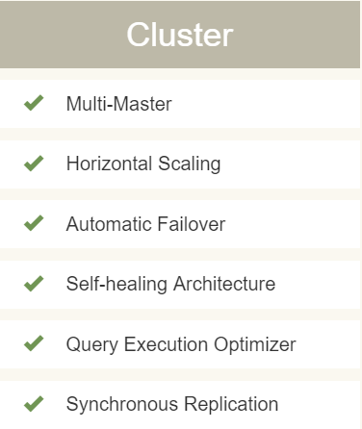
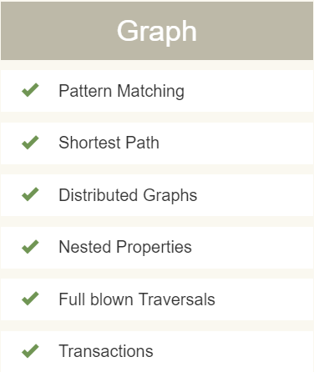
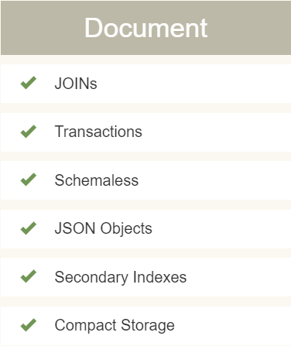
Data Model:

Slide 4
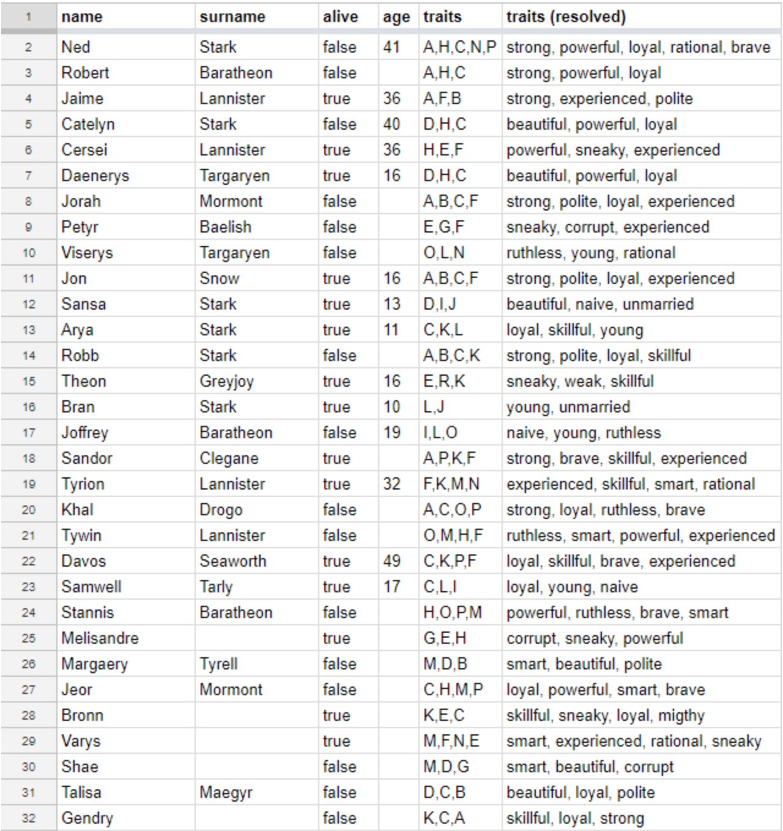
Data Set:
Characters.json

Slide 5
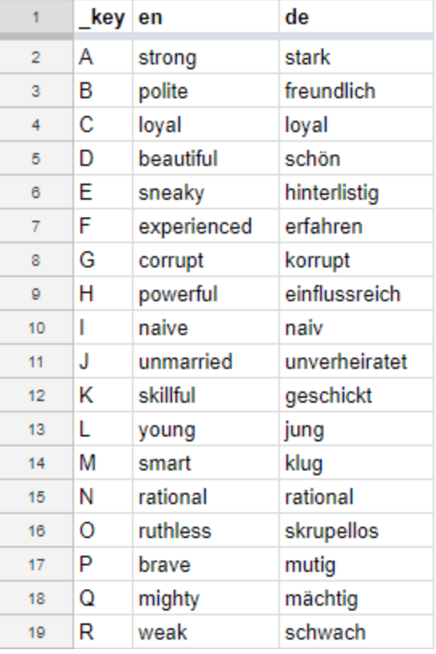
Traits.json

Slide 6
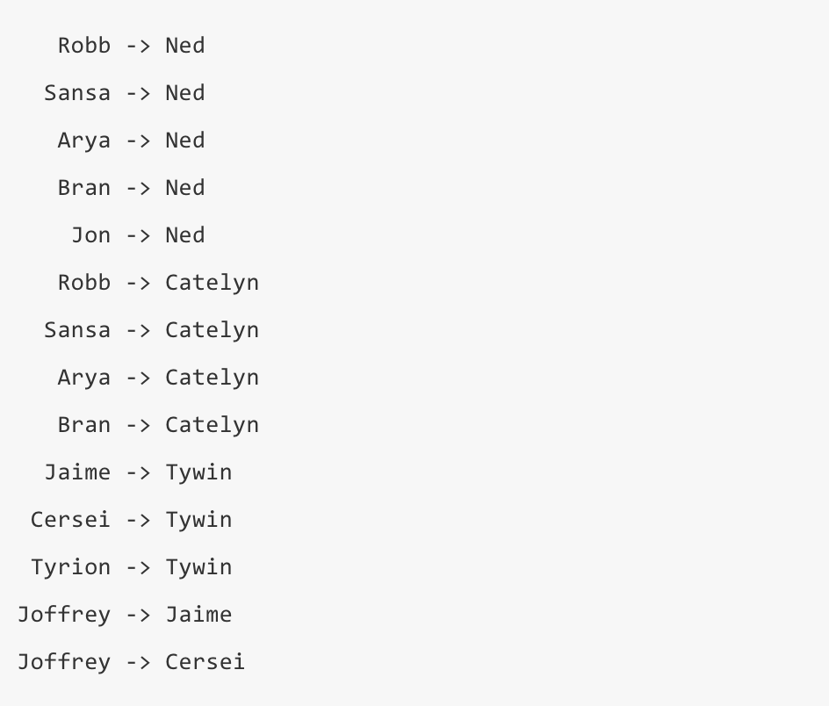
ChildOf.json

Slide 7
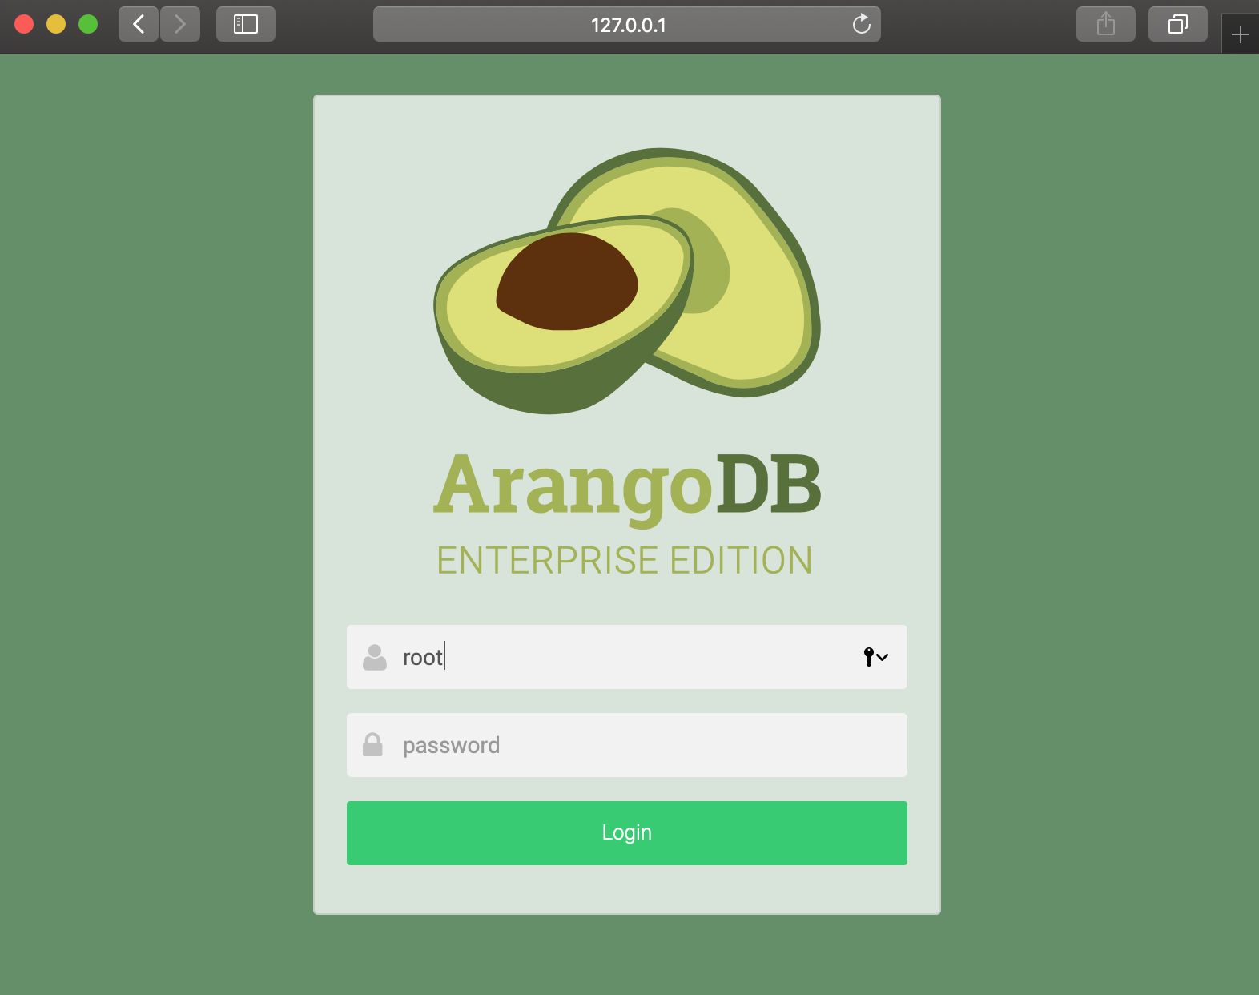
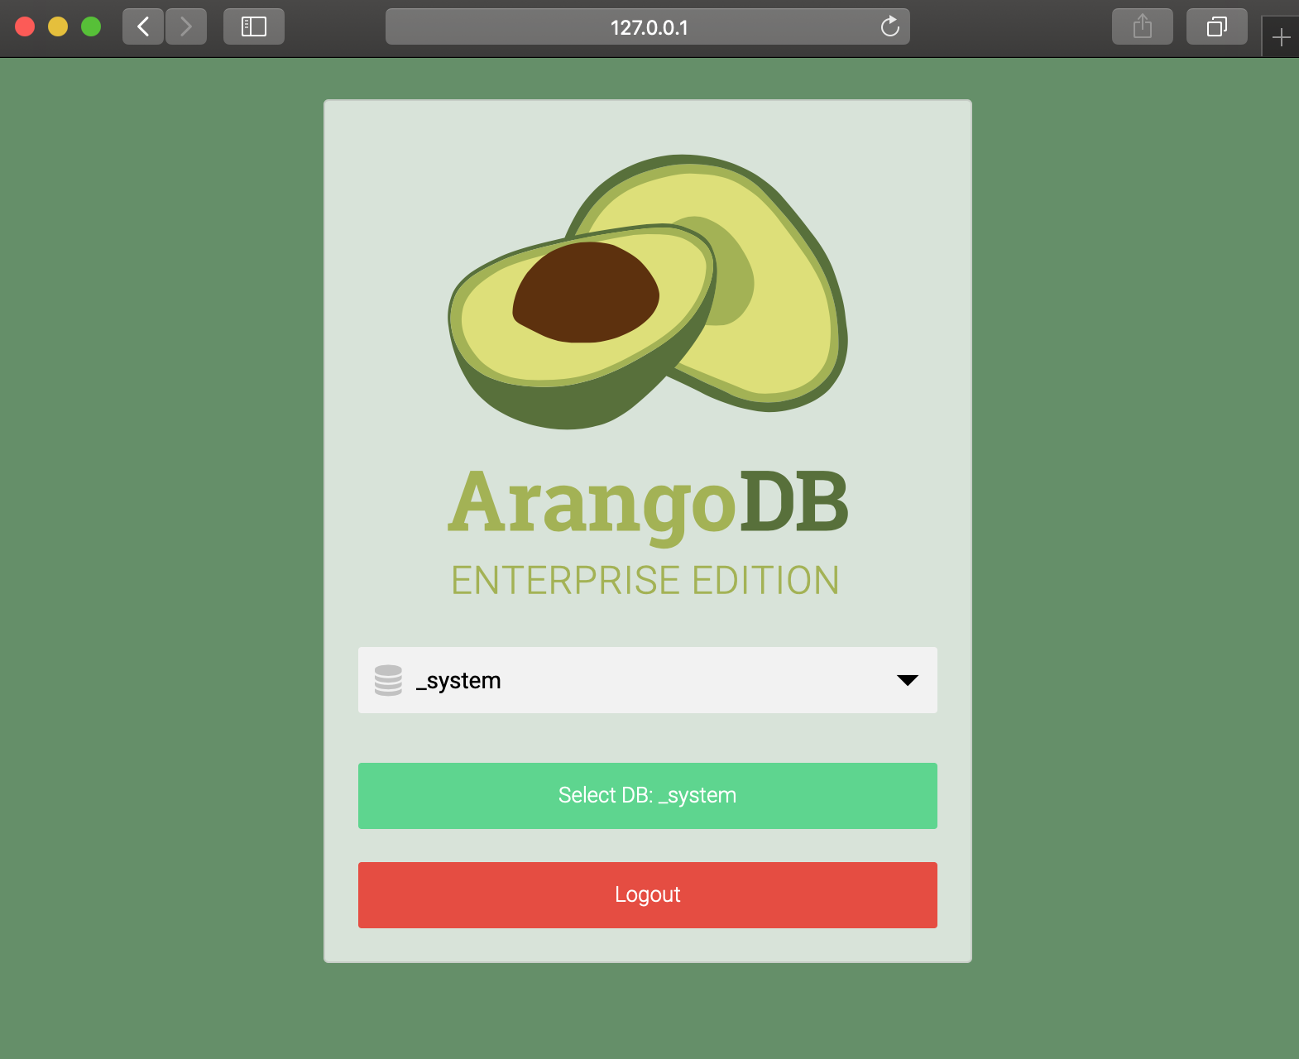
Starting DB:

Slide 8
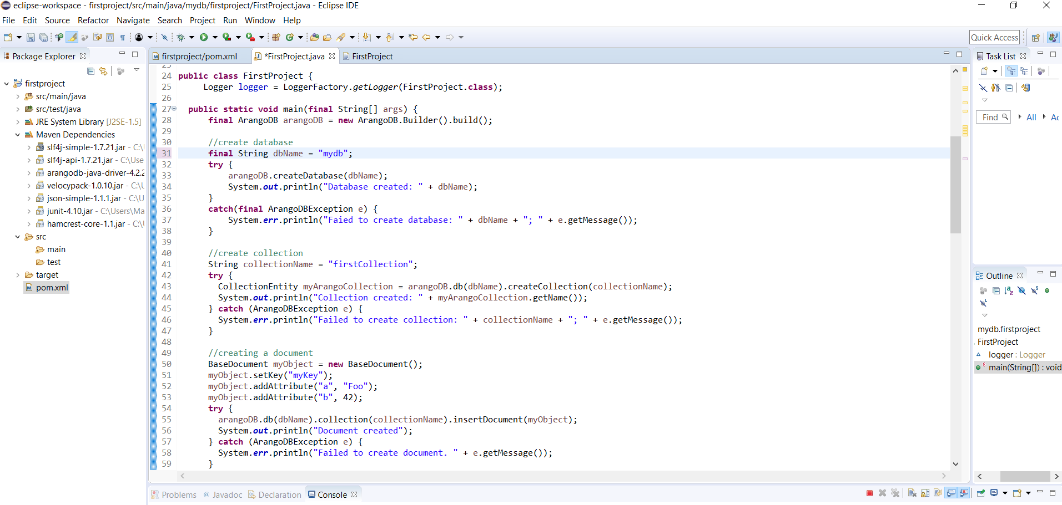
Created Database:

Slide 9
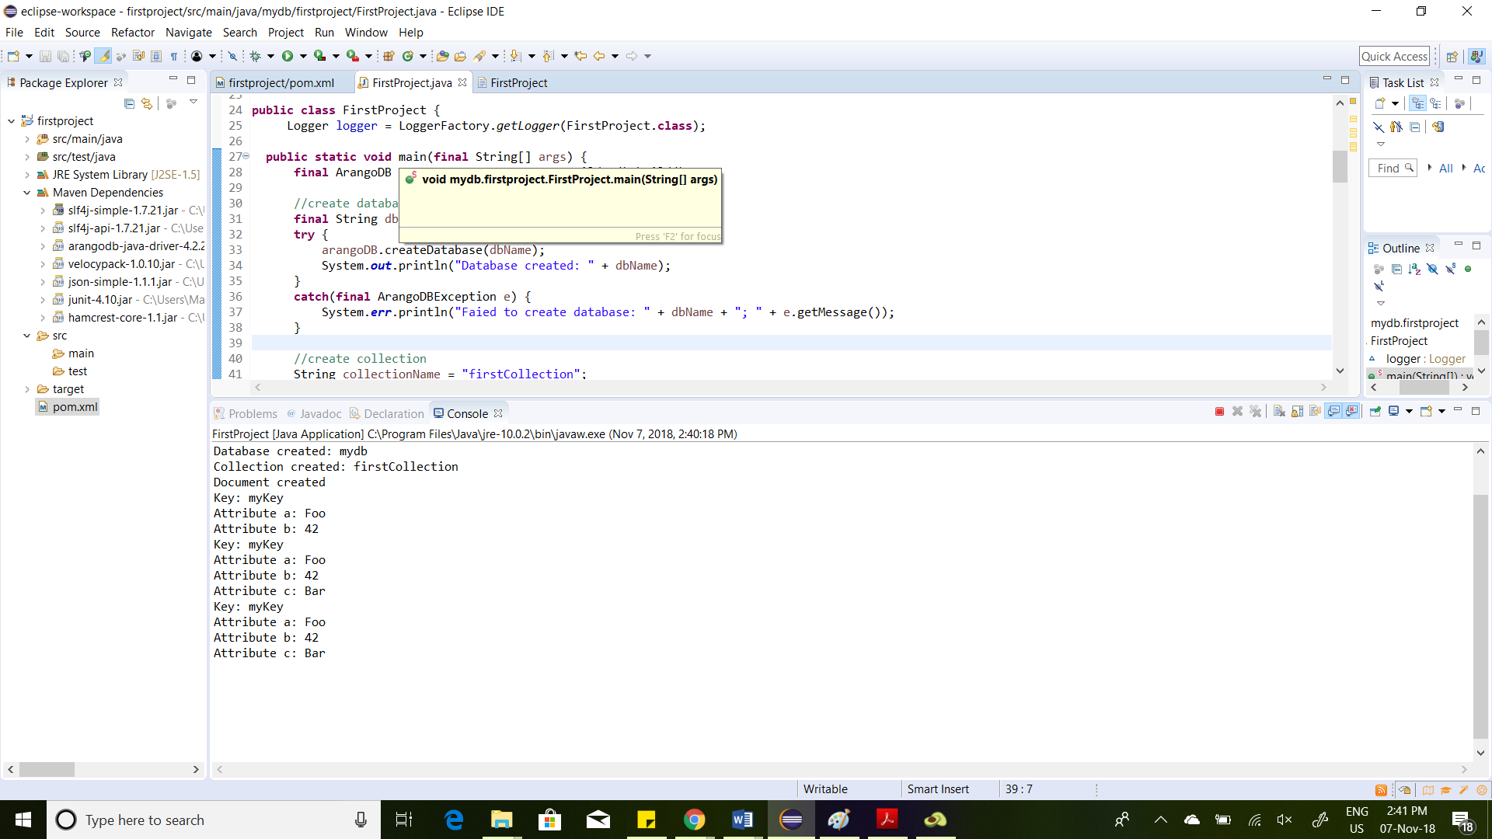
Created Database:

Slide 10
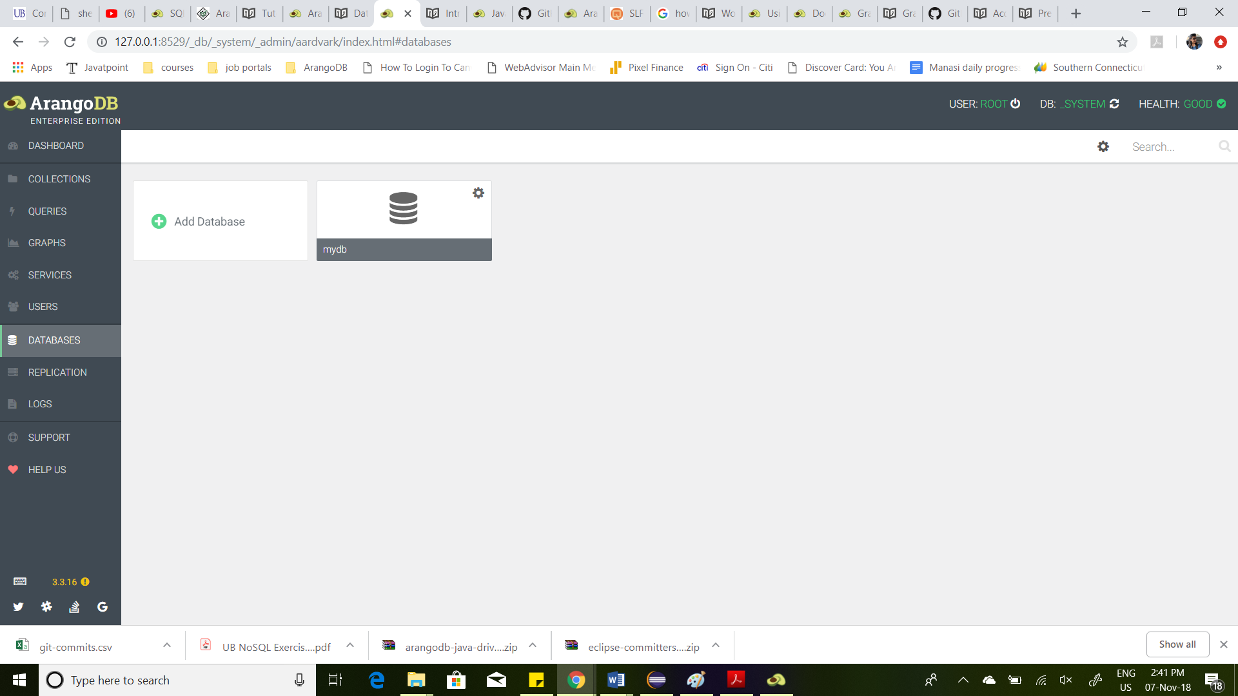
Created Database:

Slide 11
Sample Data:

Slide 12
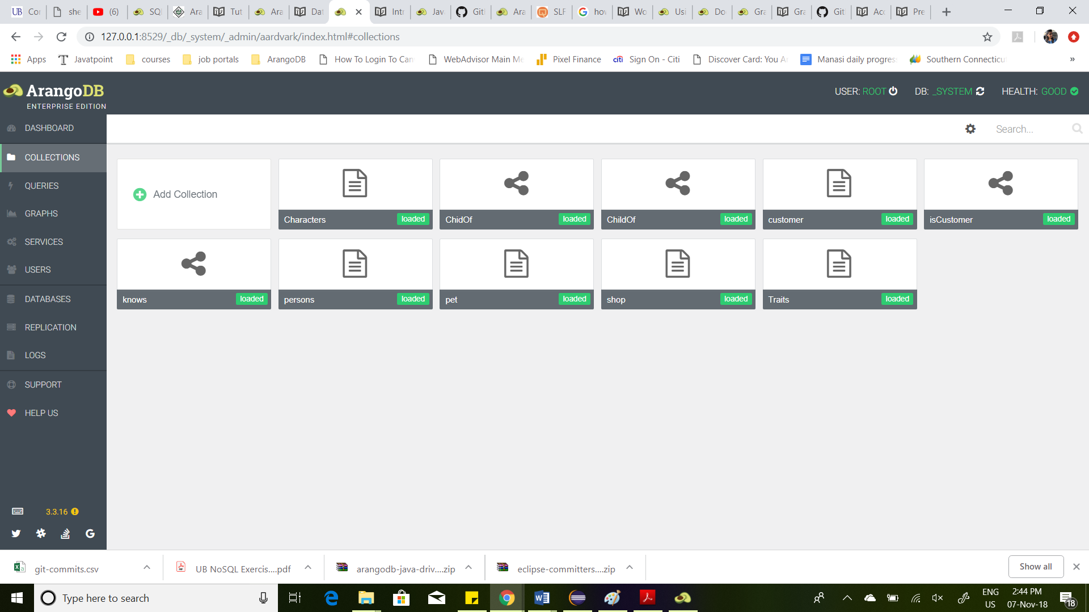
Sample Data:

Slide 13
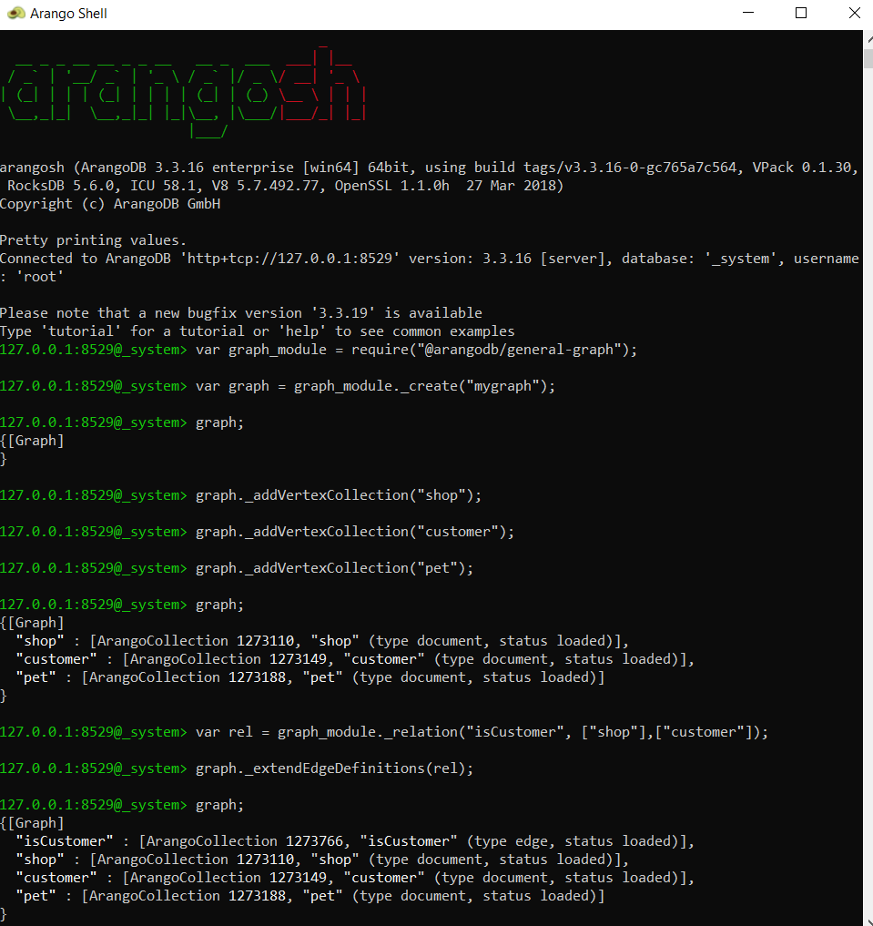
Graph Model:

Slide 14
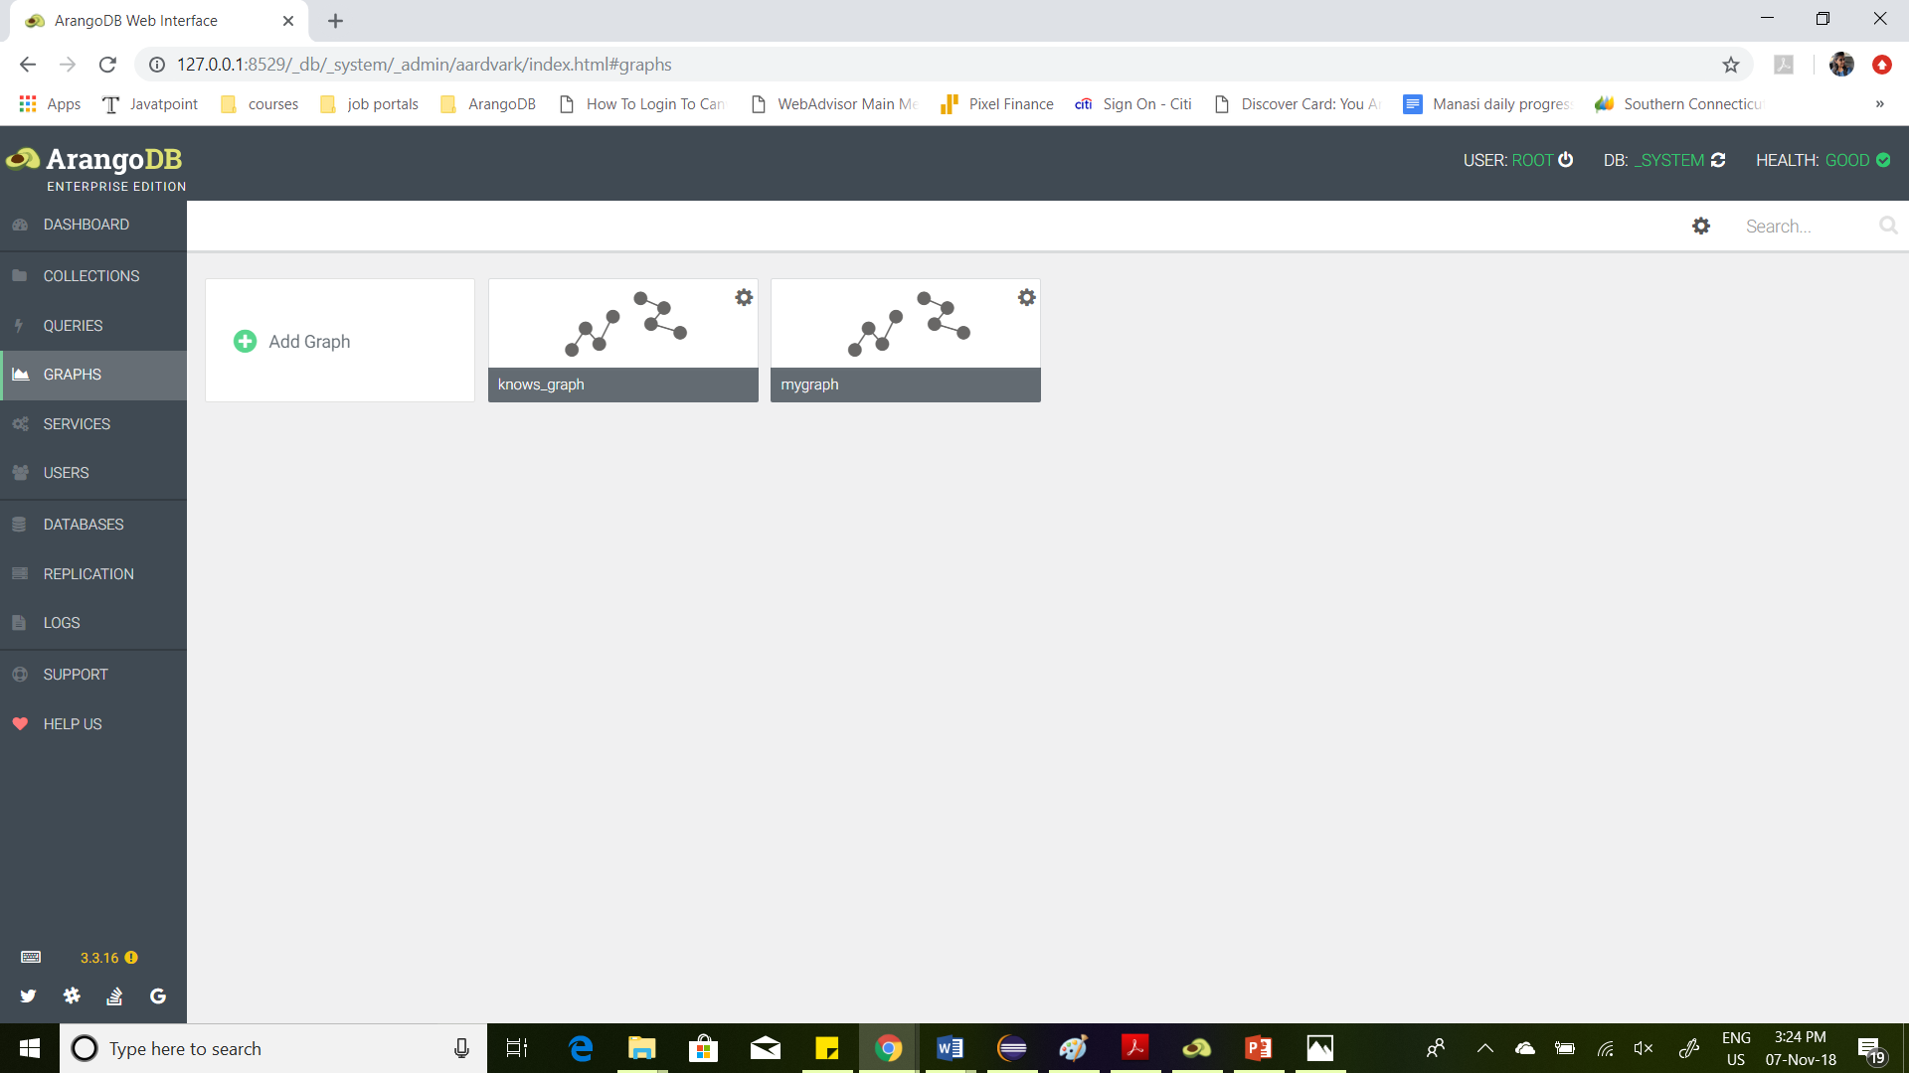
Graph Model:

Slide 15




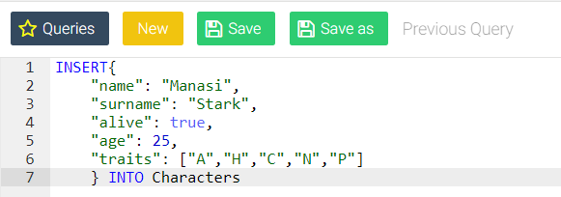

Queries DEMO:

Slide 16
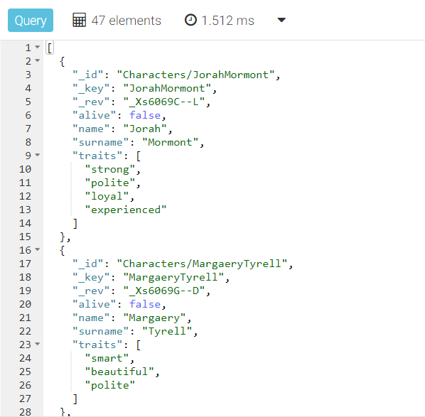
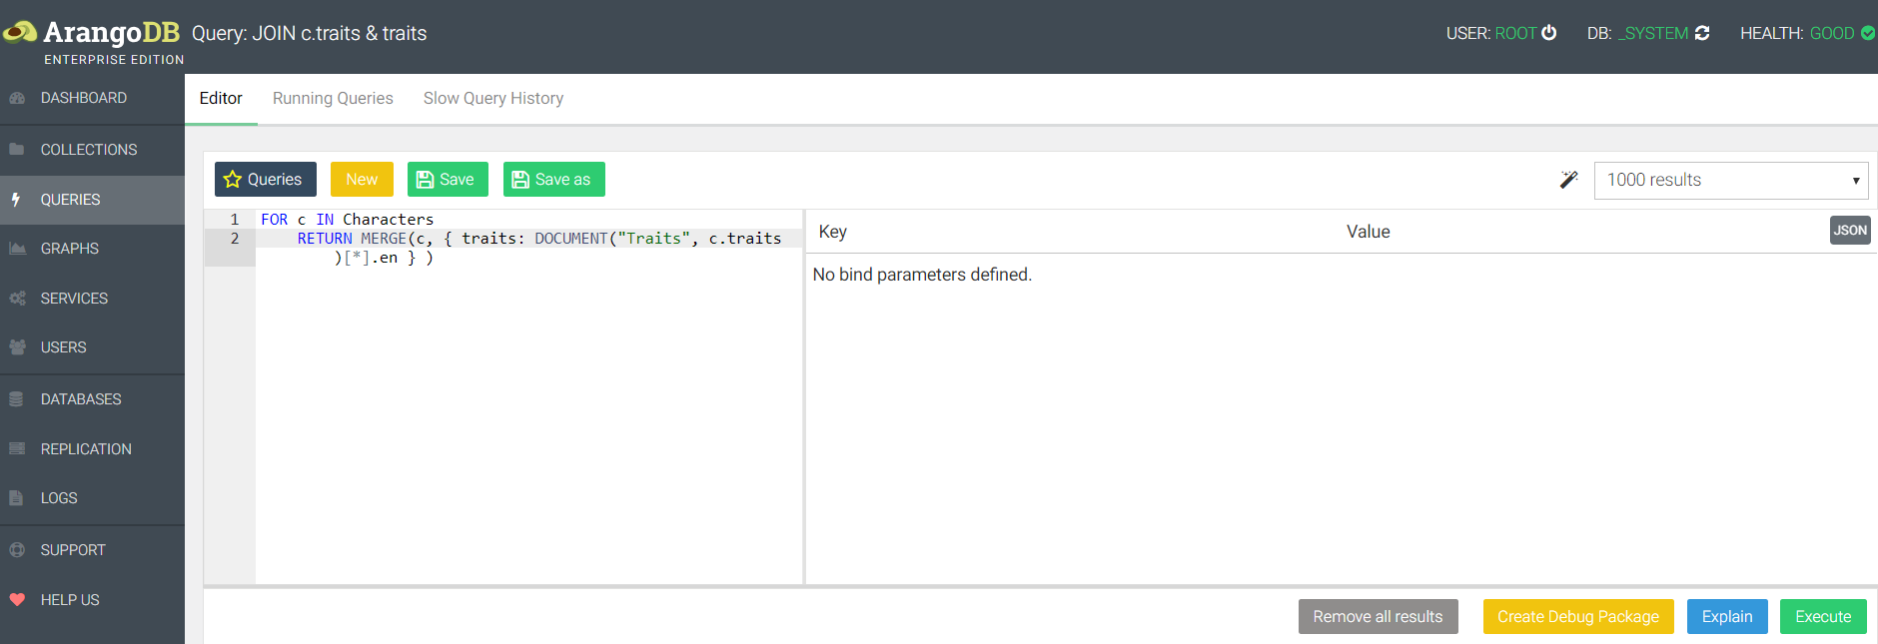

Slide 17
CRUD on ArangoDB – Document based:

Slide 18
Thank you!

