Slide 1
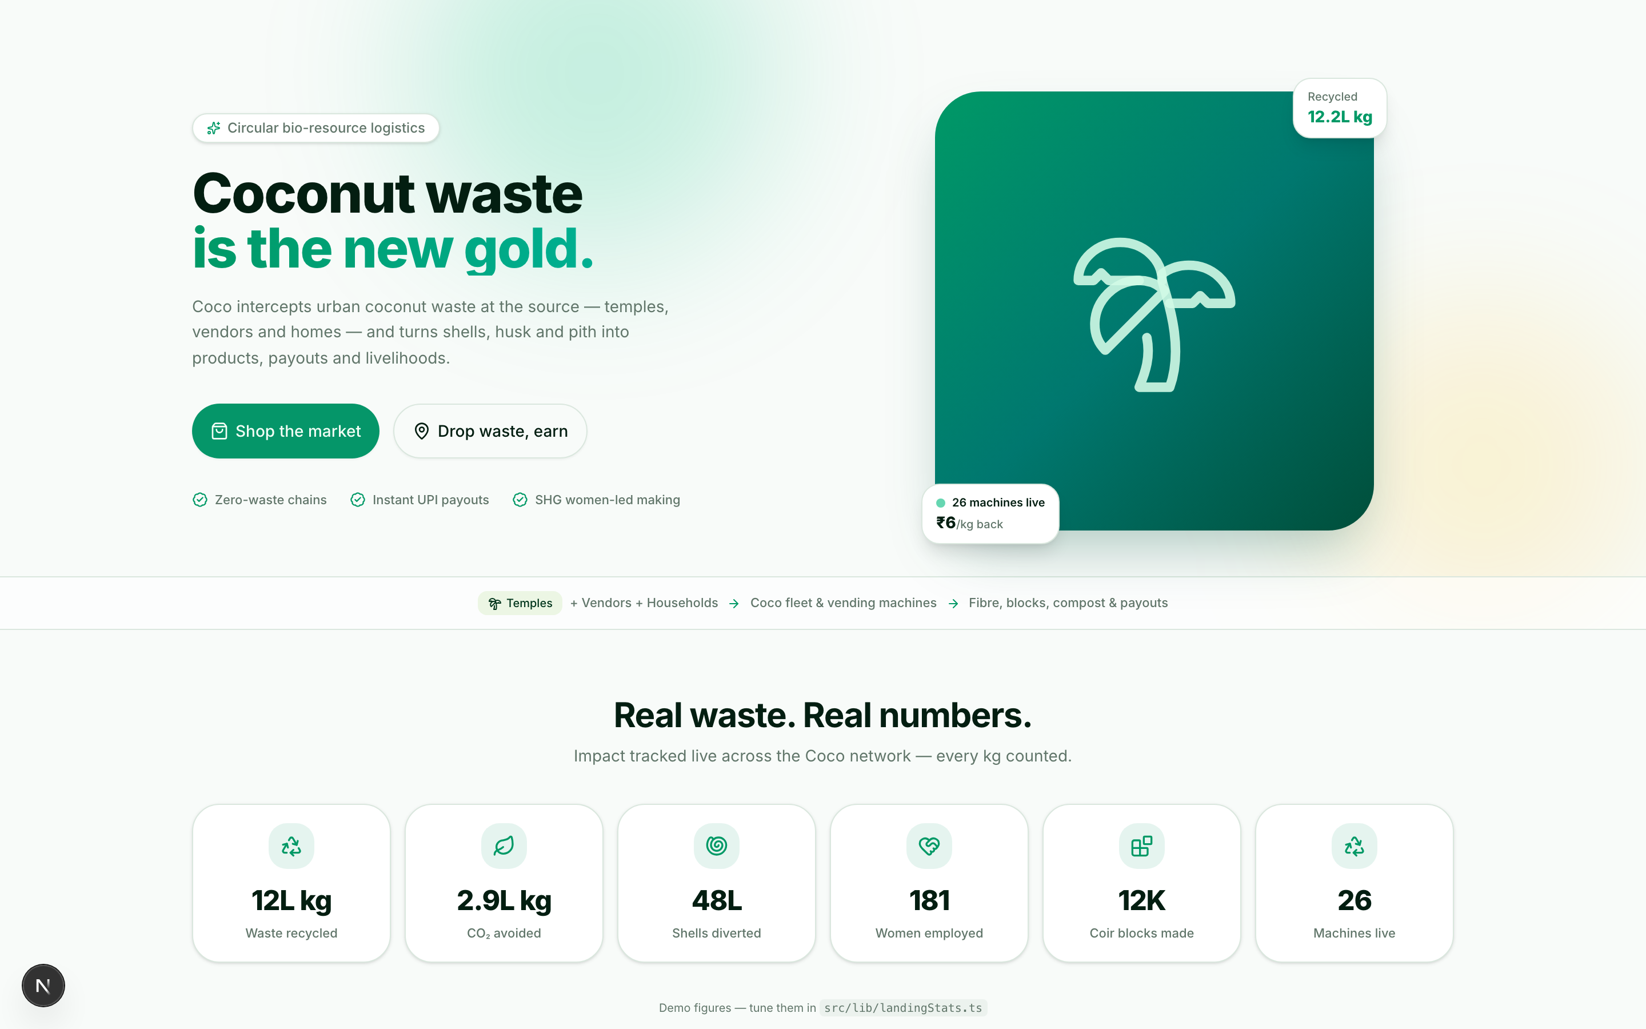
COCO
Coconut waste
is the new gold.
Coco intercepts urban coconut waste at the source — temples, vendors, homes — and turns shells, husk and pith into products, payouts and livelihoods. All tracked, priced and circular.
12L
49L
184
26
kg recycled
shells diverted
women employed
machines live
Waste that works.

Slide 2
THE PROBLEM NOBODY SEES
Your morning coconut ends up here
1
2
3
It smoulders for years
Collectors work informal
Impact has no proof
Chennai landfills receive hundreds of tonnes of coconut waste daily. Husks burn slowly — releasing methane and CO₂ for years.
No routing, no fair weighing, no receipts. Grab, weigh-by-eye, cash-offers. Earners are invisible to banks and to the system.
No one can answer: how much was diverted? By whom? To where? For what? Every kilo is untraceable waste, not asset.
1,218,490 kg already recycled by the Coco demo network

Slide 3
THE SOLUTION
The Coco circular loop
01
Drop
03
Process
Temples, vendors & consumers hand over shells, husk, pith.
Fiber, cocopeat, blocks & compost — via rural women's SHGs.
02
Collect & weigh
04
Buy & earn
Routed fleet or vending machines. QR-verified kg, instant UPI.
Marketplace sells what the loop makes; earners get paid per kg.

Slide 4
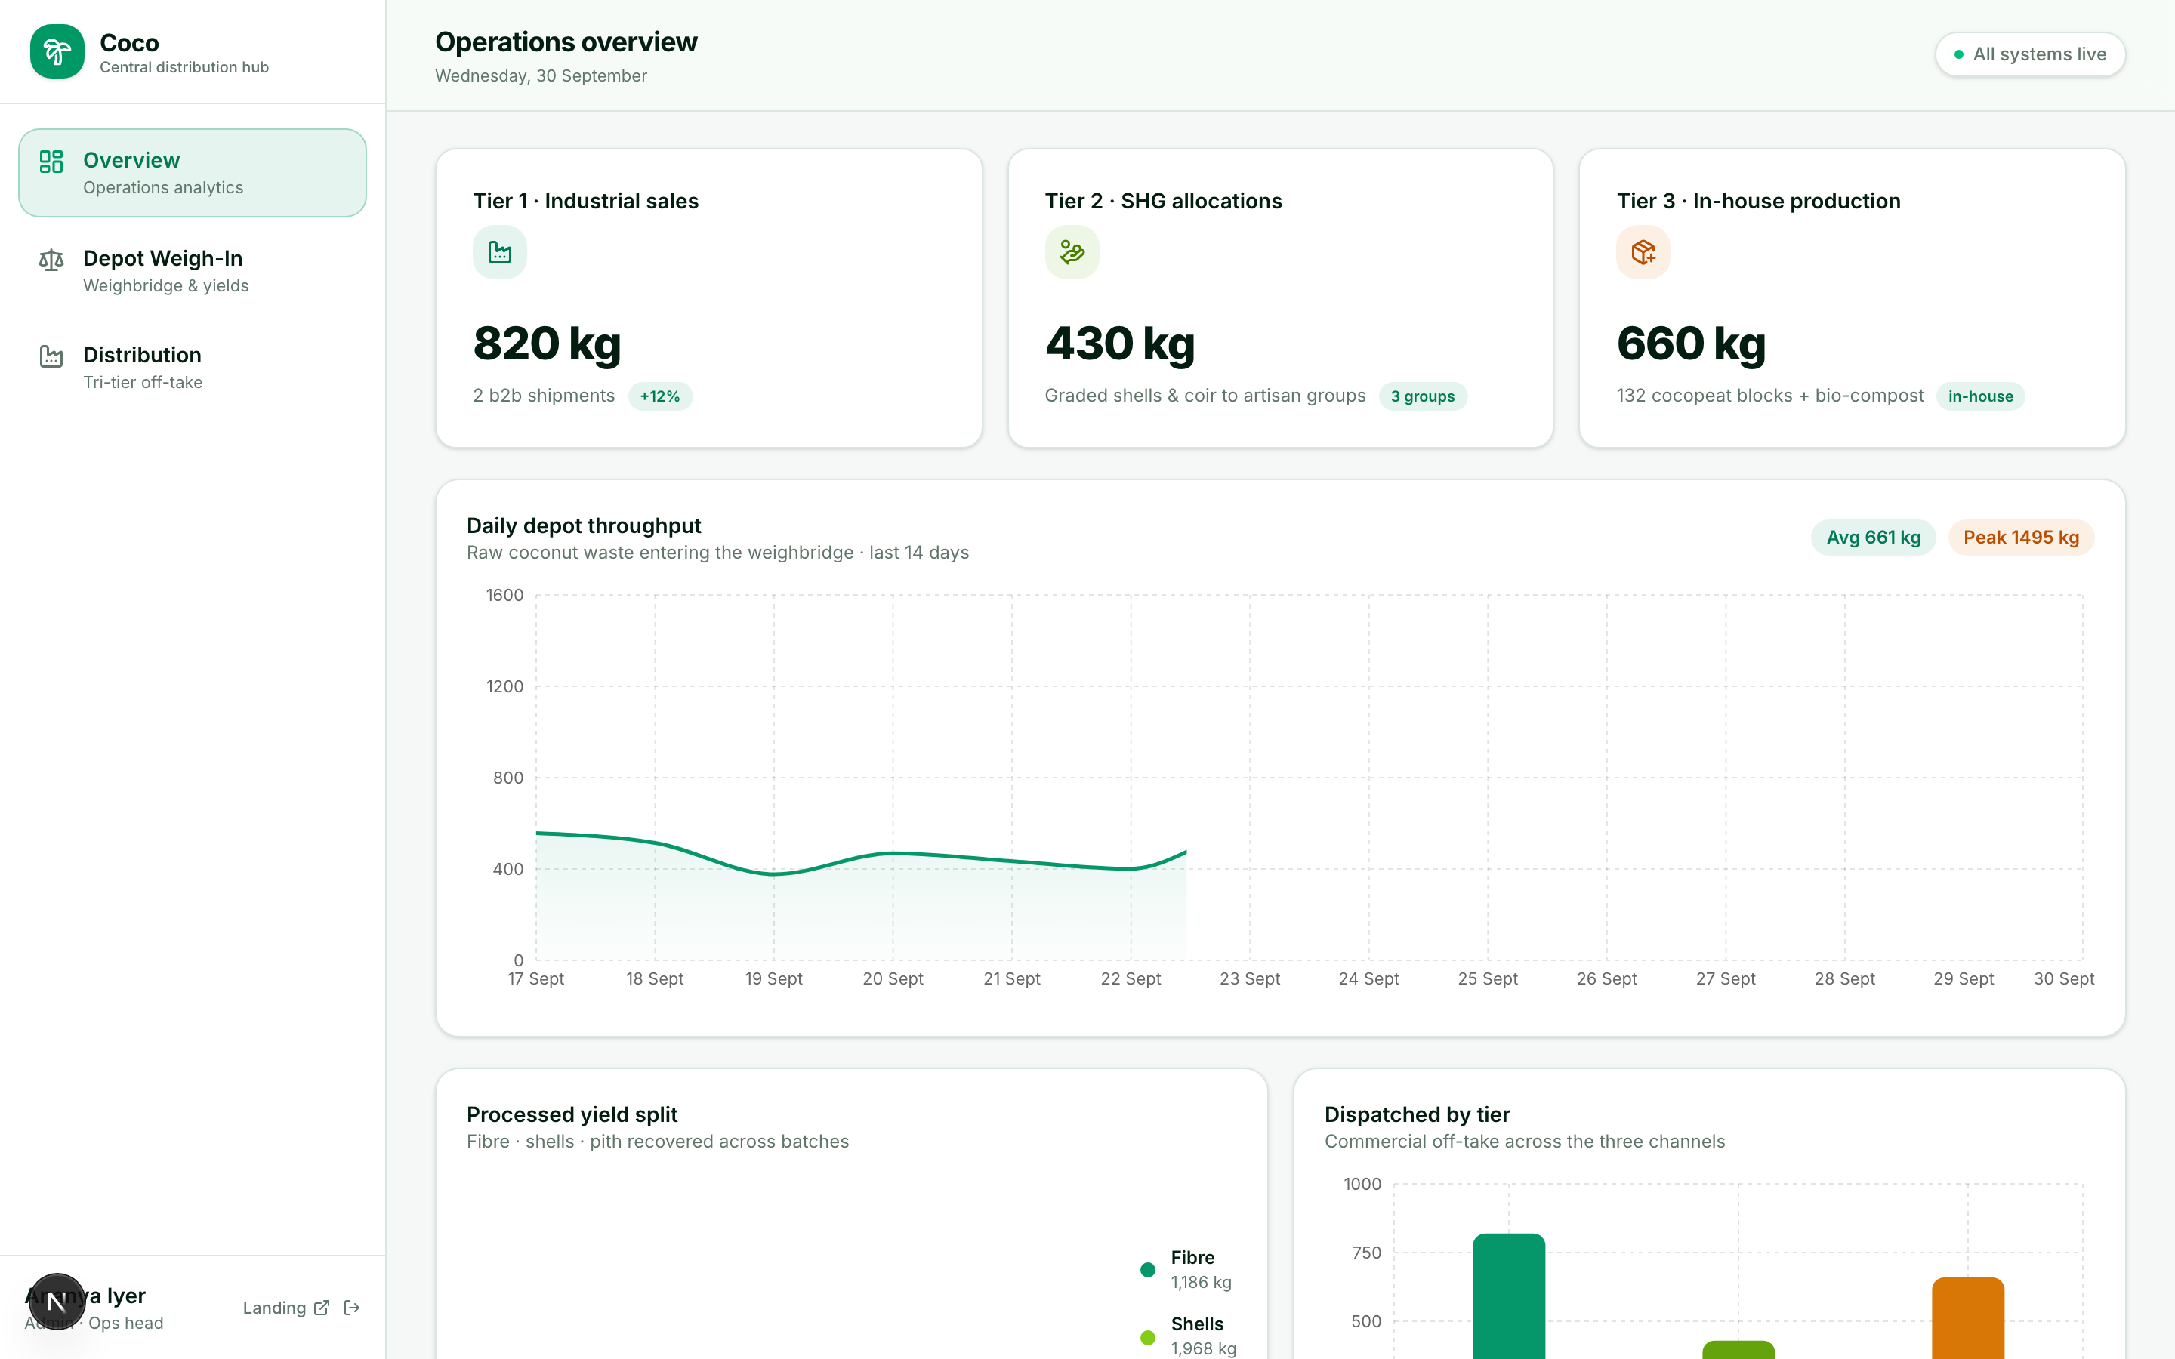
ONE LOOP, FIVE ROLES
Every interface is role-shaped
Generator
Collector
Consumer
Depot
Admin
Temples & vendors
Routed drivers
Shop & drop waste
Weighbridge
Tri-tier ops
Full-featured operations console — real-time analytics, batches, distribution:

Slide 5
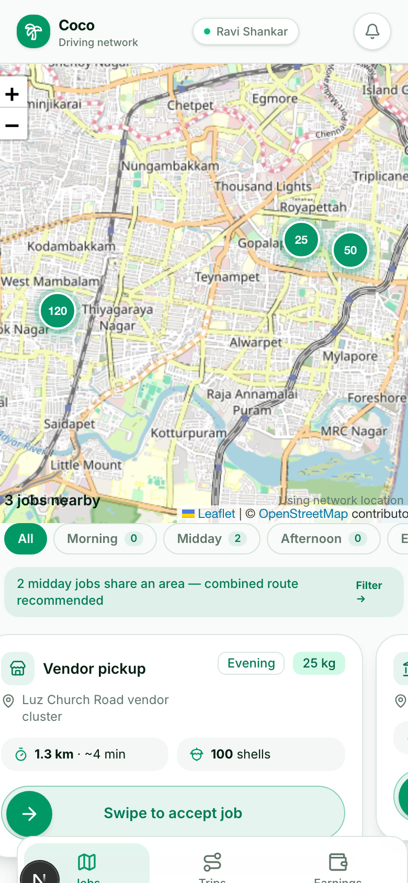
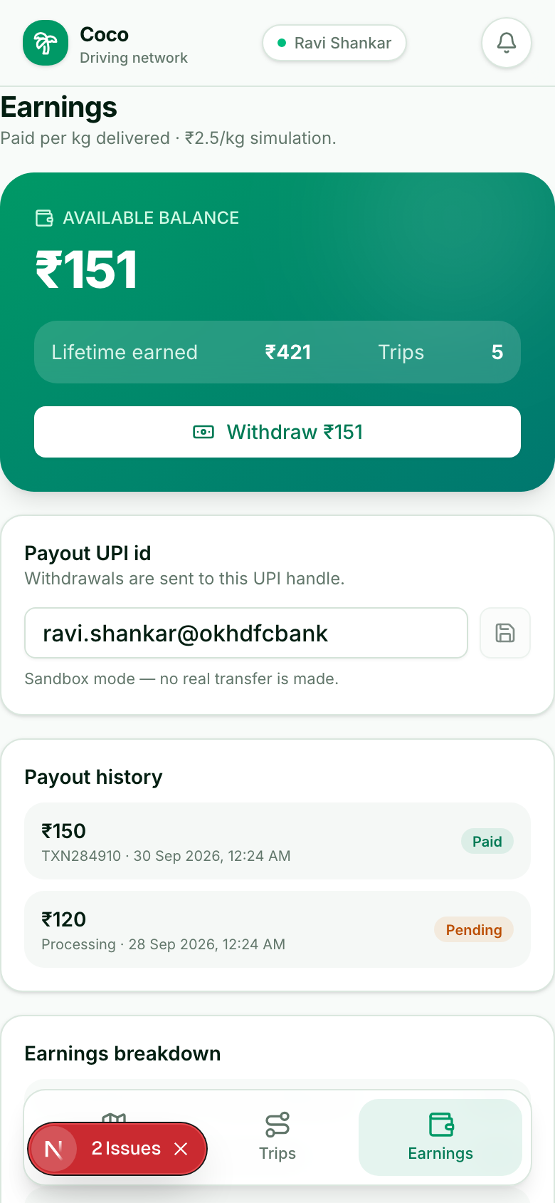
FAIR PAY, EVERY KILO
Collectors earn ₹2.5/kg — instantly
Pending jobs on a map, sorted by distance with slot filters
Swipe to accept, then an immersive turn-by-turn route
Weigh-in at the depot is QR-verified — paid on measured kg
Earnings tab: balance, payouts (Pending / Paid / Rejected) and UPI withdraw
Try it: sign in as Collector, phone +91 97400 00011, OTP 420420

Slide 6
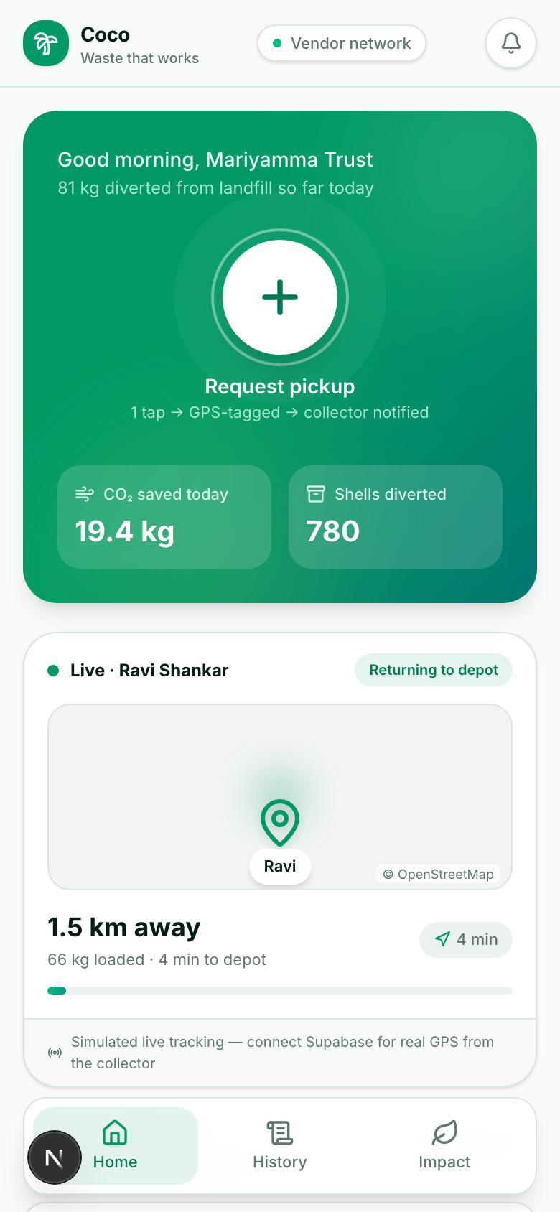
SCHEDULING THAT ACTUALLY WORKS
Book a slot. Watch the collector live.
One-tap pickup requests with automatic GPS tagging
Slots: Now · Morning · Midday · Afternoon · Evening
Slot reminders push 45 min before the window opens
Live tracking card — collector distance, ETA and mini-map
+ works fully offline — requests queue on-device and reconcile later

Slide 7
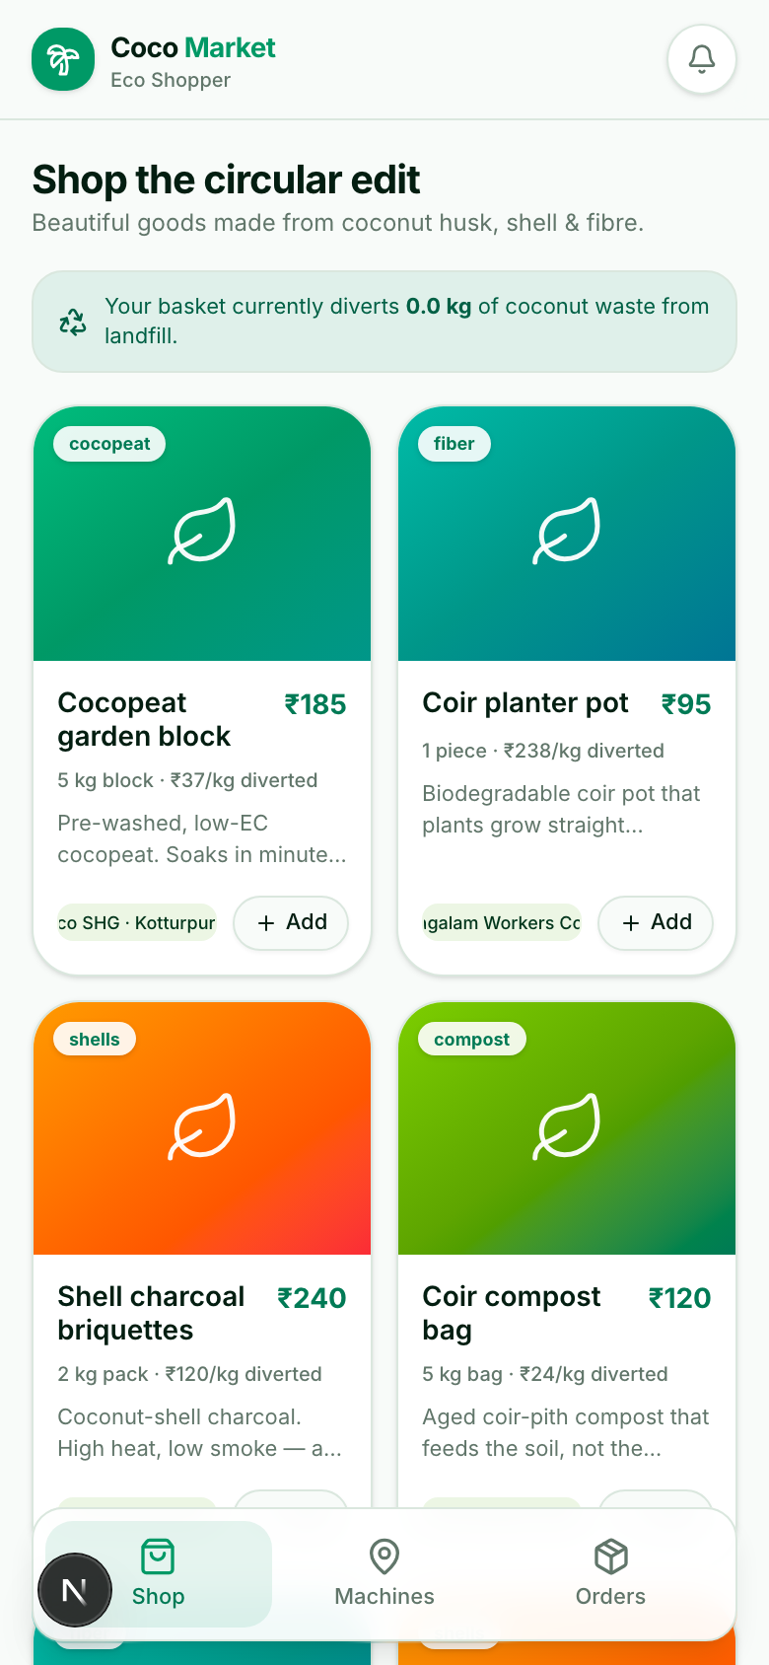
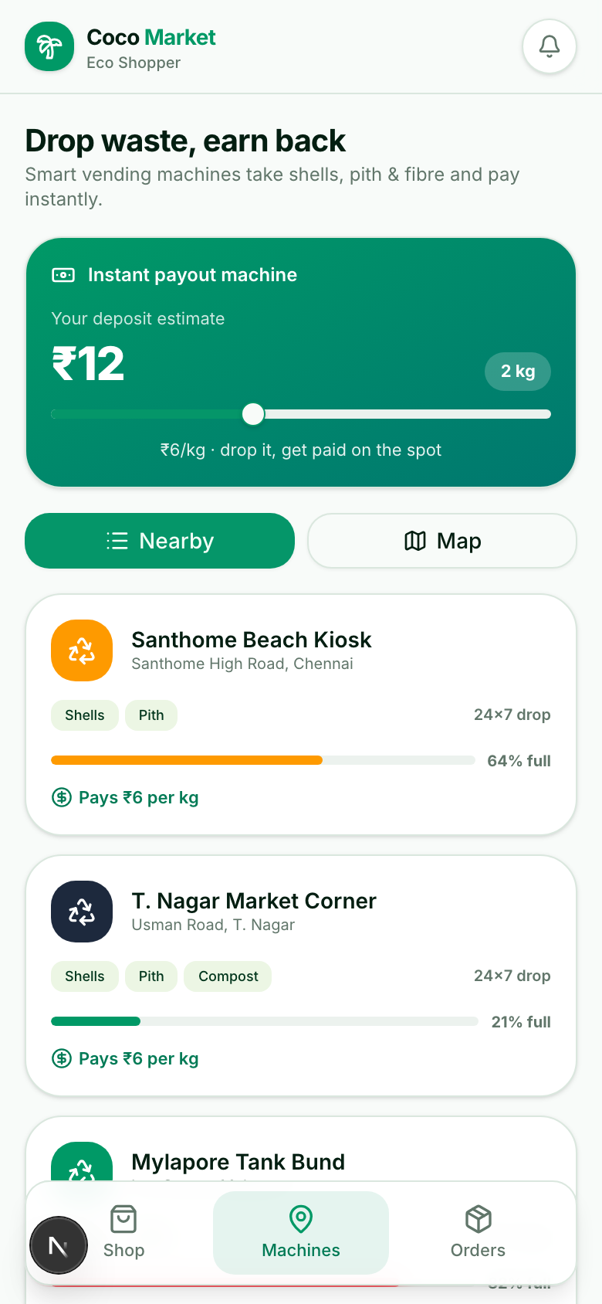
THE MARKET CATCHES THE WASTE
Shop the loop, feed a machine
Marketplace sells goods made from diverted coconut waste
Demo checkout — every order shows its diverted kg
24×7 vending machines pay ₹6/kg the moment you drop
Deposit calculator + nearest-machine map and route
Try it: sign up as a Consumer (any mobile + OTP 420420), or use +91 97400 00041

Slide 8
IMPACT WITH A HUMAN FACE
Rural women are the heart of the loop
184 women
12K
14
employed across 14 self-help groups — sorting, spinning coir and pressing blocks. Steady, dignified income close to home.
coir blocks shipped
self-help groups
Fair, instant earnings
Payouts land in UPI in real time — no cash cycles, no middlemen. Livelihoods that scale with the city.
2.9L
100%
kg CO₂ avoided
traceable kg

Slide 9
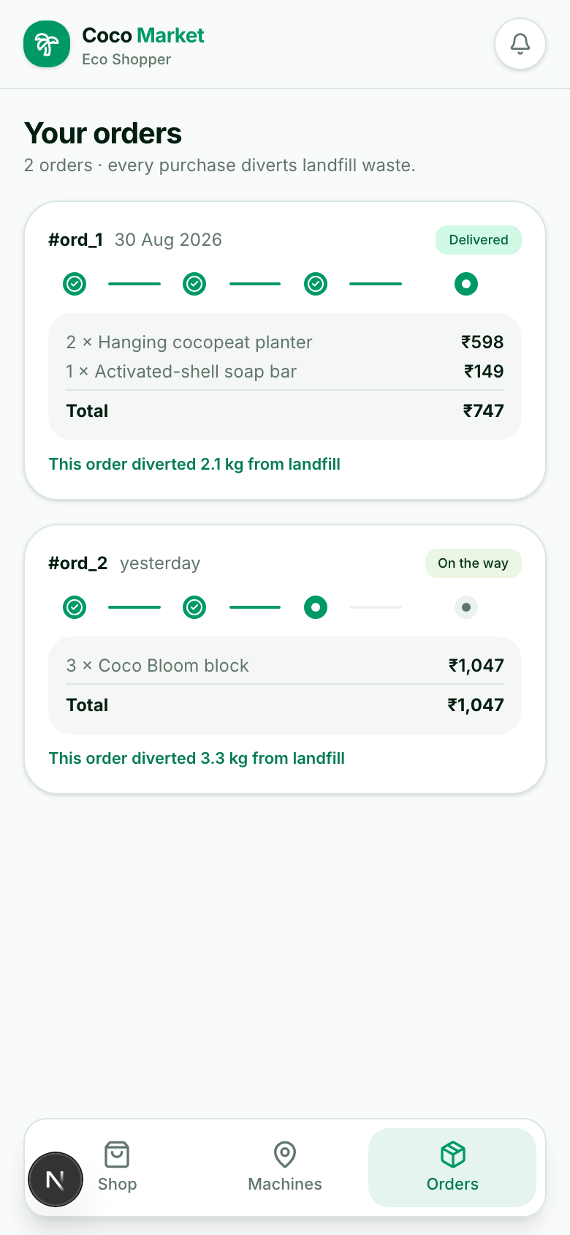
TRACKED, PRICED, PROVABLE
Your impact, live
1,218,490
292,438
4,873,960
26
kg recycled
kg CO₂ avoided
shells diverted
machines live
verified at weigh-in
methane never released
from drains & dumps
24×7 instant payouts
Impact you can touch — every order shows exactly how much waste it diverted:
Every kilo has an owner, a route,
a price and a CO₂ ledger.

Slide 10
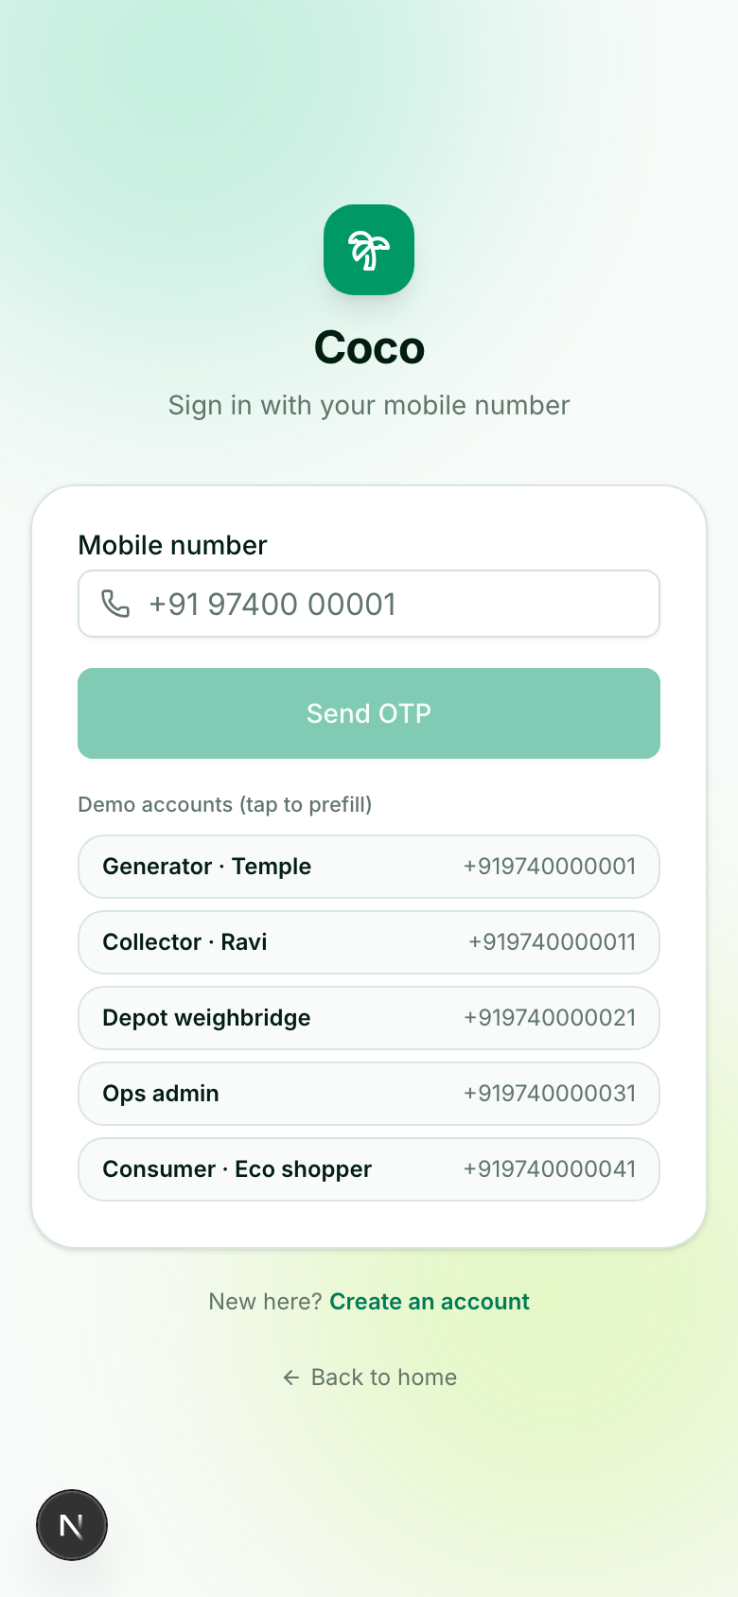
TRY IT IN 60 SECONDS
Out of the box. No setup, no keys.
npm install && npm run dev → open http://localhost:3000
Role | Demo phone (OTP 420420)
Generator · Temple | +91 97400 00001
Collector · Ravi | +91 97400 00011
Depot weighbridge | +91 97400 00021
Ops admin | +91 97400 00031
Consumer · Eco shopper | +91 97400 00041
Full walkthrough: docs/demo-script.md
github.com/Jagrithn/nariyalre

Slide 11
Waste that works.
Urban waste, digitised, tracked and priced into a circular economy — with women at its centre.
Go live on Supabase (schema + seed included)
Plug a real UPI PSP into the payments seam
Deploy vending machines & retail kiosks
Coco · github.com/Jagrithn/nariyalre

