Slide 1
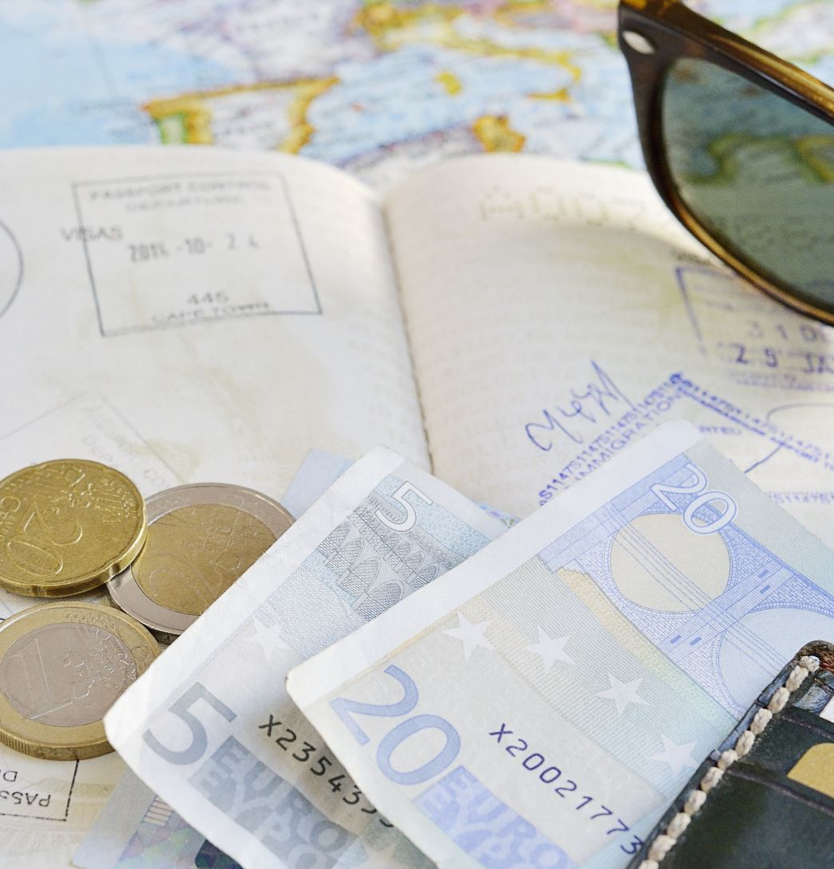
Maximizing Revenue For Drivers- Payment Type
Add a brief explanation of the presentation’s purpose

Slide 2
Agenda
Problem Statement
Research Question
Data Overview
Methodology
Analysis and Findings
Hypothesis Testing
Recommendations

Slide 3
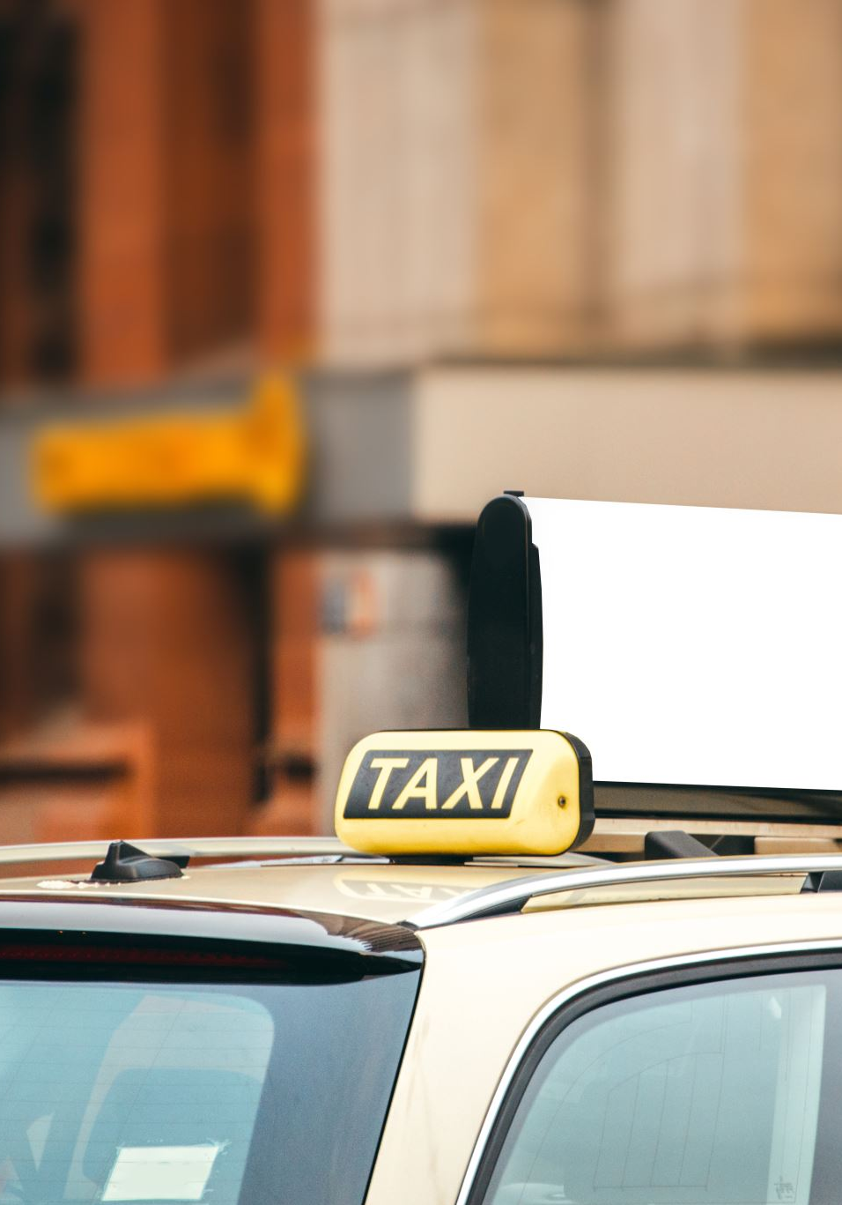
Problem Statement
In the fast-paced taxi booking sector, maximising revenue is crucial for long-term success and driver satisfaction.
Our goal is to use data-driven insight to maximise revenue streams for taxi drivers to meet this need. Our research aims to determine whether payment methods have an impact on fair pricing by focusing on the relationship between
payment type and fare amount
payment type and trip duration (pickup and dropoff time)

Slide 4
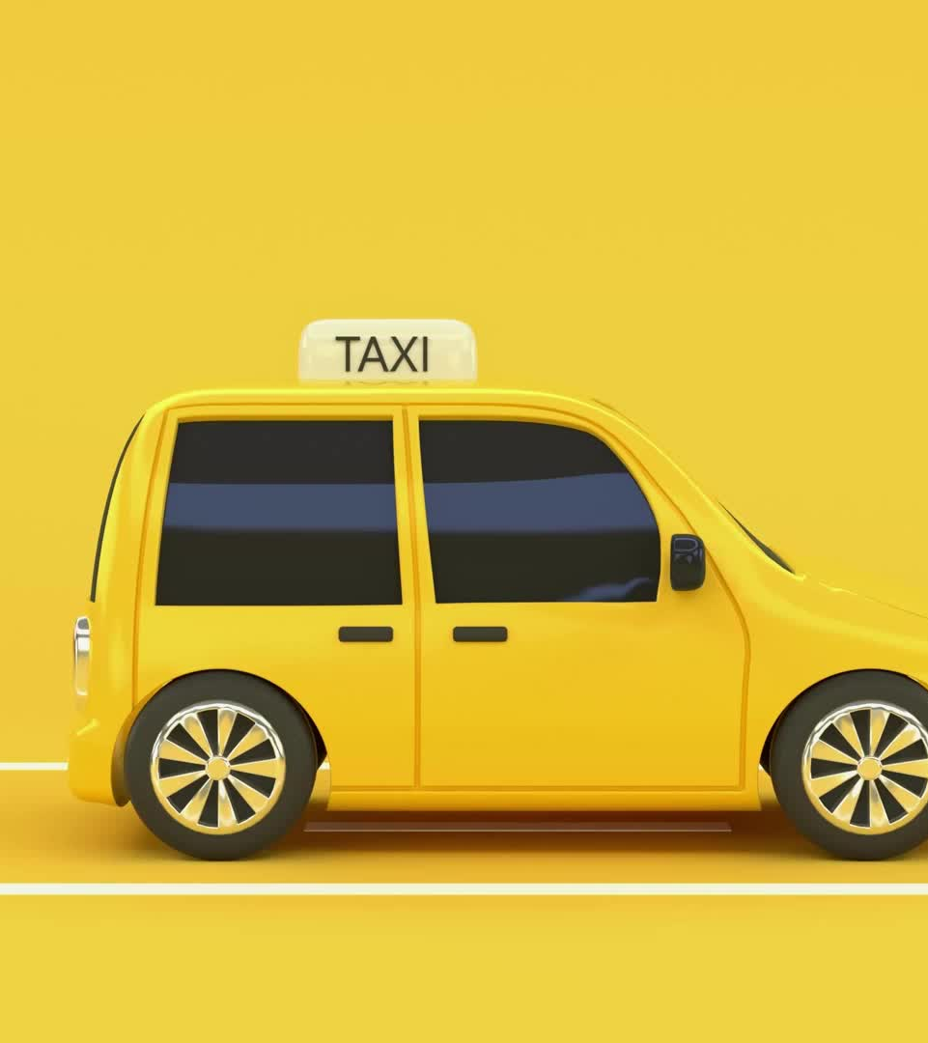
Objective
This project's main goal is to run an A/B test to examine the relationship between the total fare and the method of payment. We utilise Python's hypothesis testing and descriptive statistics to extract valuable insights that can help taxi drivers increase their revenue. In particular, we want to find out if there is a big difference in the fares for those who pay with credit cards versus those who pay with cash.

Slide 5

Research Question
Is there a relationship between total fare amount and payment type?
Is there a relationship between total trip duration and payment type?
Can we move customers towards payment methods that generate higher revenue for drivers, without affecting the CX?

Slide 6
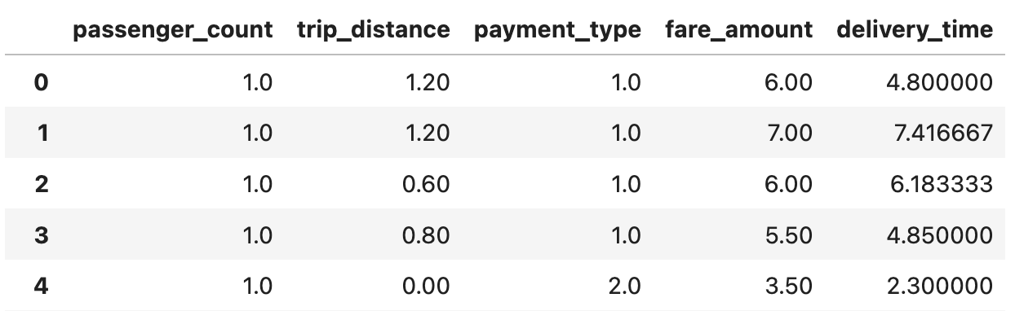
Data Overview
For this analysis, we utilized the comprehensive dataset of Yellow Taxi Trip records, used data cleaning and feature engineering procedures to concentrate solely on the relevant columns essential for our investigation
Relevant columns used for this research
passenger_count (1 to 5)
payment_type (card and cash)
fare-amount
trip-distance
duration (min)

Slide 7
Methodology
Step | Description
Descriptive Analysis | Performed statistical analysis to summarize key aspects of the data, focusing on fare amount and payment type.
Hypothesis Testing | Conducted a T-test to evaluate the relationship between payment type and fare amount, testing hypothesis that different payment methods influence fare amounts.
Regression Analysis | Implemented linear regression to explore the relationship between trip duration( calculated from pickup and drop-off times) and fare amount.

Slide 8
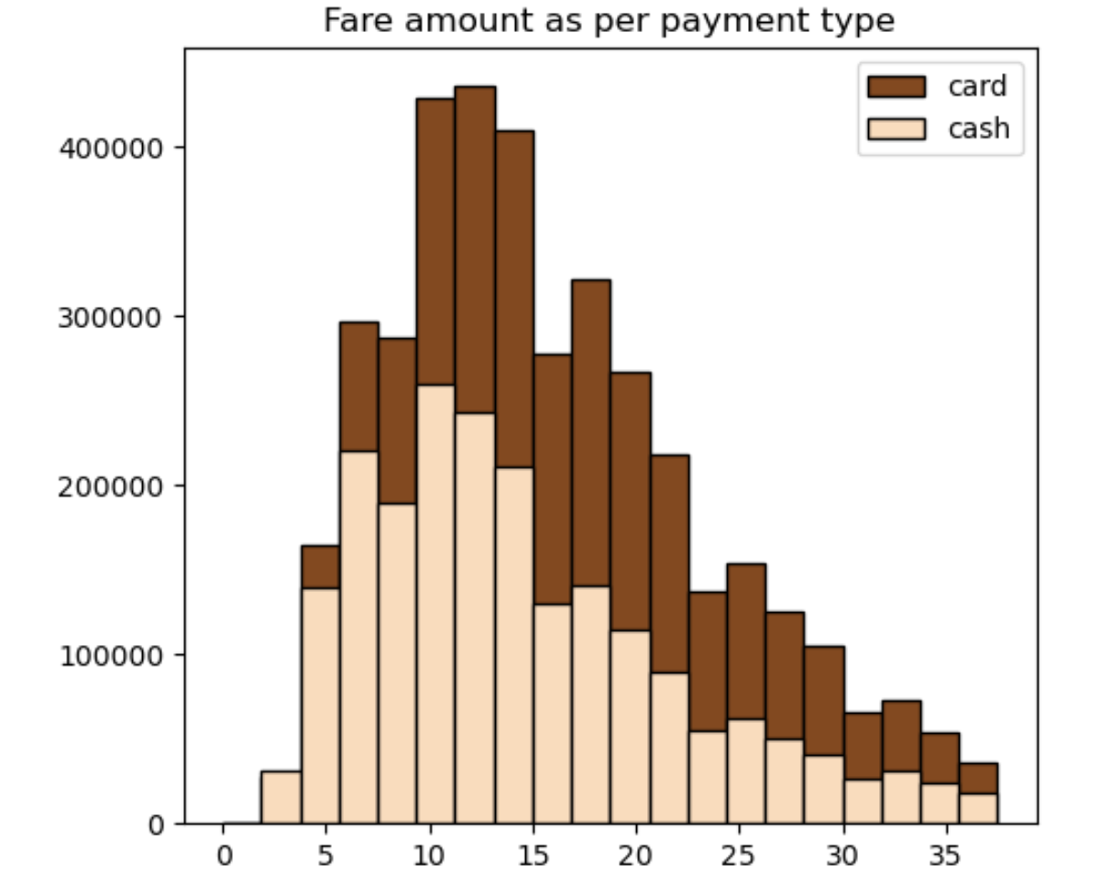
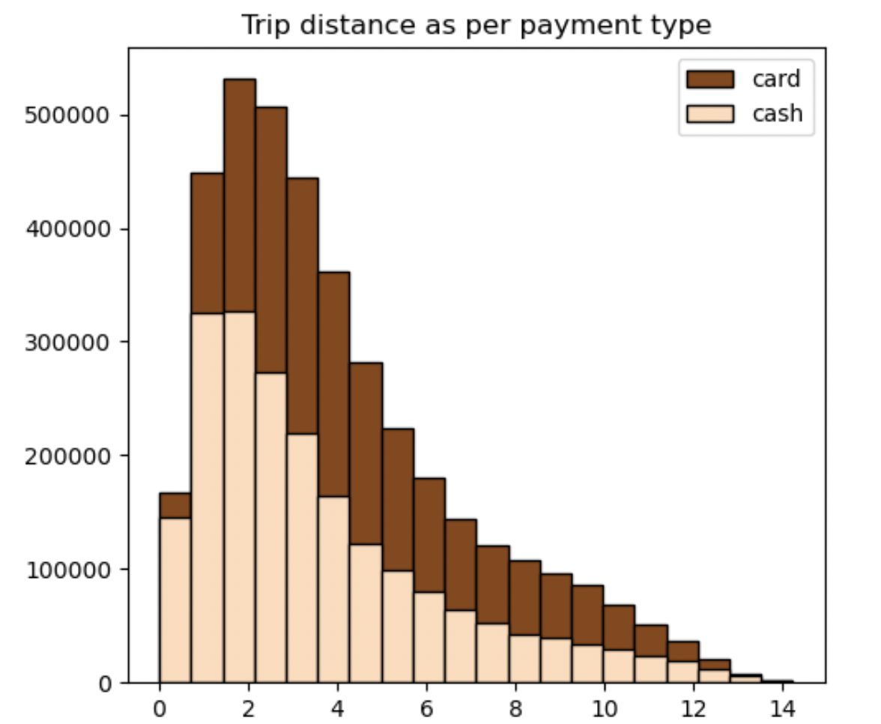
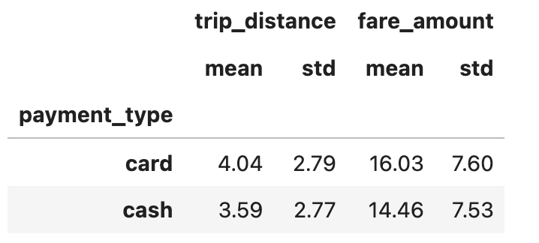
Journey Insight
-Consumers paying with card tend to have higher fare amount and longer trip distance as compared to consumers paying with cash.
- This indicates consumers prefer card usage for longer distance and higher fare.

Slide 9
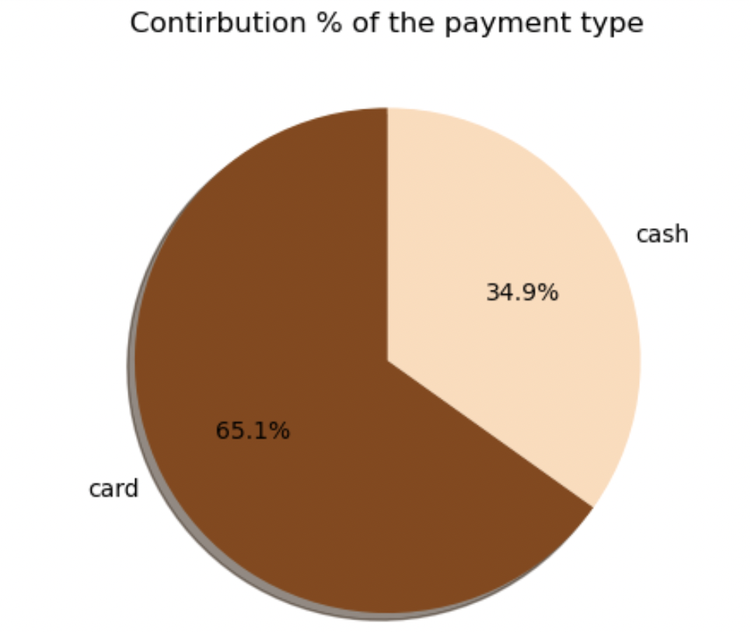
Journey Insight
The proportion of consumers paying with card is significantly higher i.e. 65% as compared to paying with cash i.e. 40%.
This indicated consumers prefer card over cash due to use now pay later payment mode, incentivize in card payment with some cashback and discounts.

Slide 10
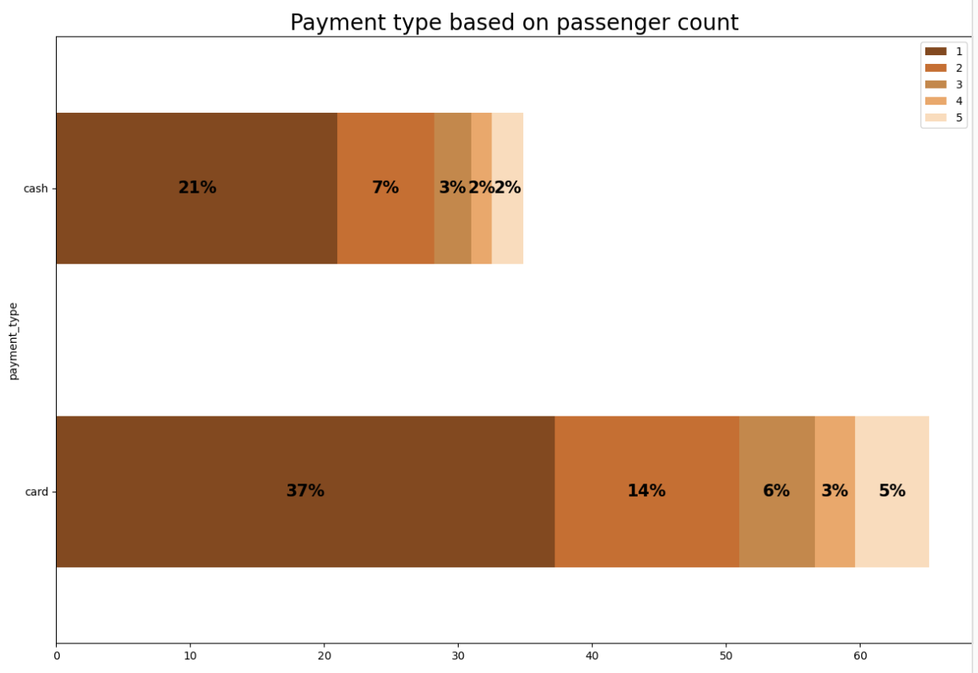
Passenger count analysis
Consumers tend to use card more when they travel alone as compared to cash.
Cash payment helps when the consumers are travelling in group for pay now then later
Solo taxi riders uses more of card or cash then riders in group.
There is a noticeable decline in the proportion of transactions as the number of passengers increases, this indicates that either larger groups are using less taxi rides or they are using some alternative payment methods other than card and cash
This insight provide valuable information if both passenger count and payment type is considered when analysing transaction data as they provide insights into consumers behavior and preference.

Slide 11
Hypothesis Testing
Null Hypothesis: There is no difference in the average fare between customers who pay with a credit card or cash
Alternative Hypothesis: There is a difference in the average fare between customers who pay with a credit card or cash
With a T-statistics of 165.5 and a P-value of less than 0.05, we reject null hypothesis, suggesting there is indeed a significant difference in average fare between the two payment methods.

Slide 12
Recommendations
Implement marketing strategy targeting solo taxi riders and include incentivizing card users as one of the tactics.
01
Provide digital discount coupons for the card users taking longer distance trip.
02
Provide safe and secure payment method for the card users.
03

Slide 13
Thank you

