Slide 1
Performance Analysis and Speedup of AWS Data Pipeline and Analytics
© JG 2021

Slide 2
Outline
Motivation
Why Choose Amazon Web Service (AWS)?
Serverless Data Analytics Architecture on AWS
Environment and Security Setup
Data and Methodology
Result – Query Performance (MySQL vs Amazon Athena)
Interactive Dashboard Demo with QuickSight
Summary

Slide 3
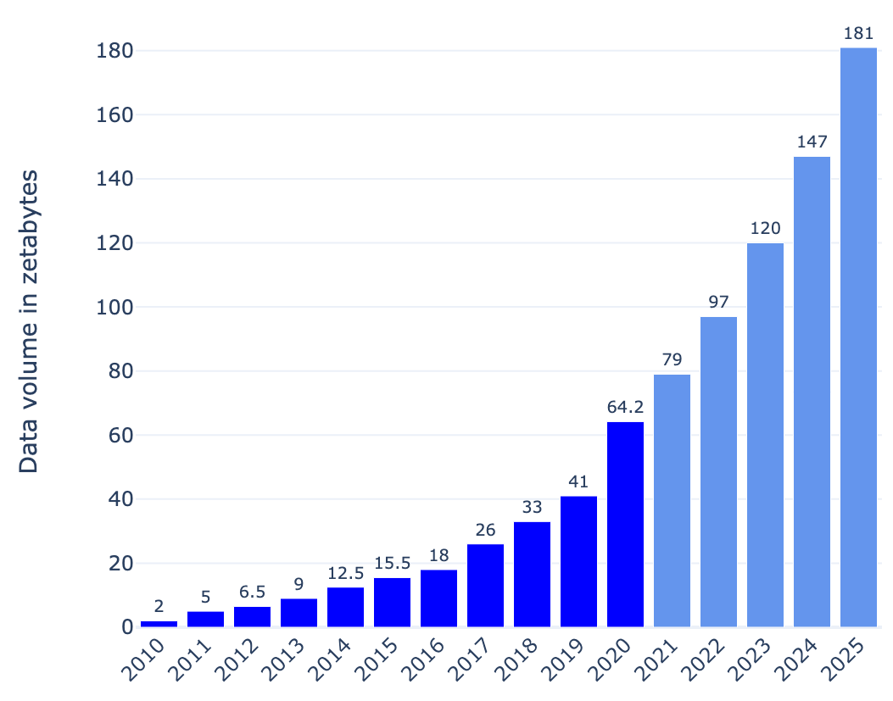
Motivation
Goal: Performance Analysis and Speedup of AWS Data Pipeline and Analytics
Data Analytics - Definition
Extracting insights from data using data analysis and management processes, tools and techniques
Data Analytics - Importance
Better and faster decision-making To predict future outcomes and enhance business intelligence Better operational efficiency To improve customer service
Data Analytics - Challenges
Exponential growth of data with time Inefficient data management due to large size, complexity, variety, and variability Data velocity – speed of data generation and process to meet demands Open-source data analytics tools to meet enterprise security standard Processing power – latency and cost of data processing
Worldwide data volume from 2010 to 2025, increasing rapidly – reaching 64.2 zettabytes in 2020 and projected to grow more than 180 zettabytes by 2025.
With the rapid growth of the data volume, storage capacity is projected to increase, growing at a compound annual growth rate of 19.2 % over the forecast period from 2020 to 2025.
[Statista 2021]
Notes:
Data analysis and management processes, tools and techniques including the collection, organization, and storage
Traditional data management tools cannot store and process large and
complex data efficiently
Data variety – heterogeneous sources and natures of data – structured,
Variability – inconsistent data leads ineffective data handling and management
Processing power – latency and cost of big data processing
semi-structured, and unstructured
In this increasing data-driven business atmosphere, Enterprises are strategizing more towards deriving meaningful insights from their vast amounts of data

Slide 4
Why Choose AWS for Data Analytics?
Cloud Infrastructure and Platform Services Reviews and Ratings: Ratings (# of reviews) [Gartner peerinsights]
 | AWS | Google | Microsoft | IBM
User Management | 4.4 (2593) | 4.4 (750) | 4.3 (1516) | 4.2 (204)
Security and Compliance | 4.6 (2647) | 4.6 (777) | 4.4 (1542) | 4.3 (211)
Architecture Flexibility | 4.5 (238) | 4.5 (136) | 4.3 (157) | 4.1 (57)
Big Data Enabled | 4.4 (293) | 4.5 (160) | 4.3 (180) | 4.2 (66)
Developer Services | 4.4 (2629) | 4.4 (774) | 4.4 (1536) | 4.1 (210)
Enterprise Integration | 4.4 (2571) | 4.3 (762) | 4.3 (1492) | 4.1 (201)
Resilience | 4.5 (293) | 4.4 (161) | 4.3 (180) | 4.0 (66)
Ease of Deployment | 4.4 (2431) | 4.5 (699) | 4.3 (1501) | 4.1 (229)
Ease of Integration using Standard APIs and Tools | 4.4 (2434) | 4.5 (696) | 4.3 (1504) | 4.1 (228)
Pricing Flexibility | 4.1 (2233) | 4.4 (588) | 4.0 (1369) | 3.9 (218)
Overall Peer Rating | 4.6 (2722) | 4.5 (816) | 4.4 (1633) | 4.3 (268)
Figure: Magic Quadrant for cloud Infrastructure and Platform Services
 | AWS | Google | Microsoft
# of Services | 200+ | 60+ | 100+
Availability Zones | 66 zones + 12 coming | 20 regions + 3 coming | 54 regions, 140 country
Market Shares, | 32% | 7% | 19%
According to Gartner report, AWS is leading with the highest score in both axes of measurement – Ability to Execute and Completeness of Vision.
[Gartnet Report 2020]
[Ref: Intellipaat]

Slide 5
Serverless Data Analytics Architecture on AWS
Store and analyze large volume of data with high durability, security, and scalability
In serverless environment, no infrastructure needed to manage and monitor the performance
Data size reduced by transforming raw CSV data into Parquet (around 5 to 1 compression), resulting in reduced query cost
Amazon S3 | Amazon Glue | Amazon Athena | Amazon QuickSight
Unlimited object storage Structured, semi-structured Cheap, reliable Cost effective ($0.023 per GB) 99.999999999% durability Standard S3 storage - 99.99% availability | Completely managed serverless ETL service Create a unified catalog to find data across multiple data stores Simple, scalable and faster data integration Cost effective – pay-as-you-go pricing | A serverless interactive query service Query data in Amazon S3 using standard SQL Faster - executes queries in parallel Easy to quickly analyze large-scale dataset Cost effective – only pay for querying data | A scalable, serverless, embedded, machine-learning (ML) powered BI service Fully integrated AWS and other third-party data sources Faster navigation with SPICE Cost effective – pay-as-you-go pricing

Slide 6
Serverless Data Analytics Architecture on AWS

Slide 7
Environment and Security Setup
Create and activate an AWS account [see instructions]
Create an Amazon Identity and Account Management (IAM) Role to give
S3 bucket access permission
Glue service permission for crawling and transforming data
IAM Dashboard
Click “Roles”
Create Role Dashboard
Select AWS service
Filter Policies
Select the AWSGlueServiceRole policy
Click on “Create Role”
Choose Glue from the list of services
Hit Next: Permission to continue
Select the AmazonS3FullAccess
Click Next: Tags
Give your role a name
Click “Create Role”
Add any tags or leave it blank and click Next: Review
Tags & Review

Slide 8
Data and Methodology
Data Overview:
Data | Size | Description | Source
City Temperature | 140MB | Daily temperature of major cities of the world | kaggle
Electronics Store | 360MB | Purchase data from April 2020 to November 2020 from a large home appliances and electronics online store | kaggle
Customer complaints | 891MB | Real world complaints data received about financial products and services | kaggle
Methodology:
01
Data Storage
Create Amazon S3 buckets
Import CSV files into buckets
Create Amazon Glue Crawler and crawl raw CSV data from Amazon S3 buckets
Create Amazon Glue Data Catalog
Transform raw CSV data to Parquet and crawl and add parquet to Glue Data Catalog
02
Data ETL
03
Data Analysis
Connect Amazon Athena with Glue Data Catalog
Use standard SQL to query data with Athena
04
Connect QuickSight with Athena and add data sources
Create data model and interactive dashboard
Visualization

Slide 9
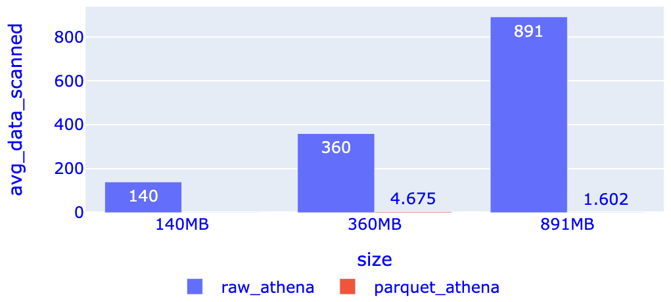
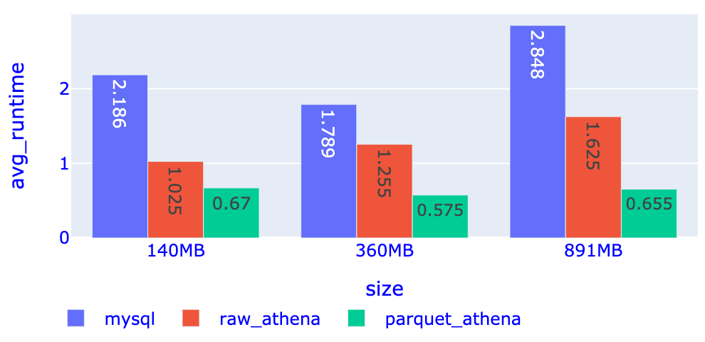
Query Performance (Measure: Data Scanned and Runtime)
Query-A: SELECT Distinct column FROM table;
Query-B: SELECT Count(*) FROM table where column=‘value’;
Table3: Query performance (data scanned): Raw vs Parquet using AWS Athena
Query performance: Avg. Data Scanned
Data | Size | SQL Query | Raw Data | Parquet Data | Decrease
City Temperature | 140MB | Query-A | 140MB | 3.18KB | 99.99%
 |  | Query-B | 140MB | 5.26KB | 99.99%
Electronics Store | 360MB | Query-A | 360MB | 2.64MB | 99.26%
 |  | Query-B | 360MB | 6.71MB | 98.14%
Customer complaints | 891MB | Query-A | 891MB | 894.48KB | 99.90%
 |  | Query-B | 891MB | 2.31MB | 99.74%
Average Data Scanned decreased by 99.50% with Parquet format
Table4: Query performance (runtime): Raw vs Parquet data with AWS Athena
Data | Size | SQL Query | MySQL | Raw data (Athena) | Parquet (Athena)
City Temperature | 140MB | Query-A | 2.526s | 1.14s | 0.74s
 |  | Query-B | 1.845s | 0.91s | 0.6s
Electronics Store | 360MB | Query-A | 1.759s | 1.16s | 0.65s
 |  | Query-B | 1.819s | 1.35s | 0.5s
Customer complaints | 891MB | Query-A | 2.490s | 2.29s | 0.71s
 |  | Query-B | 3.205s | 0.96s | 0.6s
Query performance: Avg. Runtime
Average Runtime decreased by 3.33x (from mysql) and 2.22x (from raw athena) with Parquet format

Slide 10
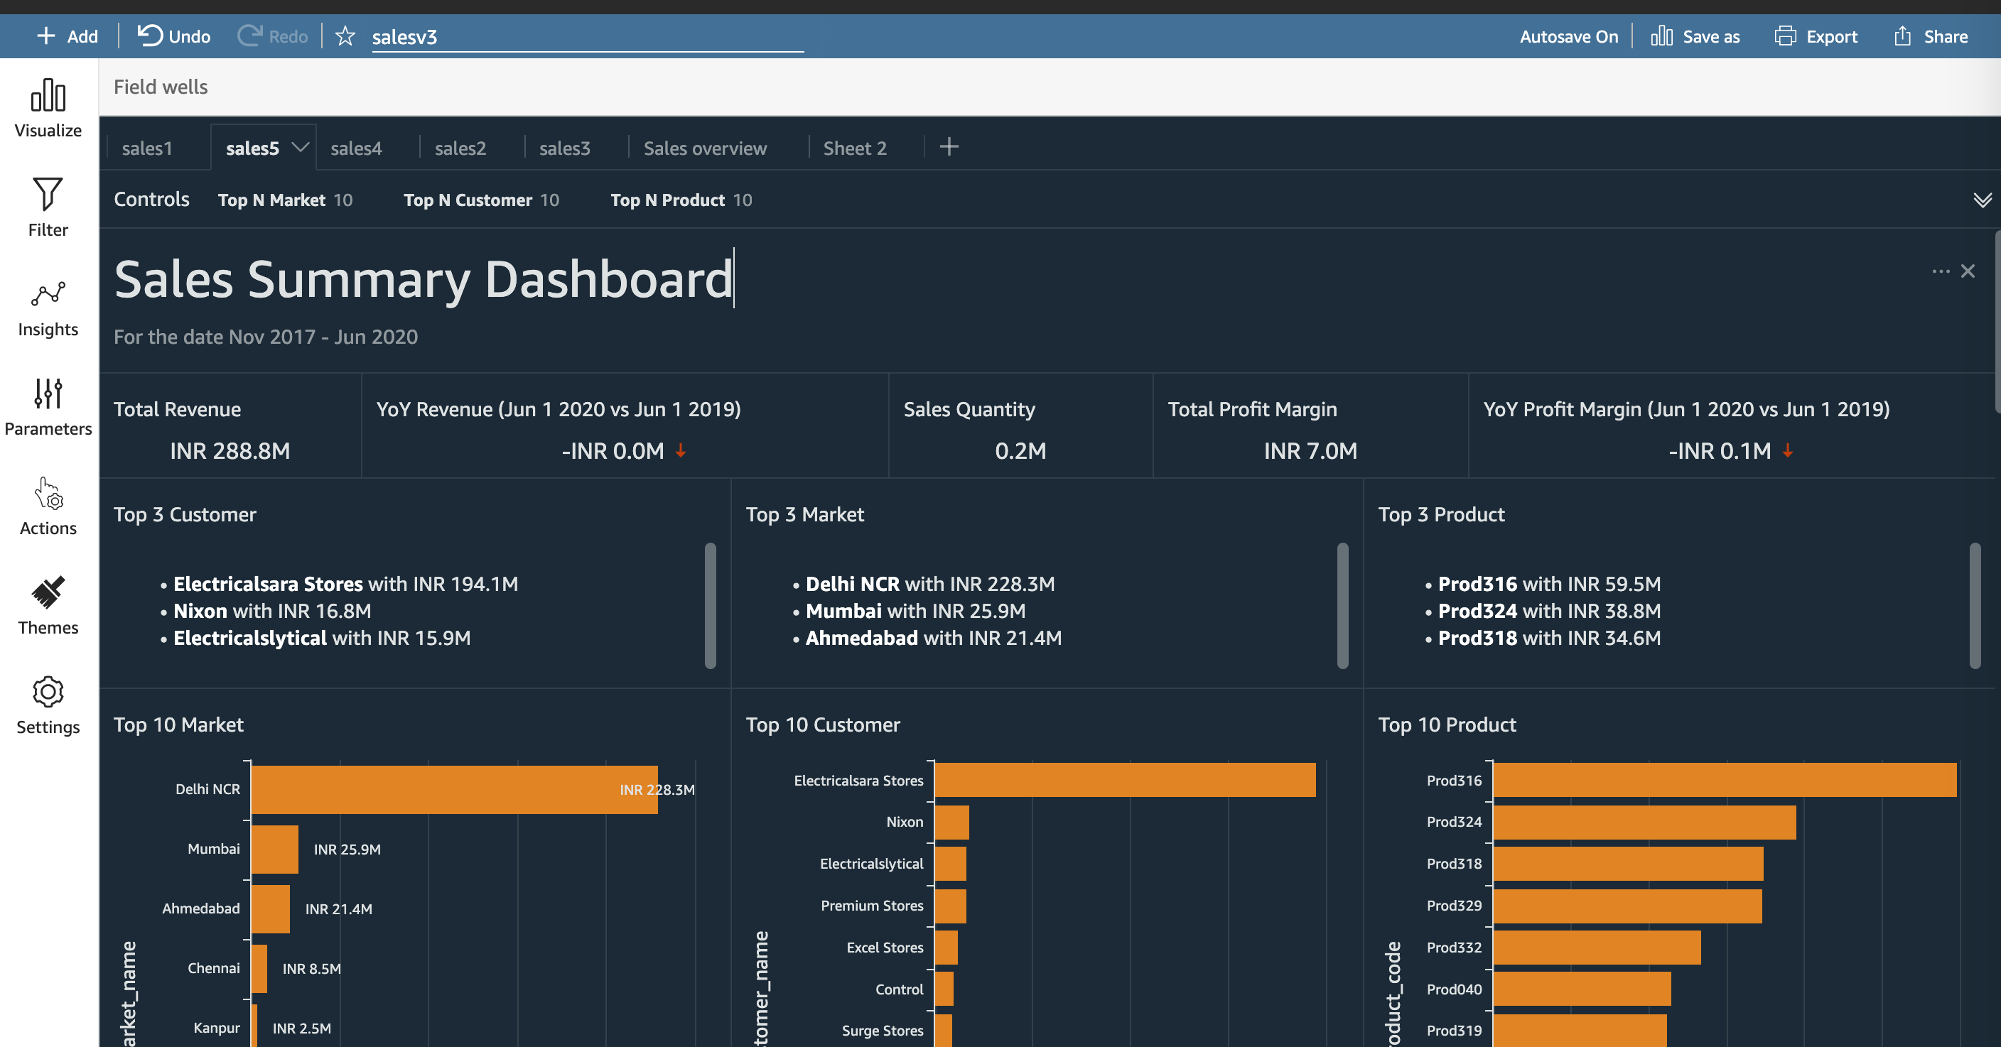
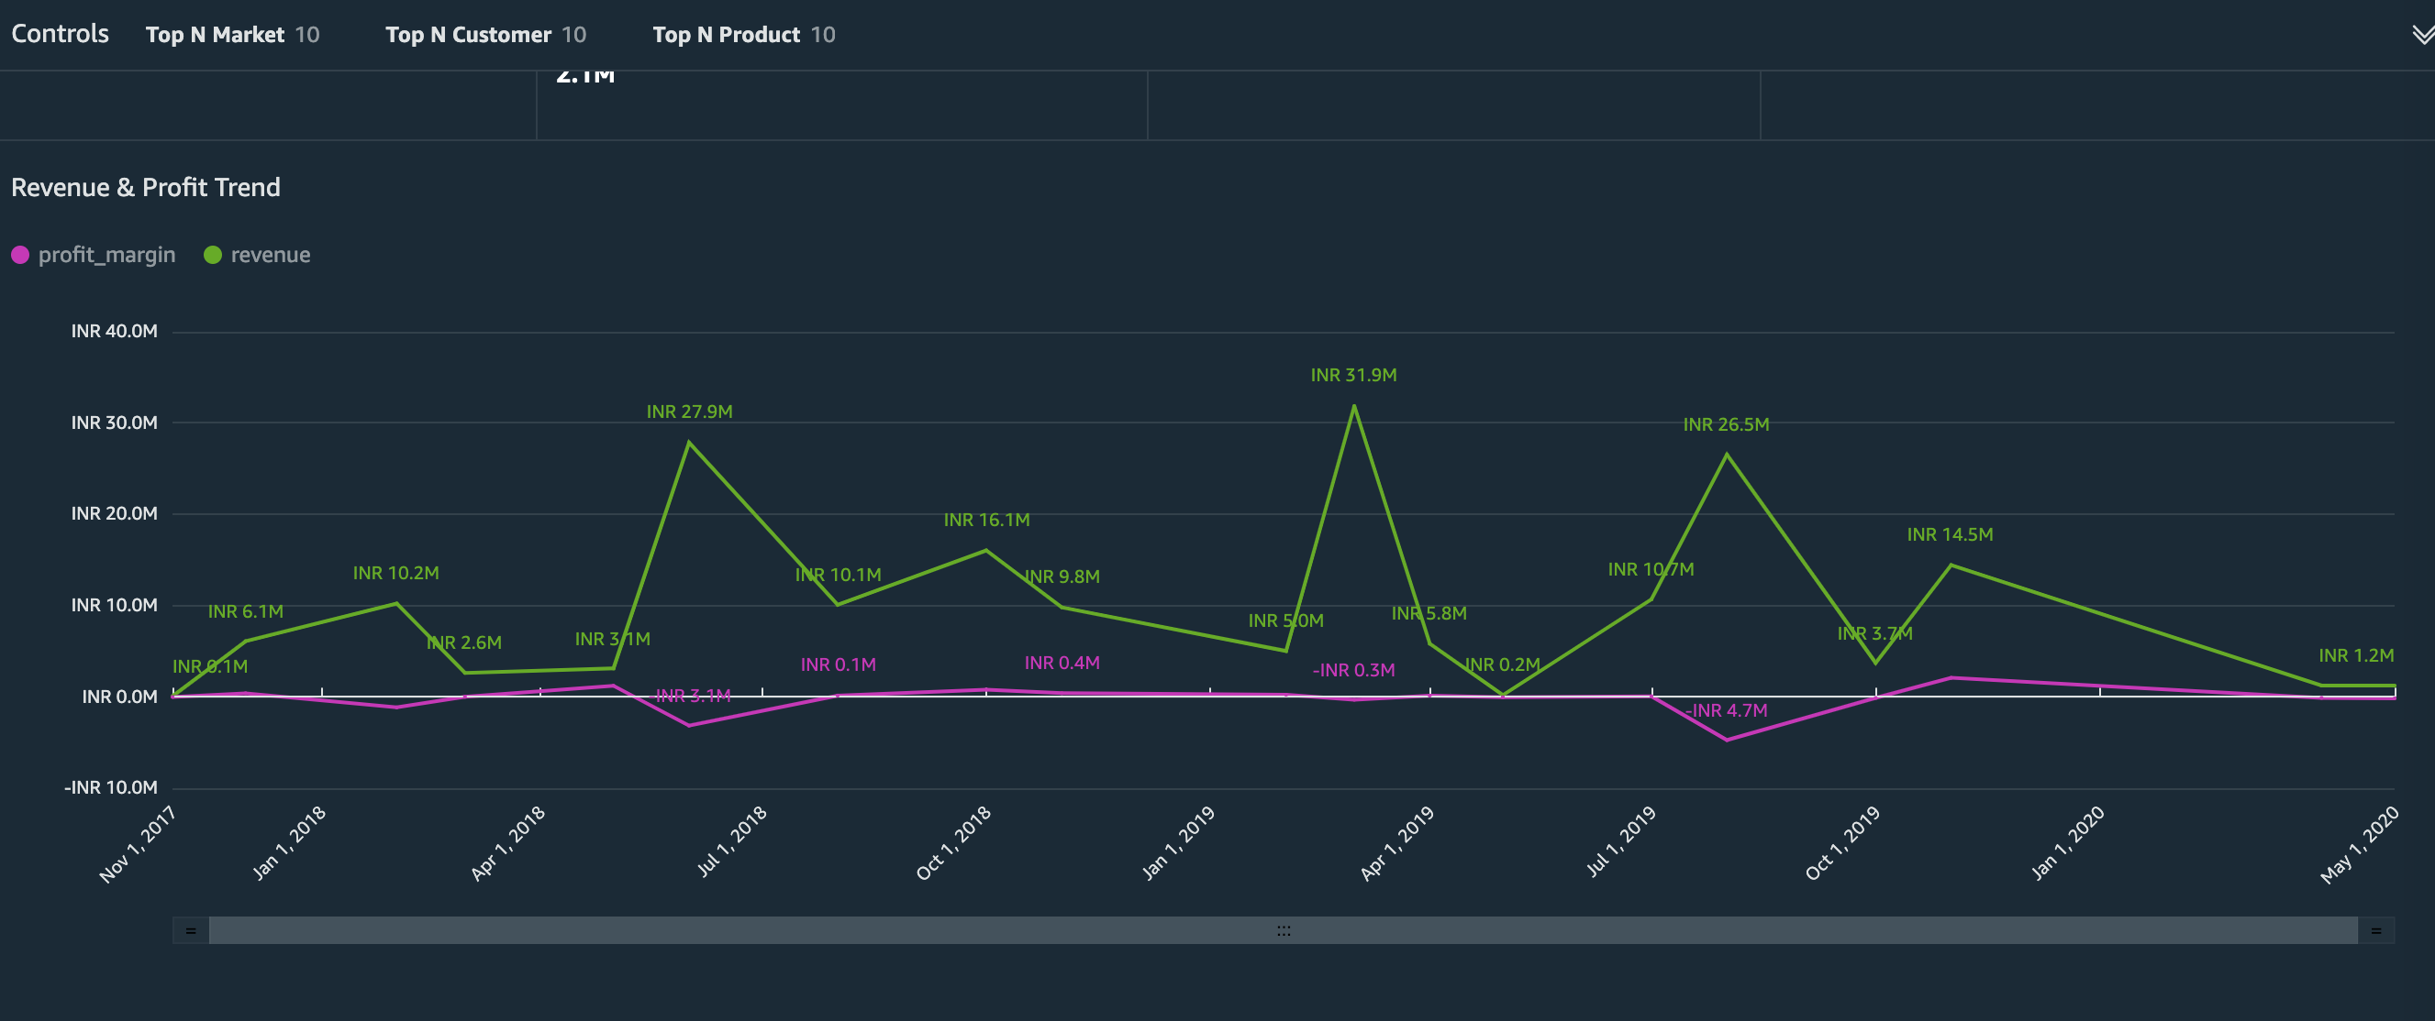
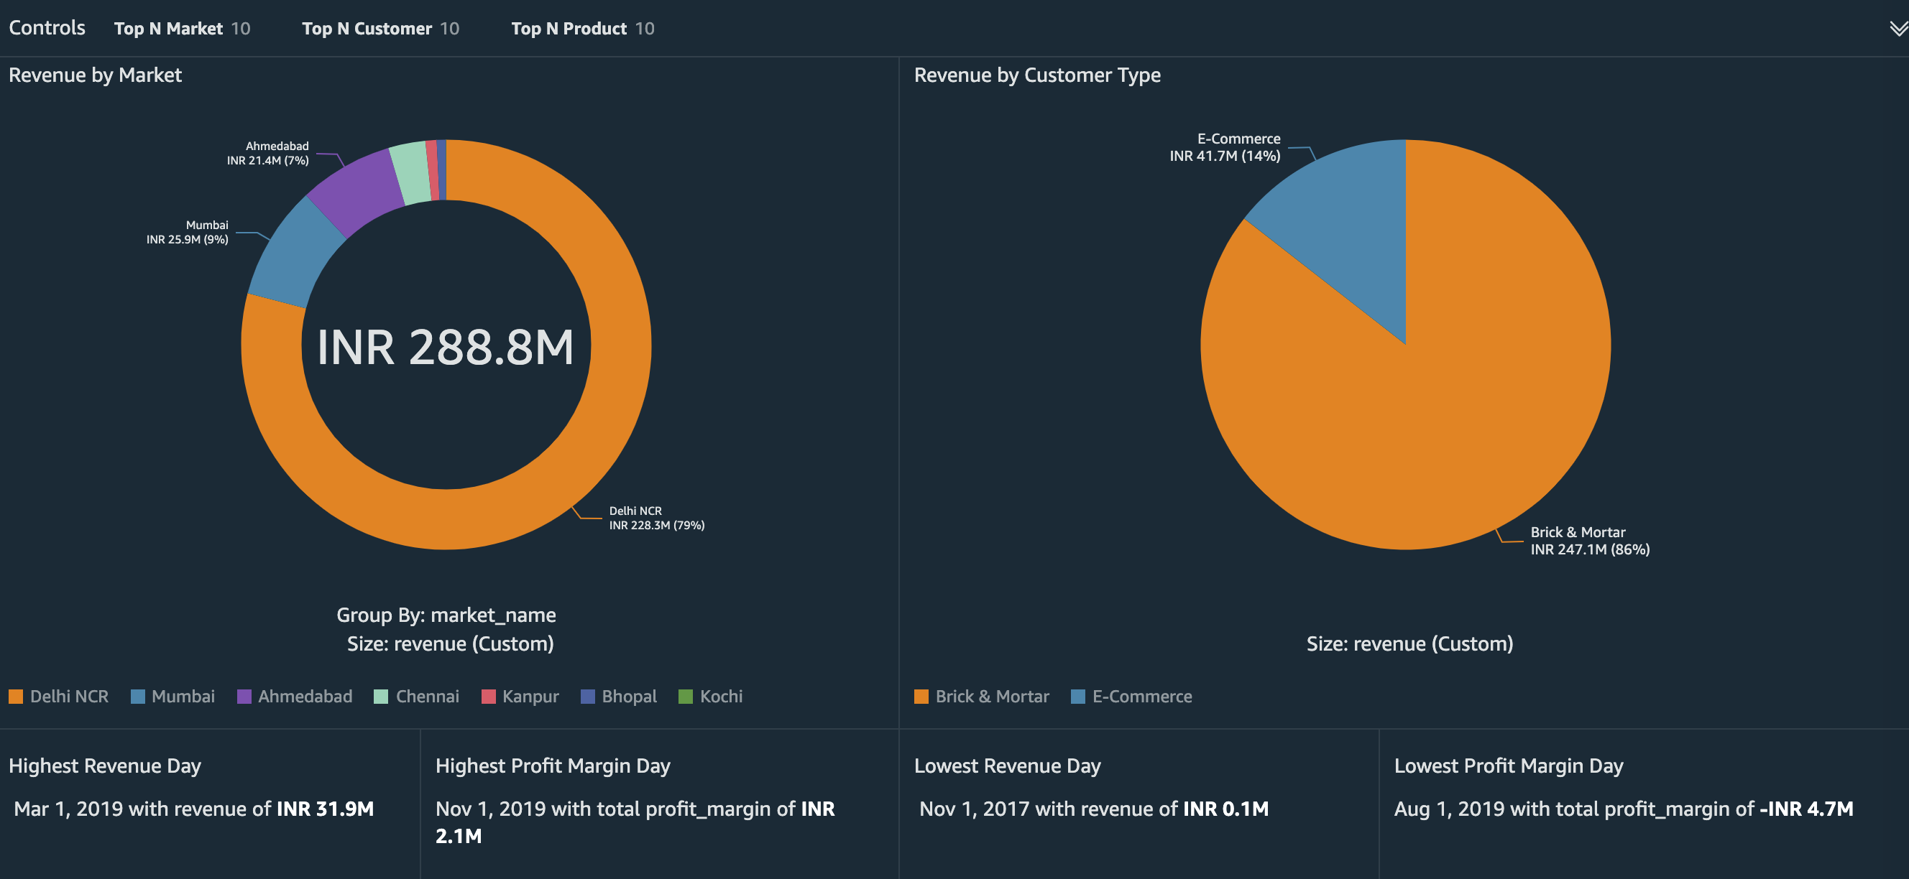
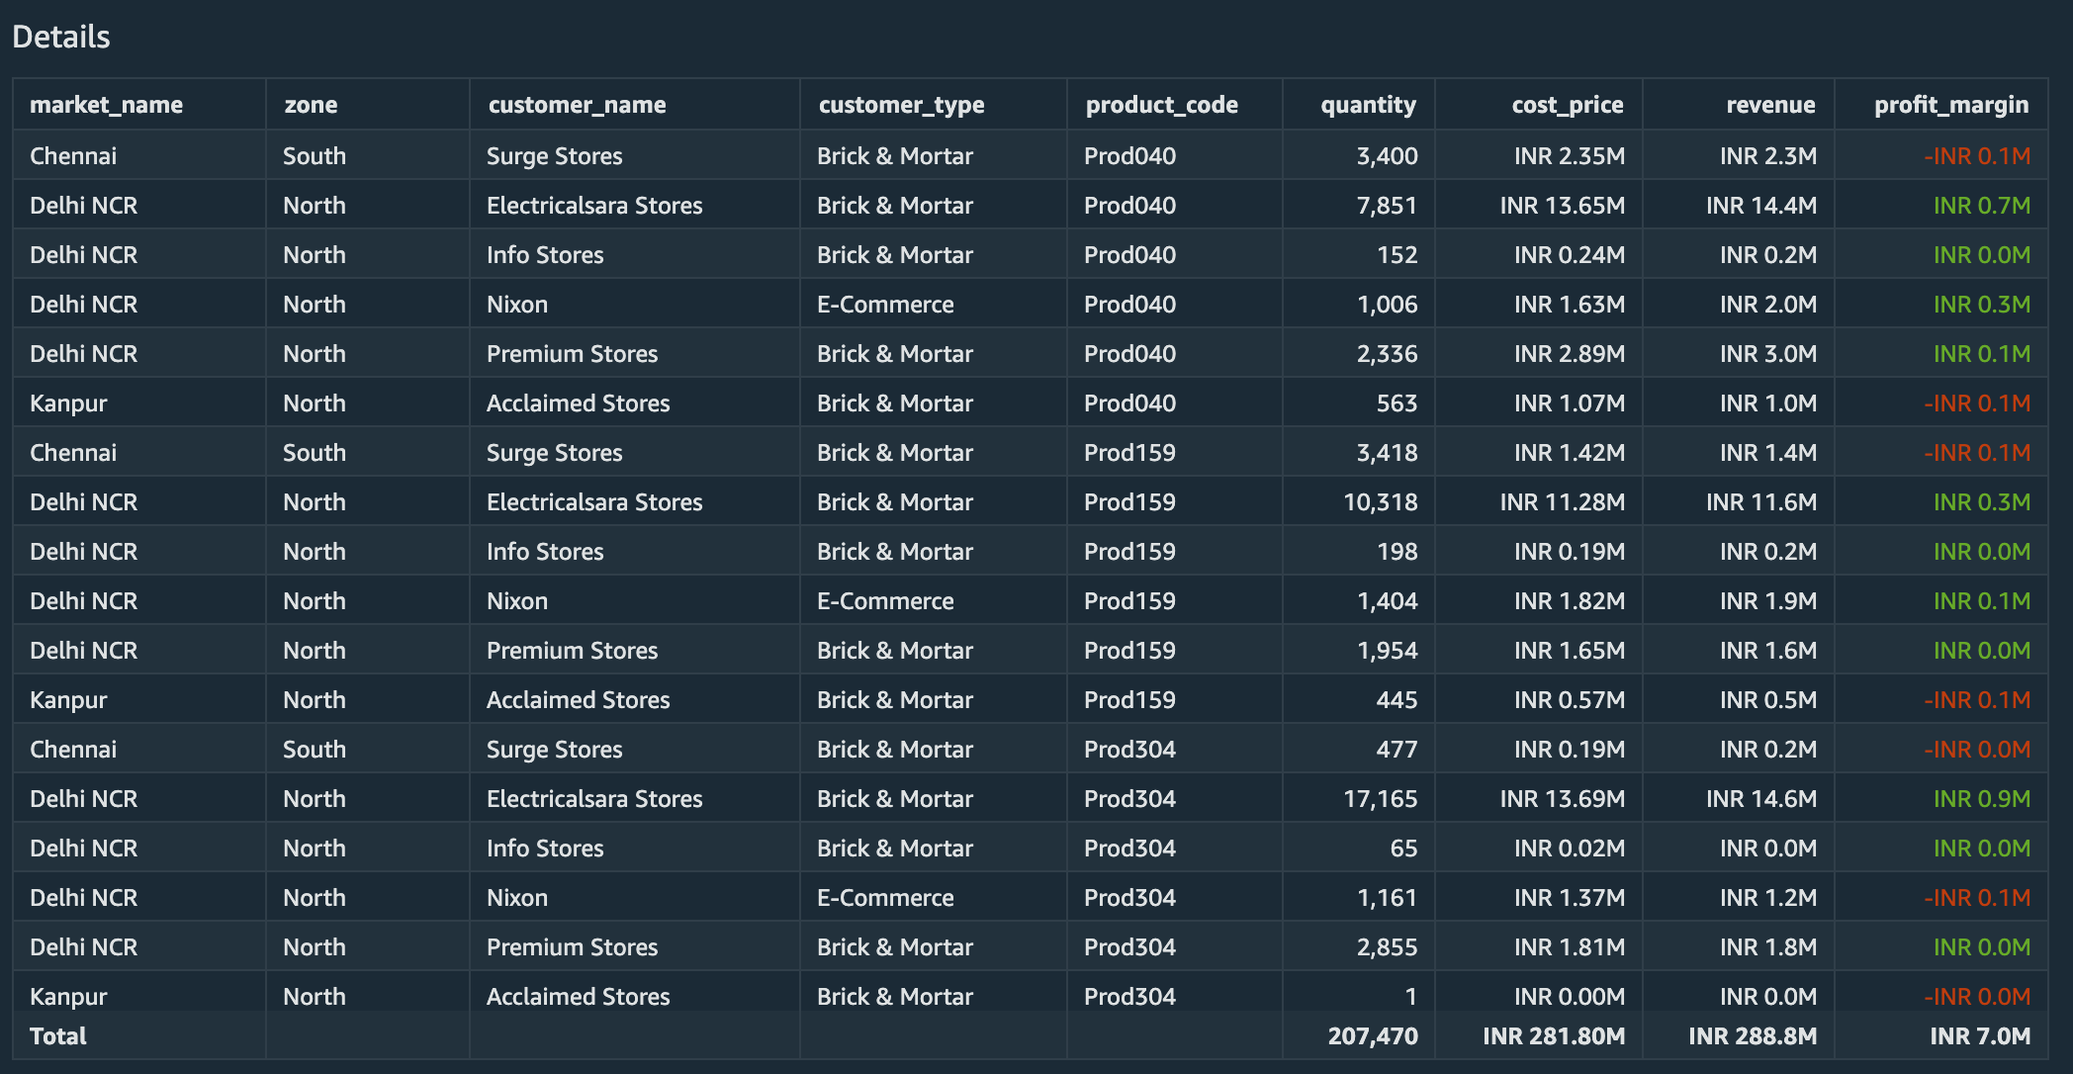
AWS QuickSight Dashboard Demo
Sales Data insights dashboard using AWS QuickSight [data source: github/codebasics].

Slide 11
Summary of Result and Achievement
Result:
Implemented serverless data pipeline on AWS for performance analysis and speedup
Performed data analysis and visualization
Stored CSV data (140MB, 360MB, 891MB) in Amazon S3 buckets
Transformed raw data into parquet format and created Glue Data catalog
Performed SQL queries on Cataloged data (both raw and parquet) using Amazon Athena
Analyzed and compared query performance: MySQL vs AWS Athena
Created Dashboard using Amazon QuickSight
Achievement:
Data size reduced by 80.46% by transforming raw CSV data into Parquet (around 5 to 1 compression), resulting in reduced query cost
Average Runtime reduced by 3.33x (from MySQL) and 2.22x (from raw athena) with parquet data
Average Data Scanned reduced by 99.5% with parquet data

