Slide 1
Data Integration Middleware (DIM)
Jagriti Goswami

Slide 2
Outline
Data Integration Middleware (DIM) - Architecture
Data Integration Middleware (DIM) - Components

Slide 3
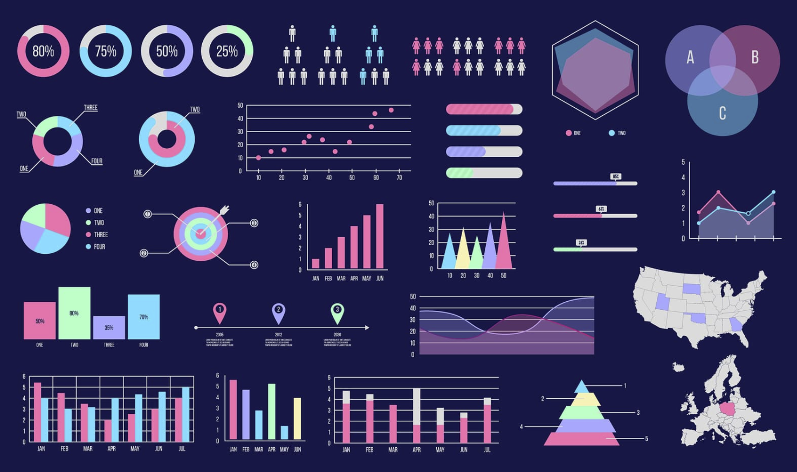
Data Integration Middleware (DIM) Architecture
External Data
(csv, text, json, xml, dat, excel)
Data Integration Middleware (DIM)
Data Processing Unit (DPU)
DIP DB Integration Bus (DDIB)
SQL
Stored
Procedures
Database
SQL/NoSQL
Vizual Library
(Visualization Library)
Savefig as png/jpeg/pdf
DB Integration Bus (DBIB)
DB Visualization Integration Bus (DVIB)
Algorithms Visualization
Integration Bus
(AVIB)
DB Algorithm Integration Bus (DAIB)
Algorithms Library
(Algorithms, Statistics, ML)

Slide 4
Data Integration Middleware (DIM) Components
Data Processing Unit – (DPU)
Data Processing Unit (DPU) transforms raw data into clean processed data.
Functions:
DPU DB Integration Bus – (DDIB)
DDIB, which is the abbreviation for “DPU DB Integration Bus”, is a software architecture that provides connection between SQL Stored Procedures and Database in Pythonic way.
Functions:
DB Integration Bus – (DBIB)
DBIB, which is the abbreviation for “DB Integration Bus”, is a software architecture that provides connection between SQL Stored Procedures and Database in Pythonic way.
Functions:
DB Algorithms Integration Bus – (DAIB)
DAIB, which is the abbreviation for “DB Algorithms Integration Bus”, is a software architecture that provides connection between Database and Algorithms Library.
Functions:
Algorithms Visualization Integration Bus – (AVIB)
AVIB, which is the abbreviation for “Algorithms Visualization Integration Bus”, is a software architecture that provides connection between Algorithms and Visualization Library.
Functions:
DB Visualization Integration Bus – (DVIB)
DVIB, which is the abbreviation for “DB Visualization Integration Bus”, is a software architecture that provides connection between Database and Visualization Library.
Functions:

Slide 5
Middleware : main script/module which takes raw data as input and visualize the data as output based on arguments.
# main.py
# download/import/get raw data
get_raw_data(param1, param2,..):
# Data cleaning/processing (DIP Library) – store processed data in DB
clean_data(param1, param2,..)
save_processed_data(param1, param2,..)
export_to_db(param1, param2,..)
# Pass data through algorithm library – ADA Library
# Get data from DB – Apply algorithm to get insight – Analyzed output to Data Visualization Library
get_data(param1, param2,…)
data_transform(param1, param2,..)
data_analyze(param1, param2,..)
-- ml_algo()
-- stat_algo() – descriptive, inferential, predictive, exploratory
-- math_algo()
-- algos()
-- eda()
data_viz(param1, param2,..)

Slide 6
Summary

