Slide 1
DataWare A Data-Oriented Middleware & Application Integration
Jagriti Goswami

Slide 2
Outline
Dataware- Architecture
Dataware- Components

Slide 3


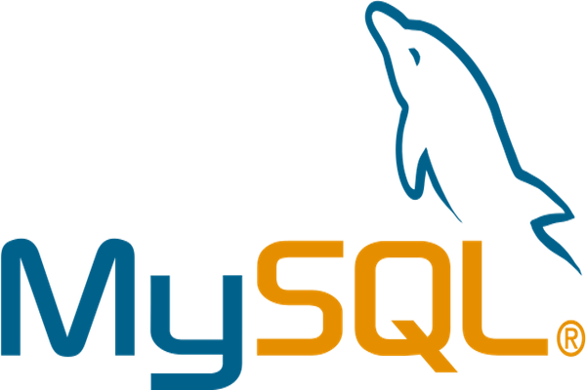
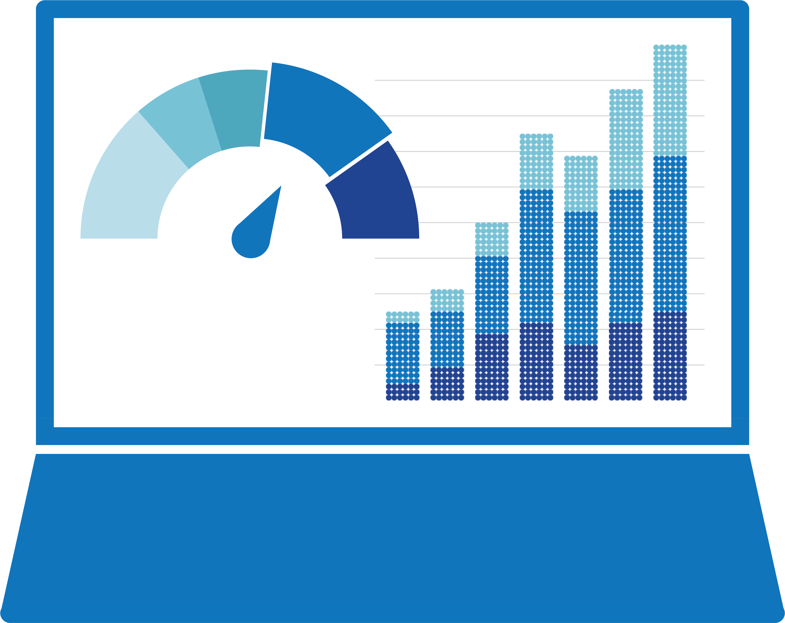

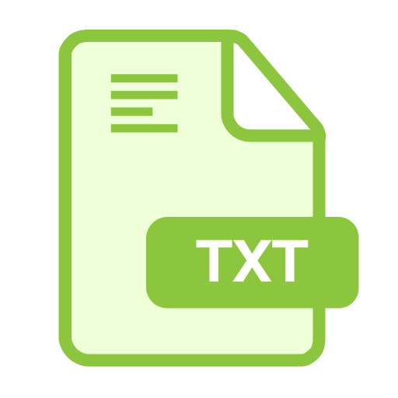
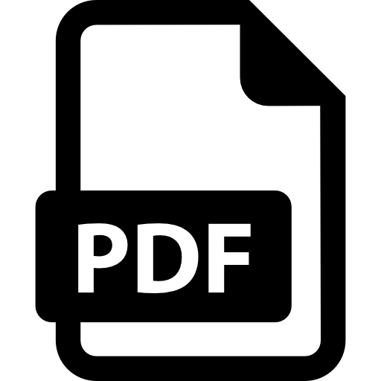
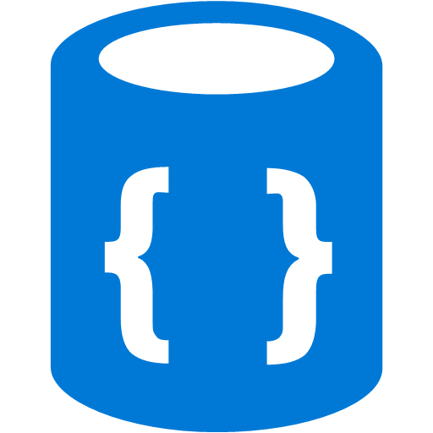




Architectural Overview
Application Layers
ETL
Query
Analytics
EDA
Models & Algorithms
Visualization
Python API Interface
Data Middleware
Data Processing Module - PyDp
Database Query Module - PyDb
Interface Module –
PyDm
Algorithms Module - PyAlgo
Data Visualization Module - PyViz
Database
File
Sources
Data Visualization
Static
Interactive
Dashboard
Web Visualization
MySQL
NoSQL
MSSQL

Slide 4
Components

Slide 6
Summary

