Slide 1
DataWare A Data-Oriented Middleware & Application Integration
Jagriti Goswami

Slide 2
Outline
Dataware- Architecture
Dataware- Components

Slide 3
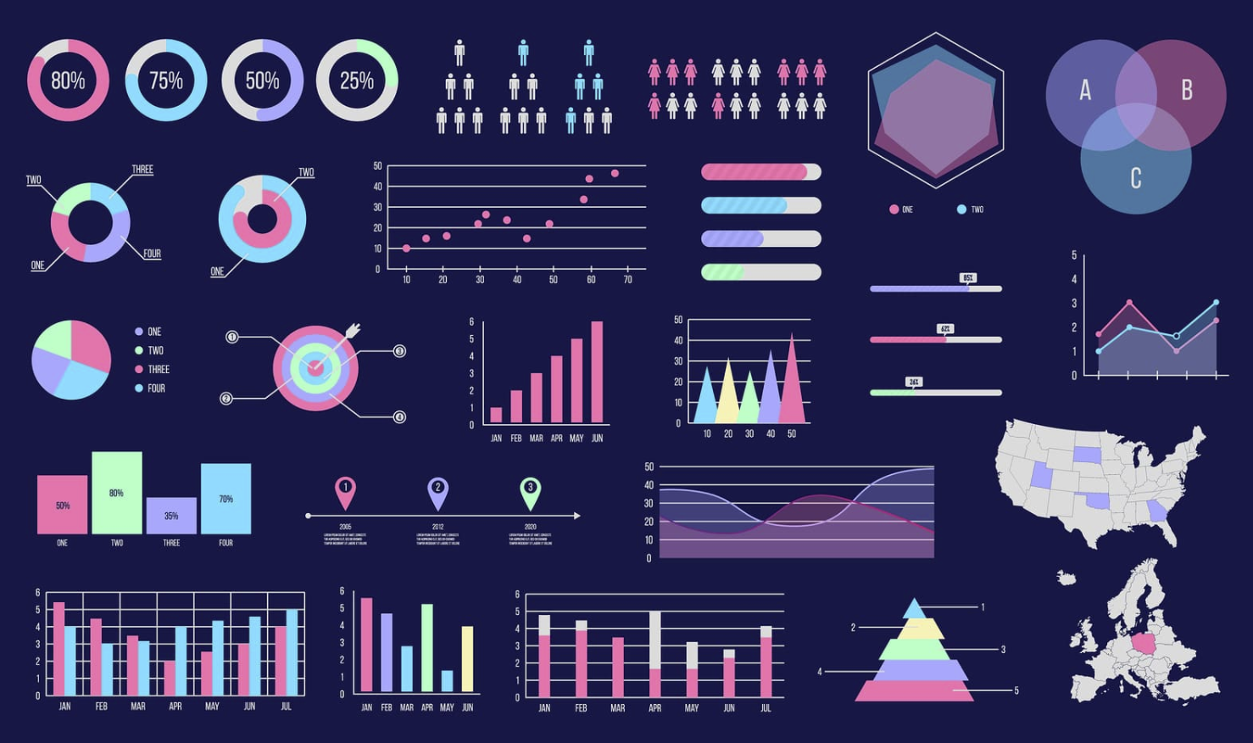
Architecture
External Data
(csv, text, json, xml, dat, excel)
Data Integration Middleware (DIM)
Data Processing Unit (DPU)
DIP DB Integration Bus (DDIB)
SQL
Stored
Procedures
Database
SQL/NoSQL
Vizual Library
(Visualization Library)
Savefig as png/jpeg/pdf
DB Integration Bus (DBIB)
DB Visualization Integration Bus (DVIB)
Algorithms Visualization
Integration Bus
(AVIB)
DB Algorithm Integration Bus (DAIB)
Algorithms Library
(Algorithms, Statistics, ML)

Slide 4

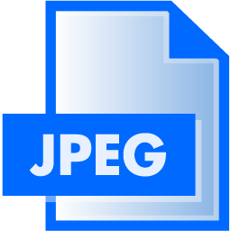
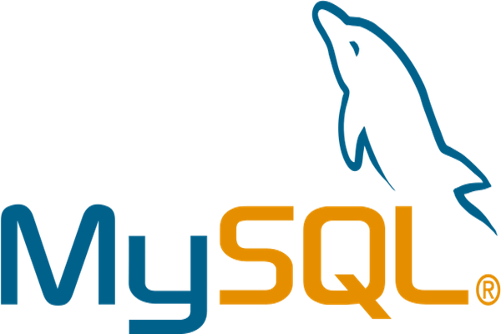
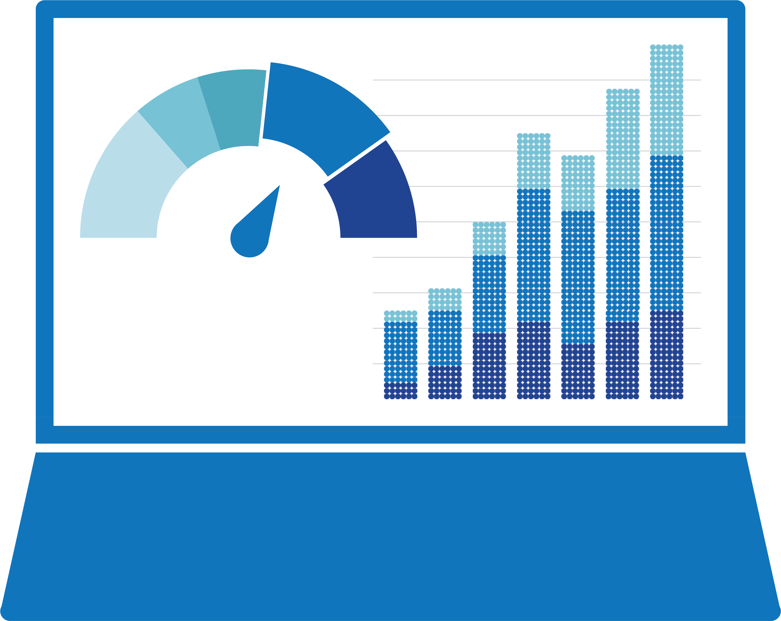

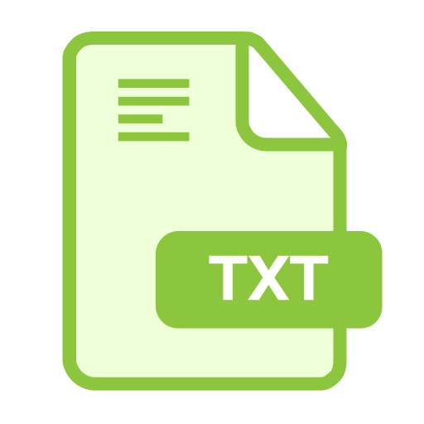
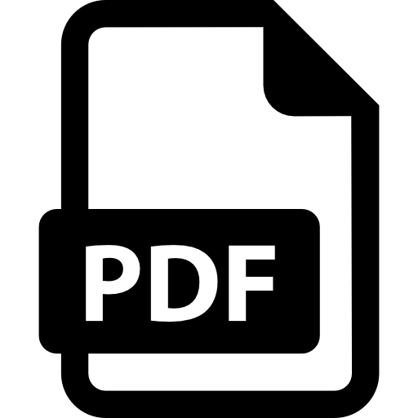





Architectural Overview
Application Layers
ETL
Query
Analytics
EDA
Models & Algorithms
Visualization
Python API Interface
Data Middleware
Data Processing Module - PyDp
Database Query Module - PyDb
Interface Module –
PyDm
Algorithms Module - PyAlgo
Data Visualization Module - PyViz
Database
File
Sources
Data Visualization
Static
Interactive
Dashboard
Web Visualization
MySQL
NoSQL
MSSQL

Slide 5
Architectural Overview
Application Layers
ETL
Query
Analytics
EDA
Models & Algorithms
Visualization
Python API Interface
Data Middleware
Data Processing Module - PyDp
Database Query Module - PyDb
Interface Module –
PyDm
Algorithms Module - PyAlgo
Data Visualization Module - PyViz
Database
File
Sources
Data Visualization
Static
Interactive
Dashboard
Web Visualization
MySQL
NoSQL
MSSQL

Slide 6
Data integration architecture

Slide 7
Components

Slide 9
Summary

