Slide 1
WebViz: Web Visualization using Django and Plotly
©Jagriti Goswami 2021

Slide 2
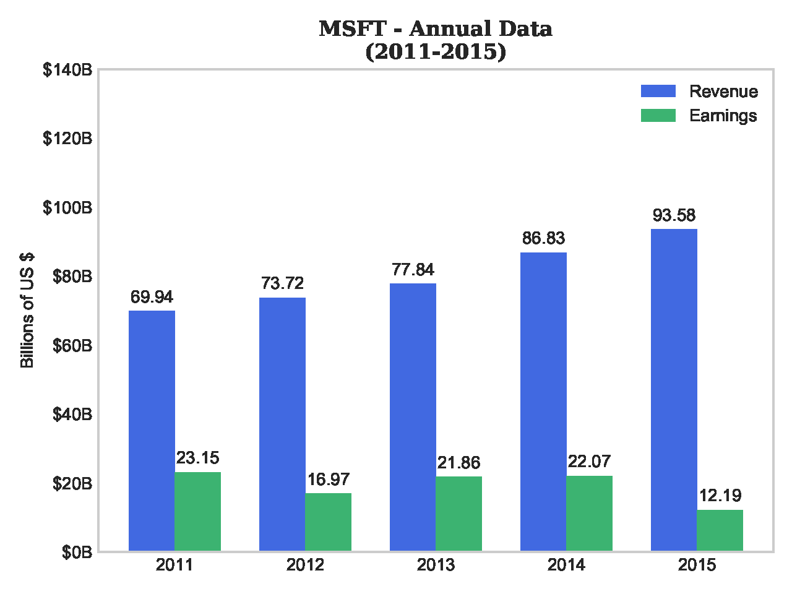
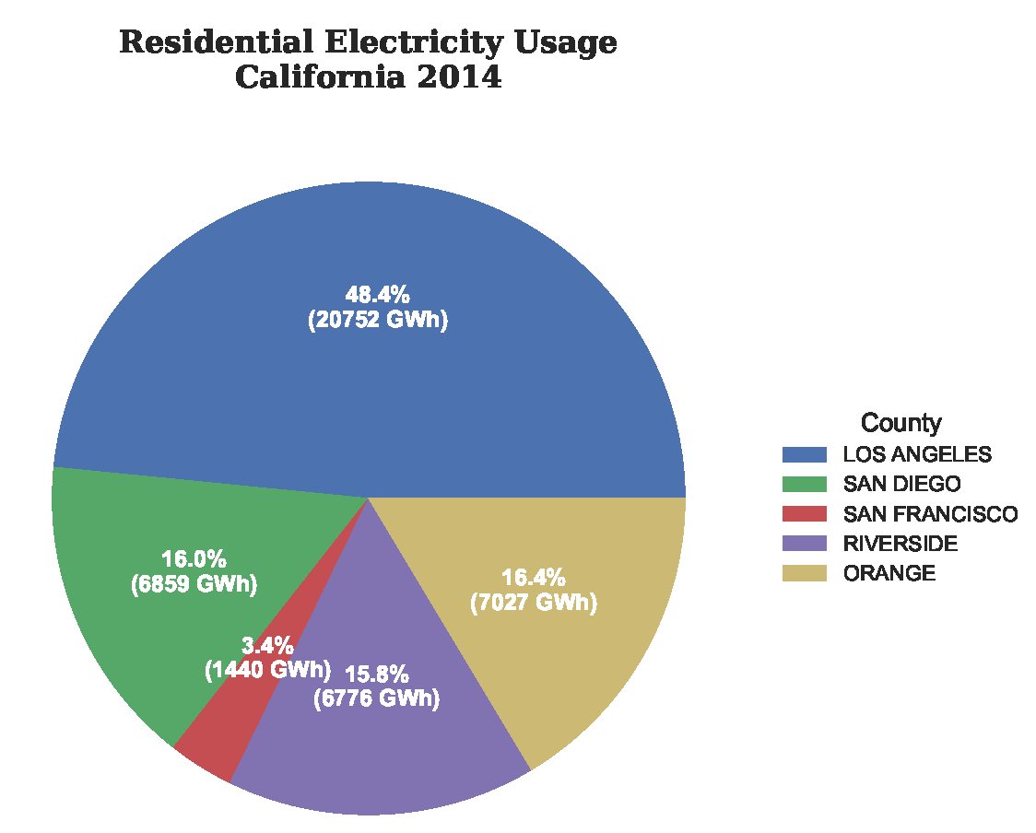
Example

