Slide 1
A10
Weight:
Wxy:
x : Coming from x node
y : Going to y nod
Node:
Axy :
x : Layer no.
y : Node no.
Bias:
Bx:
x : Layer no.
Feather: (Input)
Fx:
x : Feather #
Class: (Output)
Cx:
x : Class #
W00
A20
A00
W00
W01
C0
W02
F0
W01
A11
W02
W00
W03
W01
W02
A21
W00
C1
A01
W01
W00
A12
F1
W02
W01
W03
W02
A22
W00
W01
C2
Weight: Need to initialize Randomly.
Bias : Need to initialize with zeros.
Target Needs to one hot encoding.
Bias : needs to broad cast
A13
W02
B1
B2
Input Layer
Hidden Layer
Output Layer

Slide 2
Input : 0,1 Target Output : 2(class 3)
Activation : Relu
A10
Activation : Softmax
Predicted O/P
Target O/P
Loss
W00
A20
A00
W00
W01
C0
0.10
0
0
W02
0
F0
W01
A11
W02
W00
W03
W01
W02
A21
C1
0.20
0
0
W00
A01
W01
W00
A12
1
F1
W02
W01
W03
W02
A22
W00
W01
C2
0.80
1
0.20
A13
W02
B1
B2
Input Layer
Hidden Layer
Output Layer

Slide 3
n = No of Data Point
k = No of Features
c = No of Classes
hn = # of node in layer
W1
W2
X
(Input)
Z1
A1
Z2
A2
Y(CAP)
(Prediction)
B1
B2
X1,X2
Z1 = W*X+B1
A1 = Relu(Z1)
Z2 = W*A1+B2
A2 = Softmax(Z2)
Y(CAP) C0,C1,C2
Notation
Z2 =
n X hn2
A2 =
n X hn2
X =
n X hn0
Z1 =
n X hn1
A1 =
n X hn1
W1 =
hn0 X hn1
W2 =
hn1 X hn2
B2 =
1 X hn2
hn0 = k
hn2 = c
Since we have only 1 hidden layer
B1 =
1 X hn1
B2 (After Broadcast) =
B1 (After Broadcast) =
hn0 X hn1
hn1 X hn2
Eg
X =
300 X 2
Z1 =
300 X 4
Z2 =
300 X 3
A2 =
300 X 3
A1 =
300 X 4
W1 =
2 X 4
W2 =
4 X 3
B1 =
1 X 4
B2 =
1 X 3

Slide 4
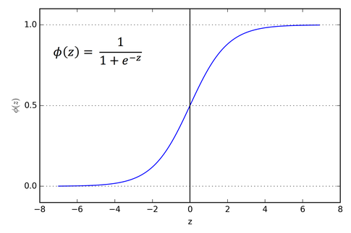
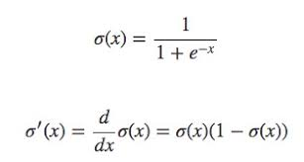
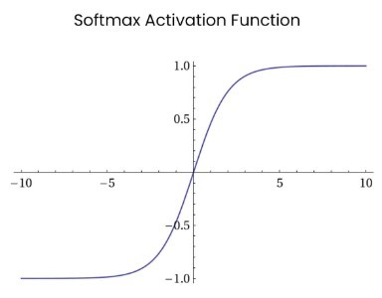
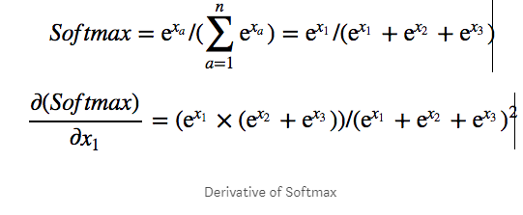
Activation Functions:
1.Sigmoid
2.Softmax
3. Relu
Sigmoid:
Limitations:
It can not work for multi class classification since it changes the output in the range of 0 to 1. for each node in output layer if it gives probability in the range of 0 to 1 then there can be chance for two classes have same probability.
Use case:
Binary classification we can use for Output layer
2. Softmax:
Limitations:
It’s having vanishing gradient problem if we use it in hidden layer, since it will convert probably to range 0 to 1 .
Use case:
we need to use it in output layer since we required probability in output layer.

Slide 5
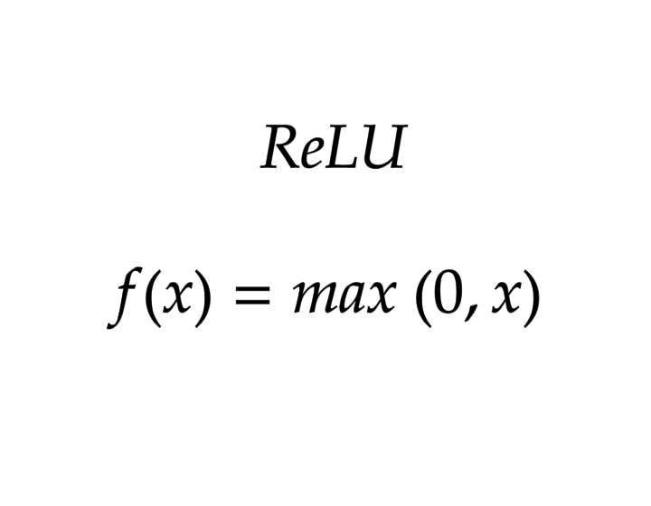
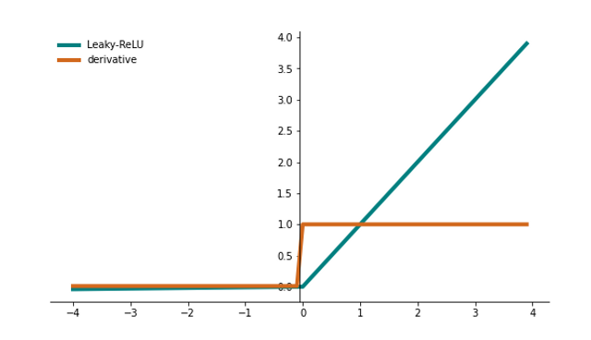
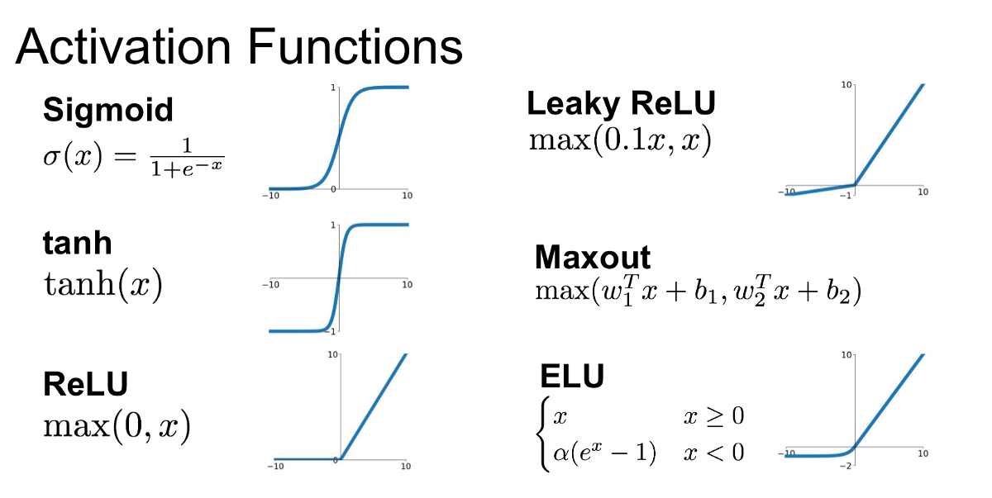
3. Relu:
Limitations:
It’s having vanishing gradient problem if we use it in hidden layer, since it will convert probably to range 0 to 1 .
Use case:
we need to use it in output layer since we required probability in output layer.
Other Activation functions:

